Slide 1

Notes:
Section six: data tests. A test is how we write down an assumption, so dbt checks it on every run. With real data, some assumptions will be wrong. That is the point.

Slide 2
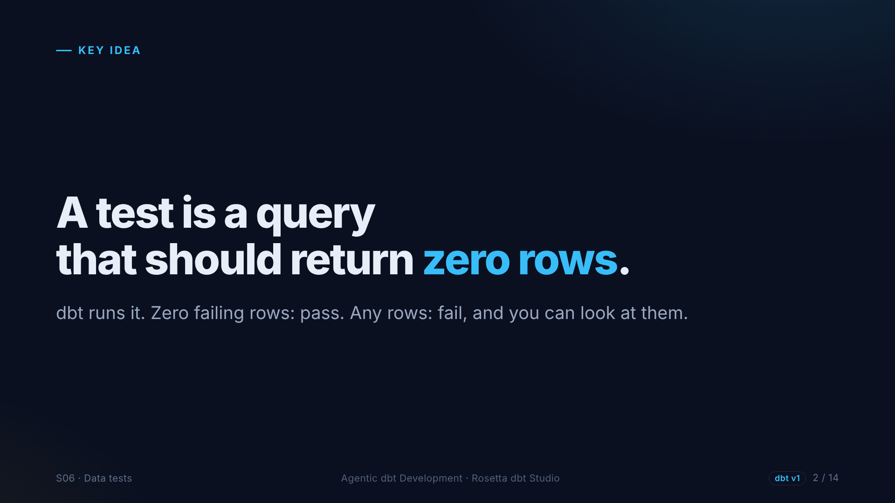
Notes:
Every dbt test is a query that looks for bad rows. Zero rows means the test passes. Any rows means it fails, and the failing rows are right there to look at.

Slide 3
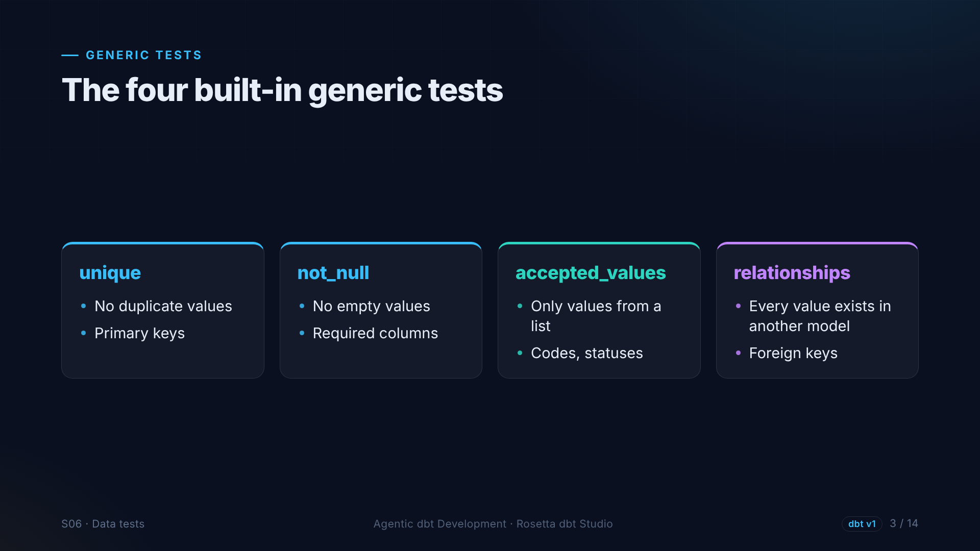
Notes:
dbt ships four generic tests. Unique and not null, usually together on a primary key. Accepted values, for columns with a known list, like payment types. And relationships, which checks that every value exists in another model, like a foreign key.

Slide 4
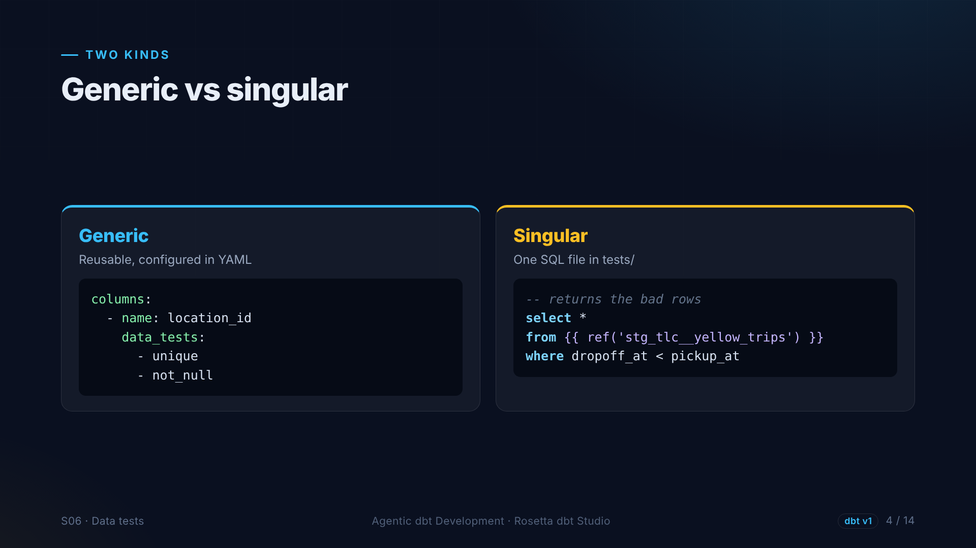
Notes:
Two kinds of test. Generic tests are reusable, and you list them under a column in YAML. Singular tests are one SQL file in the tests folder. This one returns trips that end before they start.

Slide 5
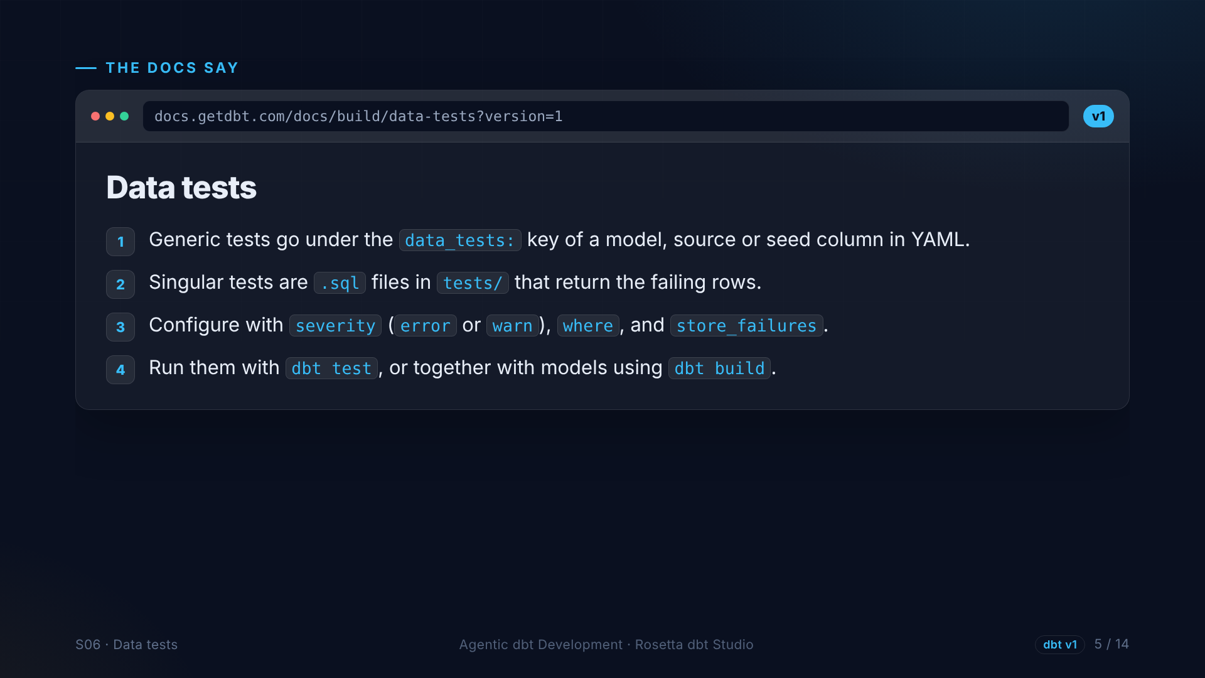
Notes:
The data tests page, version one. Generic tests go under the data tests key in YAML. Singular tests are SQL files. You can set severity to error or warn, test only some rows, and store failing rows in a table.

Slide 6
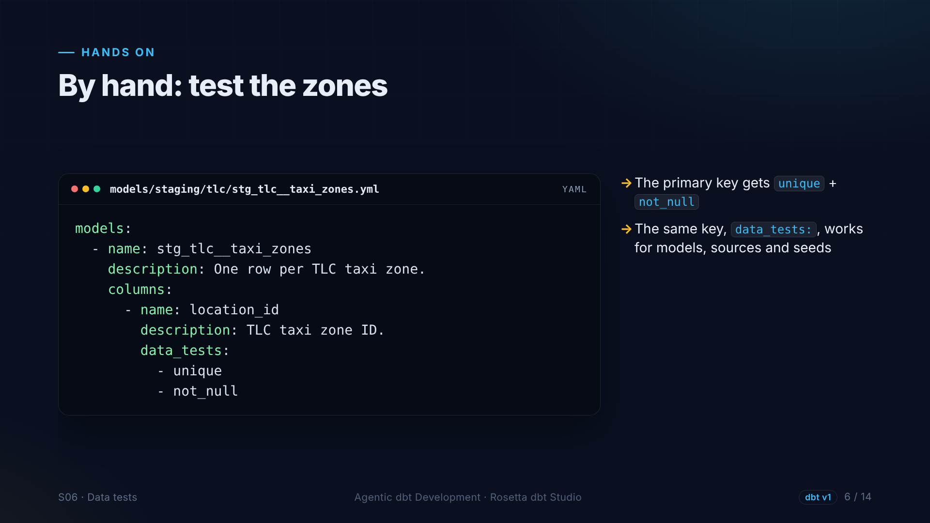
Notes:
First, by hand: the zone ID is our primary key, so it gets unique and not null. Two lines, and the official lookup passes.

Slide 7
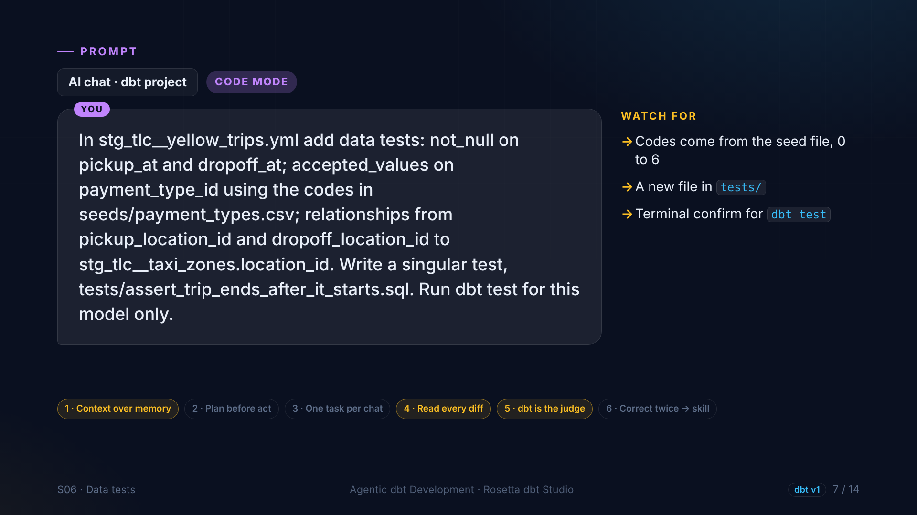
Notes:
In the demo, the agent adds the rest: not null on the timestamps, accepted values on payment type from the seed, relationships from both location columns to the zones, and the singular test for backwards trips. Then it runs the tests for this model.

Slide 8
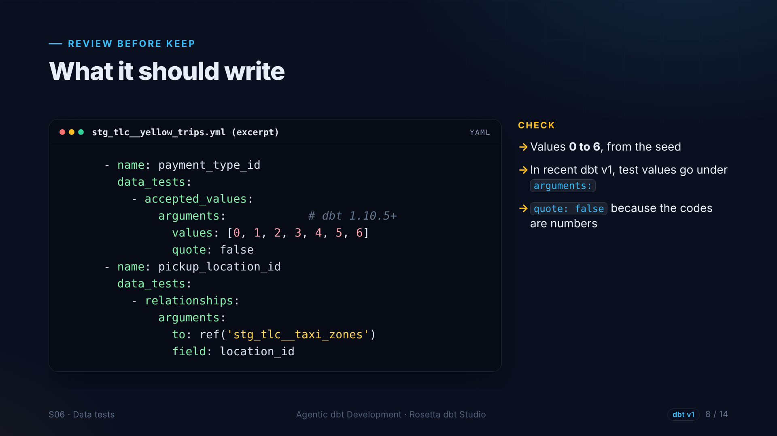
Notes:
What we review. Accepted values zero to six, taken from the seed. In recent dbt version one, the values sit under a key called arguments. Quote is false, because the codes are numbers. And the relationships test points at the zones model.

Slide 9
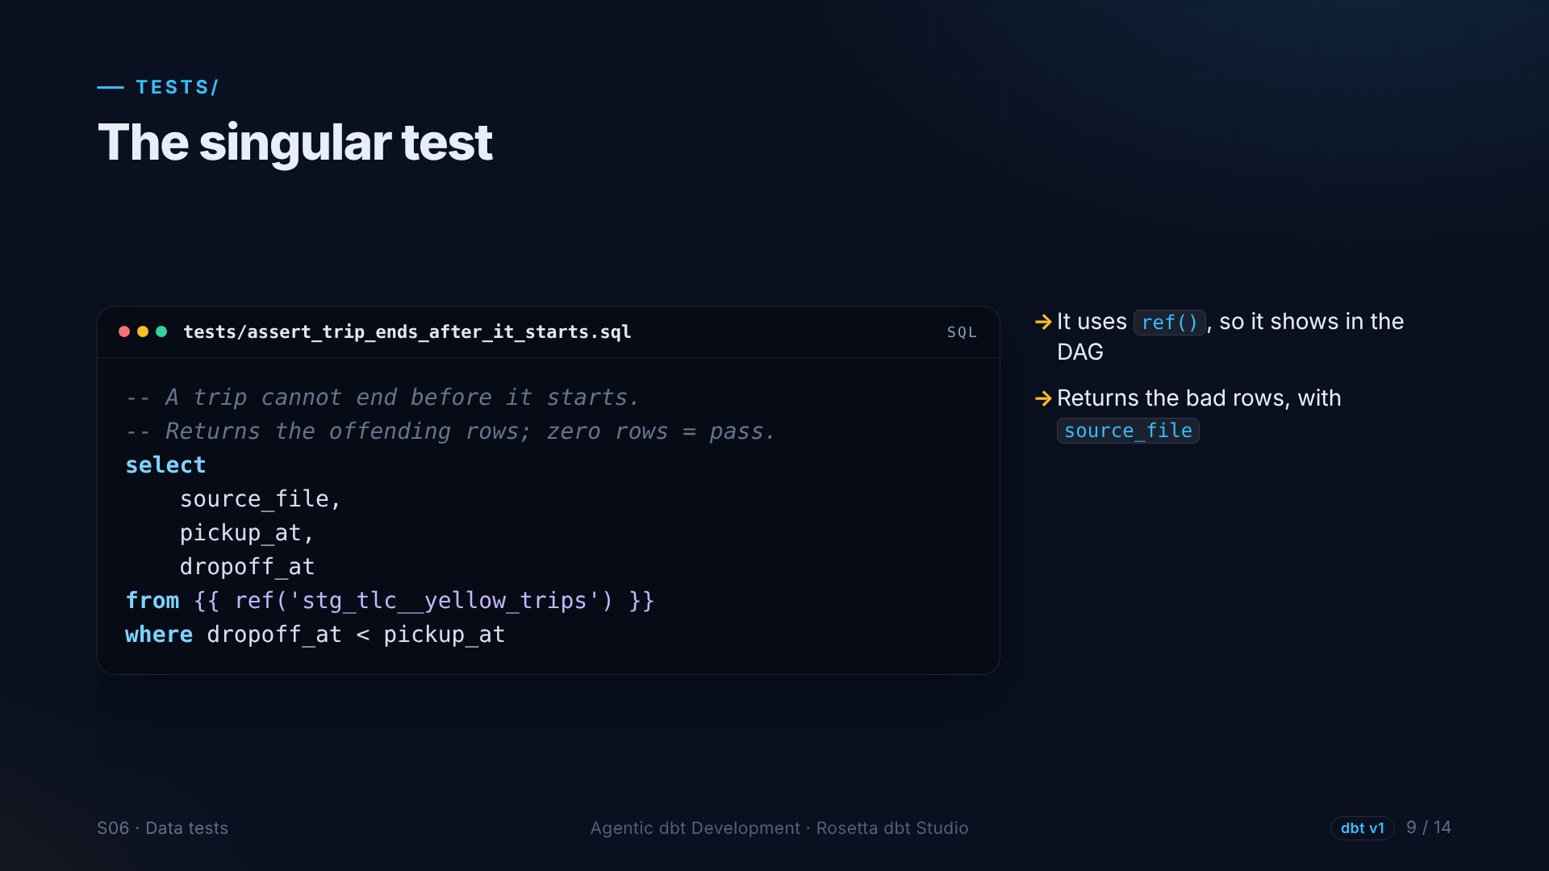
Notes:
The singular test is a plain query for the rows that break our rule: dropoff before pickup. It returns the source file too, so we can see which month the bad rows came from.

Slide 10
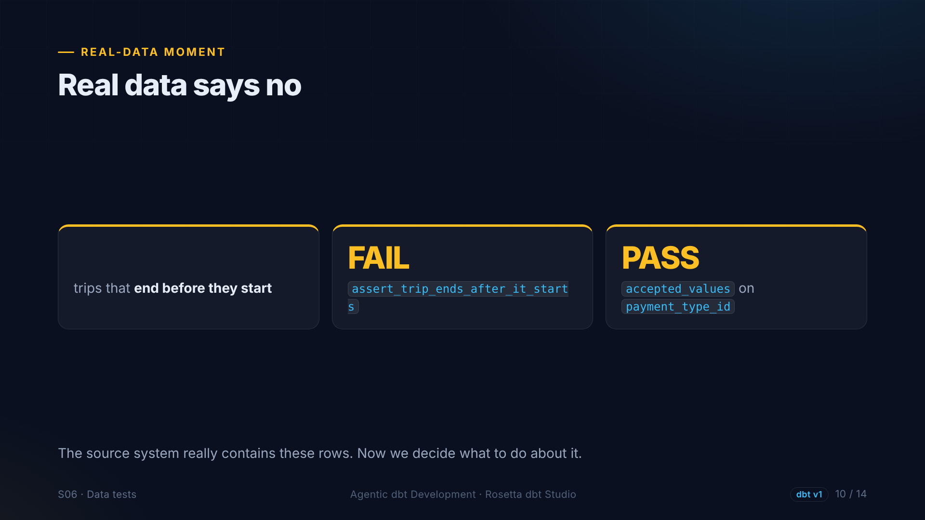
?
Notes:
And real data says no. The singular test fails: some trips really do end before they start. The accepted values test passes, because we used the current code list. Now we decide what to do.

Slide 11
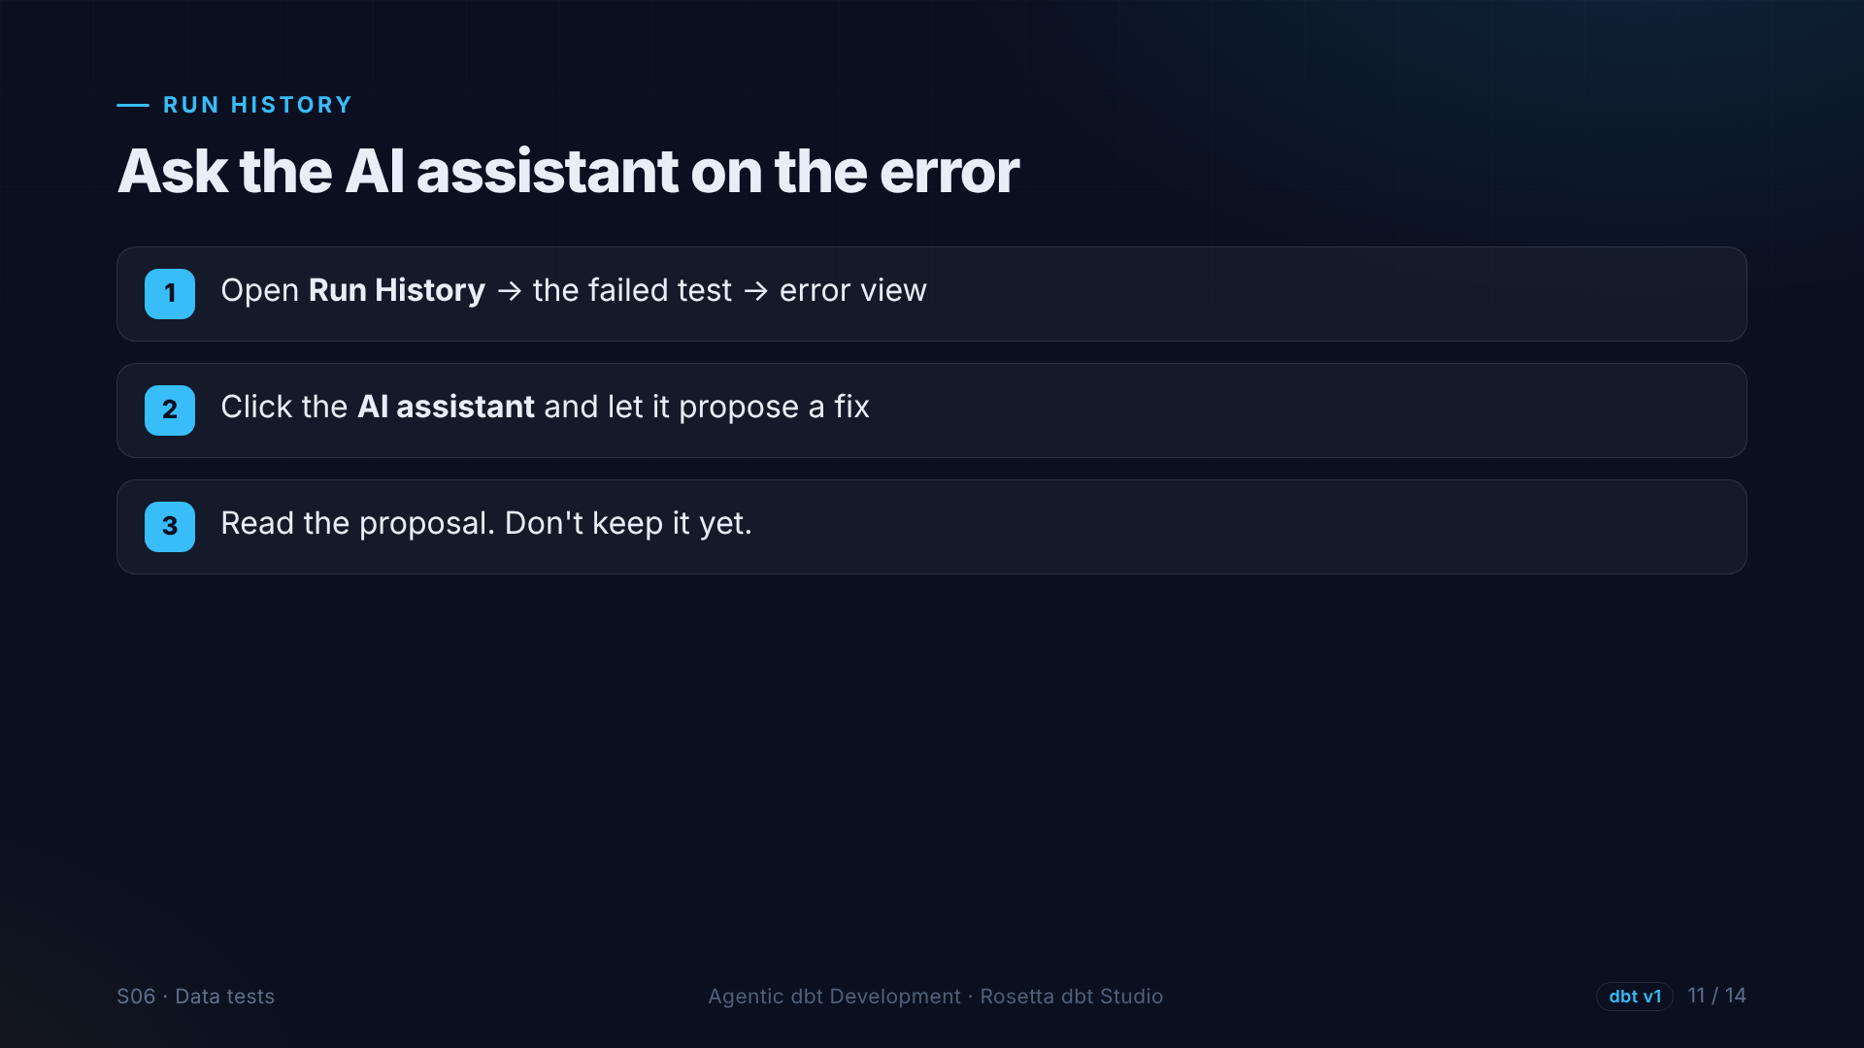
Notes:
Rosetta has a shortcut for this moment. In Run History, open the failed test, and the error view offers an AI assistant. We let it propose a fix, and we read it before deciding.

Slide 12
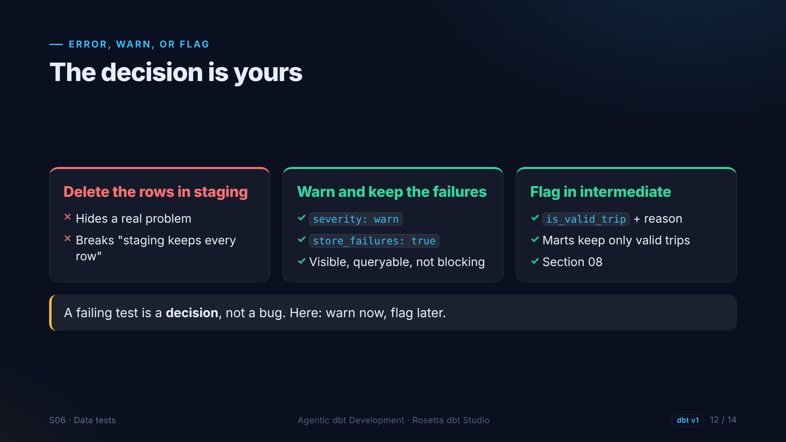
Notes:
Three options. Deleting the rows in staging hides a real problem, so no. Making the test a warning and storing the failing rows keeps them visible without blocking every build. And in section eight, we flag invalid trips in the intermediate layer. A failing test is a decision.

Slide 13
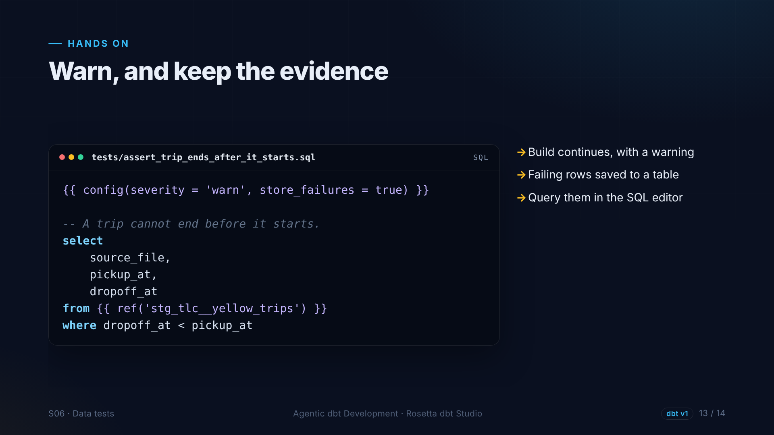
Notes:
One line at the top: severity warn, and store failures. The build continues with a warning, and the failing rows are saved in a table we can query.

Slide 14
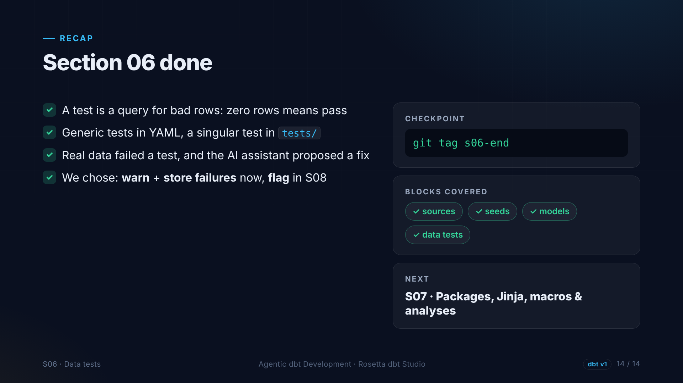
Notes:
That is section six. Tests are queries for bad rows. Real data failed one, the AI assistant made a suggestion, and we made the call. Next: reusing code with packages, Jinja and macros.

