Slide 1
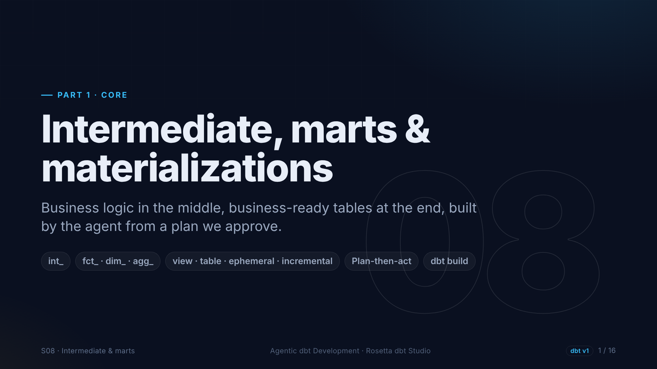
Notes:
Section eight, the end of part one. We build the layers that turn clean data into answers: an intermediate model with our business rules, and the marts analysts use. The biggest agent task so far, so we plan before we act.

Slide 2
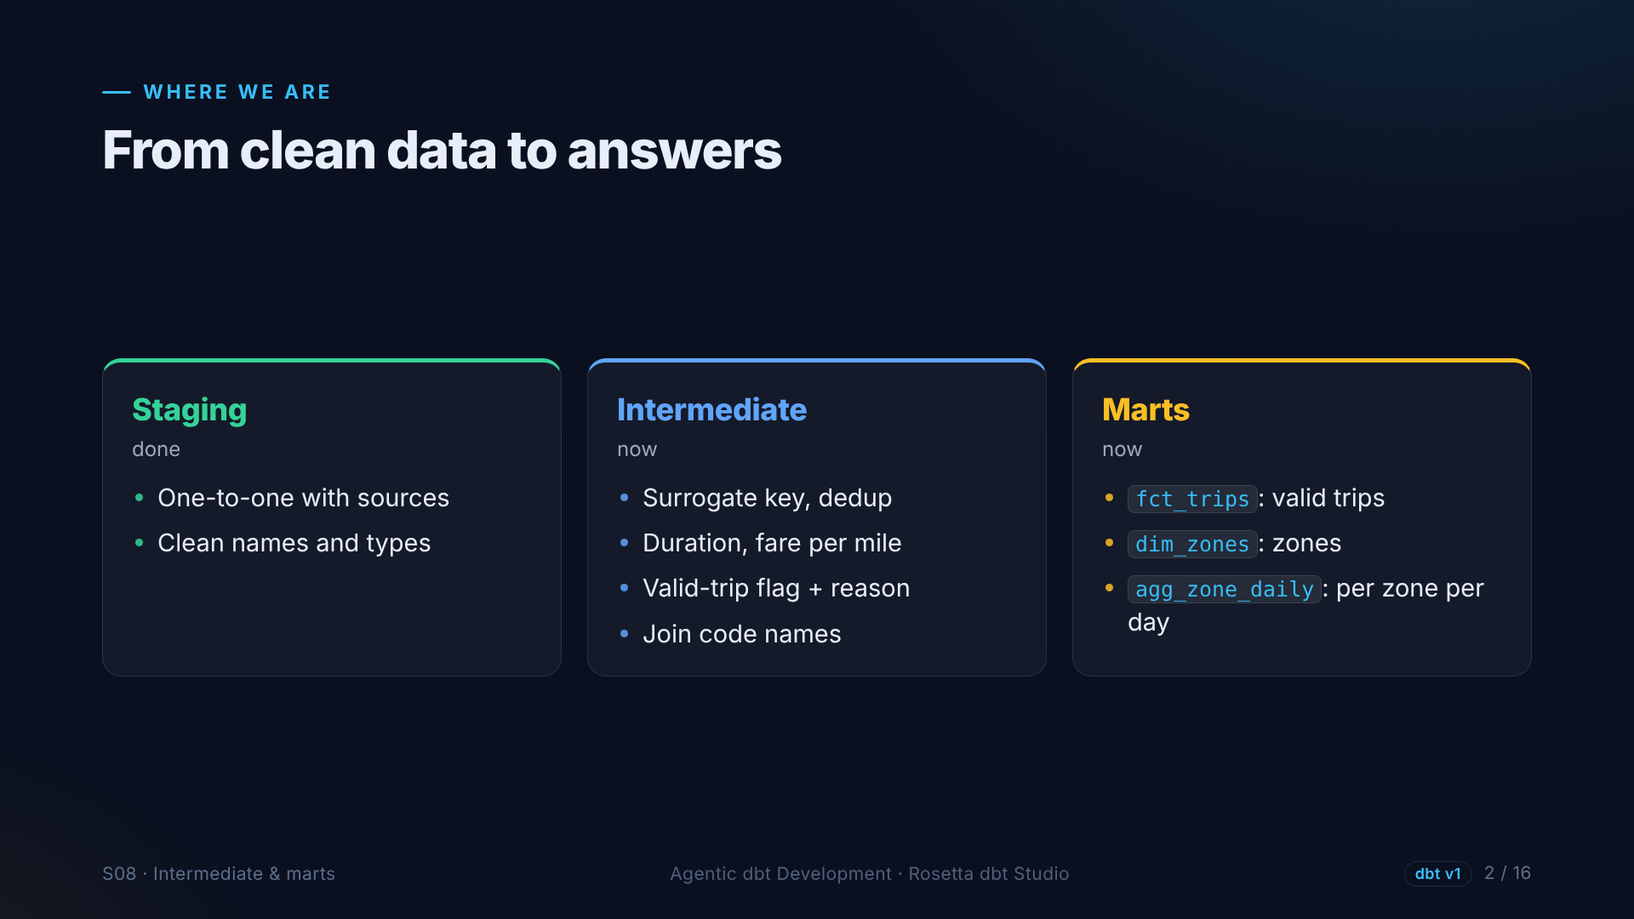
Notes:
Staging is done. The intermediate layer adds a trip ID, removes exact duplicates, and adds trip duration, fare per mile, and the valid trip flag we promised. The marts are a fact table of valid trips, a zone dimension, and a daily summary per pickup zone.

Slide 3
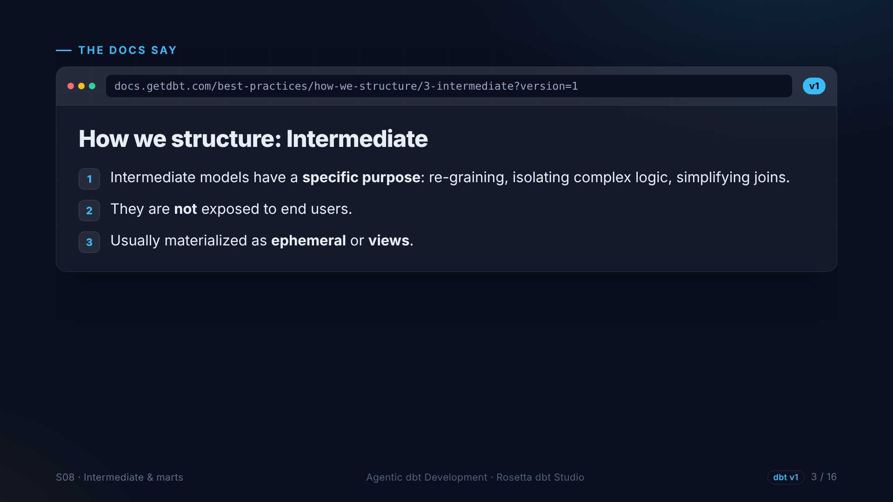
Notes:
The structure guide on intermediate models. Each one has a specific purpose, like isolating complex logic so the marts stay simple. End users never query them. They are views or ephemeral.

Slide 4
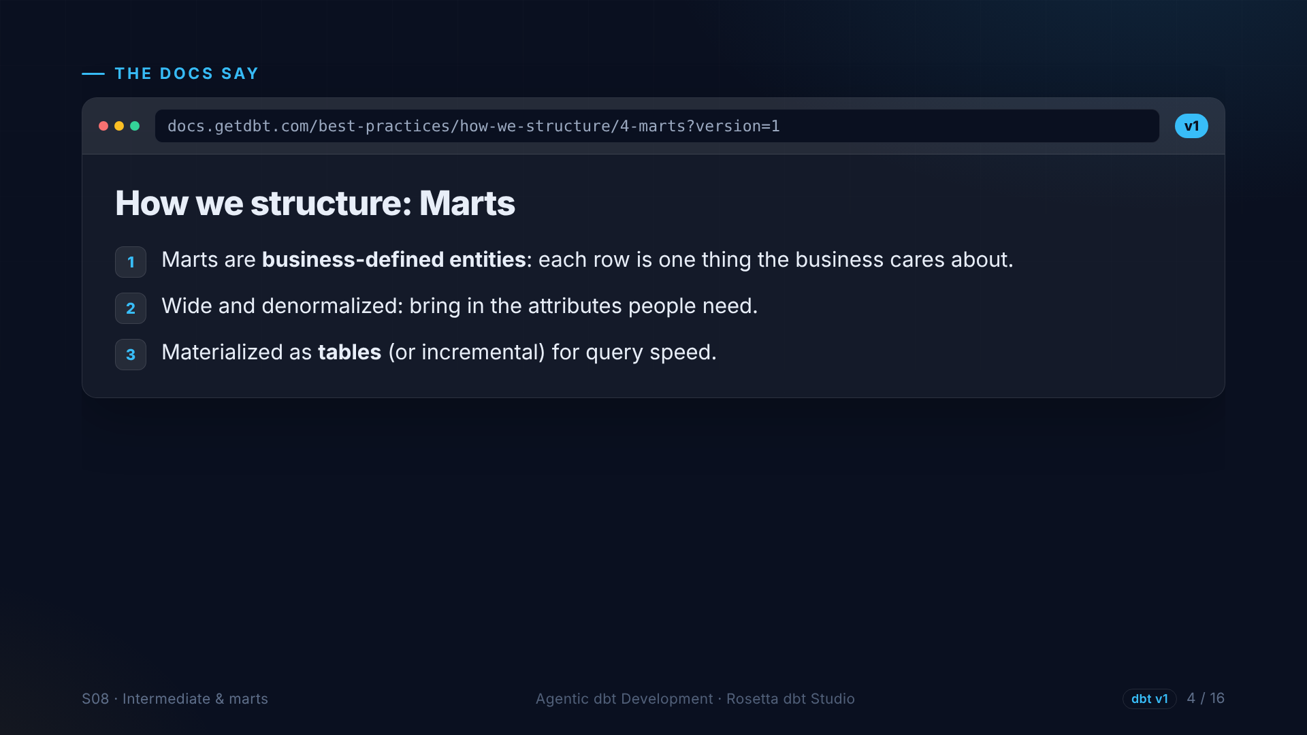
Notes:
The guide on marts. A mart is something the business understands: here, a trip, a zone, and a zone per day. Marts are wide, and they are tables, so queries are fast.

Slide 5
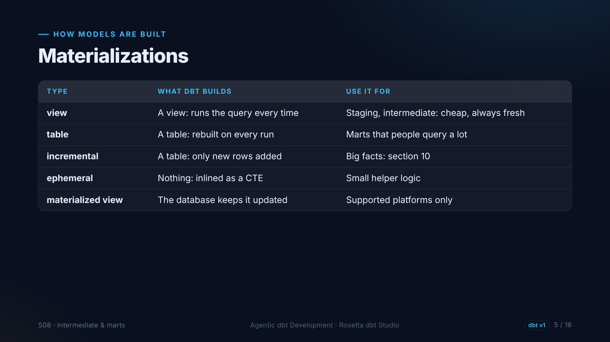
Notes:
Materialization means how dbt builds a model. A view stores only the query. A table stores the result. Incremental adds only new rows, in section ten. Ephemeral builds nothing and is inlined. A materialized view is kept up to date by the database.

Slide 6
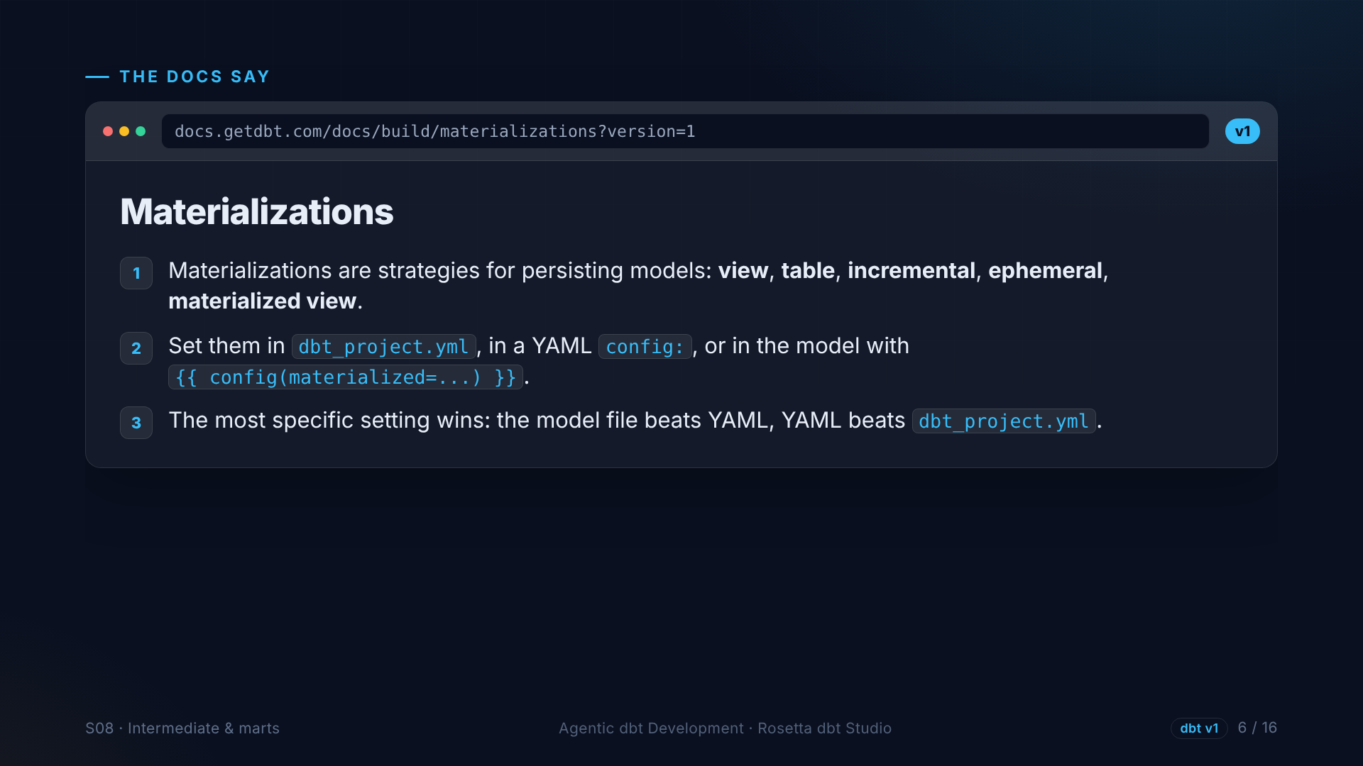
Notes:
The materializations page. You can set them in the project file, in YAML, or in the model itself, and the most specific setting wins. We set them per folder, and in section ten, one model will override its folder.

Slide 7
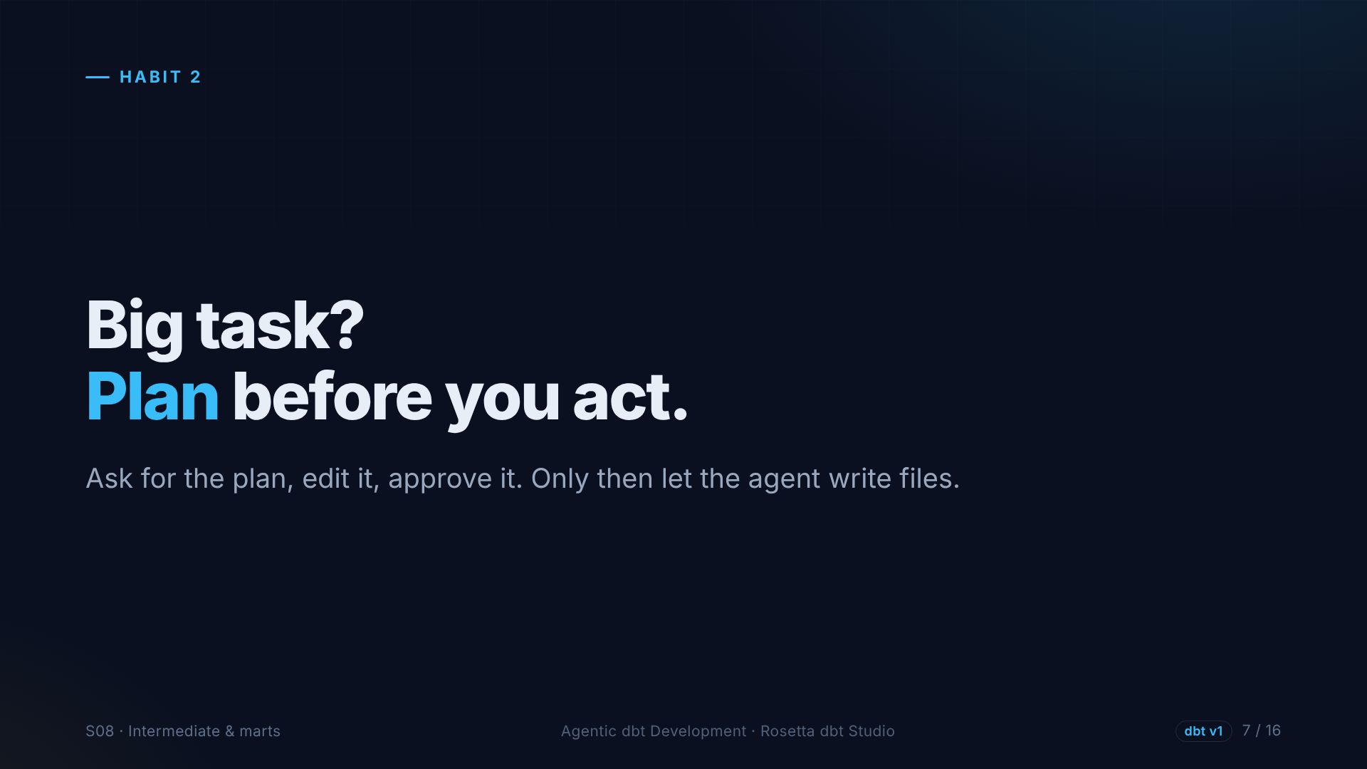
Notes:
This task touches four models and several files. If the agent starts writing and gets the grain wrong, we review a lot of wrong code. So first, we ask for a plan, and we fix the plan.

Slide 8
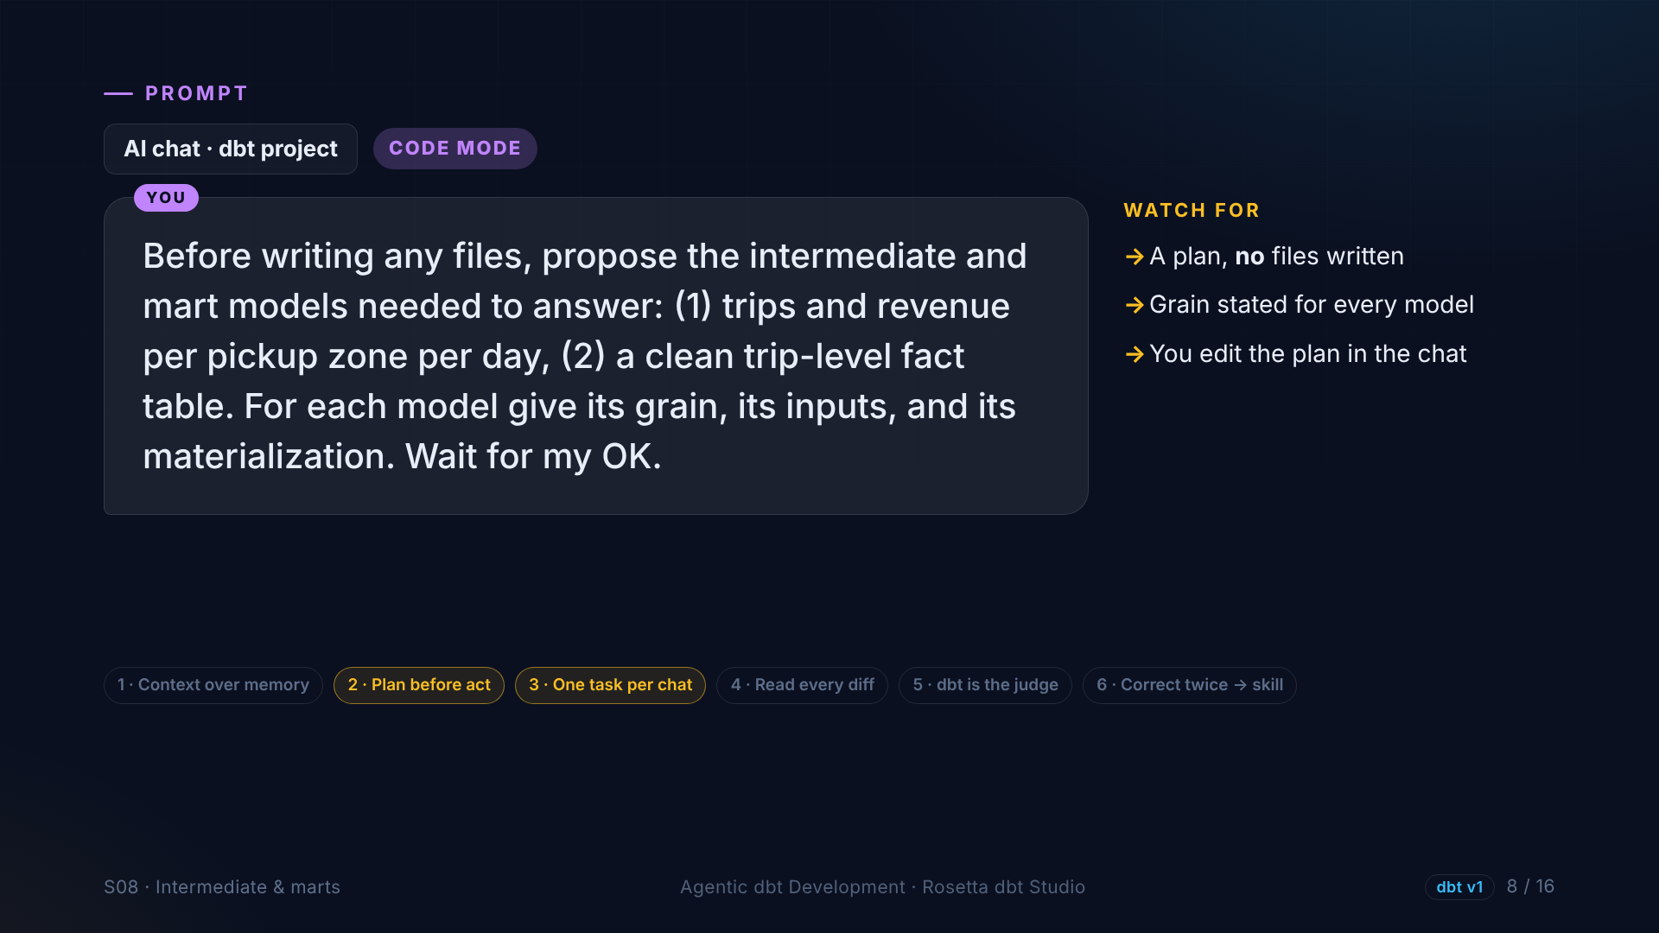
Notes:
In the demo, the first prompt asks for the plan only: which intermediate and mart models, the grain of each one, its inputs and its materialization. And it must wait for our OK, without writing any files.

Slide 9
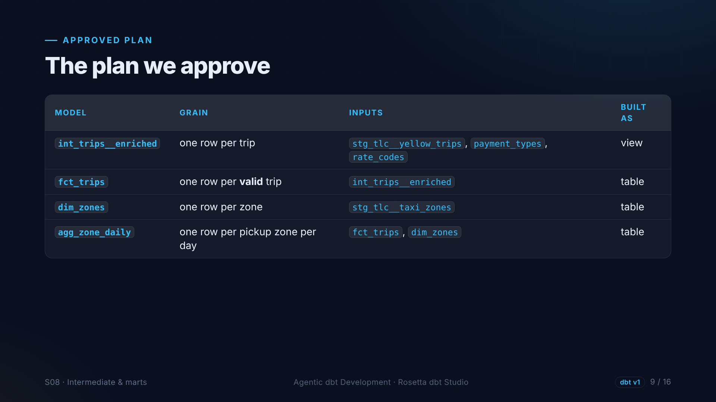
Notes:
This is the plan we approve. One intermediate model, one row per trip. A fact table, one row per valid trip. A zone dimension. And a daily summary, one row per zone per day. Fixing a plan is much cheaper than fixing code.

Slide 10
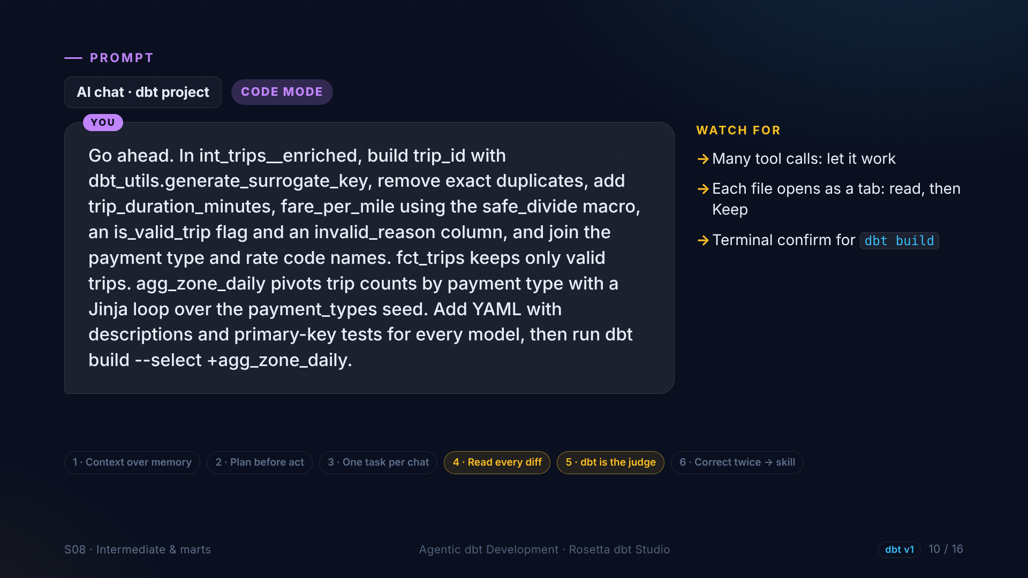
Notes:
Then: go ahead. The agent builds the trip ID, removes duplicates, adds duration and fare per mile with our macro, the validity flag with a reason, and the code names. Then the marts, YAML with tests for every model, and one dbt build.

Slide 11
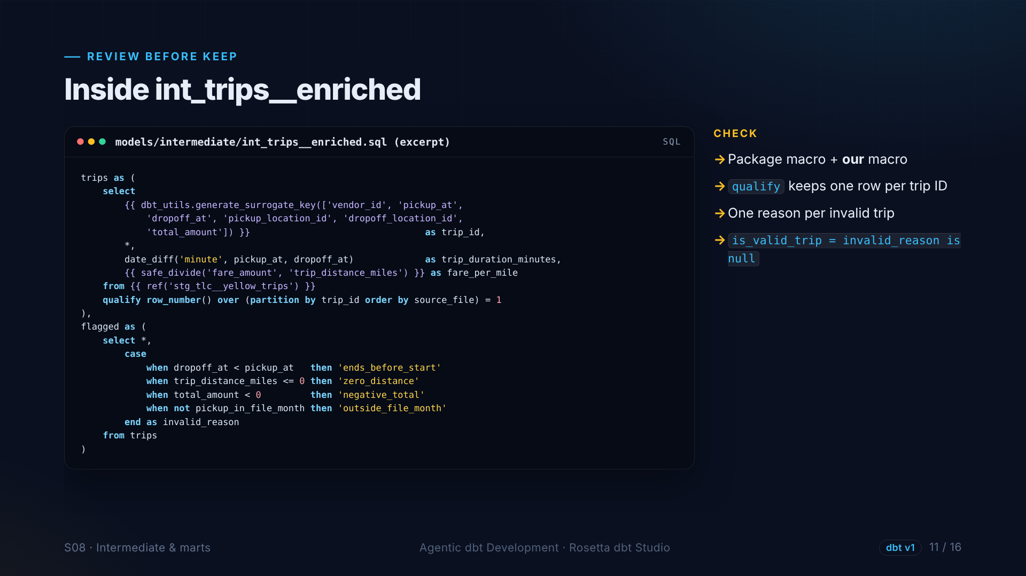
Notes:
The heart of the project. The surrogate key from dbt utils. Duration in minutes. Fare per mile with our safe divide. One row per trip ID. And a reason for every invalid trip: ends before it starts, zero distance, negative total, or a pickup outside its file month.

Slide 12
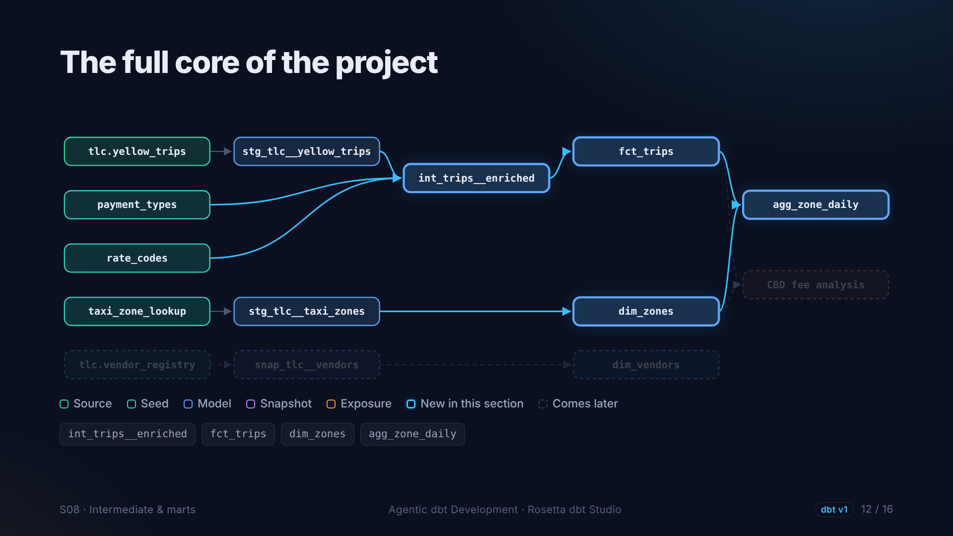
Notes:
Four new nodes. The intermediate model, fed by staging and two seeds. Then the fact table, the zone dimension, and the daily summary that uses both.

Slide 13
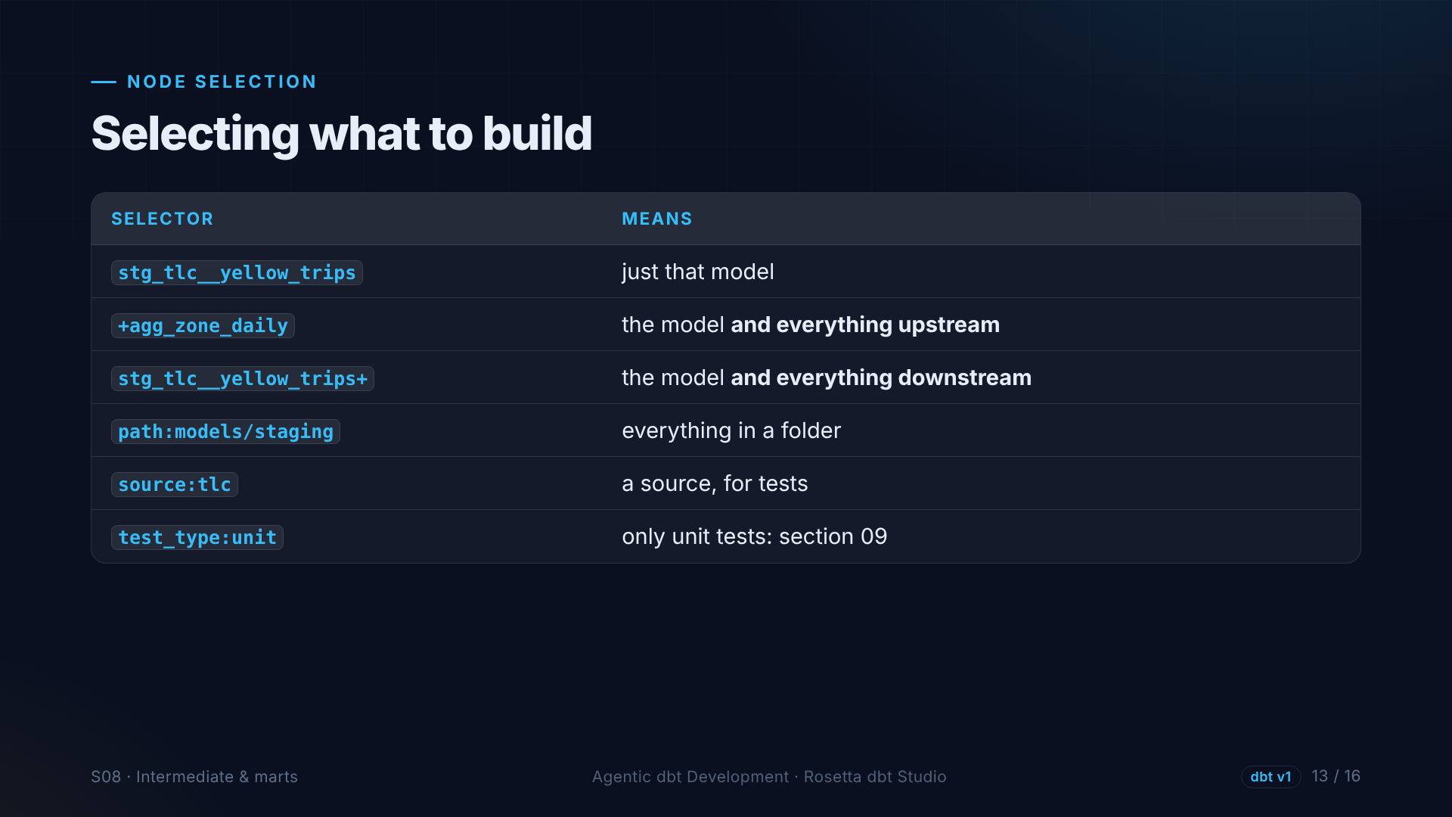
Notes:
A word on selecting models. A name selects one model. A plus before it adds everything upstream. A plus after it adds everything downstream. You can also select by folder, by source, or by test type.

Slide 14
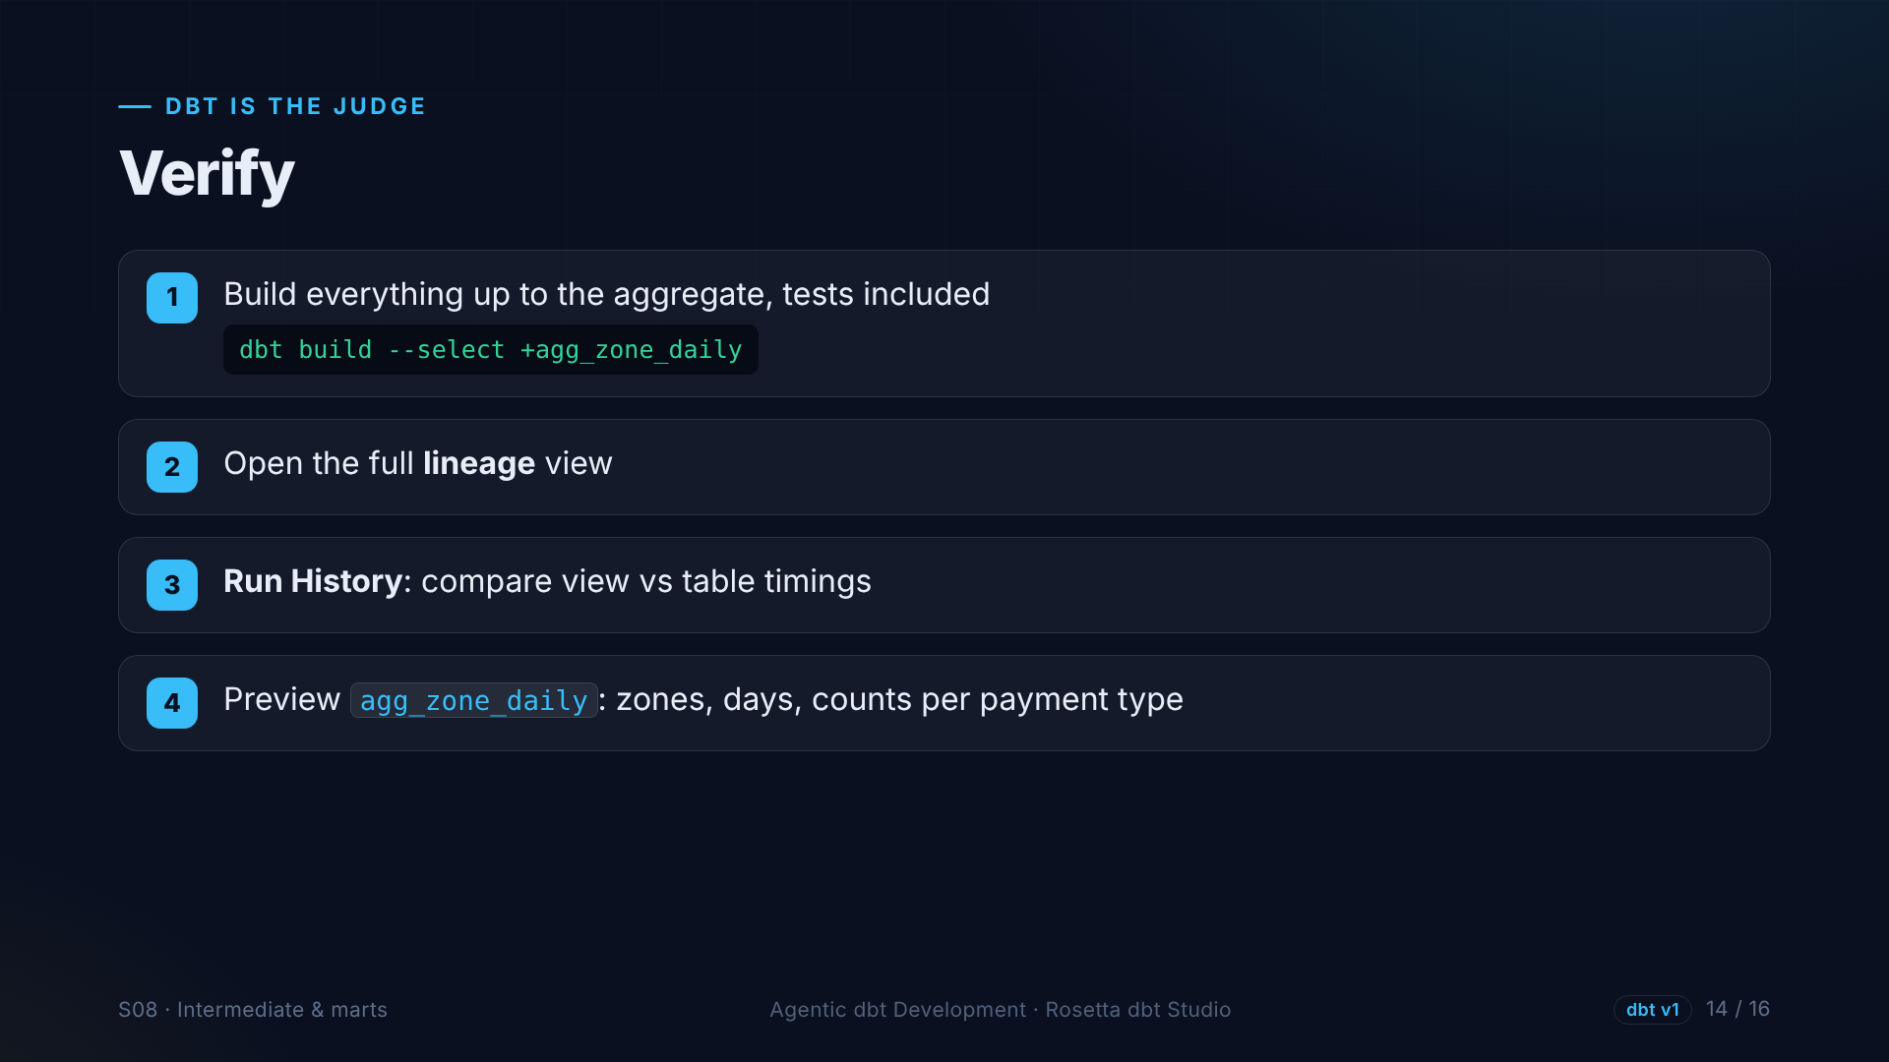
Notes:
We run dbt build for everything up to the daily summary: seeds, staging, intermediate, marts, and every test, in the right order. Then we look at the lineage, the timings in Run History, and preview the result.

Slide 15
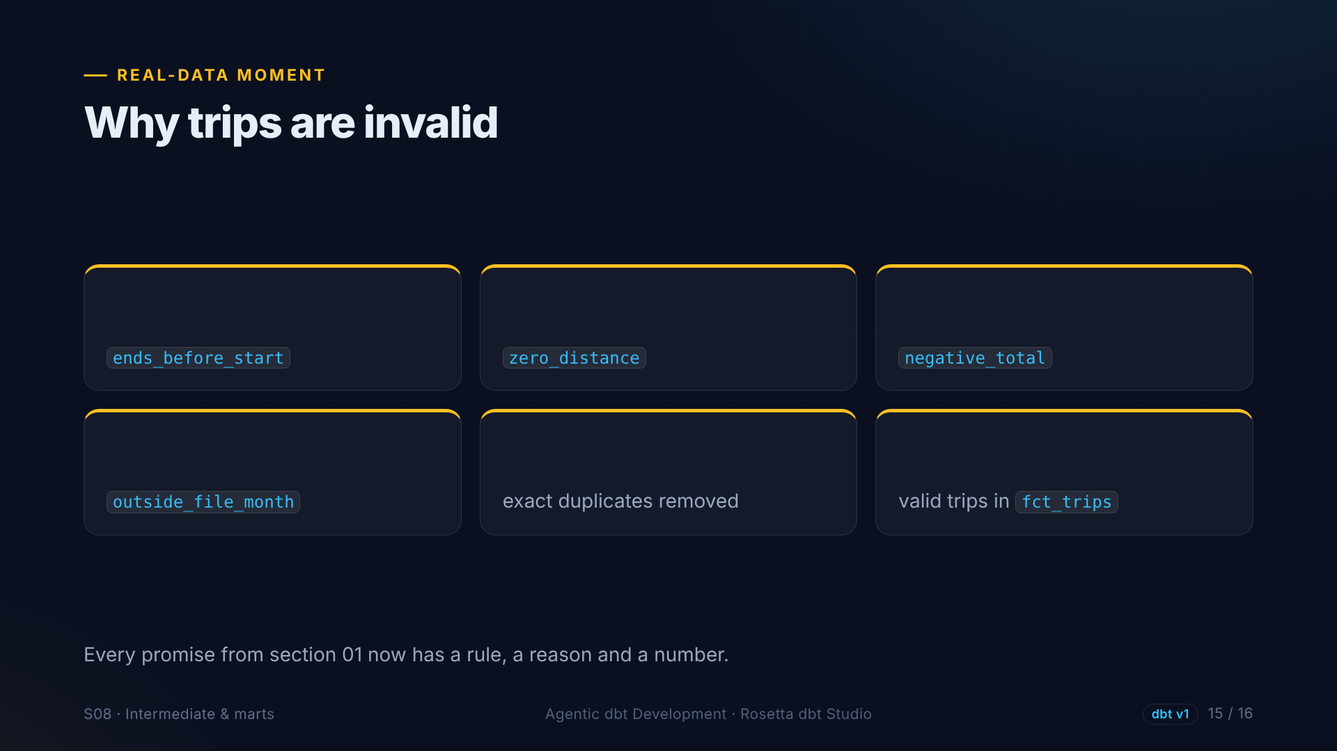
?
?
?
?
?
?
Notes:
We ask the data why trips are invalid, by reason, and how many duplicates were removed. Every problem we found in section one now has a rule, a name, and a count. The fact table only contains valid trips.

Slide 16
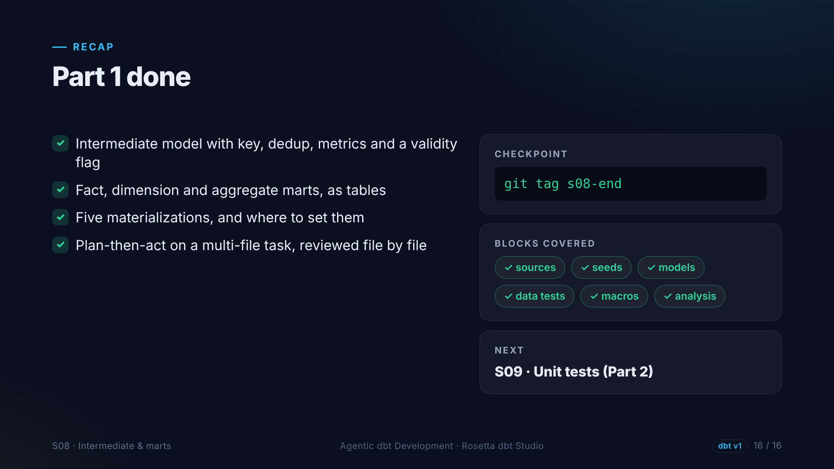
Notes:
That is the end of part one. A complete, tested dbt project, from raw files to a fact table and a daily summary, with our business rules in one reviewed place. In part two we make it production-ready.

