Slide 1
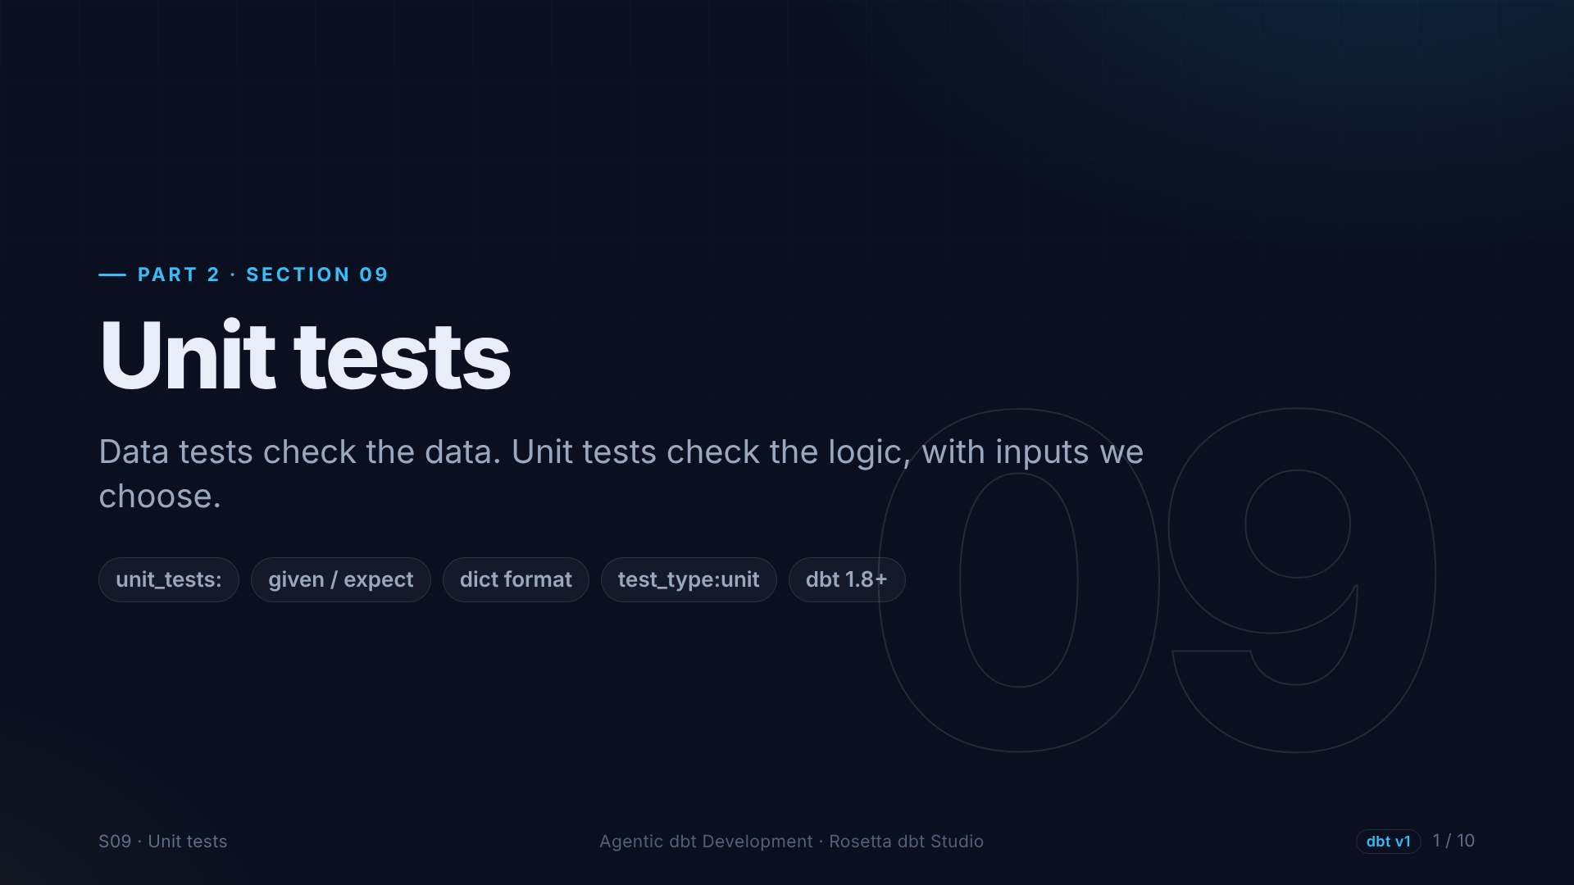
Notes:
Welcome to part two: production patterns. We start with unit tests. Our tests so far check the data, but our business logic could have a bug that today's data simply does not show. Unit tests catch that.

Slide 2
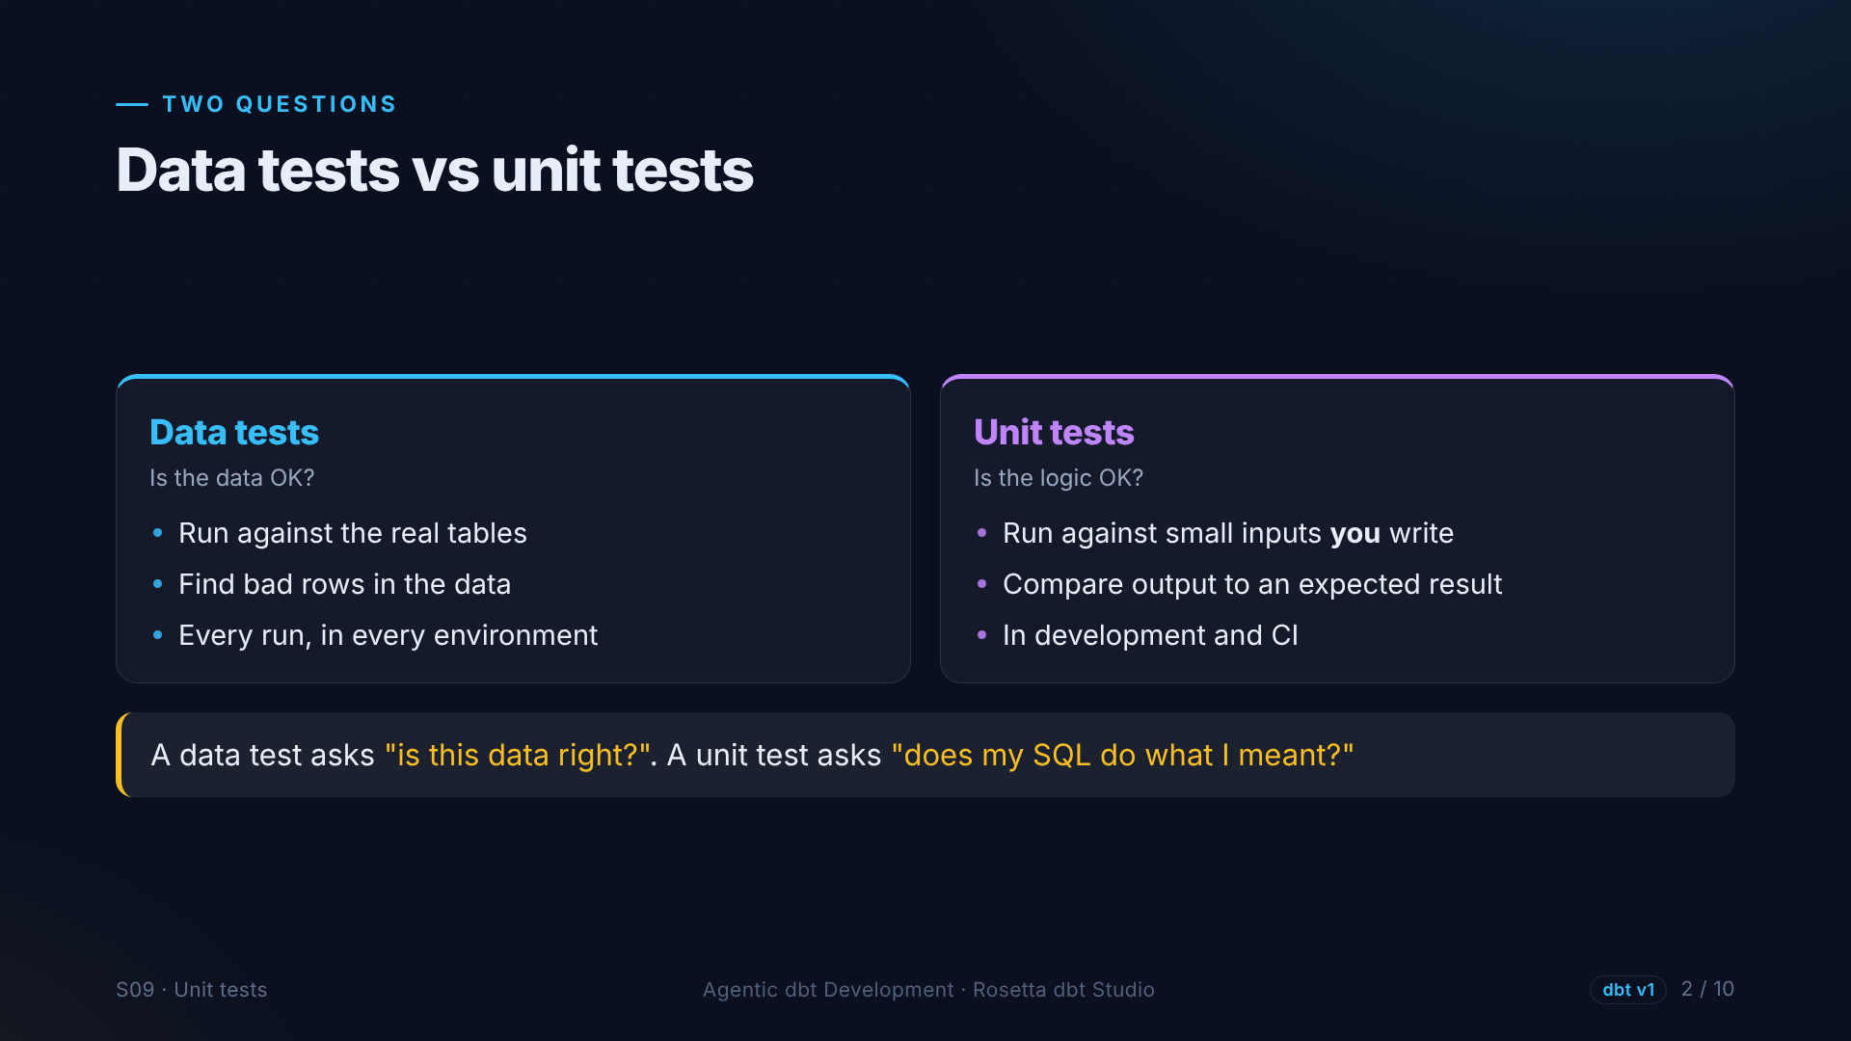
Notes:
Two different questions. A data test runs on the real tables and asks: is this data right? A unit test feeds a model a few rows that we invent, and asks: does my SQL do what I meant?

Slide 3
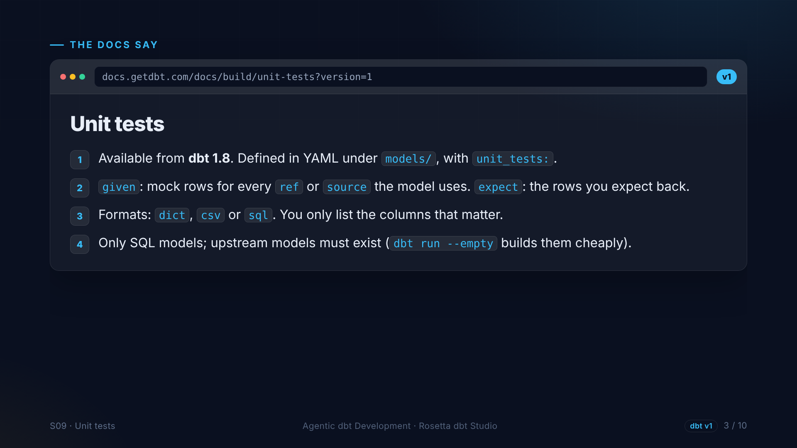
Notes:
The unit tests page, version one, available since dbt one point eight. A unit test lives in YAML. Given: fake input rows for every model the tested model reads. Expect: the rows that should come out. You only list the columns that matter.

Slide 4
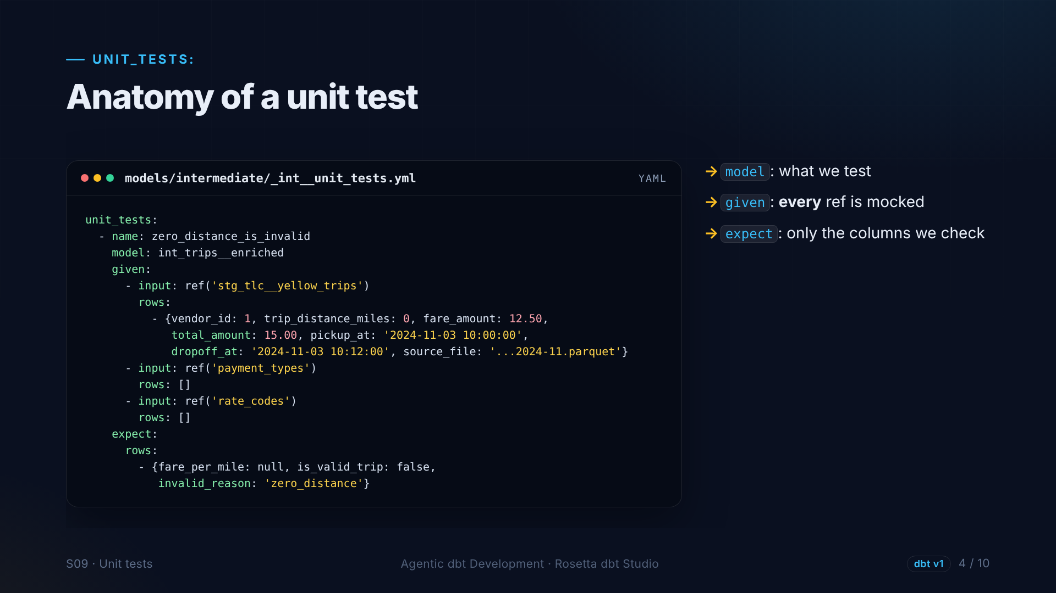
Notes:
One unit test. The model under test is the intermediate trips model. Given one fake trip with zero distance, and empty inputs for the two seeds, because every input must be mocked. We expect fare per mile to be empty, the trip invalid, and the reason zero distance.

Slide 5
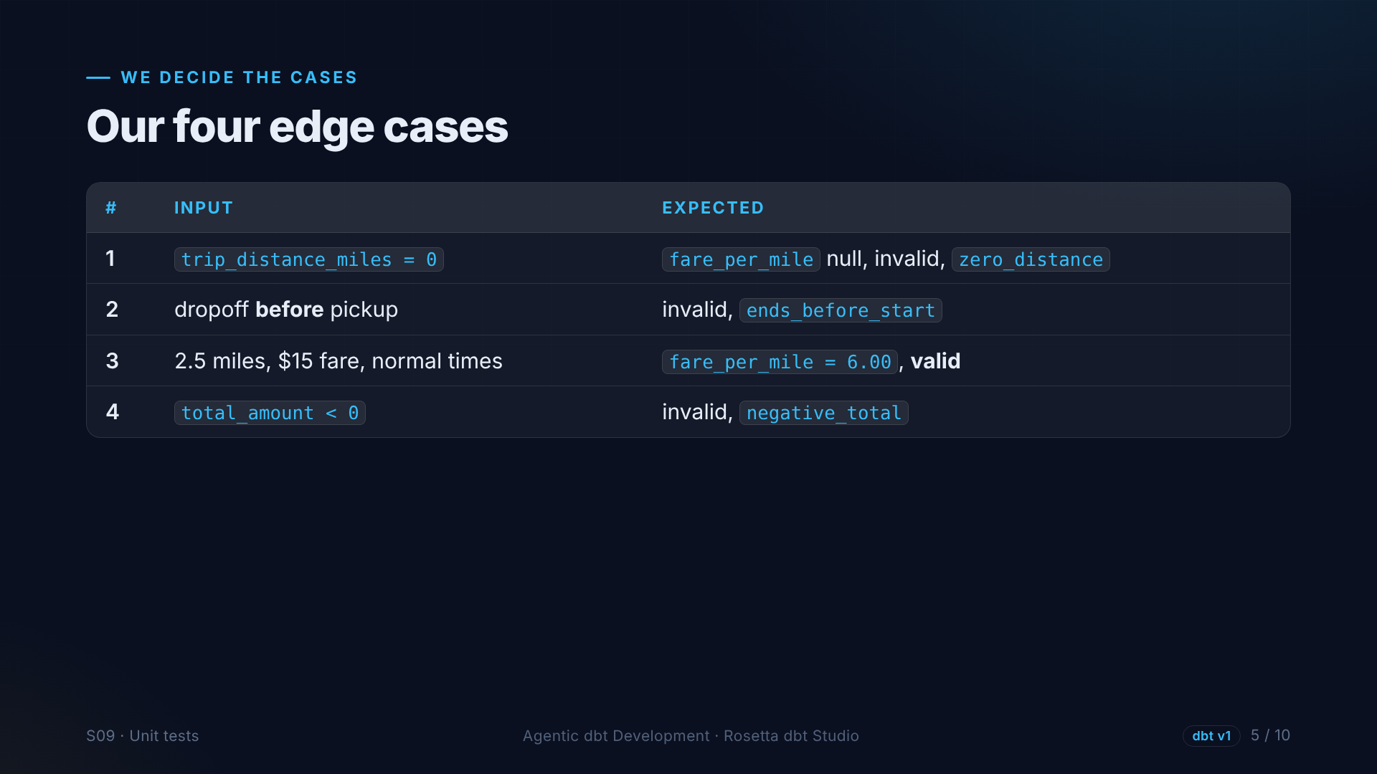
Notes:
Deciding what to test is the human part. Four cases from the problems we found. Zero distance. A trip that ends before it starts. A normal trip, two and a half miles for fifteen dollars, which must be valid at six dollars a mile. And a negative total.

Slide 6
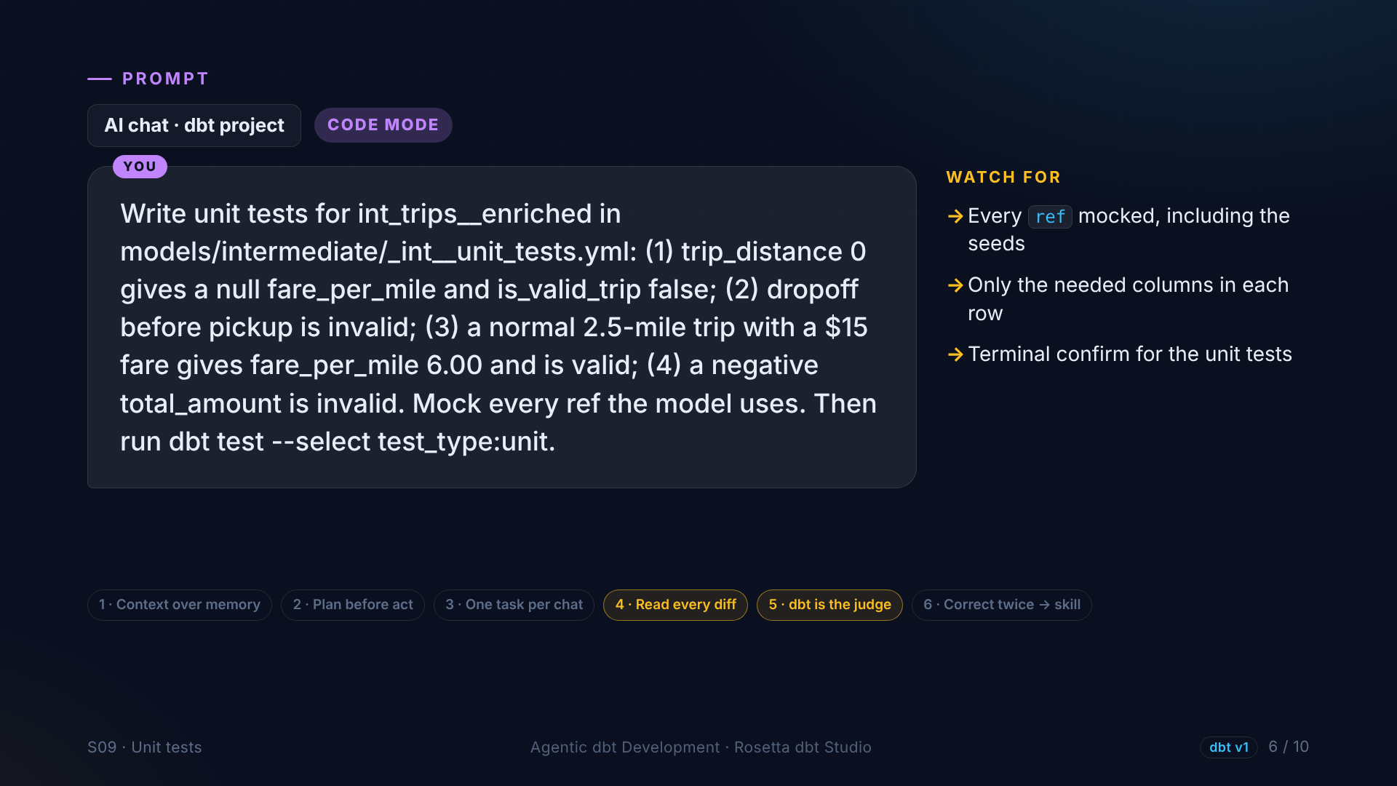
Notes:
In the demo, we describe the four cases in plain English, and the agent writes the YAML, mocks every input, and runs only the unit tests. Verbose YAML is perfect agent work. The cases are ours.

Slide 7
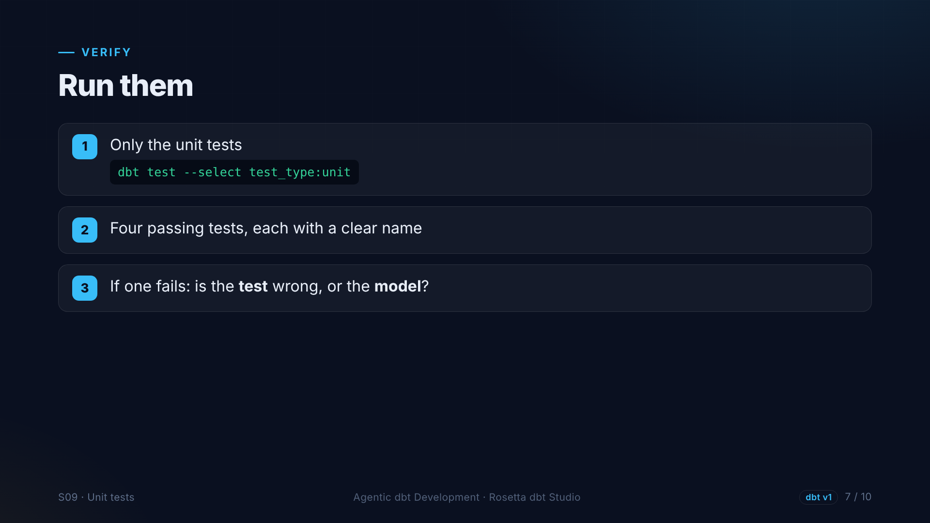
Notes:
We run only the unit tests, and four pass. If one fails, ask the honest question: is the test wrong, or the model?

Slide 8
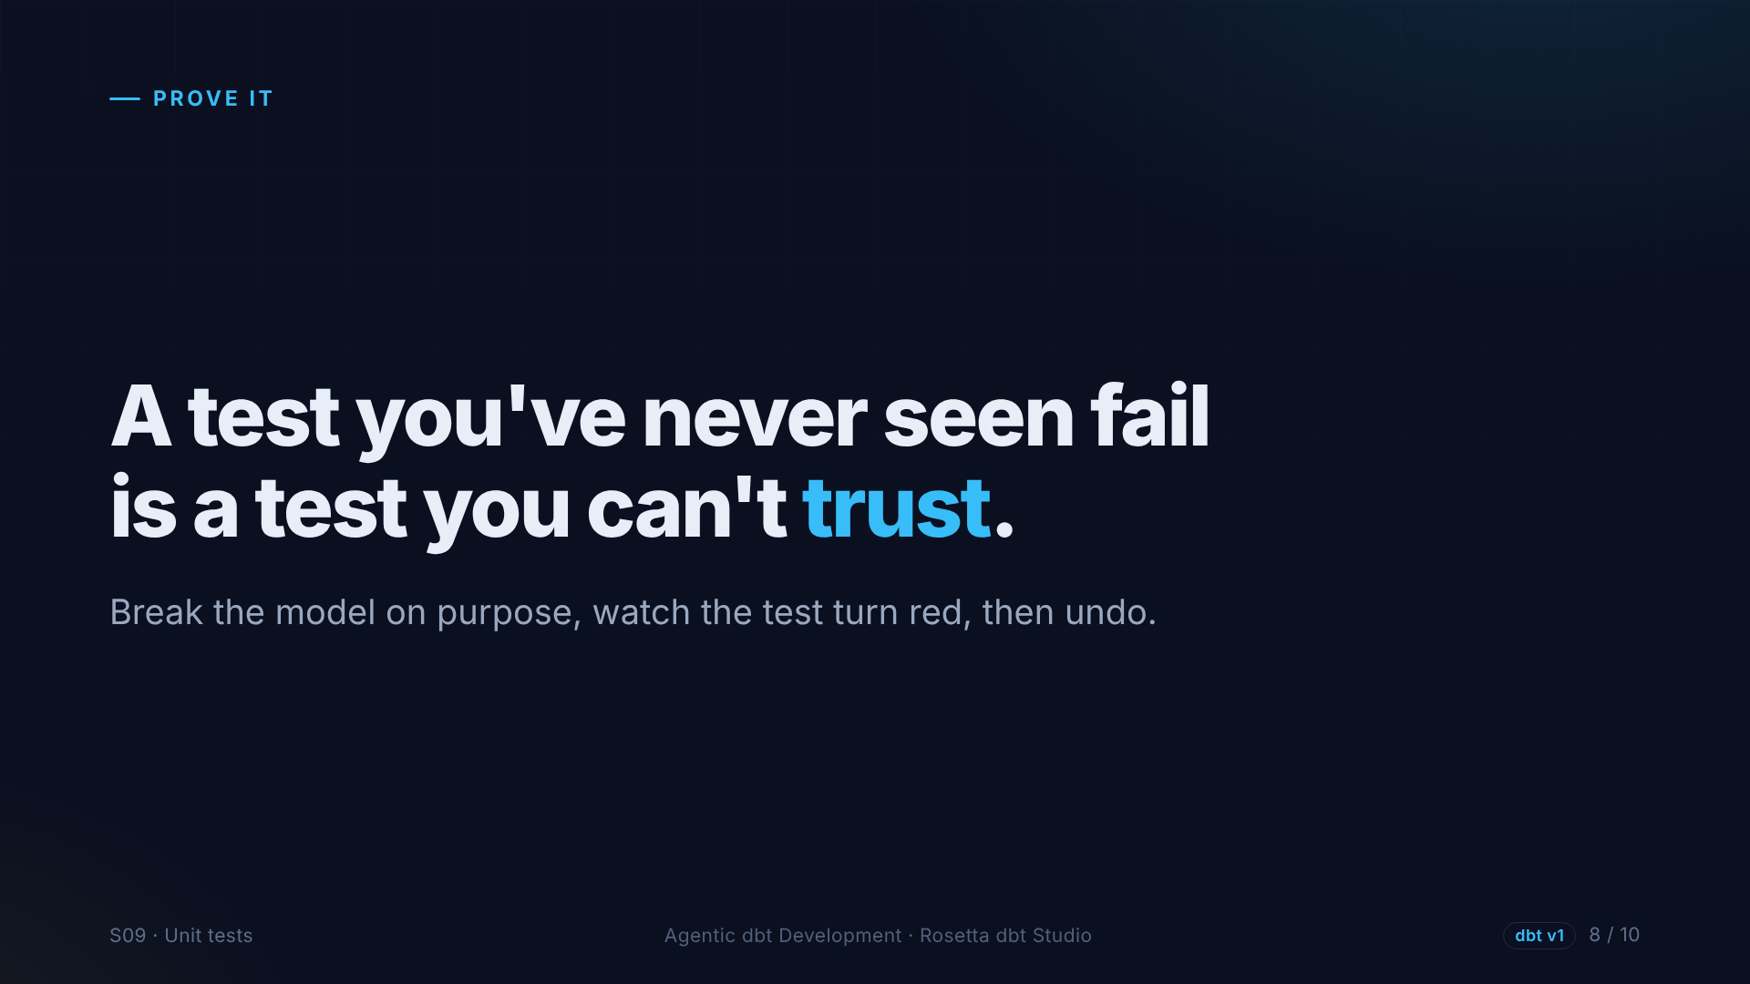
Notes:
A test you have never seen fail is a test you cannot trust. So we break the model on purpose.

Slide 9
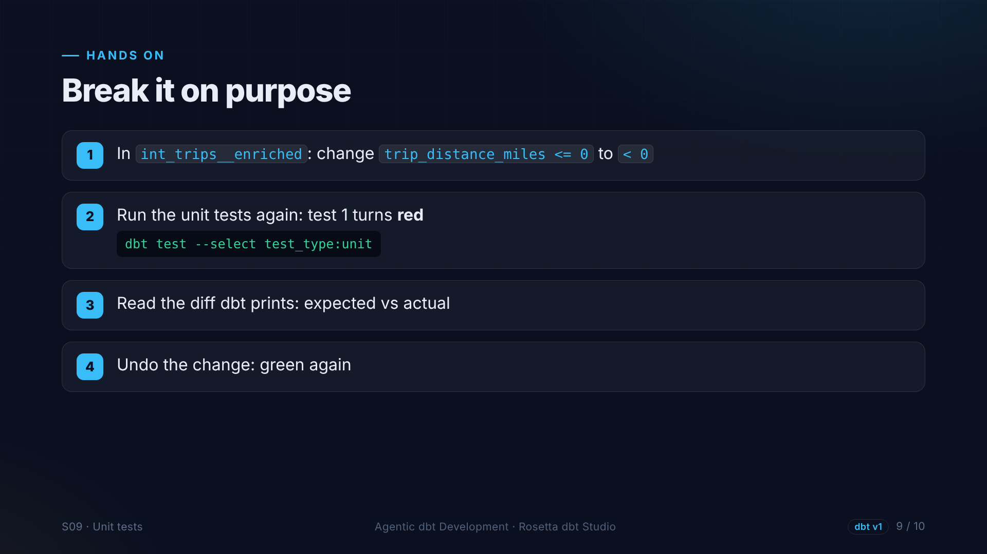
Notes:
We change one character: less than or equal to zero becomes less than zero. Now zero-distance trips are valid. The first unit test turns red, and dbt shows what we expected and what we got. We undo the change, and it is green again.

Slide 10
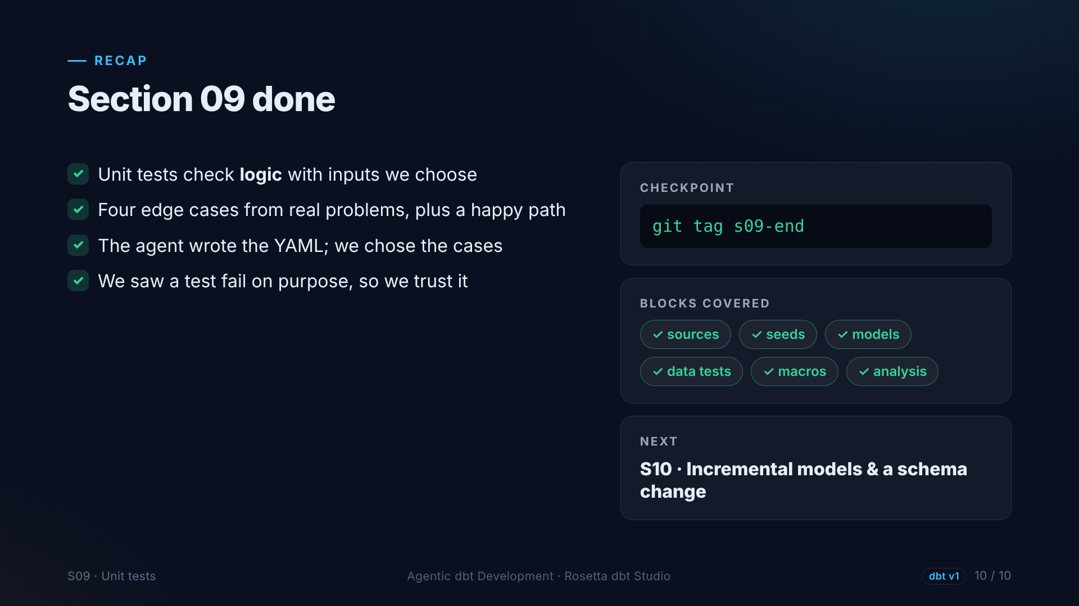
Notes:
That is section nine. Unit tests lock our business logic. We chose the cases, the agent wrote the YAML, and we watched a test fail on purpose. Next: incremental models.

