Slide 1
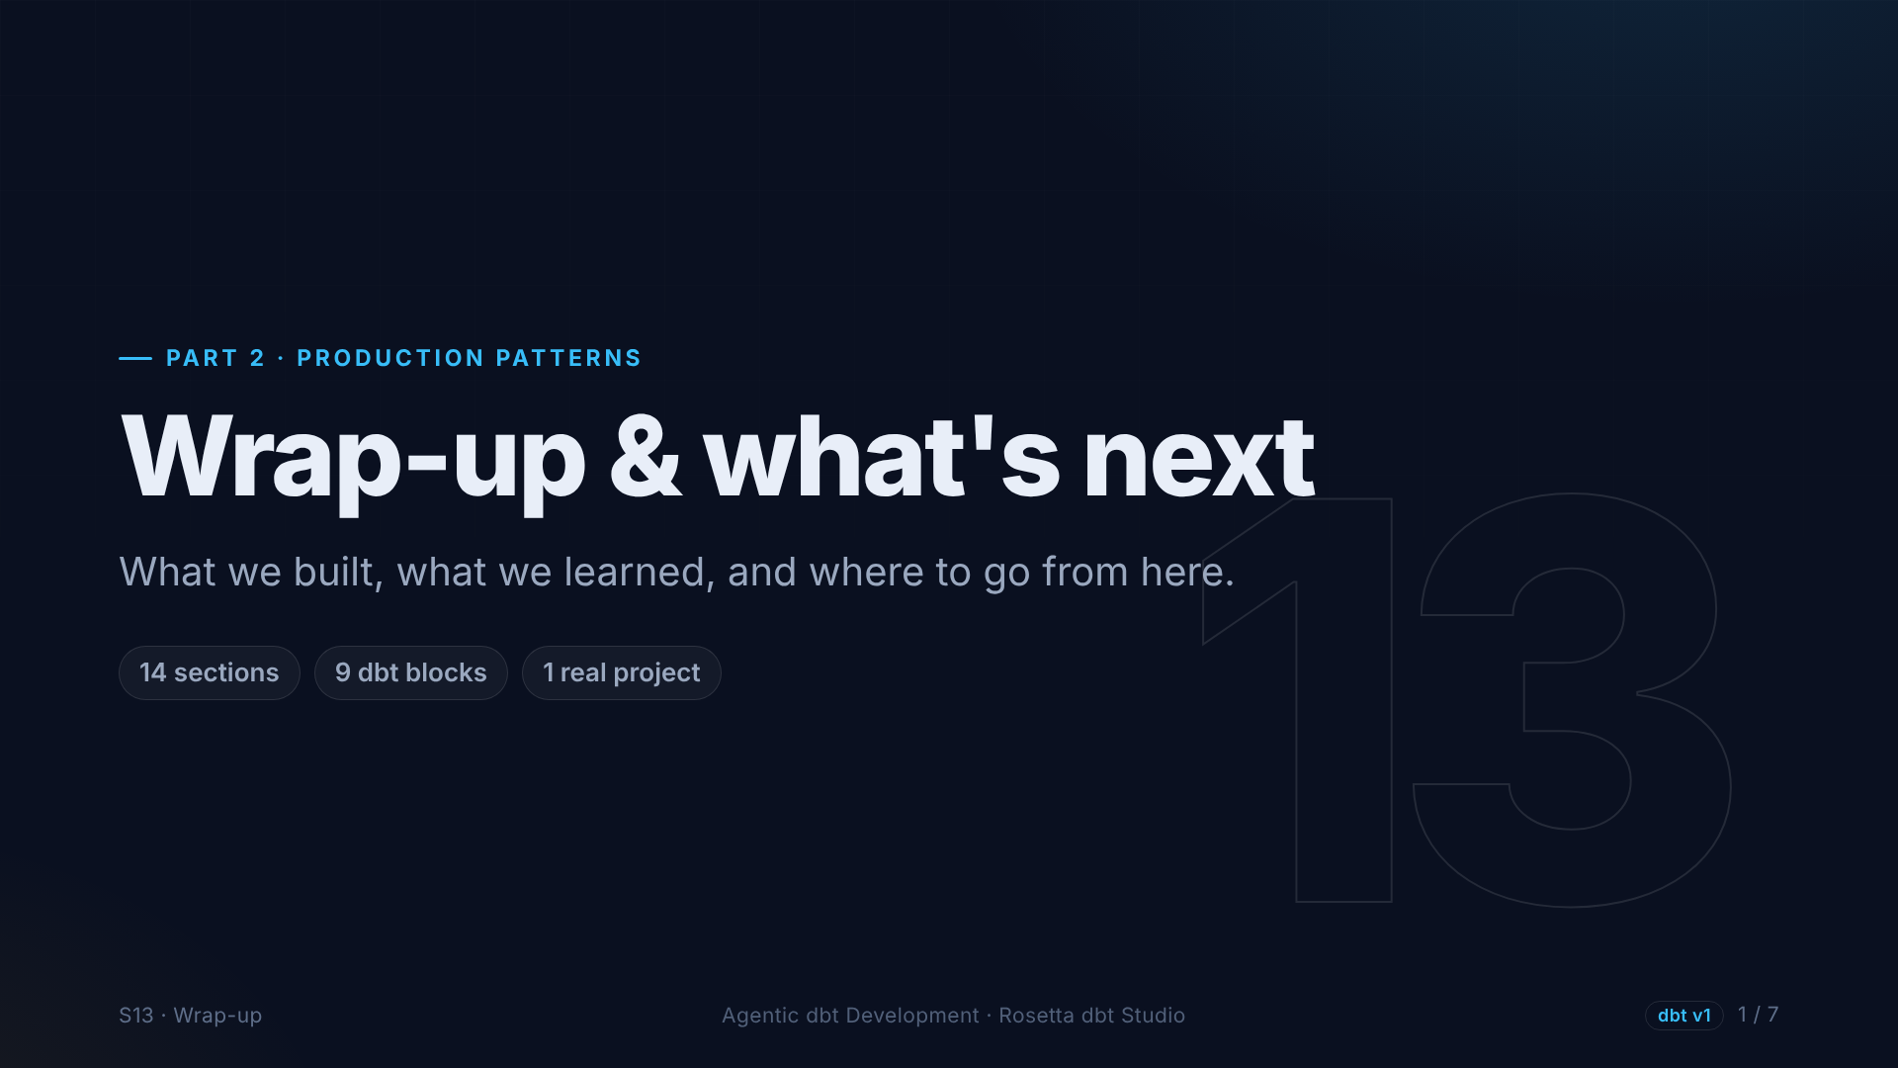
Notes:
The final section. Let's look back at what we built, and where you can go next.

Slide 2
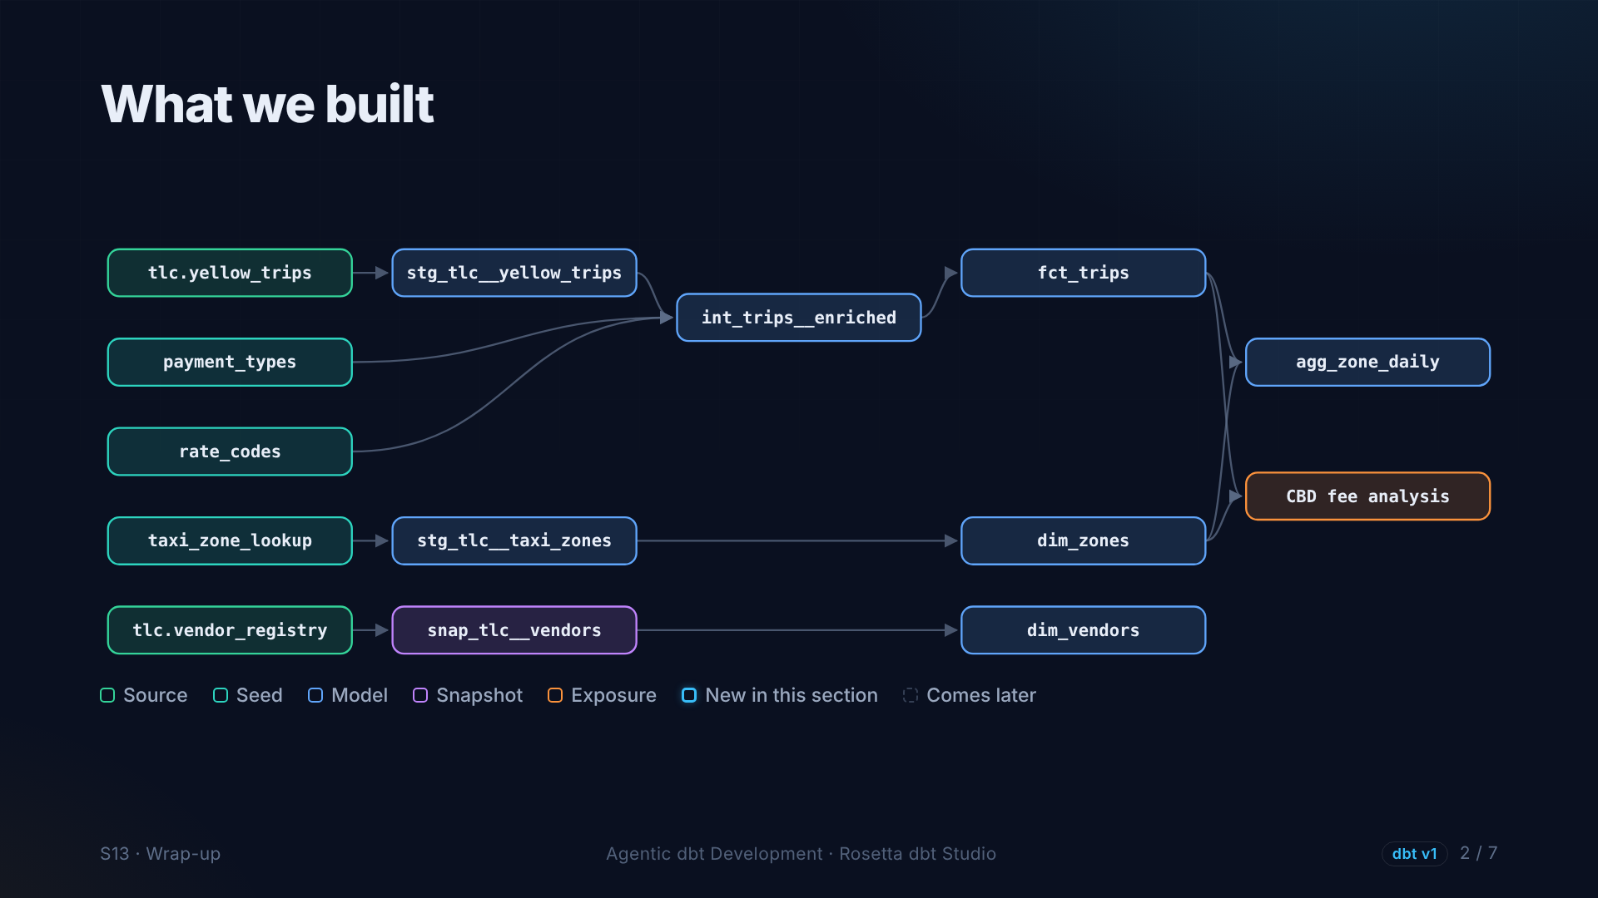
Notes:
This is your project. Sources and seeds, staging, an intermediate model with tested business rules, marts, a snapshot keeping history, and an exposure for a real analysis. Real data, real problems, real decisions.

Slide 3
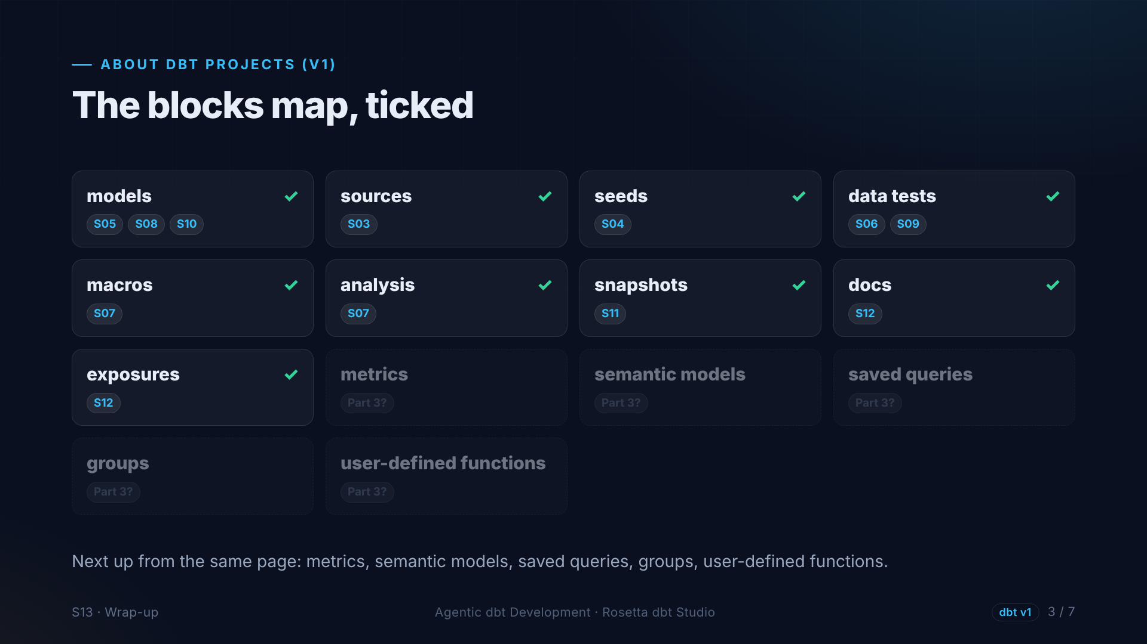
Notes:
Remember the map from section two? Every planned block is ticked: models, sources, seeds, tests, macros, analyses, snapshots, docs and exposures. The dashed ones, like metrics and the semantic layer, are your next steps.

Slide 4
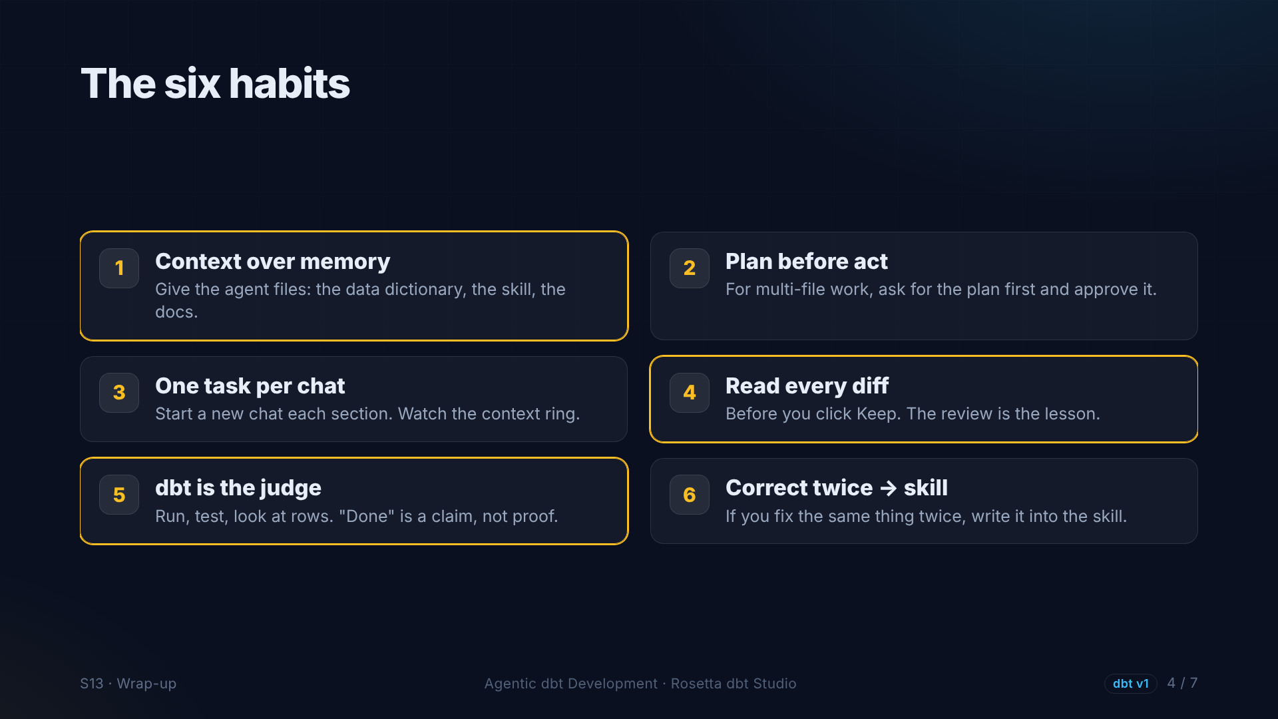
Notes:
If you keep only three habits: give the agent context, not memory. Read every diff before you keep it. And let dbt be the judge. The agent made us faster, but every decision in this project was ours.

Slide 5
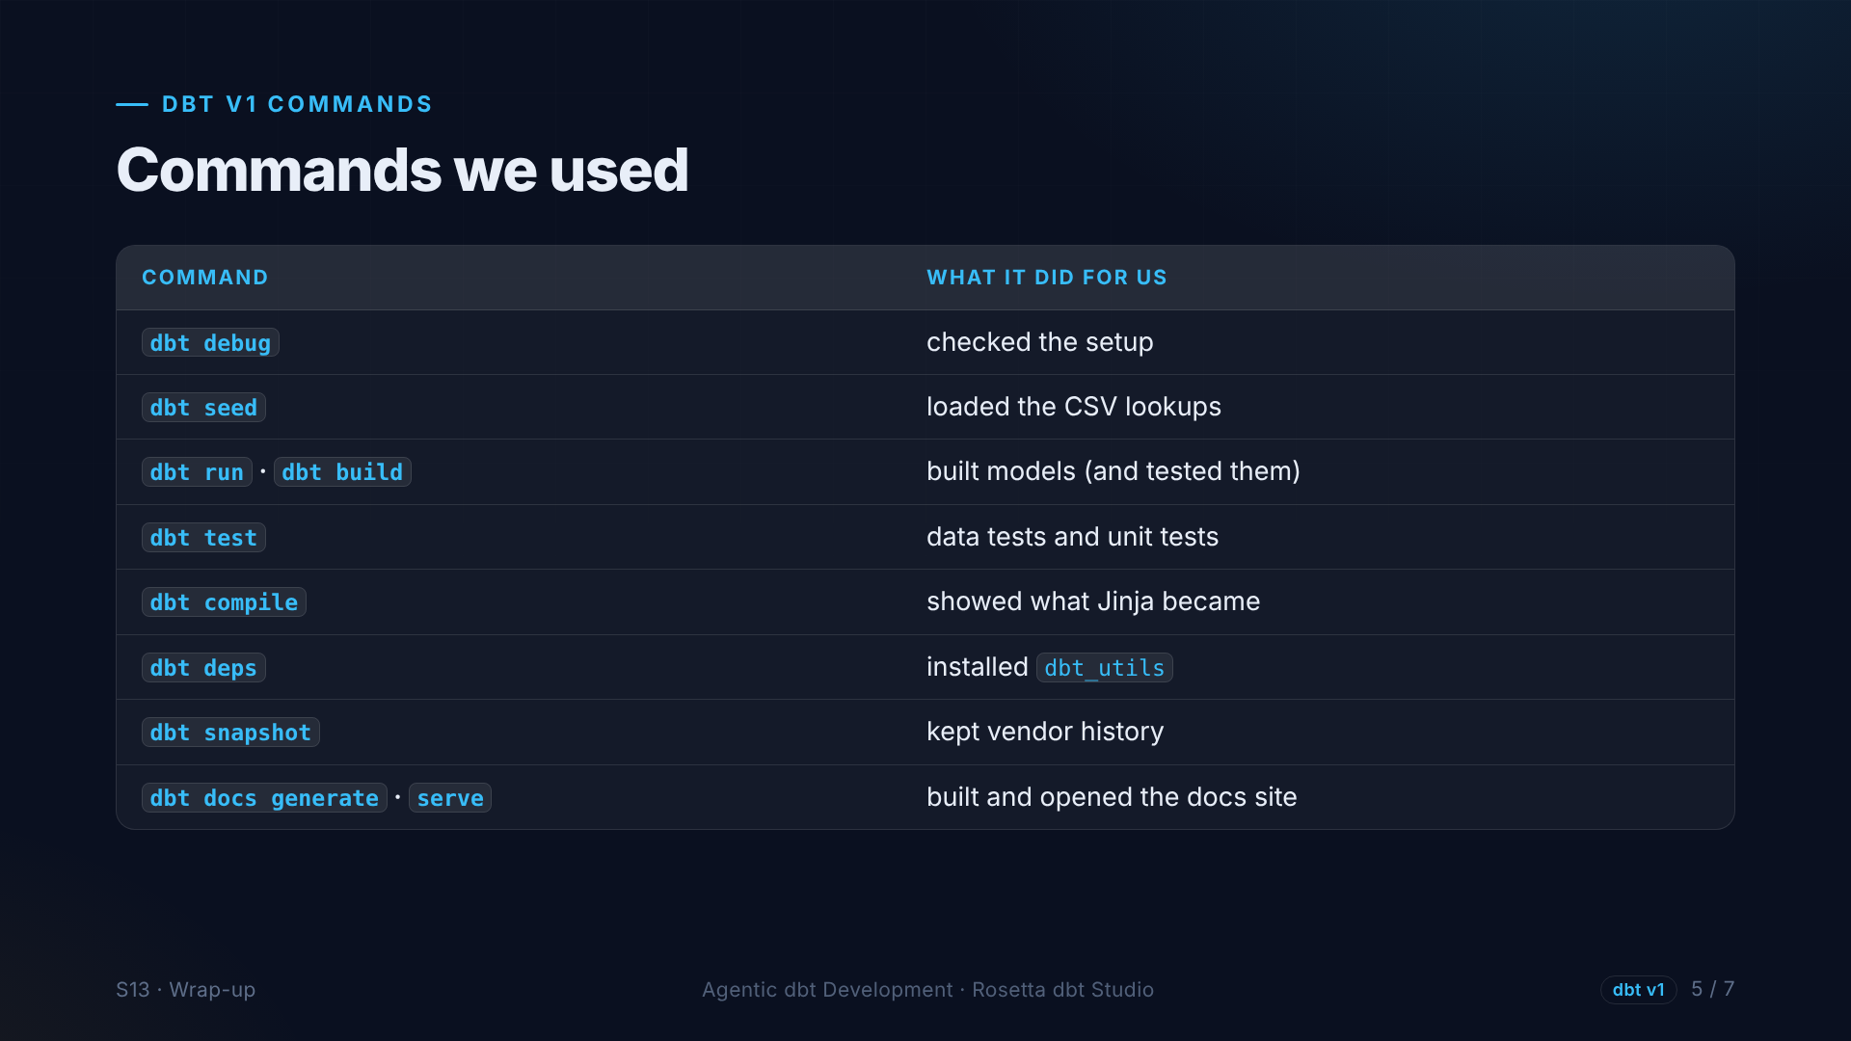
Notes:
The dbt commands we used, all from version one: debug, seed, run and build, test, compile, deps, snapshot, and docs. In Rosetta most of them are buttons, and now you know what each one does.

Slide 6
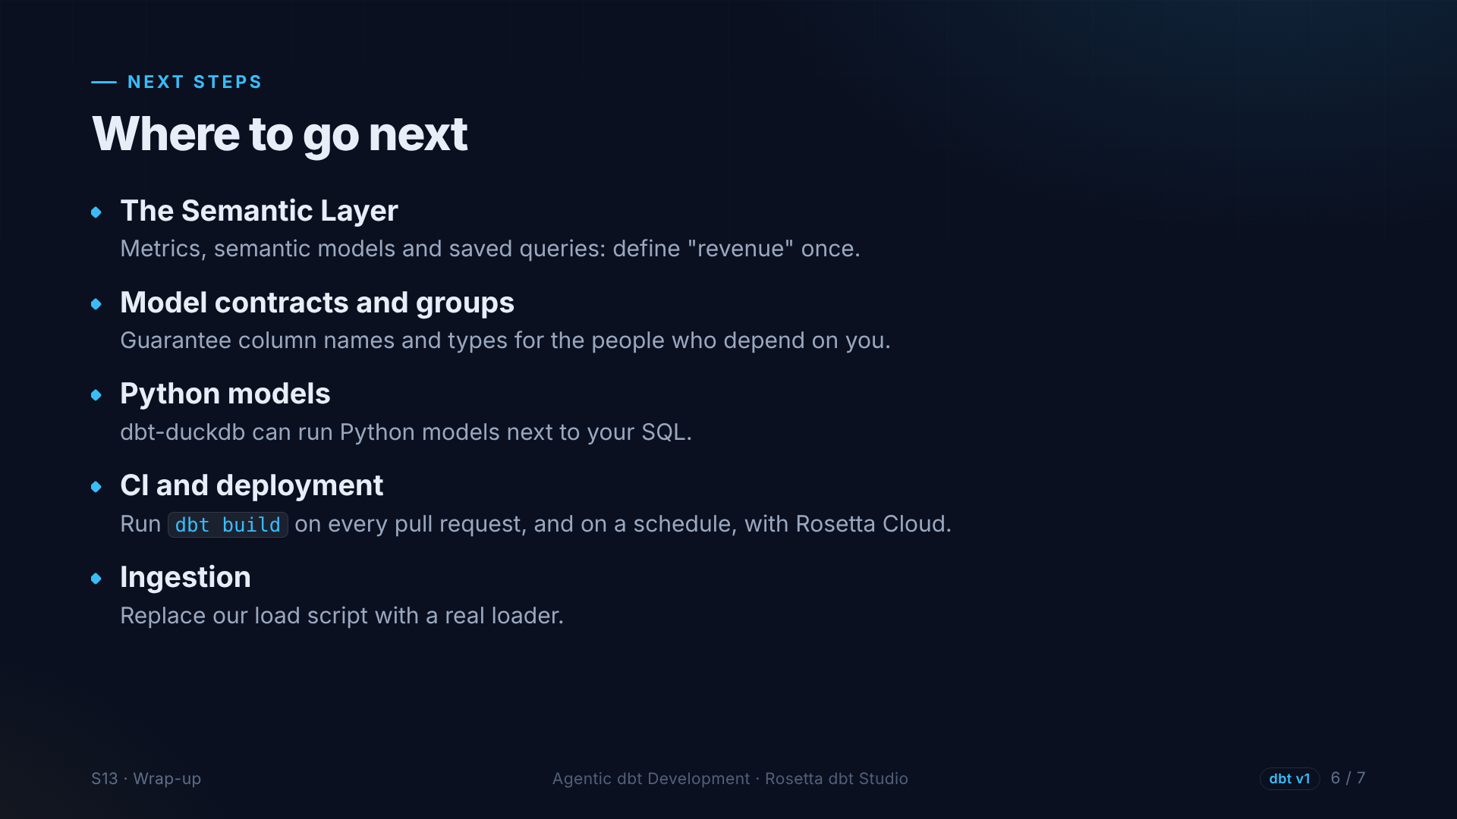
Notes:
Where to go next. The semantic layer, to define metrics like revenue once. Contracts and groups, when other teams depend on your models. Python models, which DuckDB supports. And automatic builds on every change, with Rosetta Cloud.

Slide 7
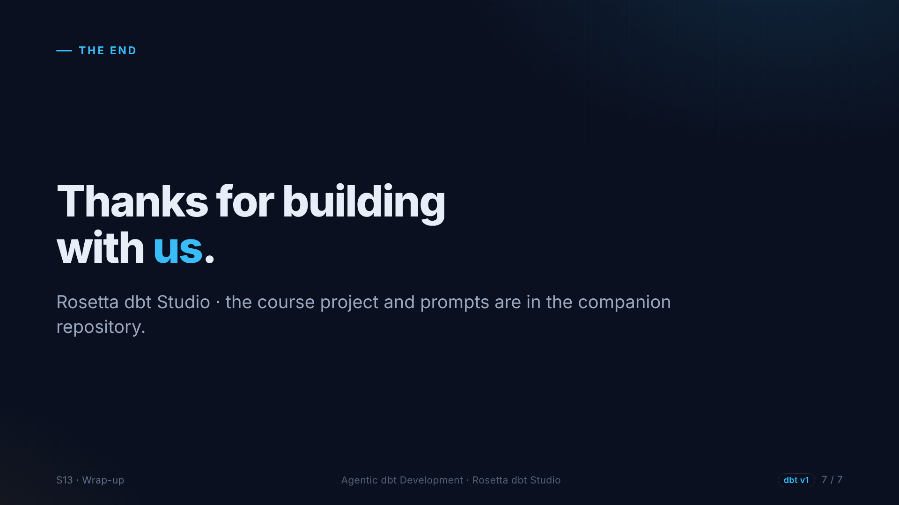
Notes:
Thank you for building this with us. The project, every checkpoint, and every prompt from this course are in the companion repository. Clone it, try the prompts, and let us know what you build.

