Slide 1


Measuring the degree of library dependency
Núria Bruch Tàrrega
January 2020
Academic Supervisor: | dr. Ana Oprescu
Host Supervisor: | Lodewijk Bergmans
Host Organization: | Software Improvement Group (SIG)

Slide 2
Outline
Introduction
Research Question 1
Research Question 2
Expected results

Slide 3
Introduction

Slide 4
Dependency Management
Library vulnerabilities
Library versions adoption

Slide 5
Dependency Management
How to model Software ecosystems?

Slide 6
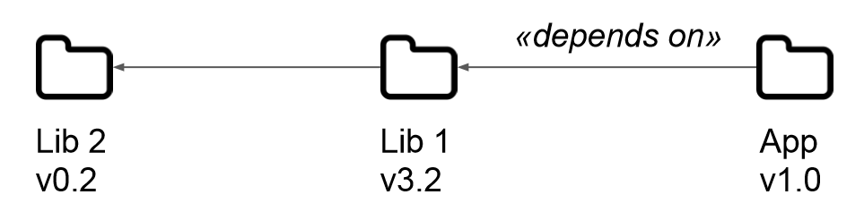
Dependency Management
How to model Software ecosystems?

Slide 7
Research Question
1

Slide 9
How can we measure the degree of library dependency?

Slide 10
How can we measure the degree of library dependency?
Which metrics are used to measure dependency in a project?
Coupling metrics

Slide 11
Research Question
2

Slide 13
How can we measure the effort needed to replace a library?

Slide 14
How can we measure the effort needed to replace a library?
How do we measure effort? COCOMO II

Slide 15
How can we measure the effort needed to replace a library?
How do we measure effort? COCOMO II
COCHCOMO → Effort to change code

Slide 16
Expected results

Slide 17
1. Set of metrics
Coupling between a project and the libraries it uses
Model to estimate the effort needed to replace a library

Slide 18
1. Set of metrics
Coupling between a project and the libraries it uses
Model to estimate the effort needed to replace a library
Formal definition
Validation criteria

Slide 19
2. Proof-of-Concept
Prototype to calculate the metrics

Slide 20
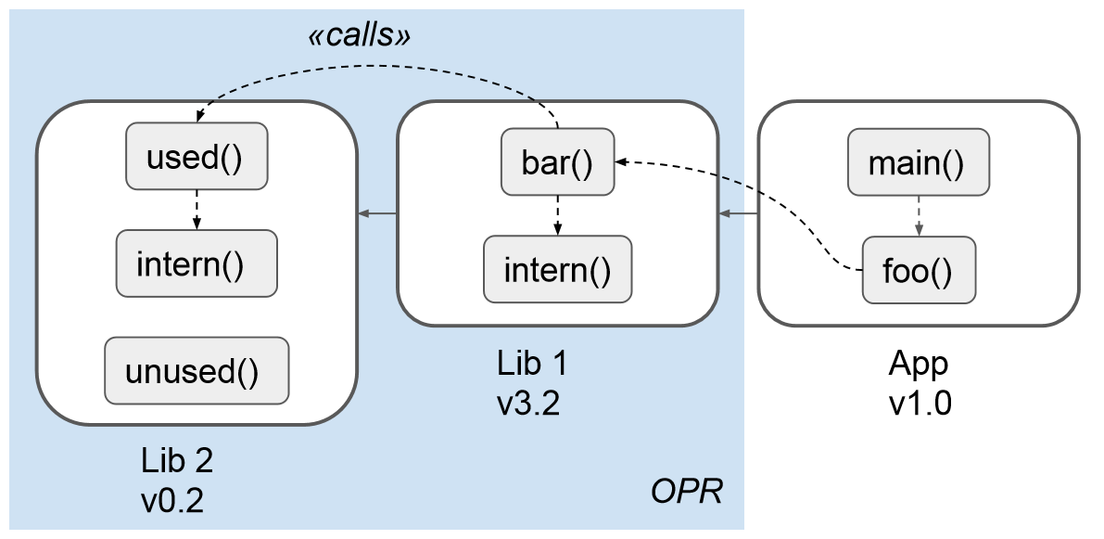
2. Proof-of-Concept
Prototype to calculate the metrics
Call-level dependency graph
J. Hejderup, M. Beller,
G. Gousios (2018)
J. Hejderup, A. van Deursen,
G. Gousios (2018)

Slide 21
3. Evaluation and validation
Metrics Theoretically
Validation Empirically
Mathematical Properties of Measures for Coupling
Srinivasan et al. 2014
Validation criteria for metrics
Meneely et al. 2013

Slide 22
Measuring the degree of library dependency
Núria Bruch Tàrrega
January 2020
Academic Supervisor: | dr. Ana Oprescu
Host Supervisor: | Lodewijk Bergmans
Host Organization: | Software Improvement Group (SIG)

Slide 24
Research Method
Technical Action Research
Controlled experiments → Coupling metrics
Case study → Effort measurement

Slide 25
Choosing applicable coupling metrics
Does the metric depend on the two projects being developed by the same team?
Does the metric consider inheritance?
Does the metric consider indirect coupling?
In which direction does the metric measure coupling?

Slide 26
Some applicable metrics
RFCα → Response for class
Considers transitivity
Both inheritance and non-inheritance
ICP → Information-flow-based coupling
Sum inheritance and non-inheritance

Slide 27
D()
B()
C()
A()
Lib2
Lib1
App

