Slide 1
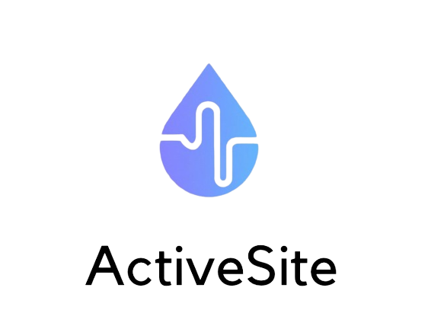

“Empower your health with Active Site's continuous monitoring.”

Slide 2
TABLE OF CONTENTS
01
02
03
PROJECT DOMAIN
PROJECT SOLUTION
Objectives, target users, what is ActiveSite …
Requirements, use case, diagrams, architecture
CONCLUSIONS
Impact, future projects

Slide 3
01
PROJECT DOMAIN
Objectives, target users, what is ActiveSite

Slide 4
Do you want to have your health in one single site,
in an affordable and accessible software,
that learns from the user, and you do not have to
manually input information each time?
Then, you should try . . .
ActiveSite

Slide 5
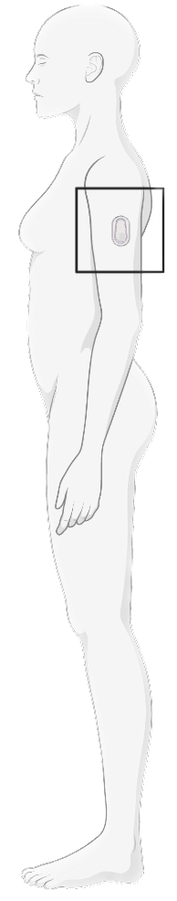
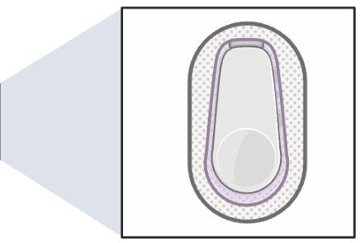
What is ActiveSite?
AI for the monitoring of heart rate, arrhythmias, glucose, hydration, and other nutritional and health items with continuous monitoring from a sensor.
Empowering the users by enabling them to monitor their health constants and be sure that in case of any abnormality they will be notified as soon as it is detected.

Slide 6

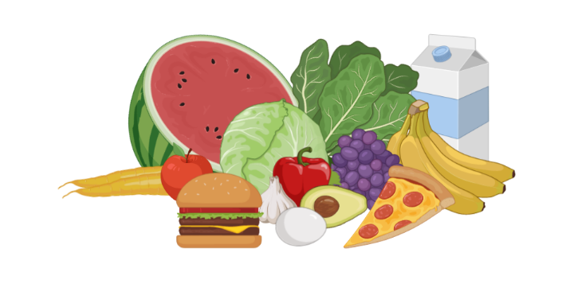

TARGET USERS
LIFESTYLE
People interested in monitoring their nutrition and health on a continuous basis
HEALTH
People with specific dietary or health goals that require ongoing monitoring and tracking
FITNESS
Athletes, fitness and active people who want to optimize their performance and recovery

Slide 7
MAIN FUNCTIONALITIES
Continuous monitoring of different nutritional and health indicators using a pain free sensor (sticker-like) attached to the skin.
Possibility to integrate with other apps or platforms to provide a more complete picture of the user's health and wellness.
Real-time data analysis and tracking using AI algorithms to provide personalized recommendations and insights.

Slide 8
RELEVANT FUNCTIONS
Heart rate and arrhythmia detection
Glucose levels monitoring
O2 levels detection
Temperature and hydration measurement
Activity monitoring and sleep cycle detection
Personalized insights using machine learning algorithms

Slide 9
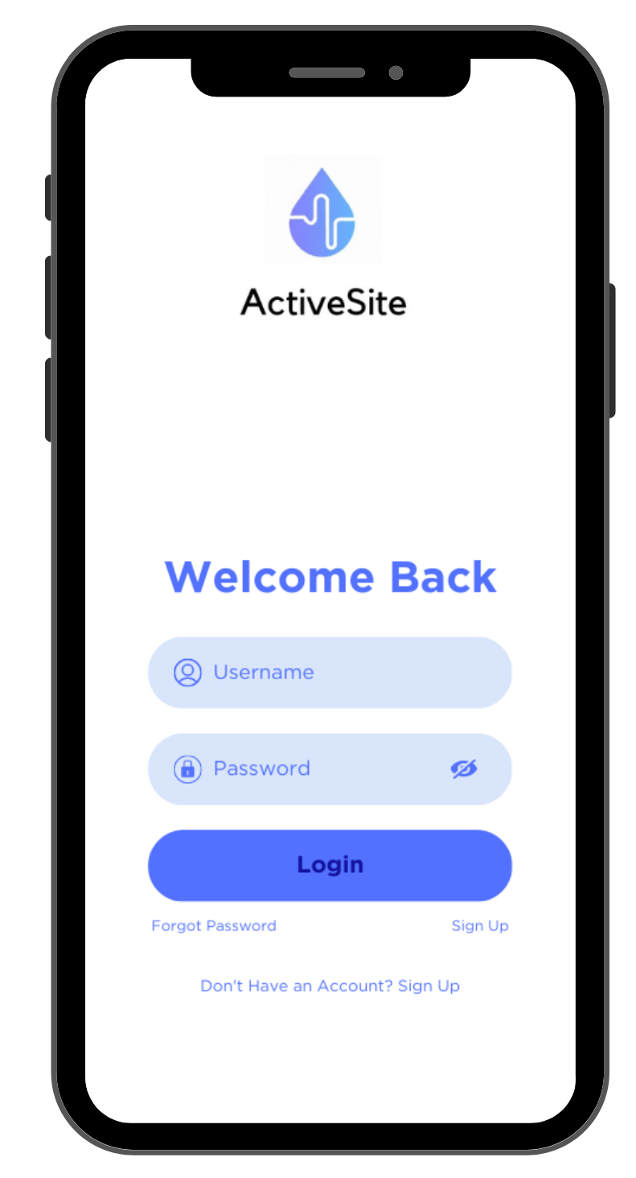
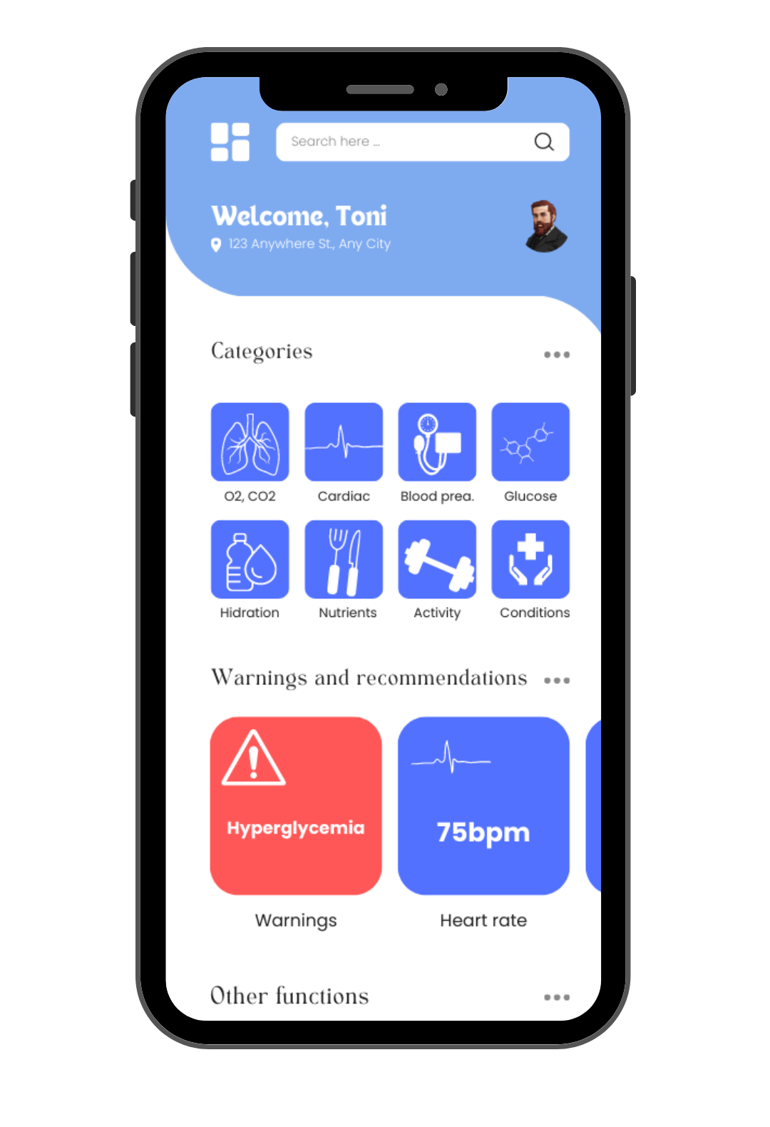
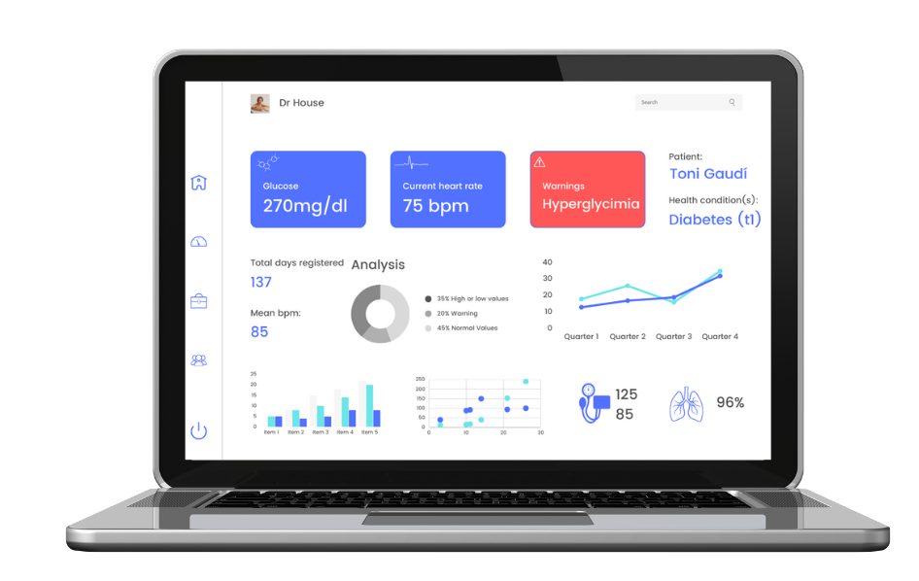
How can I connect to ActiveSite?
Give access to your Doctor!

Slide 10
02
PROJECT SOLUTION
Requirements, use case, diagrams, architecture

Slide 11
REQUIREMENTS
What requirements do we have to satisfy?
FUNCTIONAL | NON-FUNCTIONAL
User registration Data collection Data processing User interface Sensor pairing Data storage and Security User Profile Management External Panel (for Doctors) Notifications and Alerts | Performance Usability Reliability Compatibility

Slide 12
FUNCTIONAL REQUIREMENTS
User registration
Create an account.
Provide personal information.
Select mode and set goals.
Data collection
Data gained by the sensor.
Data added manually by the user.
Data validated and stored.
Data processing
Data sent to the Web server.
Validation of the data.
If data is correct, data is processed.
Provide advice and alerts.
User interface
User can input data.
User can view data.
View real-time metrics, access recommendations.
User can set goals and alerts.

Slide 13
Sensor pairing
Sensor paired with the user’s app via Bluetooth.
User Profile Management
Allow user to view and edit personal information.
Allow user to edit health and nutritional goals.
Data storage and Security
Data protection regulations.
Data encryption.
Regular back-ups to prevent data loss.
External Panel
For Doctors or healthcare professionals.
Observe and monitor patients data.
Secure and restricted access.
Notifications and Alerts
Alerts and notifications based on preferences and personal settings.
Notifications of critical or unusual health events.

Slide 14
NON-FUNCTIONAL REQUIREMENTS
Performance
Process large data quickly and accurately.
Handle high levels of user traffic.
Usability
Easy-to-use app.
Clear instructions and intuitive design.
Text-to-speech and high-contrast modes.
Reliability
App must be always available and reliable.
Minimal downtime for maintenance.
One update per month.
Compatibility
App has to be compatible with other devices.
App compatible with Windows, iOS, Android and Linux.

Slide 15
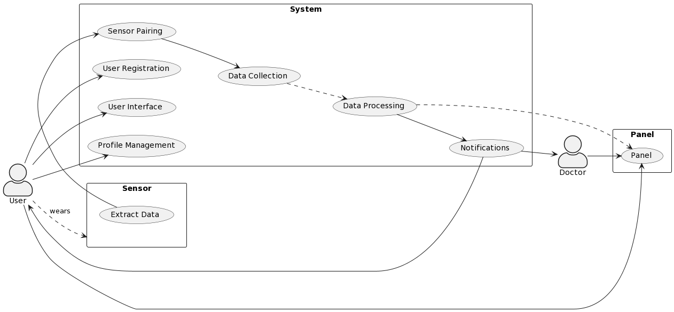
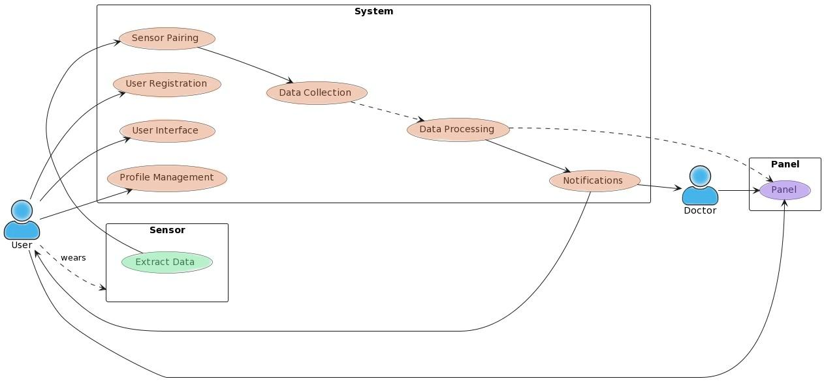
USE CASE DIAGRAM

Slide 16
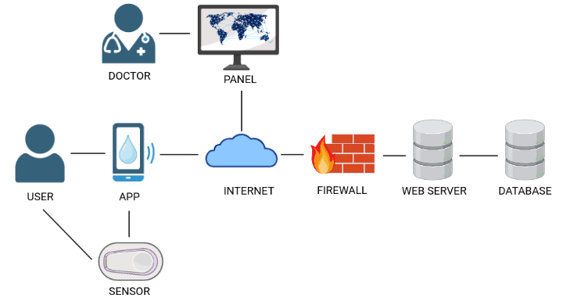
ARCHITECTURE IMPLEMENTED
- Represents the individuals
- Create an account within the app
- Set goals
- View and edit personal information
- Access real-time and historical sensor data
- Separate interface designed for doctors
- Dedicated platform to access and analyze data
- Doctors can view individual patient data
- Advanced visualization tools, data filtering…
- Allows to monitor the progress of their patients
- Represents the network infrastructure
- Exchange of data between app and web server
- Established through various means
- The app uses the internet to transmit data
- Stable and reliable internet connection
- Receives API requests from the app
- Processes API to perform various operations.
- Interacts with the database system
- Define and expose the APIs that app utilizes
- Implement additional security measures
- Store and manage the system persistent data
- User profiles, goals, and historical sensor data.
- Ensures data integrity and concurrency control
- Interacts with database system to store data
- Relational database management system
- Software application on the user's mobile device.
- User interface and functionality for users
- Register an account, log in, store information
- Connection with the sensor
- Relies on an internet connection
- Represents healthcare professionals
- Have authorized access to the panel
- View and analyze the health metrics and trends.
- Monitor multiple patients simultaneously
- Customize alerts and notifications
- Represents set of tools, libraries, and protocols
to build and expose the APIs of the web server.
- Infrastructure to define, implement, and manage
- Include features: routing, authentication…
- Secure and standardized communication
- Physical device that captures health-related data
- Uses specific technologies to collect data.
- Communicates with the mobile app
- Employs industry-standard protocols like
Bluetooth to connect with the mobile app.

Slide 17
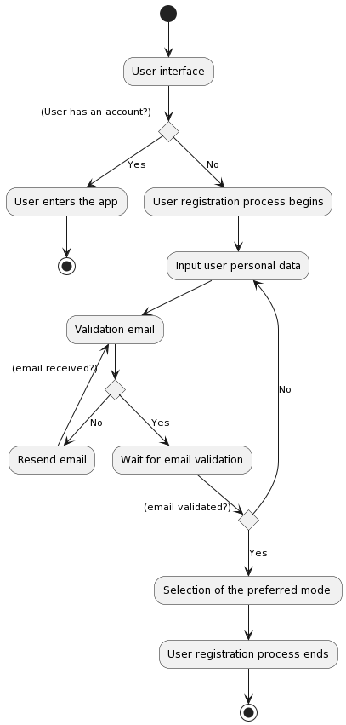
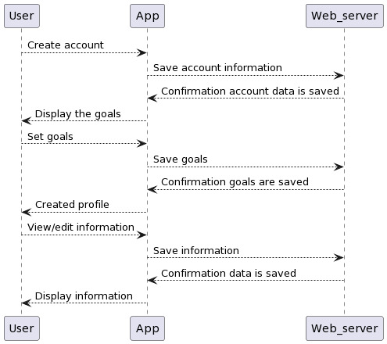
USER REGISTRATION DIAGRAMS
Sequence diagram
Activity diagram

Slide 18
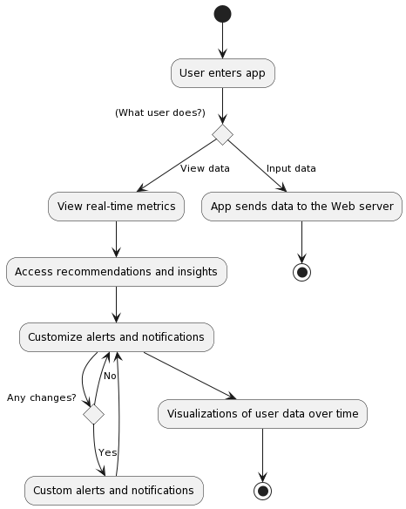
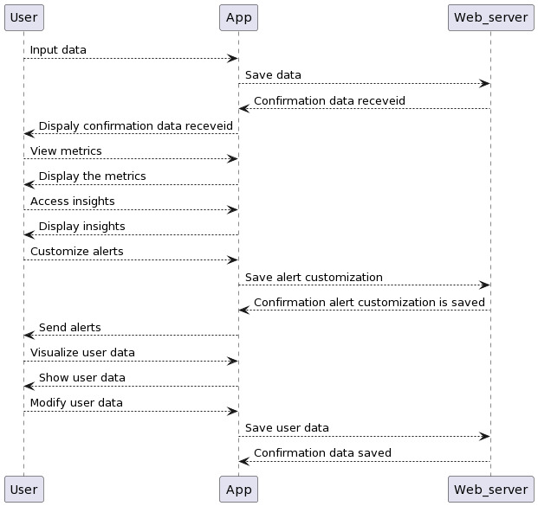
USER INTERFACE DIAGRAMS
Sequence diagram
Activity diagram

Slide 19
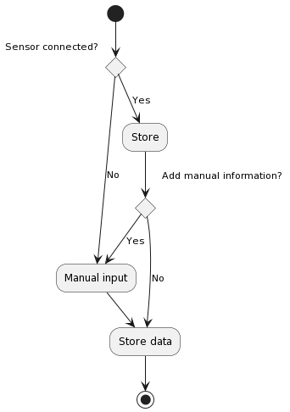
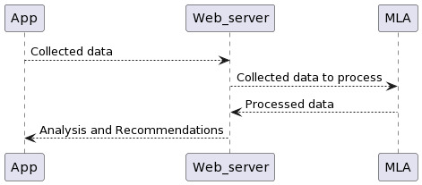
DATA COLLECTION DIAGRAMS
Sequence diagram
Activity diagram

Slide 20
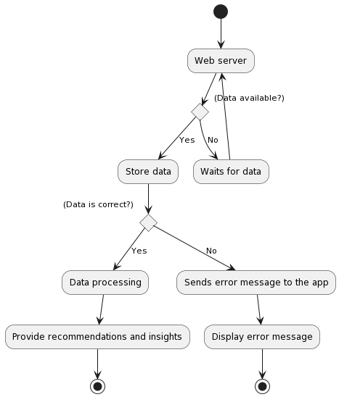
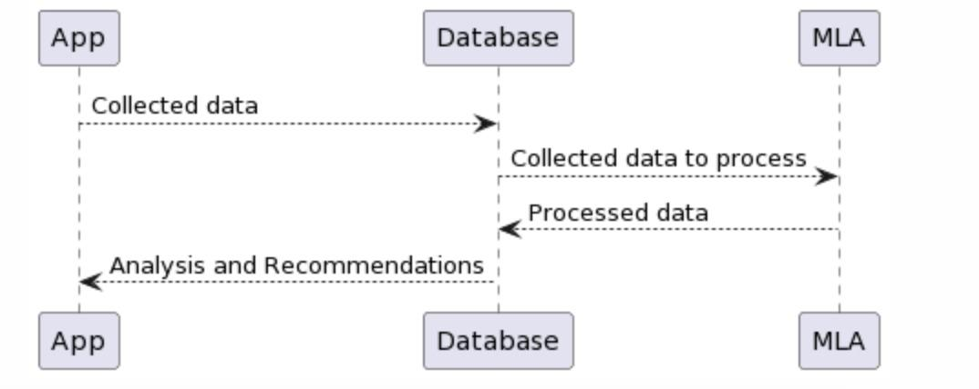
DATA PROCESSING DIAGRAMS
Activity diagram
Sequence diagram

Slide 21
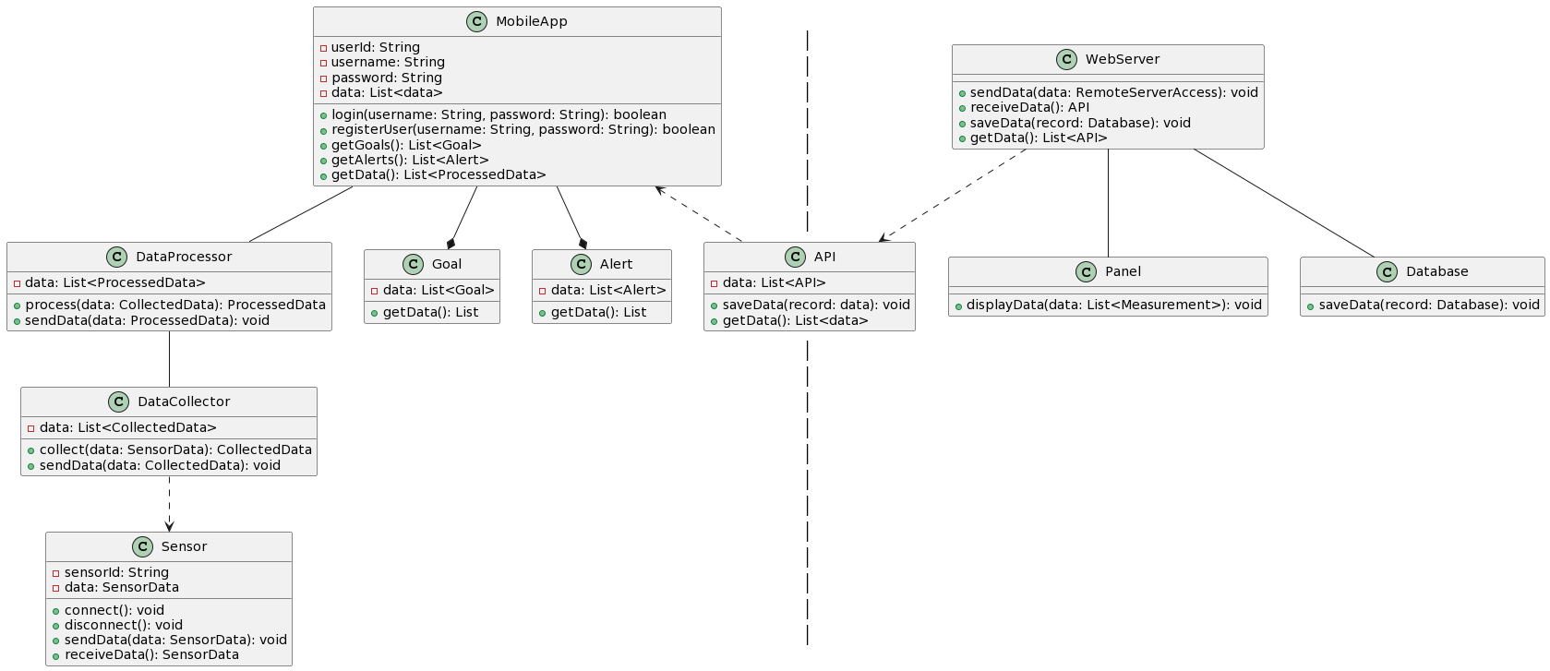


CLASS DIAGRAM

Slide 22
03
CONCLUSIONS
Impact, future projects

Slide 23
HIGH IMPACT SOFTWARE
Empowering and improving life quality of users through continuous monitoring and customizable alerts
Allows medical providers to access data from their patients at any time and receive alerts in case of abnormal values
Control of user symptoms
Custom recommendations based on the data collected by the site

Slide 24
FUTURE PROJECTS
Other wearable devices
Pre-detection of other diseases
New applications in clinical / research areas

Slide 25
THANKS!
DO YOU HAVE ANY QUESTIONS?
The app require user feedback to continually improve
Núria, Mònica i Marta
102-09
GitHub: https://github.com/NuriaMitjavila/Software-Engineering

