Slide 1

UDACITY- BERTELSMANN
Business Analytics Nanodegree
2022
Boglarka Pankucsi-Szabo

Slide 2
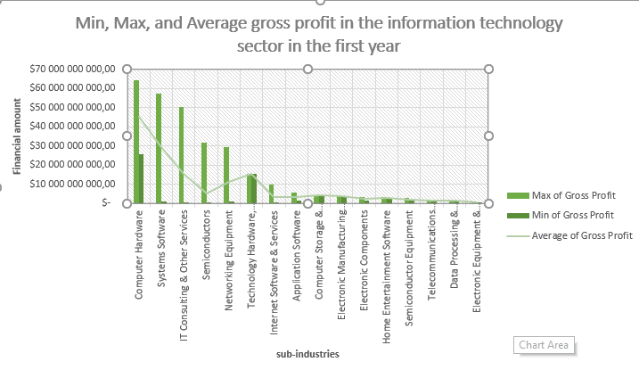
Q: Which IT sector had the highest average gross profit at the end of the first year? Which sector had the lowest gross profit at the end of the first quarter year? What could be the reason for this?
The table shows the first year’s average gross profit in the IT sector.
The vertical axis shows the financial amounts and the horizontal axis lists the sub-indrusties of the IT sector.
As can be seen from the table, the largest profit generators in the IT sector are Computer Hardware, System Software, IT Consulting, Semiconductors, and Networking sub-sectors.
The picture is misleading, because for all five sub-sectors, the minimum and maximum are significantly different. This could mean that there are some very prominent players in these sectors that significantly raise the average.
In the next graph, I will look at how the overall picture evolves if I exclude the five most prominent players in the sector.

Slide 3
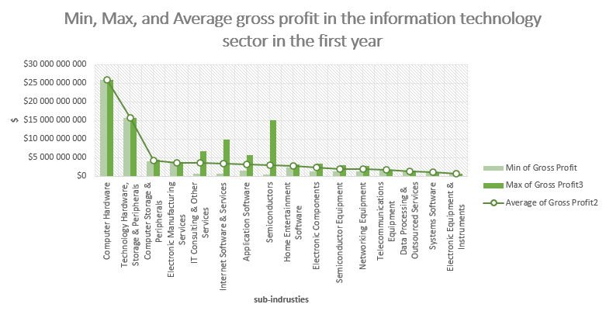
What happens if I take out the 5 most significant companies in the market?
Then we get a completely different picture.
The Computer Hardware sector is still in the lead, but from the second place onwards we get a completely different order.
This shows how dominant these five strongest players: Apple, Microsoft, IBM, Intel, and Cisco in the sector

