Slide 1


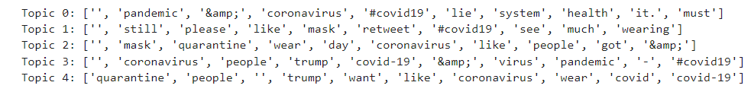
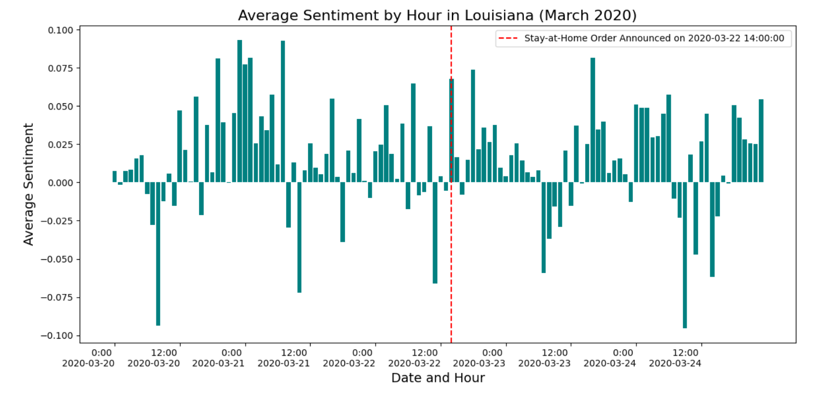
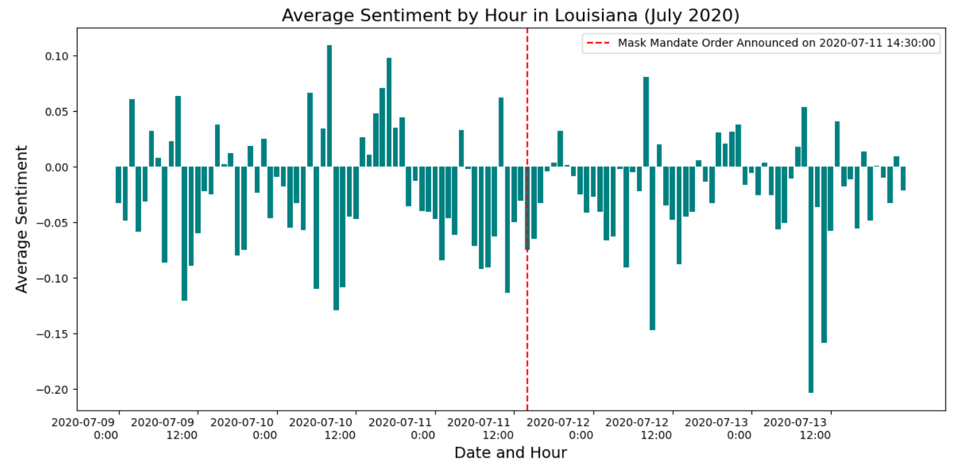
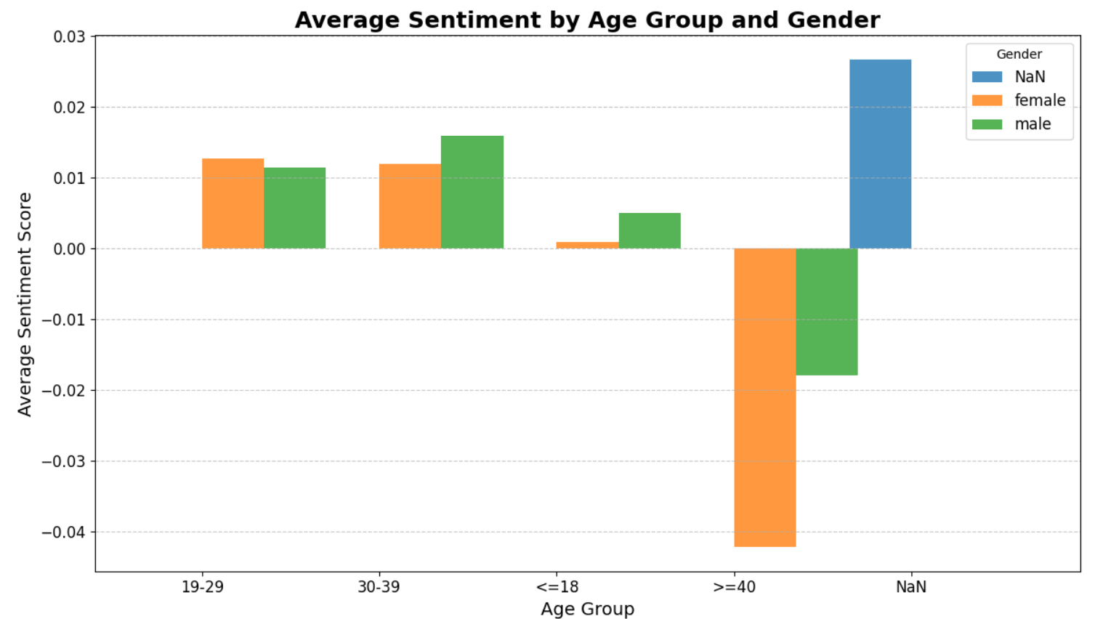
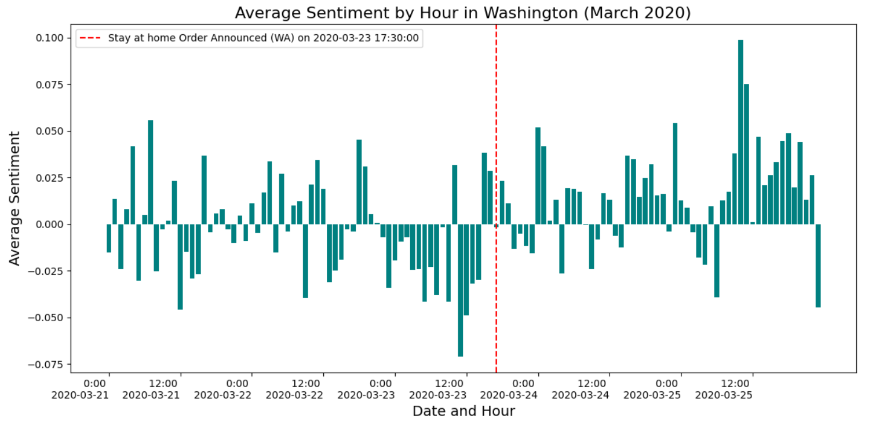
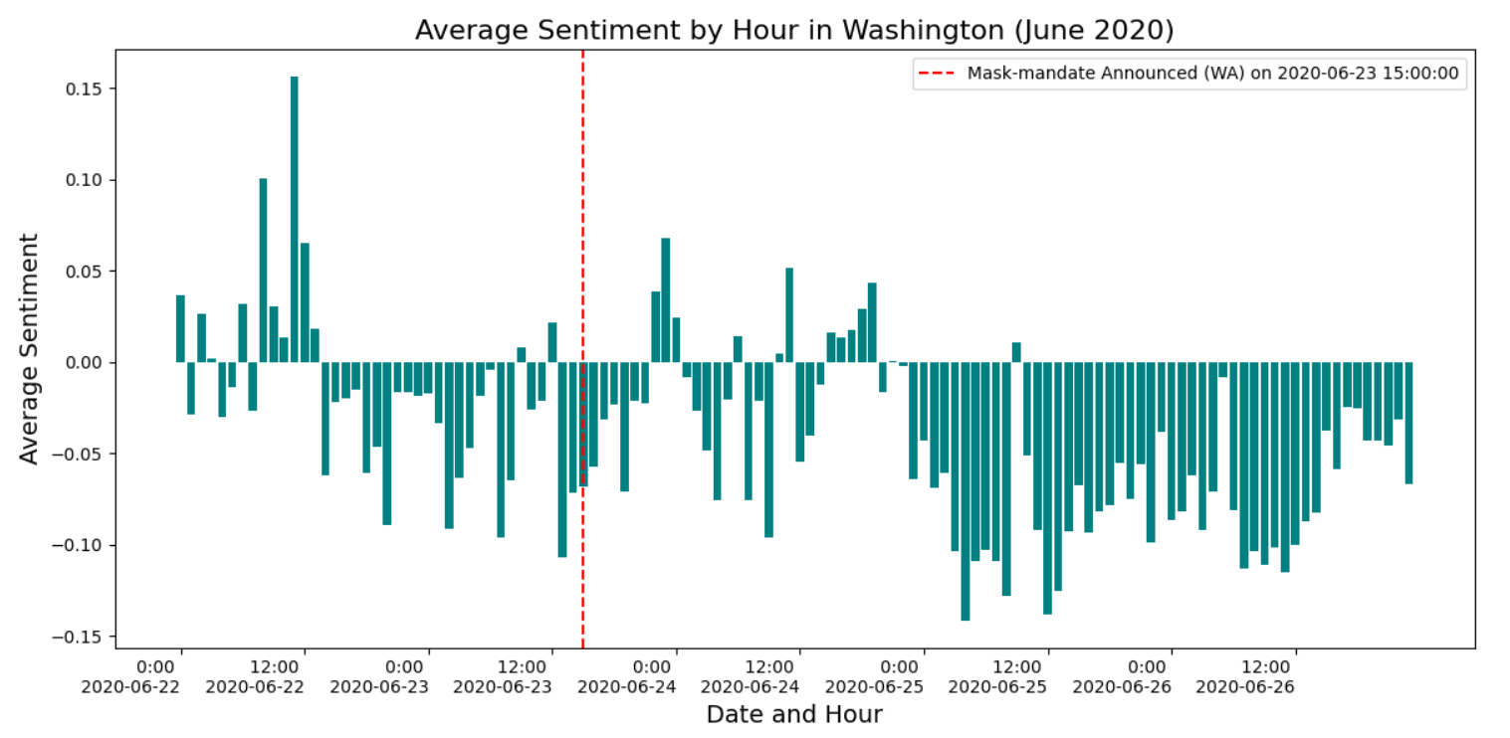
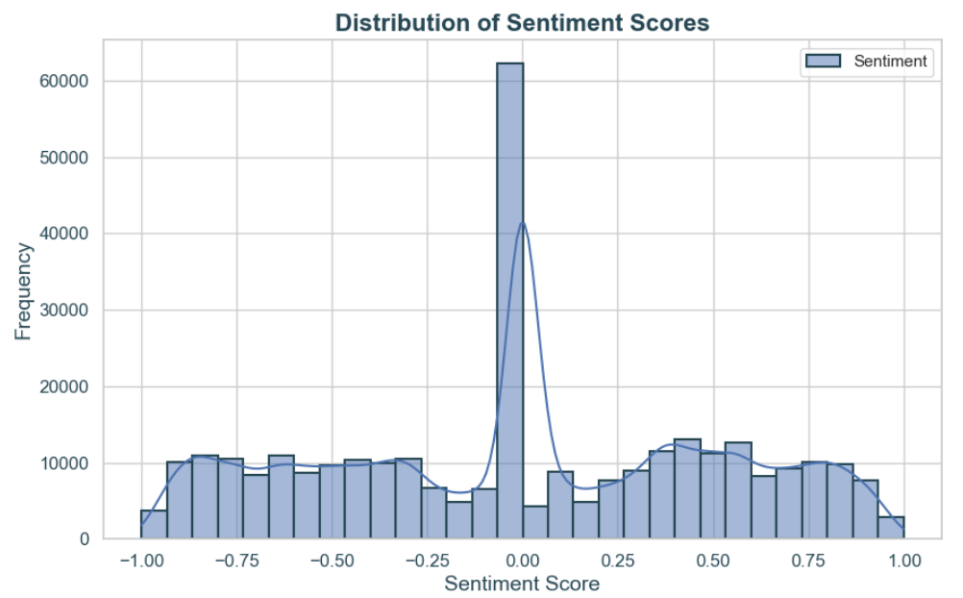
314534
314534
Sentiment Analysis and Topic Modeling Using Spark
Nurjahan
Louisiana State University, Baton Rouge, LA
Your Project Description
Big Data Frameworks
Datasets
To analyze how people’s sentiment towards COVID-19 varies across geo-locations and time-periods.
To analyze sentiments based on gender and age-group of Louisiana and Washington.
To apply topic modeling technique Latent Dirichlet Allocation (LDA) on the dataset using Spark with MLlib.
PySpark: PySpark is the Python API for Apache Spark, a powerful open-source distributed computing framework designed for large-scale data processing
MLlib: Pyspark Library for performing preprocessing and applying ML techniques.
Matplotlib and Seaborn: Both are not big data framework but can work with pyspark dataframe for visualization purposes.
Spark SQL: Spark library for Query and Data Analysis.
Dataset(s): Twitter Data of Louisiana and Washington (48 hours before and 48 hours after of the stay-at-home order and mask-mandate order);
URL: Not Publicly Available
Total Row: 314534 (only Covid),
2769978 (all)
Total Attributes: 16
Your Development Details
Main Results & Screenshots
Conclusion & Future Work
Environment: Jupyter Notebook on Windows PC, core i7, 13th Generation, 16 GB RAM.
Pyspark version is 3.5.3
Faced problem about python version compatibility with pyspark. Needed to downgrade python version from 3.12 to 3.10
Specific JDK version-3.11. Updated version do not work.
Faced challenges to read csv file using spark functions. It incorrectly place one column’s data to another column.
Spark can not handle of datetime patterns ‘E MMM dd HH:mm:ss Z yyyy’ after version 3.0.
Faced storage shortage problem for driver program.
Faced Timezone problem. Need to set up the spark time to UTC.
Topics found using LDA like conspiracies or health system mistrust, requests or recommendations regarding mask usage, quarantine and mask-wearing, politics and the pandemic. quarantine, mask-wearing, and desires or frustrations.
Aim to time-series analysis of the twitter data, tweets containing misinformation data.
Classification of tweets into factual or misinforming tweets.
Analyze whether the tweet is from human or bot-like accounts.
To explore more ML models for analysis.

