Slide 1
Discrete Probability
Chapter 7
With Question/Answer Animations
Copyright © McGraw-Hill Education. All rights reserved. No reproduction or distribution without the prior written consent of McGraw-Hill Education.

Slide 2
Chapter Summary
Introduction to Discrete Probability
Probability Theory
Bayes’ Theorem
Expected Value and Variance

Slide 3
An Introduction to Discrete Probability
Section 7.1

Slide 4
Section Summary
Finite Probability
Probabilities of Complements and Unions of Events
Probabilistic Reasoning

Slide 5

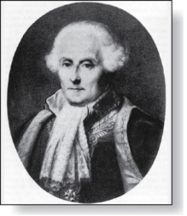
Probability of an Event
Pierre-Simon Laplace
(1749-1827)
We first study Pierre-Simon Laplace’s classical theory of probability, which he introduced in the 18th century, when he analyzed games of chance.
We first define these key terms:
An experiment is a procedure that yields one of a given set of possible outcomes.
The sample space of the experiment is the set of possible outcomes.
An event is a subset of the sample space.
Here is how Laplace defined the probability of an event:
Definition: If S is a finite sample space of equally likely outcomes, and E is an event, that is, a subset of S, then the probability of E is p(E) = |E|/|S|.
For every event E, we have 0 ≤ p(E) ≤ 1. This follows directly from the definition because 0 ≤ p(E) = |E|/|S| ≤ |S|/|S| ≤ 1, since 0 ≤ |E| ≤ |S|.

Slide 6
Applying Laplace’s Definition
Example: An urn contains four blue balls and five red balls. What is the probability that a ball chosen from the urn is blue?
Example: What is the probability that when two dice are rolled, the sum of the numbers on the two dice is 7?

Slide 7
Applying Laplace’s Definition
Example: An urn contains four blue balls and five red balls. What is the probability that a ball chosen from the urn is blue?
Solution: The probability that the ball is chosen is 4/9 since there are nine possible outcomes, and four of these produce a blue ball.
Example: What is the probability that when two dice are rolled, the sum of the numbers on the two dice is 7?
Solution: By the product rule there are 6² = 36 possible outcomes. Six of these sum to 7. Hence, the probability of obtaining a 7 is 6/36 = 1/6.

Slide 8
Applying Laplace’s Definition
Example: In a lottery, a player wins a large prize when they pick four digits that match, in correct order, four digits selected by a random mechanical process. What is the probability that a player wins the prize?
A smaller prize is won if only three digits are matched. What is the probability that a player wins the small prize?

Slide 9
Applying Laplace’s Definition
Example: In a lottery, a player wins a large prize when they pick four digits that match, in correct order, four digits selected by a random mechanical process. What is the probability that a player wins the prize?
Solution: By the product rule there are 10⁴ = 10,000 ways to pick four digits.
Since there is only 1 way to pick the correct digits, the probability of winning the large prize is 1/10,000 = 0.0001.
A smaller prize is won if only three digits are matched. What is the probability that a player wins the small prize?
Solution: If exactly three digits are matched, one of the four digits must be incorrect and the other three digits must be correct. For the digit that is incorrect, there are 9 possible choices. Hence, by the sum rule, there a total of 36 possible ways to choose four digits that match exactly three of the winning four digits. The probability of winning the small price is 36/10,000 = 9/2500 = 0.0036.

Slide 10
Applying Laplace’s Definition
Example: There are many lotteries that award prizes to people who correctly choose a set of six numbers out of the first n positive integers, where n is usually between 30 and 60. What is the probability that a person picks the correct six numbers out of 40?

Slide 11
Applying Laplace’s Definition
Example: There are many lotteries that award prizes to people who correctly choose a set of six numbers out of the first n positive integers, where n is usually between 30 and 60. What is the probability that a person picks the correct six numbers out of 40?
Solution: The number of ways to choose six numbers out of 40 is
C(40,6) = 40!/(34!6!) = 3,838,380.
Hence, the probability of picking a winning combination is 1/ 3,838,380 ≈ 0.00000026.
Can you work out the probability of winning the lottery with the biggest prize where you live?

Slide 12
Applying Laplace’s Definition
Example: What is the probability that the numbers 11, 4, 17, 39, and 23 are drawn in that order from a bin with 50 balls labeled with the numbers 1,2, …, 50 if
The ball selected is not returned to the bin.
The ball selected is returned to the bin before the next ball is selected.

Slide 13
Applying Laplace’s Definition
Example: What is the probability that the numbers 11, 4, 17, 39, and 23 are drawn in that order from a bin with 50 balls labeled with the numbers 1,2, …, 50 if
The ball selected is not returned to the bin.
The ball selected is returned to the bin before the next ball is selected.
Solution: Use the product rule in each case.
Sampling without replacement: The probability is 1/254,251,200 since there are 50 ∙49 ∙47 ∙46 ∙45 = 254,251,200 ways to choose the five balls.
b) Sampling with replacement: The probability is 1/50⁵ = 1/312,500,000 since 50⁵ = 312,500,000.

Slide 14

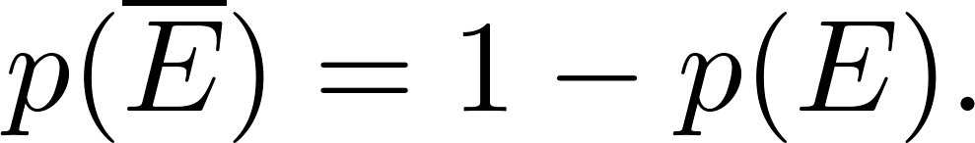
The Probability of Complements and Unions of Events
Theorem 1: Let E be an event in sample space S. The probability of the event = S − E, the complementary event of E, is given by

Slide 15
The Probability of Complements and Unions of Events
Example: A sequence of 10 bits is chosen randomly. What is the probability that at least one of these bits is 0?

Slide 16
The Probability of Complements and Unions of Events
Example: A sequence of 10 bits is chosen randomly. What is the probability that at least one of these bits is 0?
Solution: Let E be the event that at least one of the 10 bits is 0. Then is the event that all of the bits are 1s. The size of the sample space S is 2¹⁰. Hence,

Slide 17
The Probability of Complements and Unions of Events
Theorem 2: Let E₁ and E₂ be events in the sample space S. Then

Slide 18
The Probability of Complements and Unions of Events
Example: What is the probability that a positive integer selected at random from the set of positive integers not exceeding 100 is divisible by either 2 or 5?

Slide 19
The Probability of Complements and Unions of Events
Example: What is the probability that a positive integer selected at random from the set of positive integers not exceeding 100 is divisible by either 2 or 5?
Solution: Let E₁ be the event that the integer is divisible by 2 and E₂ be the event that it is divisible 5? Then the event that the integer is divisible by 2 or 5 is E₁ ∪ E₂ and E₁ ∩ E₂ is the event that it is divisible by 2 and 5.
It follows that:
p(E₁ ∪ E₂) = p(E₁) + p(E₂) – p(E₁ ∩ E₂)
= 50/100 + 20/100 − 10/100 = 3/5.

Slide 20
Monty Hall Puzzle
1
2
3
Example: You are asked to select one of the three doors to open. There is a large prize behind one of the doors and if you select that door, you win the prize. After you select a door, the game show host opens one of the other doors (which he knows is not the winning door). The prize is not behind the door and he gives you the opportunity to switch your selection. Should you switch?
(This is a notoriously confusing problem that has been the subject of much discussion . Do a web search to see why!)

Slide 21
Monty Hall Puzzle
1
2
3
Example: You are asked to select one of the three doors to open. There is a large prize behind one of the doors and if you select that door, you win the prize. After you select a door, the game show host opens one of the other doors (which he knows is not the winning door). The prize is not behind the door and he gives you the opportunity to switch your selection. Should you switch?
Solution: You should switch. The probability that your initial pick is correct is 1/3. This is the same whether or not you switch doors. But since the game show host always opens a door that does not have the prize, if you switch the probability of winning will be 2/3, because you win if your initial pick was not the correct door and the probability your initial pick was wrong is 2/3.
(This is a notoriously confusing problem that has been the subject of much discussion . Do a web search to see why!)

Slide 22
Probability Theory
Section 7.2

Slide 23
Section Summary
Assigning Probabilities
Probabilities of Complements and Unions of Events
Conditional Probability
Independence
Bernoulli Trials and the Binomial Distribution
Random Variables
The Birthday Problem
Monte Carlo Algorithms
The Probabilistic Method (not currently included in the overheads)

Slide 24
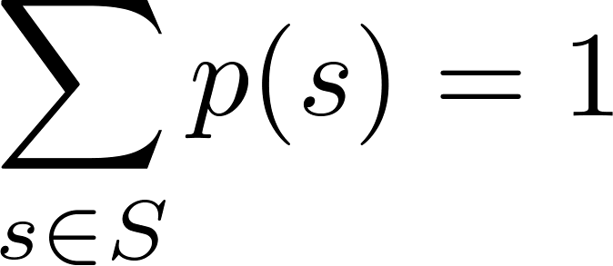
Assigning Probabilities
Laplace’s definition from the previous section, assumes that all outcomes are equally likely. Now we introduce a more general definition of probabilities that avoids this restriction.
Let S be a sample space of an experiment with a finite number of outcomes. We assign a probability p(s) to each outcome s, so that:
i. 0 ≤ p(s) ≤ 1 for each s ∈ S
ii.
The function p from the set of all outcomes of the sample space S is called a probability distribution.

Slide 25
Assigning Probabilities
Example: What probabilities should we assign to the outcomes H(heads) and T (tails) when a fair coin is flipped? What probabilities should be assigned to these outcomes when the coin is biased so that heads comes up twice as often as tails?

Slide 26
Assigning Probabilities
Example: What probabilities should we assign to the outcomes H(heads) and T (tails) when a fair coin is flipped? What probabilities should be assigned to these outcomes when the coin is biased so that heads comes up twice as often as tails?
Solution: For a fair coin, we have p(H) = p(T) = ½.
For a biased coin, we have p(H) = 2p(T).
Because p(H) + p(T) = 1, it follows that
2p(T) + p(T) = 3p(T) = 1.
Hence, p(T) = 1/3 and p(H) = 2/3.

Slide 27
Uniform Distribution
Definition: Suppose that S is a set with n elements. The uniform distribution assigns the probability 1/n to each element of S. (Note that we could have used Laplace’s definition here.)
Example: Consider again the coin flipping example, but with a fair coin. Now p(H) = p(T) = 1/2.

Slide 28
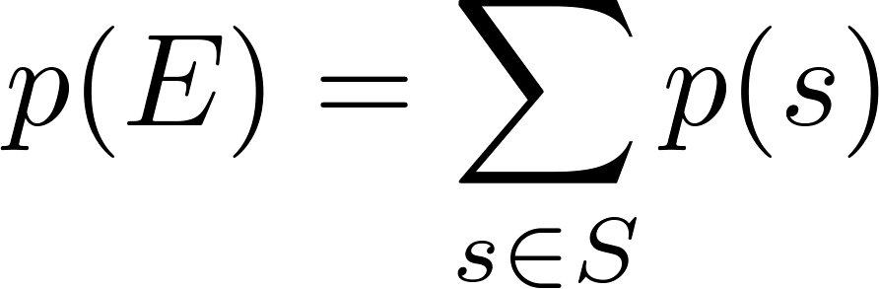
Probability of an Event
Definition: The probability of the event E is the sum of the probabilities of the outcomes in E.
Note that now no assumption is being made about the distribution.

Slide 29
Example
Example: Suppose that a die is biased so that 3 appears twice as often as each other number, but that the other five outcomes are equally likely. What is the probability that an odd number appears when we roll this die?

Slide 30
Example
Example: Suppose that a die is biased so that 3 appears twice as often as each other number, but that the other five outcomes are equally likely. What is the probability that an odd number appears when we roll this die?
Solution: We want the probability of the event E = {1,3,5}. We have p(3) = 2/7 and
p(1) = p(2) = p(4) = p(5) = p(6) = 1/7.
Hence, p(E) = p(1) + p(3) + p(5) =
1/7 + 2/7 + 1/7 = 4/7.

Slide 31
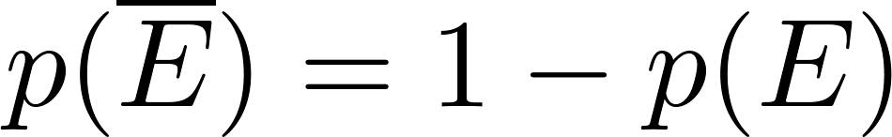
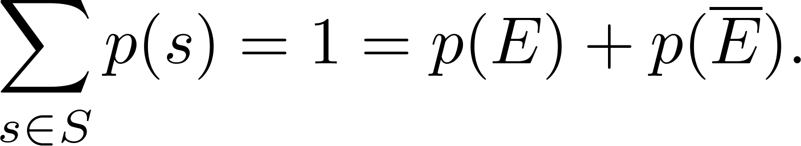
Probabilities of Complements and Unions of Events
Complements: still holds. Since each outcome is in either E or , but not both,
Unions:
also still holds under the new definition.

Slide 32
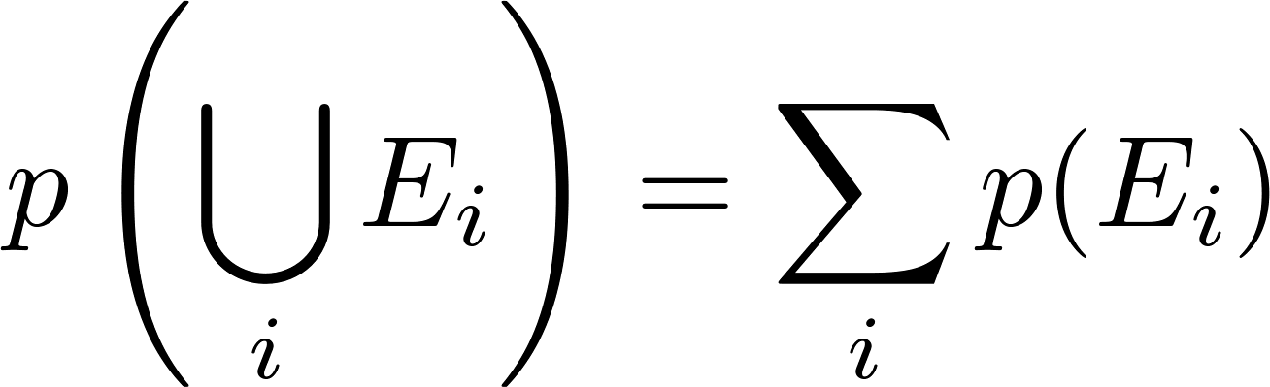
Combinations of Events
Theorem: If E₁, E₂, … is a sequence of pairwise disjoint events in a sample space S, then
see Exercises 36 and 37 for the proof

Slide 33
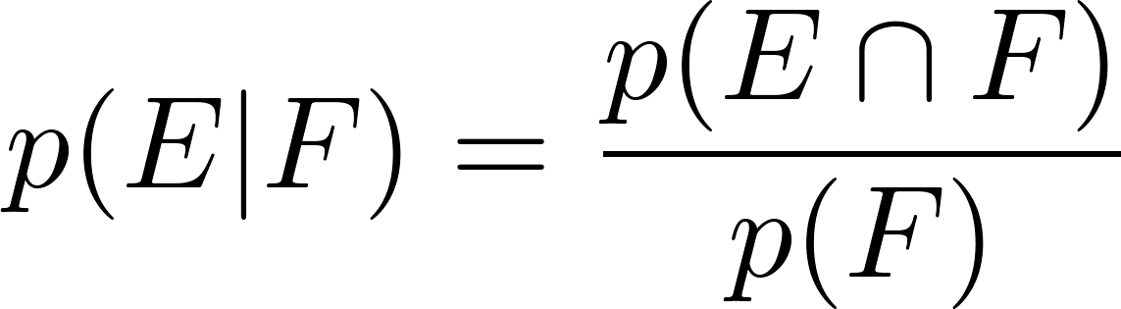
Conditional Probability
Definition: Let E and F be events with p(F) > 0. The conditional probability of E given F, denoted by P(E|F), is defined as:
Example: A bit string of length four is generated at random so that each of the 16 bit strings of length 4 is equally likely. What is the probability that it contains at least two consecutive 0s, given that its first bit is a 0?

Slide 34
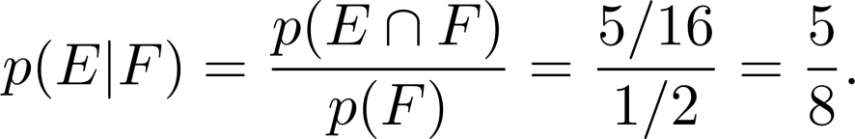
Conditional Probability
Definition: Let E and F be events with p(F) > 0. The conditional probability of E given F, denoted by P(E|F), is defined as:
Example: A bit string of length four is generated at random so that each of the 16 bit strings of length 4 is equally likely. What is the probability that it contains at least two consecutive 0s, given that its first bit is a 0?
Solution: Let E be the event that the bit string contains at least two consecutive 0s, and F be the event that the first bit is a 0.
Since E ⋂ F = {0000, 0001, 0010, 0011, 0100}, p(E⋂F)=5/16.
Because 8 bit strings of length 4 start with a 0, p(F) = 8/16= ½.
Hence,

Slide 35
Conditional Probability
Example: What is the conditional probability that a family with two children has two boys, given that they have at least one boy. Assume that each of the possibilities BB, BG, GB, and GG is equally likely where B represents a boy and G represents a girl.

Slide 36
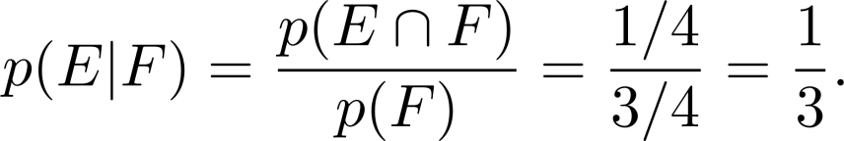
Conditional Probability
Example: What is the conditional probability that a family with two children has two boys, given that they have at least one boy. Assume that each of the possibilities BB, BG, GB, and GG is equally likely where B represents a boy and G represents a girl.
Solution: Let E be the event that the family has two boys and let F be the event that the family has at least one boy. Then E = {BB}, F = {BB, BG, GB}, and E ⋂ F = {BB}.
It follows that p(F) = 3/4 and p(E⋂F)=1/4.
Hence,

Slide 37
Independence
Definition: The events E and F are independent if and only if
Example: Suppose E is the event that a randomly generated bit string of length four begins with a 1 and F is the event that this bit string contains an even number of 1s. Are E and F independent if the 16 bit strings of length four are equally likely?
p(E⋂F) = p(E)p(F).

Slide 38
Independence
Definition: The events E and F are independent if and only if
Example: Suppose E is the event that a randomly generated bit string of length four begins with a 1 and F is the event that this bit string contains an even number of 1s. Are E and F independent if the 16 bit strings of length four are equally likely?
Solution: There are eight bit strings of length four that begin with a 1, and eight bit strings of length four that contain an even number of 1s.
Since the number of bit strings of length 4 is 16,
Since E⋂F = {1111, 1100, 1010, 1001}, p(E⋂F) = 4/16=1/4.
We conclude that E and F are independent, because
p(E⋂F) =1/4 = (½) (½)= p(E) p(F)
p(E⋂F) = p(E)p(F).
p(E) = p(F) = 8/16 = ½.

Slide 39
Independence
Example: Assume (as in the previous example) that each of the four ways a family can have two children (BB, GG, BG,GB) is equally likely. Are the events E, that a family with two children has two boys, and F, that a family with two children has at least one boy, independent?

Slide 40
Independence
Example: Assume (as in the previous example) that each of the four ways a family can have two children (BB, GG, BG,GB) is equally likely. Are the events E, that a family with two children has two boys, and F, that a family with two children has at least one boy, independent?
Solution: Because E = {BB}, p(E) = 1/4. We saw previously that that p(F) = 3/4 and p(E⋂F)=1/4. The events E and F are not independent since
p(E) p(F) = 3/16 ≠ 1/4= p(E⋂F) .

Slide 41
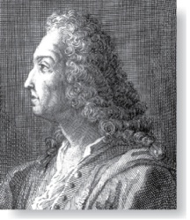
Bernoulli Trials
James Bernoulli
(1854 – 1705)
Definition: Suppose an experiment can have only two possible outcomes, e.g., the flipping of a coin or the random generation of a bit.
Each performance of the experiment is called a Bernoulli trial.
One outcome is called a success and the other a failure.
If p is the probability of success and q the probability of failure, then p + q = 1.
Many problems involve determining the probability of k successes when an experiment consists of n mutually independent Bernoulli trials.

Slide 42
Bernoulli Trials
Example: A coin is biased so that the probability of heads is 2/3. What is the probability that exactly four heads occur when the coin is flipped seven times?

Slide 43
Bernoulli Trials
Example: A coin is biased so that the probability of heads is 2/3. What is the probability that exactly four heads occur when the coin is flipped seven times?
Solution: There are 2⁷ = 128 possible outcomes. The number of ways four of the seven flips can be heads is C(7,4). The probability of each of the outcomes is (2/3)⁴(1/3)³ since the seven flips are independent. Hence, the probability that exactly four heads occur is
C(7,4) (2/3)⁴(1/3)³ = (35∙ 16)/ 2⁷ = 560/ 2187.

Slide 44
Probability of k Successes in n Independent Bernoulli Trials.
Theorem 2: The probability of exactly k successes in n independent Bernoulli trials, with probability of success p and probability of failure q = 1 − p, is
C(n,k)p^{k}q^{n−k}.
We denote by b(k:n,p) the probability of k successes in n independent Bernoulli trials with p the probability of success. Viewed as a function of k, b(k:n,p) is the binomial distribution. By Theorem 2,
b(k:n,p) = C(n,k)p^{k}q^{n−k}.

Slide 45
Random Variables
Definition: A random variable is a function from the sample space of an experiment to the set of real numbers. That is, a random variable assigns a real number to each possible outcome.
A random variable is a function. It is not a variable, and it is not random!
In the late 1940s W. Feller and J.L. Doob flipped a coin to see whether both would use “random variable” or the more fitting “chance variable.” Unfortunately, Feller won and the term “random variable” has been used ever since.

Slide 46
Random Variables
Definition: The distribution of a random variable X on a sample space S is the set of pairs (r, p(X = r)) for all r ∊ X(S), where p(X = r) is the probability that X takes the value r.
Example: Suppose that a coin is flipped three times. Let X(t) be the random variable that equals the number of heads that appear when t is the outcome. Then X(t) takes on the following values:
X(HHH) = 3, X(TTT) = 0,
X(HHT) = X(HTH) = X(THH) = 2,
X(TTH) = X(THT) = X(HTT) = 1.
Each of the eight possible outcomes has probability 1/8. So, the distribution of X(t) is p(X = 3) = 1/8, p(X = 2) = 3/8, p(X = 1) = 3/8, and p(X = 0) = 1/8.

Slide 47
The Famous Birthday Problem
The puzzle of finding the number of people needed in a room to ensure that the probability of at least two of them having the same birthday is more than ½ has a surprising answer, which we now find.
Solution: We assume that all birthdays are equally likely and that there are 366 days in the year. First, we find the probability p_{n} that at least two of n people have different birthdays.
Now, imagine the people entering the room one by one. The probability that at least two have the same birthday is 1− p_{n} .
The probability that the birthday of the second person is different from that of the first is 365/366.
The probability that the birthday of the third person is different from the other two, when these have two different birthdays, is 364/366.
In general, the probability that the jth person has a birthday different from the birthdays of those already in the room, assuming that these people all have different birthdays, is (366 − (j − 1))/366 = (367 − j)/366.
Hence, p_{n} = (365/366)(364/366)∙∙∙ (367 − n)/366.
Therefore , 1− p_{n} = 1−(365/366)(364/366)∙∙∙ (367 − n)/366.
Checking various values for n with computation help tells us that for n = 22, 1− p_{n} ≈ 0.457, and for n = 23, 1− p_{n} ≈ 0.506. Consequently, a minimum number of 23 people are needed so that that the probability that at least two of them have the same birthday is greater than 1/2.

Slide 48
Monte Carlo Algorithms
Algorithms that make random choices at one or more steps are called probabilistic algorithms.
Monte Carlo algorithms are probabilistic algorithms used to answer decision problems, which are problems that either have “true” or “false” as their answer.
A Monte Carlo algorithm consists of a sequence of tests. For each test the algorithm responds “true” or ‘unknown.’
If the response is “true,” the algorithm terminates with the answer is “true.”
After running a specified sequence of tests where every step yields “unknown”, the algorithm outputs “false.”
The idea is that the probability of the algorithm incorrectly outputting “false” should be very small as long as a sufficient number of tests are performed.

Slide 49
Probabilistic Primality Testing
Probabilistic primality testing (see Example 16 in text) is an example of a Monte Carlo algorithm, which is used to find large primes to generate the encryption keys for RSA cryptography (as discussed in Chapter 4).
An integer n greater than 1 can be shown to be composite (i.e., not prime) if it fails a particular test (Miller’s test), using a random integer b with 1 < b < n as the base. But if n passes Miller’s test for a particular base b, it may either be prime or composite. The probability that a composite integer passes n Miller’s test is for a random b, is less that ¼.
So failing the test, is the “true” response in a Monte Carlo algorithm, and passing the test is “unknown.”
If the test is performed k times (choosing a random integer b each time) and the number n passes Miller’s test at every iteration, then the probability that it is composite is less than (1/4)^{k}. So for a sufficiently, large k, the probability that n is composite even though it has passed all k iterations of Miller’s test is small. For example, with 10 iterations, the probability that n is composite is less than 1 in 1,000,000.

Slide 50
Bayes’ Theorem
Section 7.3

Slide 51
Section Summary
Bayes’ Theorem
Generalized Bayes’ Theorem
Bayesian Spam Filters
A.I. Applications (optional, not currently included in the overheads)

Slide 52
Motivation for Bayes’ Theorem
Bayes’ theorem allows us to use probability to answer questions such as the following:
Given that someone tests positive for having a particular disease, what is the probability that they actually do have the disease?
Given that someone tests negative for the disease, what is the probability, that in fact they do have the disease?
Bayes’ theorem has applications to medicine, law, artificial intelligence, engineering, and many diverse other areas.

Slide 53
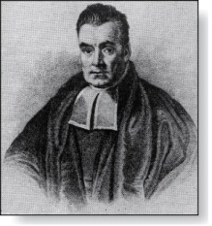
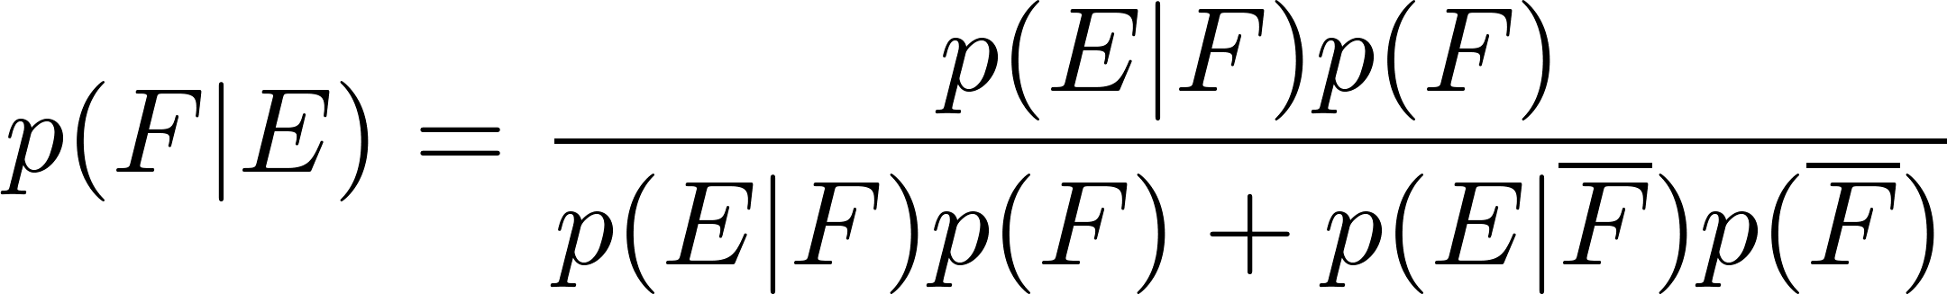
Bayes’ Theorem
Thomas Bayes
(1702-1761)
Bayes’ Theorem: Suppose that E and F are events from a sample space S such that p(E)≠ 0 and p(F) ≠ 0. Then:
Example: We have two boxes. The first box contains two green balls and seven red balls. The second contains four green balls and three red balls. Bob selects one of the boxes at random. Then he selects a ball from that box at random. If he has a red ball, what is the probability that he selected a ball from the first box.
Let E be the event that Bob has chosen a red ball and F be the event that Bob has chosen the first box.

Slide 54
Bayes’ Theorem
Thomas Bayes
(1702-1761)
Bayes’ Theorem: Suppose that E and F are events from a sample space S such that p(E)≠ 0 and p(F) ≠ 0. Then:
Example: We have two boxes. The first box contains two green balls and seven red balls. The second contains four green balls and three red balls. Bob selects one of the boxes at random. Then he selects a ball from that box at random. If he has a red ball, what is the probability that he selected a ball from the first box.
Let E be the event that Bob has chosen a red ball and F be the event that Bob has chosen the first box.
By Bayes’ theorem the probability that Bob has picked the first box is:

Slide 55
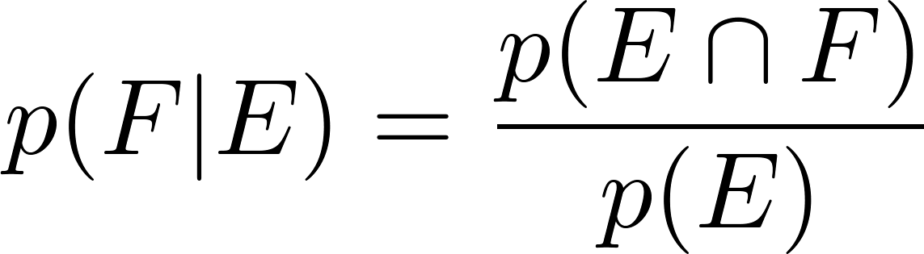
Derivation of Bayes’ Theorem
Recall the definition of the conditional probability p(E|F):
From this definition, it follows that:
,
continued →

Slide 56
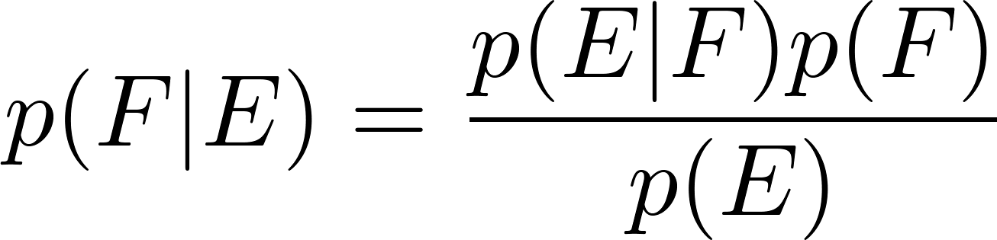
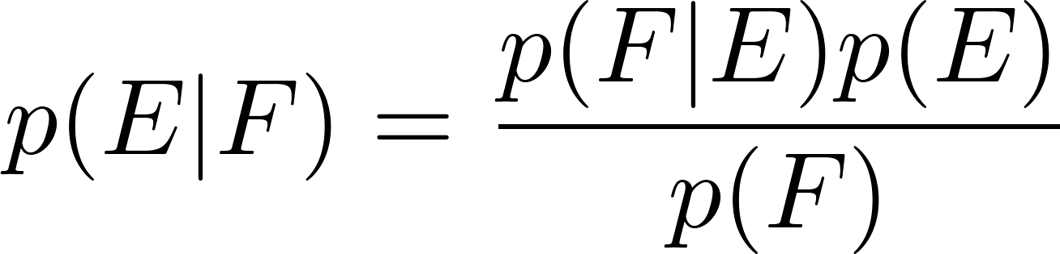
Derivation of Bayes’ Theorem
On the last slide we showed that
,
Equating the two formulas for p(E F) shows that
Solving for p(E|F) and for p(F|E) tells us that
,
continued →

Slide 57
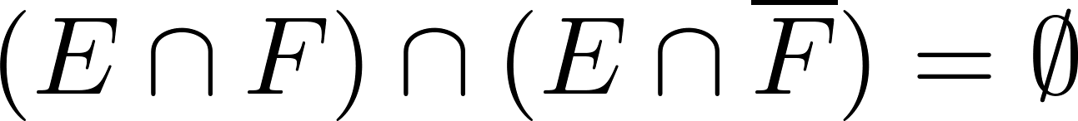
Derivation of Bayes’ Theorem
On the last slide we showed that:
Note that
since
because
and
By the definition of conditional probability,
Hence,

Slide 58
Applying Bayes’ Theorem
Example: Suppose that one person in 100,000 has a particular disease. There is a test for the disease that gives a positive result 99% of the time when given to someone with the disease. When given to someone without the disease, 99.5% of the time it gives a negative result. Find
the probability that a person who test positive has the disease.
the probability that a person who test negative does not have the disease.
Should someone who tests positive be worried?

Slide 59

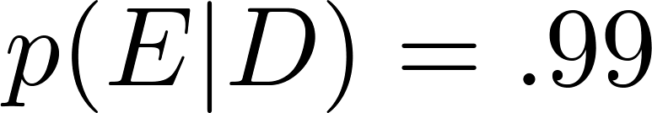

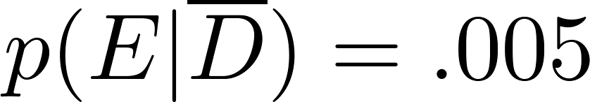
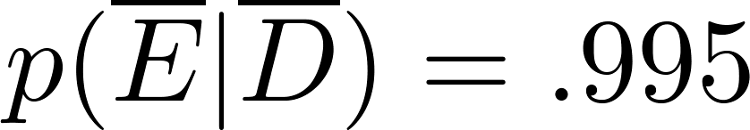
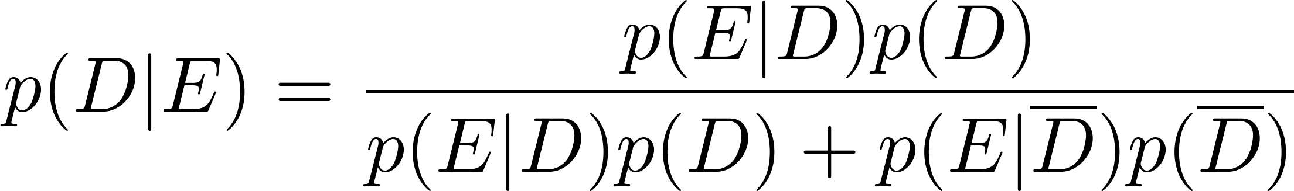
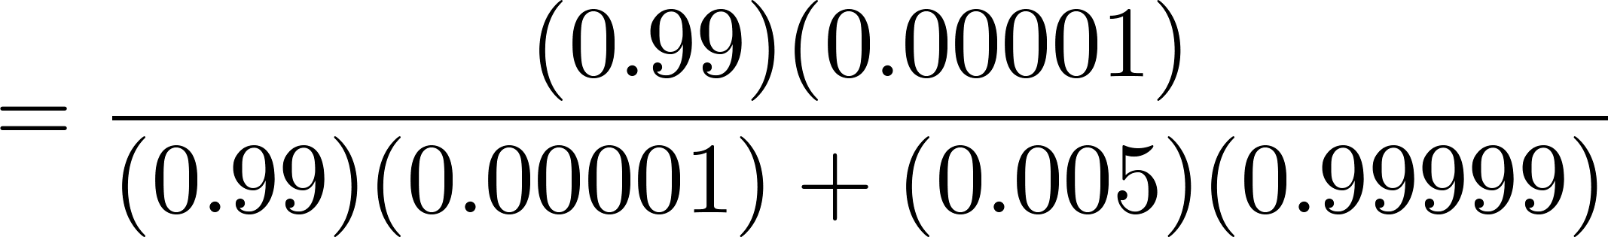

Applying Bayes’ Theorem
Solution: Let D be the event that the person has the disease, and E be the event that this person tests positive. We need to compute p(D|E) from p(D), p(E|D), p( E | ), p( ).
Can you use this formula to explain why the resulting probability is surprisingly small?
So, don’t worry too much, if your test for this disease comes back positive.

Slide 60
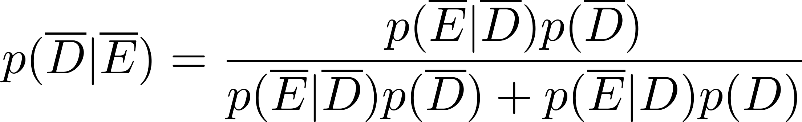
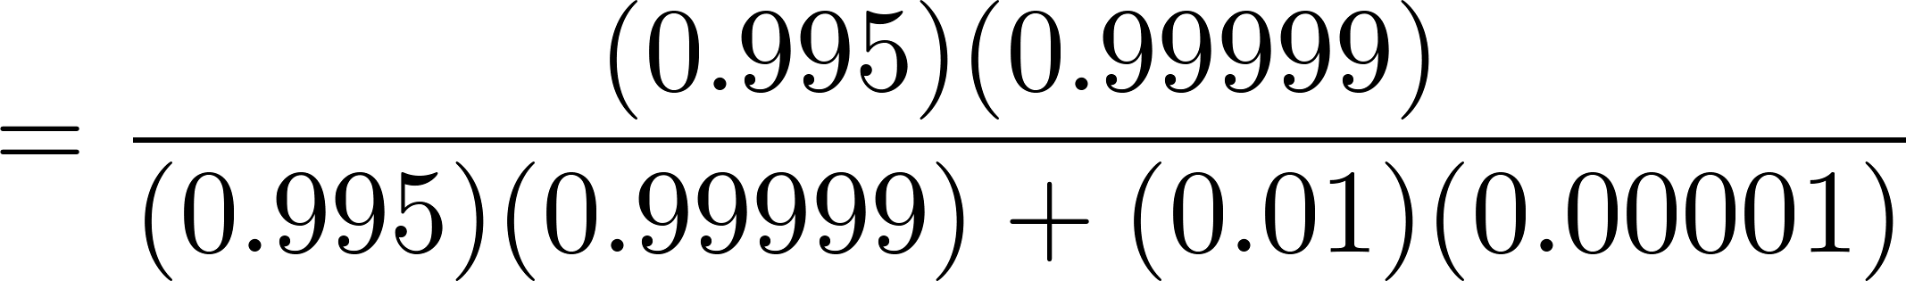
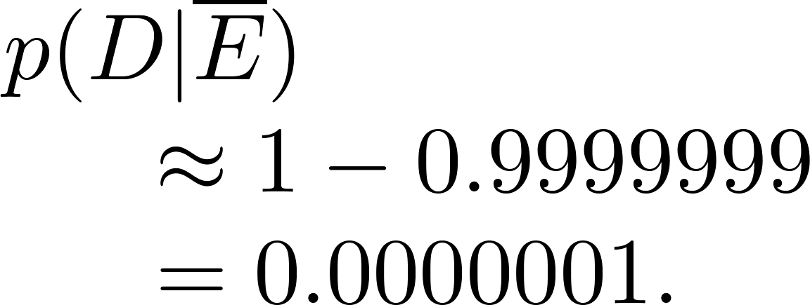

Applying Bayes’ Theorem
What if the result is negative?
So, it is extremely unlikely you have the disease if you test negative.
So, the probability you have the disease if you test negative is

Slide 61
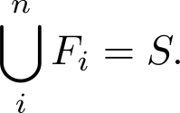
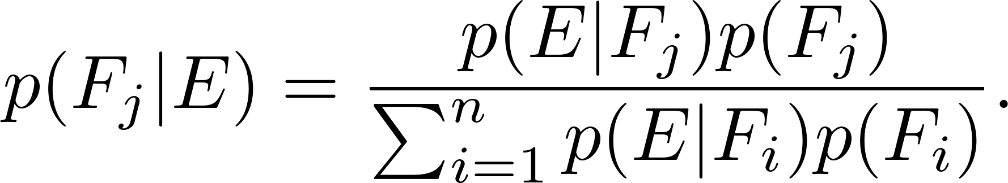
Generalized Bayes’ Theorem
Generalized Bayes’ Theorem: Suppose that E is an event from a sample space S and that F₁, F₂, …, F_{n} are mutually exclusive events such that
Assume that p(E) ≠ 0 for i = 1, 2, …, n. Then
Exercise 17 asks for the proof.

Slide 62
Bayesian Spam Filters
How do we develop a tool for determining whether an email is likely to be spam?
If we have an initial set B of spam messages and set G of non-spam messages. We can use this information along with Bayes’ law to predict the probability that a new email message is spam.
We look at a particular word w, and count the number of times that it occurs in B and in G; n_{B}(w) and n_{G}(w).
Estimated probability that a spam message contains w is: p(w) = n_{B}(w)/|B|
Estimated probability that a message that is not spam contains w is: q(w) = n_{G}(w)/|G|
continued →

Slide 63
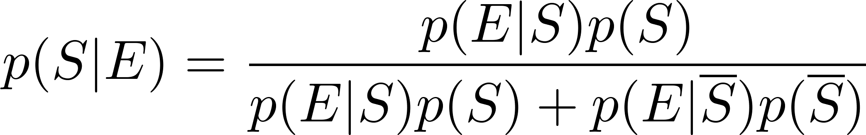
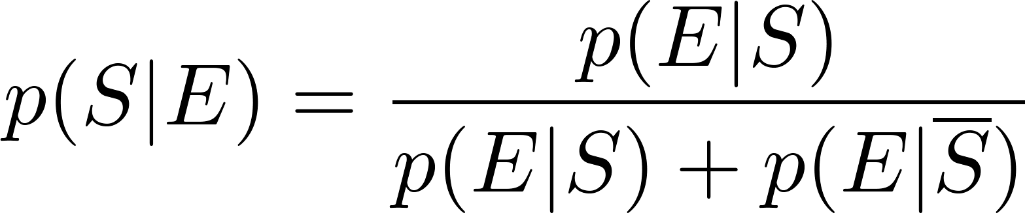
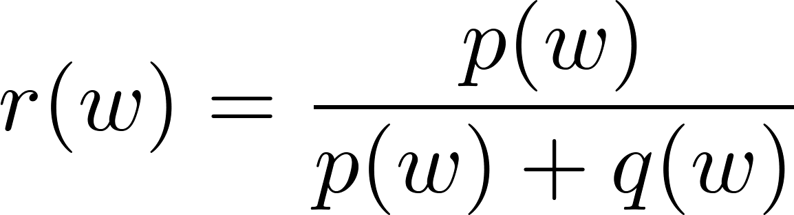
Bayesian Spam Filters
Let S be the event that the message is spam, and E be the event that the message contains the word w.
Using Bayes’ Rule,
Assuming that it is equally likely that an arbitrary message is spam and is not spam; i.e., p(S) = ½.
Note: If we have data on the frequency of spam messages, we can obtain a better estimate for p(s).
(See Exercise 22.)
Using our empirical estimates of
p(E | S) and
p(E |‾S).
r(w) estimates the probability that the message is spam. We can class the message as spam if r(w) is above a threshold.

Slide 64
Bayesian Spam Filters
Example: We find that the word “Rolex” occurs in 250 out of 2000 spam messages and occurs in 5 out of 1000 non-spam messages. Estimate the probability that an incoming message is spam. Suppose our threshold for rejecting the email is 0.9.
Solution: p(Rolex) = 250/2000 =.0125 and q(Rolex) = 5/1000 = 0.005.
We class the message as spam and reject the email!

Slide 65
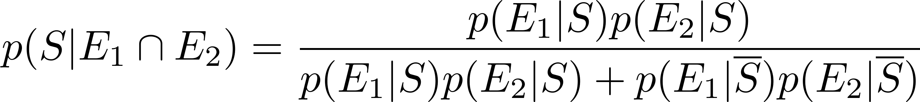
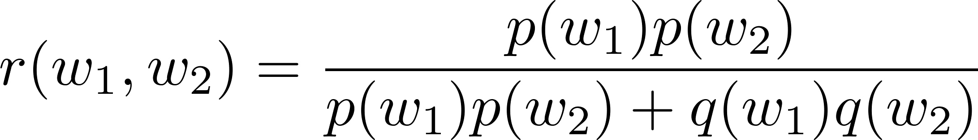
Bayesian Spam Filters using Multiple Words
Accuracy can be improved by considering more than one word as evidence.
Consider the case where E₁ and E₂ denote the events that the message contains the words w₁ and w₂ respectively.
We make the simplifying assumption that the events are independent. And again we assume that p(S) = ½.

Slide 66
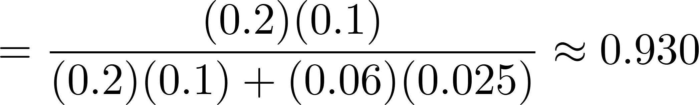
Bayesian Spam Filters using Multiple Words
Example: We have 2000 spam messages and 1000 non-spam messages. The word “stock” occurs 400 times in the spam messages and 60 times in the non-spam. The word “undervalued” occurs in 200 spam messages and 25 non-spam.
Solution: p(stock) = 400/2000 = .2, q(stock) = 60/1000=.06,
p(undervalued) = 200/2000 = .1, q(undervalued) = 25/1000 = .025
If our threshold is .9, we class the message as spam and reject it.

Slide 67
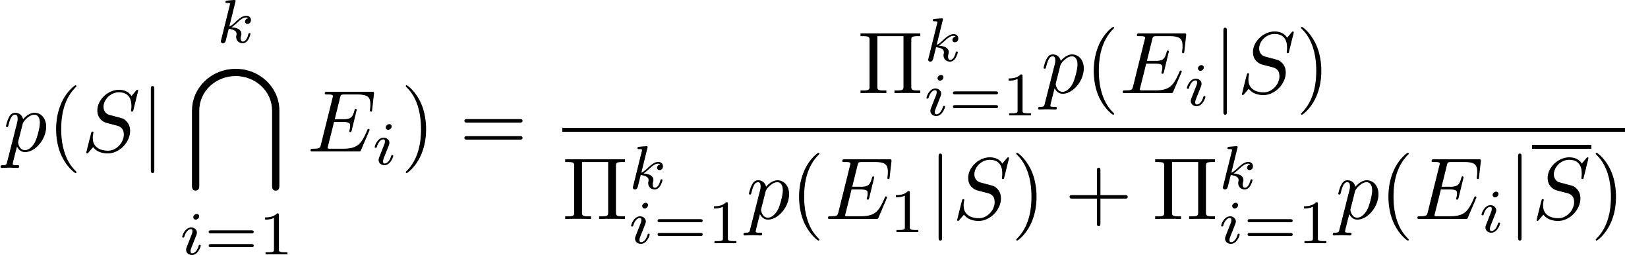
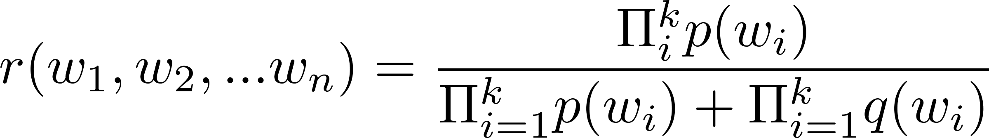
Bayesian Spam Filters using Multiple Words
In general, the more words we consider, the more accurate the spam filter. With the independence assumption if we consider k words:
We can further improve the filter by considering pairs of words as a single block or certain types of strings.

Slide 68
Expected Value and Variance
Section 6.4

Slide 69
Section Summary
Expected Value
Linearity of Expectations
Average-Case Computational Complexity
Geometric Distribution
Independent Random Variables
Variance
Chebyshev’s Inequality

Slide 70
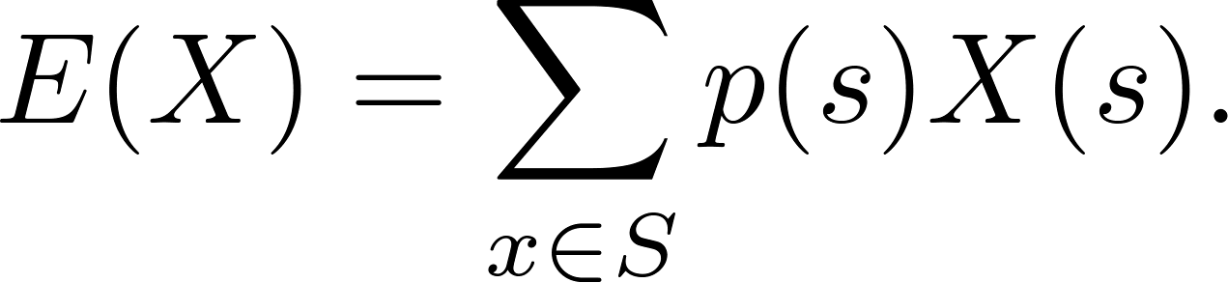
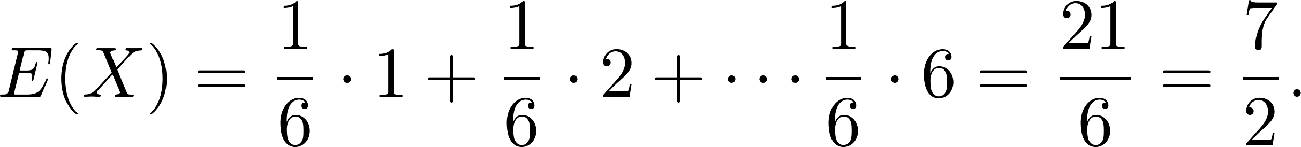
Expected Value
Definition: The expected value (or expectation or mean) of the random variable X(s) on the sample space S is equal to
Example-Expected Value of a Die: Let X be the number that comes up when a fair die is rolled. What is the expected value of X?
Solution: The random variable X takes the values 1, 2, 3, 4, 5, or 6. Each has probability 1/6. It follows that

Slide 71
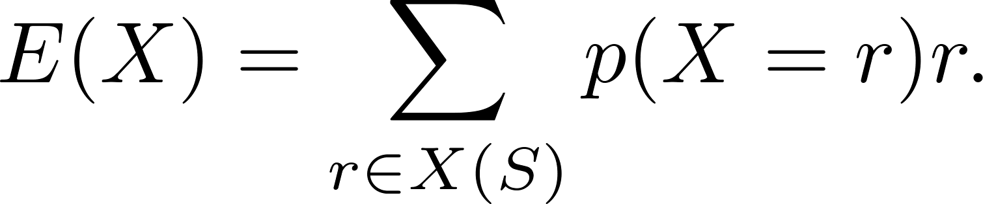
Expected Value
Theorem 1: If X is a random variable and p(X = r) is the probability that X = r, so that
then
Proof: Suppose that X is a random variable with range X(S) and let p(X = r) be the probability that X takes the value r. Consequently, p(X = r) is the sum of the probabilities of the outcomes s such that X(s) = r. Hence,

Slide 72
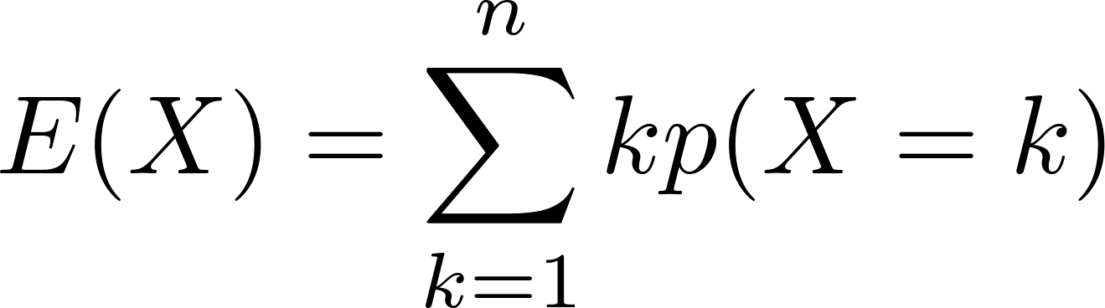
Expected Value
Theorem 2: The expected number of successes when n mutually independent Bernoulli trials are performed, where, the probability of success on each trial, p = np.
Proof: Let X be the random variable equal to the number of success in n trials. By Theorem 2 of section 7.2, p(X = k) = C(n,k)p^{k}q^{n−k}. Hence,
by Theorem 1
continued →

Slide 73
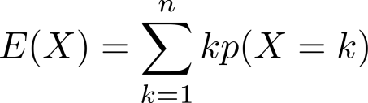
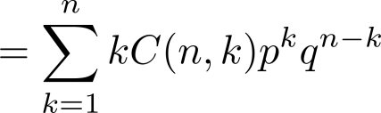
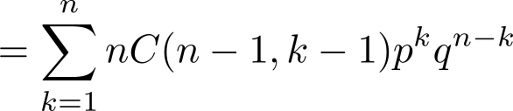
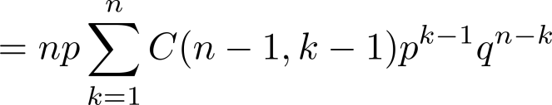
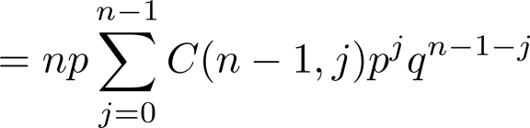

Expected Value
from previous page
by Theorem 2 in Section 7.2
by Exercise 21 in Section 6.4
factoring np from each term
shifting index of summation with j = k − 1
by the binomial theom
because p + q = 1
We see that the expected number of successes in n mutually independent Bernoulli trials is np.

Slide 74
Linearity of Expectations
The following theorem tells us that expected values are linear. For example, the expected value of the sum of random variables is the sum of their expected values.
Theorem 3: If X_{i}, i = 1, 2, …,n with n a positive integer, are random variables on S, and if a and b are real numbers, then
(i) E(X₁ + X₂ + …. + X_{n}) = E(X₁ )+ E(X₂) + …. + E(X_{n})
(ii) E(aX + b) = aE(X) + b.
see the text for the proof

Slide 75
Linearity of Expectations
Expected Value in the Hatcheck Problem: A new employee started a job checking hats, but forgot to put the claim check numbers on the hats. So, the n customers just receive a random hat from those remaining. What is the expected number of hat returned correctly?
Solution: Let X be the random variable that equals the number of people who receive the correct hat. Note that X = X₁ + X₂ + ∙∙∙ + X_{n},
where X_{i} = 1 if the ith person receives the hat and X_{i} = 0 otherwise.
Because it is equally likely that the checker returns any of the hats to the ith person, it follows that the probability that the ith person receives the correct hat is 1/n. Consequently (by Theorem 1), for all I
E(X_{i}) = 1 ∙p(X_{i} = 1) + 0 ∙p(X_{i} = 0) = 1 ∙ 1/n + 0 = 1/n .
By the linearity of expectations (Theorem 3), it follows that:
E(X )= E(X₁) + E(X₂) + ∙∙∙ + E(X_{n}) = n ∙ 1/n – 1.
Consequently, the average number of people who receive the correct hat is exactly 1. ( Surprisingly, this answer remains the same no matter how many people have checked their hats!)

Slide 76
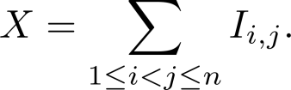

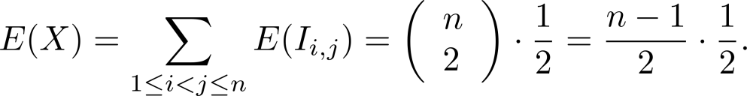
Linearity of Expectations
Expected Number of Inversions in a Permutation: The ordered pair (i,j) is an inversion in a permutation of the first n positive integers if i < j, but j precedes i in the permutation.
Example: There are six inversions in the permutation of 3,5, 1, 4, 2
(1, 3), (1, 5), (2, 3), (2, 4), (2, 5), (4, 5).
Find the average number of inversions in a random permutation of the first n integers.
Solution: Let I_{i,j} be the random variable on the set of all permutations of the first n positive integers with I_{i,j} = 1 if (i,j) is an inversion of the permutation and I_{i,j} = 0 otherwise. If X is the random variable equal to the number of inversions in the permutation, then
Since it is equally likely for i to precede j in a randomly chosen permutation as it is for j to precede i, we have: E(I_{i,j}) = 1 ∙p(I_{i ,j} = 1) + 0 ∙p(I_{i,j} = 0) = 1 ∙ 1/2 + 0 = ½, for all (i,j) .
Because there are pairs i and j with 1 ≤ i < j ≤ n, by the linearity of expectations (Theorem 3), we have:
Consequently, it follows that there is an average of n(n −1)/4 inversions in a random permutation of the first n positive integers.

Slide 77
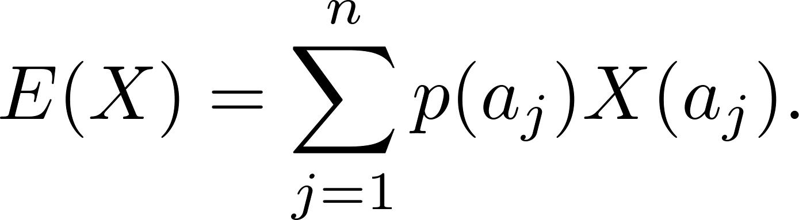
Average-Case Computational Complexity
The average-case computational complexity
of an algorithm can be found by computing the
expected value of a random variable.
Let the sample space of an experiment be the set of possible inputs a_{j}, j = 1, 2, …,n, and let the random variable X be the assignment to a_{j} of the number of operations used by the algorithm when given a_{j} as input.
Assign a probability p(a_{j}) to each possible input value a_{j}.
The expected value of X is the average-case computational complexity of the algorithm.

Slide 78
Average-Case Complexity of Linear Search
What is the average-case complexity of linear search (described in Chapter 3) if the probability that x is in the list is p and it is equally likely that x is any of the n elements of the list?
procedure linear search(x: integer, a₁, a₂, …,a_{n}: distinct integers)
i := 1
while (i ≤ n and x ≠ a_{i})
i := i + 1
if i ≤ n then location := i
else location := 0
return location{location is the subscript of the term that equals x, or is 0 if x is not found}
continued →

Slide 79
Average-Case Complexity of Linear Search
Solution: There are n + 1 possible types of input: one type for each of the n numbers on the list and one additional type for the numbers not on the list.
Recall that:
2i + 1 comparisons are needed if x equals the ith element of the list.
2n + 2 comparisons are used if x is not on the list.
The probability that x equals a_{i} is p/n and the probability that x is not in the list is q = 1− p. The average-case case computational complexity of the linear search algorithm is:
E = 3p/n + 5p/n + … + (2n + 1)p/n + (2n + 2)q
= (p/n)( 3 + 5 + …. + (2n + 1)) + (2n + 2)q
= (p/n)((n + 1)² − 1) + (2n + 2)q (Example 2 from Section 5.1)
= p(n + 2) + (2n + 2)q.
When x is guaranteed to be in the list, p = 1, q = 0, so that E = n + 2.
When p is ½ and q = ½, then E = (n + 2)/2 + n + 1 = (3n + 4) /2.
When p is ¾ and q = ¼ then E = (n + 2)/4 + (n + 1)/2 = (5n + 8) /4.
When x is guaranteed not to be in the list, p = 0 and q = 1, then E = 2n + 2.

Slide 80
Average-Case Complexity of Insertion Sort
What is the average number of comparisons used by insertion sort from Chapter 3) to sort n distinct elements?
procedure insertion sort
(a₁,…,a_{n}: reals with n ≥ 2)
for j := 2 to n
i := 1
while a_{j} > a_{i}
i := i + 1
m := a_{j}
for k := 0 to j − i − 1
a_{j-k} := a_{j-k-1}
a_{i} := m
{Now a₁,…,a_{n} is in increasing order}
At step i for i = 2, ….,n, insertion sort inserts the ith element in the original list into the correct position in the sorted list of the first i -1 elements.
continued →

Slide 81
Average-Case Complexity of Insertion Sort
Solution: Let X be the random variable equal to the number of comparisons used by insertion sort to sort a list of a₁, a₂, …., a_{n} distinct elements. E(X) is the average number of comparisons.
Let X_{i} be the random variable equal to the number of comparisons used to insert a_{i} into the proper position after the first i −1 elements a₁, a₂, …., a_{i-1} have been sorted.
Since X = X₂ + X₃ + ∙∙∙ + X_{n},
E(X) = E(X₂ + X₃ + ∙∙∙ + X_{n}) = E(X₂) + E(X₃) + ∙∙∙ + E(X_{n}).
To find E(X_{i}) for i = 2,3,…,n, let p_{j}(k) be the probability that the largest of the first j elements in the list occurs at the kth position, that is, max(a₁, a₂, …., a_{j} ) = a_{k}, where 1 ≤ k ≤ j.
Assume uniform distribution; p_{j}(k) = 1/j .
Then X_{i}(k) = k.
continued →

Slide 82
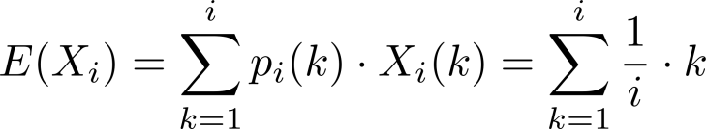
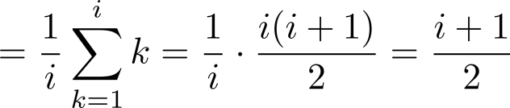
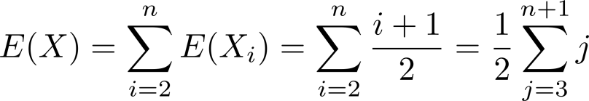


Average-Case Complexity of Insertion Sort
Since a_{i} could be inserted into any of the first i positions
It follows that
Hence, the average-case complexity is .

Slide 83
The Geometric Distribution
Definition 2: A random variable X has geometric distribution with parameter p if p(X = k) = (1 − p)^{k-1}p for k = 1,2,3,…, where p is a real number with 0 ≤ p ≤ 1.
Theorem 4: If the random variable X has the geometric distribution with parameter p, then E(X) = 1/p.
Example: Suppose the probability that a coin comes up tails is p. What is the expected number of flips until this coin comes up tails?
The sample space is {T, HT, HHT, HHHT, HHHHT, …}.
Let X be the random variable equal to the number of flips in an element of the sample space; X(T) = 1, X(HT) = 2, X(HHT) = 3, etc.
By Theorem 4, E(X) = 1/p.
see text for full details

Slide 84
Independent Random Variables
Definition 3: The random variables X and Y on a sample space S are independent if
p(X = r₁ and Y = r₂) = p(X = r₁)∙ p(Y = r₂).
Theorem 5: If X and Y are independent variables on a sample space S, then E(XY) = E(X)E(Y).
see text for the proof

Slide 85


Variance
Deviation: The deviation of X at s ∊ S is X(s) − E(X), the difference between the value of X and the mean of X.
Definition 4: Let X be a random variable on the sample space S. The variance of X, denoted by V(X) is
That is V(X) is the weighted average of the square of the deviation of X. The standard deviation of X, denoted by σ(X) is defined to be
Theorem 6: If X is a random variable on a sample space S, then V(X) = E(X²) − E(X)².
Corollary 1: If X is a random variable on a sample space S and E(X) = μ , then V(X) = E((X −μ)²).
see text for the proof
see text for the proof.

Slide 86

Variance
Example: What is the variance of the random variable X, where X(t) = 1 if a Bernoulli trial is a success and X(t) = 0 if it is a failure, where p is the probability of success and q is the probability of failure?
Solution: Because X takes only the values 0 and 1, it follows that X²(t) = X(t). Hence,
Variance of the Value of a Die: What is the variance of a random variable X, where X is the number that comes up when a fair die is rolled?
Solution: We have V(X) = E(X²) − E(X)² . In an earlier example, we saw that E(X) = 7/2. Note that
E(X²) = 1/6(1² + 2² + 3² +4² + 5² + 6²) = 91/6.
We conclude that
V(X) = E(X²) − E(X)² = p − p² = p(1 − p) = pq.

Slide 87

Variance
Irenée-Jules Bienaymé
(1796-1878)
Bienaymé‘s Formula: If X and Y are two independent random variables on a sample space S, then V(X + Y) = V(X) + V(Y). Furthermore, if X_{i}, i = 1,2, …,n, with n a positive integer, are pairwise independent random variables on S, then
V(X₁ + X₂ + ∙∙∙ + X_{n}) = V(X₁) + V(X₂) + ∙∙∙ + V(X_{n}).
Example: Find the variance of the number of successes when n independent Bernoulli trials are performed, where on each trial, p is the probability of success and q is the probability of failure.
Solution: Let X_{i} be the random variable with X_{i} ((t₁, t₂, …., t_{n})) = 1 if trial t_{i} is a success and X_{i} ((t₁, t₂, …., t_{n})) = 0 if it is a failure. Let X = X₂ + X₃ + …. X_{n}. Then X counts the number of successes in the n trials.
By Bienaymé ‘s Formula, it follows that V(X)= V(X₁) + V(X₂) + ∙∙∙ + V(X_{n}).
By the previous example ,V(X_{i}) = pq for i = 1,2, …,n.
Hence, V(X) = npq.
see text for the proof

Slide 88

Chebyshev’s Inequality
Pafnuty Lvovich Chebyshev
(1821-1894)
Chebyschev’s Inequality: Let X be a random variable on a sample space S with probability function p. If r is a positive real number, then
p(|X(s) − E(X)| ≥ r ) ≤ V(X)/r².
Example: Suppose that X is a random variable that counts the number of tails when a fair coin is tossed n times. Note that X is the number of successes when n independent Bernoulli trials, each with probability of success ½ are done. Hence, (by Theorem 2) E(X) = n/2 and (by Example 18) V(X) = n/4.
By Chebyschev’s inequality with r = √n,
p(|X(s) − n/2 | ≥ √n ) ≤ (n/4 )(√n )² = ¼.
This means that the probability that the number of tails that come up on n tosses deviates from the mean , n/2, by more than √n is no larger than ¼.
see text for the proof

