Slide 1
MACHINE LEARNING ALGORITHMS · MIDTERM DEFENSE
Astana Apartment Price Prediction
Regression on 4,086 cleaned Krisha.kz listings: from raw ads to a model with 12% median error
Nurkhan Kuanyshov
Bakytzhan Jangazy
Group SE-2431
Notes:
Нурхан: представляемся, тема — предсказание цены квартиры в Астане. Кратко: взяли объявления с Krisha.kz, прошли весь ML-воркфлоу, лучшая модель ошибается в среднем на 12%.

Slide 2
Problem statement and success criterion
4,086
23
log1p
≤ 15%
cleaned listings
raw columns
modelled target
target median % error
Project question
How we measure success
Question: can we predict the asking price of an apartment in Astana from area, rooms, district, floor, building age, coordinates and amenities?
Task: supervised regression.
Target: price (KZT), modelled as log1p(price) because it is right-skewed (skew 1.95 → 0.50).
On log scale: RMSE, MAE, R².
In tenge: MAE and median absolute percentage error (MedAPE), easy to explain to a buyer.
Criterion: every model must clearly beat the median-price baseline; best model should reach MedAPE ≈ 15% or lower.
2
Notes:
Нурхан: задача регрессии, целевая переменная price, моделируем log1p(price) из-за скошенности. Критерий успеха: модель должна явно побить медианный бейзлайн и достичь MedAPE около 15% или ниже.

Slide 3
Dataset: Astana Real Estate (Krisha.kz)
Source and size
Features (23 columns)
Source: Kaggle, Astana Real Estate Dataset by turarr (kaggle.com/datasets/turarr/astana-real-estate-dataset).
Origin: apartment ads scraped from Krisha.kz, current as of March 2026.
Size: 5,003 rows × 23 columns, no missing values in raw data.
Price range: 3.5M to 33.9B KZT before cleaning, so extreme outliers are present.
Target: price in KZT; 4,086 rows remain after cleaning.
Size & floors: area_m2, rooms, current_floor, total_floors
Location: district, residential_complex, apartment / district lat-lon
Quality: condition, furnished, bathroom, parking, security, ceiling height, building type, build year
Known issues
Asking, not sale prices: includes negotiation margin.
829 exact duplicate rows (same ad posted repeatedly).
Seller-typed values: typos in ceiling height (up to 27 m) and build year (up to 2028).
3
Notes:
Бахытжан: датасет с Kaggle (автор turarr), объявления Krisha.kz, март 2026. 5003 строки, 23 колонки. Важно: это цены предложения, а не сделки, есть дубликаты и опечатки продавцов.

Slide 4
Data cleaning: 5,003 → 4,086 listings
5,003
4,169
4,086
→
→
raw listings
after removing 834 duplicates
after range rules and 1–99% price trim
What we did
Sanity rules
Types: text columns that hold numbers converted to numeric.
Dropped: url, title, address (identifiers / near-unique text); any price-like column would be removed to avoid target leakage.
Duplicates: 834 rows removed after dropping identifiers.
Area: 10–500 m²; rooms 1–10.
Floors: 1 ≤ floor ≤ total_floors.
Build year: 1900–2029, else set to missing; ceiling 2.0–6.0 m else missing.
Price: keep 1st–99th percentile (13.5M–185M KZT); 83 rows removed.
4
Notes:
Нурхан: пошаговая чистка. Типы и колонки, дубликаты (834 после удаления url/title/address), диапазоны, обрезка цен по 1–99 перцентилю. Каждый шаг в ноутбуке печатает, что было найдено и что сделано.

Slide 5
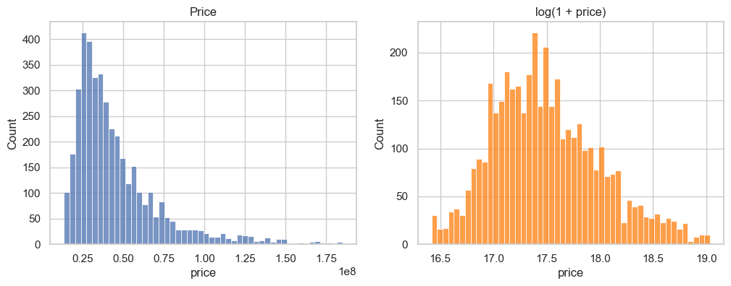
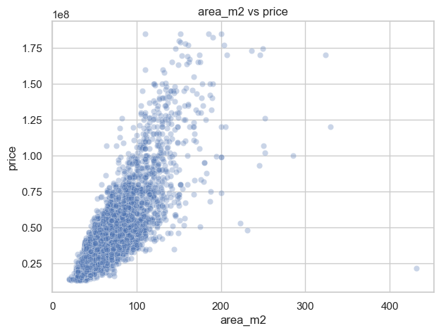
EDA (1/2): target distribution and area
1.95 raw skew
0.50 skew after log
Price is right-skewed
Area drives price
Most listings are low to mid priced, with a long tail of premium flats. We model log1p(price) to get a near-symmetric target.
Larger flats cost more, but the spread widens with size: area alone is not enough, location and quality are needed.
5
Notes:
Бахытжан: цена сильно скошена вправо (skew 1.95), после логарифма 0.50 — поэтому моделируем log1p(price). Площадь явно связана с ценой, но разброс растёт, значит нужны ещё район и качество.

Slide 6
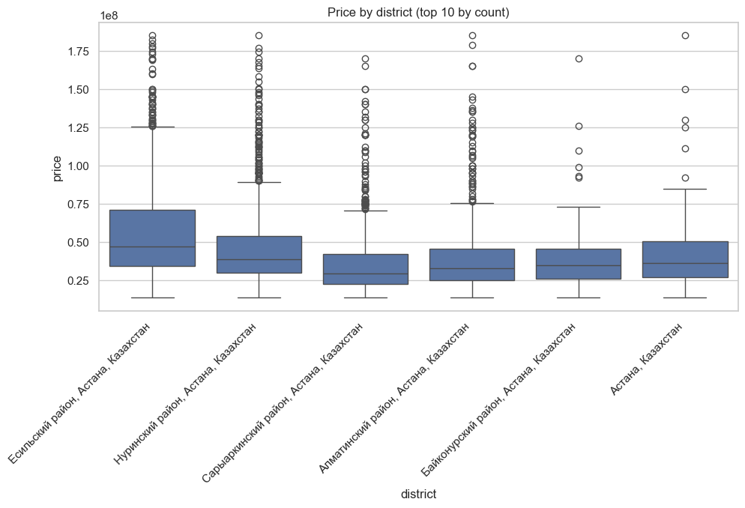
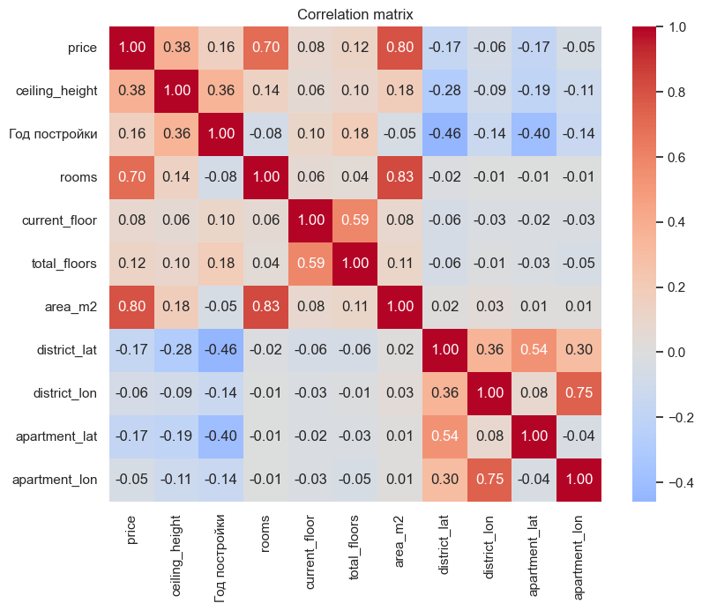
EDA (2/2): districts and correlations
Price by district
Correlation matrix
Esil is clearly the most expensive district; all have long upper tails. District stays as a categorical feature.
Area and rooms are strongly related; coordinates and age add signal. Checked before modelling.
6
Notes:
Нурхан: районы отличаются и медианой, и разбросом — Есиль самый дорогой. Тепловая карта показывает корреляции и избыточность (площадь/комнаты). Все графики в ноутбуке.

Slide 7
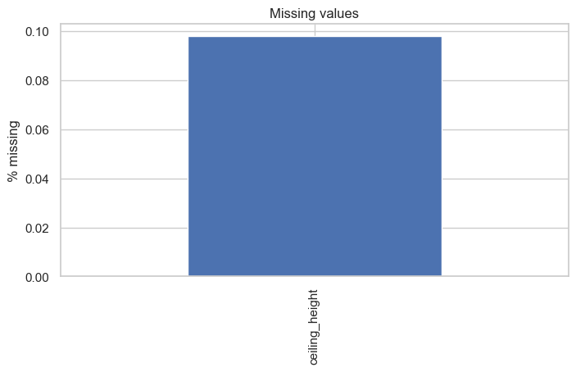
Feature engineering and missing values
New features (each justified)
house_age = 2026 − build year: age is more meaningful than the raw year.
is_first_floor, is_last_floor: first and last floors form cheaper / special segments.
floor_ratio = floor / total floors: relative position in the building.
area_per_room = area / rooms: separates compact from spacious layouts.
Preprocessing inside the pipeline
Remaining missing values
Numeric: median imputer + StandardScaler (14 columns).
Categorical: most-frequent imputer + OneHotEncoder, rare categories grouped (9 columns).
Only ceiling_height has gaps (about 0.1% of rows), created by our 2.0–6.0 m range rule. Imputed in the pipeline, fitted on train only.
7
Notes:
Бахытжан: пять новых признаков с обоснованием. Пропуски появились после чистки (потолки и год постройки), их заполняет пайплайн: медиана для чисел, мода для категорий. Масштабирование и one-hot тоже внутри пайплайна.

Slide 8
Splitting strategy and leakage control
Train
2,860 (70%)
Validation
613 (15%)
Test
613 (15%)
How we split
How leakage is avoided
Fixed seed: random_state = 42, reproducible.
Stratified: 10 quantile bins of log-price, so cheap, mid and expensive flats appear in every split.
Order: split first, then impute, scale, encode.
Sizes: 2,860 train / 613 validation / 613 test.
Imputer, scaler and encoder live in a Pipeline: fitted on train (and train folds in CV) only.
Price-like columns removed, since they are computed from the target.
Tuning uses train CV only; test used once at the end.
8
Notes:
Нурхан: сплит 70/15/15 до любой предобработки; стратификация через квантильные корзины log-цены. Имьютер, скейлер и энкодер — внутри Pipeline, поэтому учатся только на train. Тест используем один раз.

Slide 9
Baseline and lecture models (validation)
Model | RMSE log | R² | MAE KZT | MedAPE
Baseline (median) | 0.500 | -0.013 | 17.9M | 33.9%
Linear Regression | 0.191 | 0.853 | 7.1M | 11.2%
Decision Tree (tuned) | 0.218 | 0.808 | 8.0M | 12.8%
KNN (tuned) | 0.221 | 0.802 | 7.7M | 13.4%
Validation MedAPE, %
33.9
What we see
13.4
12.8
Linear Regression wins on validation and generalises (val RMSE 0.191 < train 0.203).
KNN overfits: train R² = 1.00 vs val 0.80 with 7 neighbours.
All models cut baseline error by about two thirds.
Tuning helped little: tree val RMSE 0.216 → 0.218; CV is the safer guide.
11.2
Baseline
Linear
Tree
KNN
9
Notes:
Бахытжан: бейзлайн — медиана, MedAPE 33.9%. Линейная регрессия лучшая: RMSE 0.191, R² 0.853, MedAPE 11.2%. KNN на train даёт R² = 1.0 — явное переобучение, на валидации хуже. Дерево тоже переобучается сильнее линейной модели.

Slide 10
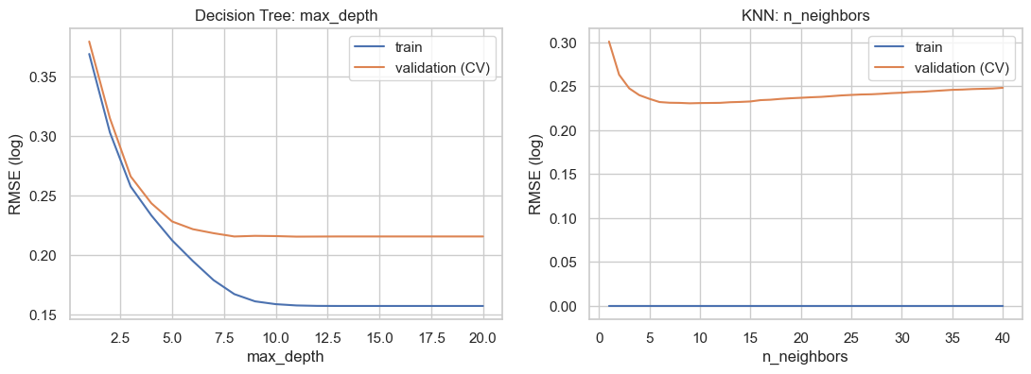
Cross-validation and hyperparameter tuning
5-fold CV on train (RMSE log)
GridSearchCV (5-fold, train only)
Baseline: 0.509 ± 0.013
Linear Regression: 0.219 ± 0.031
Decision Tree: 0.215 ± 0.015
KNN: 0.231 ± 0.009
Tree: max_depth = 12, min_samples_leaf = 10 (CV RMSE 0.2152).
KNN: k = 9, weights = distance, euclidean (CV RMSE 0.2308).
Validation curves
Tree: train error keeps falling with depth while CV error flattens after depth ≈ 7–10, so deeper trees only overfit. KNN: train error is 0 with distance weights; CV error is lowest at small k (≈ 9).
10
Notes:
Нурхан: 5-fold CV на train: линейная 0.219, дерево 0.215, KNN 0.231, бейзлайн 0.509. GridSearchCV подобрал max_depth=12, min_samples_leaf=10 для дерева и k=9, distance, euclidean для KNN. Кривые валидации показывают, где начинается переобучение.

Slide 11
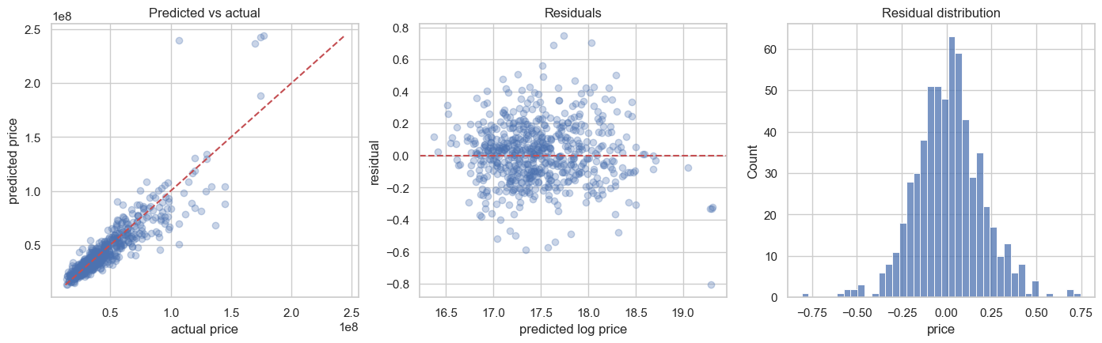
Error analysis and final test result
Reading the plots
Points follow the diagonal; residuals centre on 0. Outliers remain, e.g. a 107M flat predicted at 240M. Best district: Saryarka (9.7%).
Median % error by price segment
12.0%
0.838
7.5M
15.0
10.5
9.7
11.1
11.1
test MedAPE
test R²
test MAE, KZT
Linear Regression, trained on train+val, test used once. Worst district: Baikonur (14.9%).
Cheapest
Low
Mid
High
Top 20%
11
Notes:
Бахытжан: лучшая модель — линейная регрессия. Ошибка растёт в топ-20% дорогих квартир (15.0%), в остальных сегментах 9.7–11.1%. По районам лучше всего Сарыарка (9.7%), хуже всего Байконур (14.9%). Тест использовали один раз: RMSE 0.205, R² 0.838, MedAPE 12.0%.

Slide 12
Conclusions, plan for the final and team contributions
Conclusions
Open problems
Plan for the final
Linear Regression: MedAPE 12.0% vs 33.9% baseline.
Midterm criterion (≈15%) is met.
Asking prices, not sale prices.
Near-duplicates; complexes with high cardinality; luxury flats (15% error).
Random Forest, Gradient Boosting.
Distance to centre; complex statistics from train folds; feature importance.
Team contributions
NK
Nurkhan Kuanyshov
Data and features
BJ
Bakytzhan Jangazy
Modelling and evaluation
Data loading and first look at the 5,003 × 23 table
Cleaning: types, duplicates, ranges, outliers
5 engineered features (age, floor flags, ratios)
Notebook structure and README
Baseline, Linear Regression, Decision Tree, KNN
5-fold cross-validation and GridSearchCV
Metrics, error analysis by price segment and district
Presentation preparation
12
Notes:
Вместе: вывод — линейная регрессия бьёт бейзлайн (MedAPE 12.0% против 33.9%), критерий ≤15% выполнен. Открытые проблемы: цены предложения, near-duplicates, ЖК с большой кардинальностью, дорогие квартиры. План: Random Forest, Gradient Boosting, расстояние до центра, агрегаты по ЖК на train-фолдах. Нурхан: данные, чистка, признаки, структура ноутбука. Бахытжан: модели, оценка, анализ ошибок, презентация. Оба выступают.

