Slide 1
Subqueries & Query Expressions

Slide 2
Agenda
Introduction to Subquery
Properties and benefits
Subquery using
where clause
Outer reference
Existence & Quantified Test
From Clause
Nested Subqueries

Slide 3
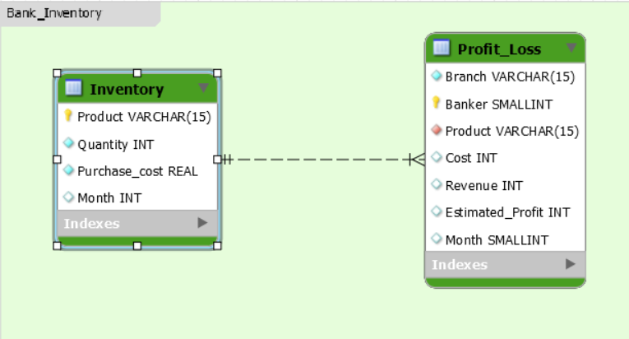
E-R Diagram

Slide 4
E-R Diagram
Table | Columns | Description
INVENTORY | Product | Bank has products which are purchased from vendor and selling them to customers. Products : Plastic visa debit/credit cards .
 | Quantity | Quantity purchased from Vendor
 | Purchase _cost | Purchase cost of product from vendor
 | Month | Month during which inventory maintained

Slide 5
E-R Diagram
Table | Columns | Description
PROFIT_LOSS | Branch | Bank has branches across different locations
 | Banker | Salesperson who is said to be banker
 | Product | Product details maintained with banker at different branches
 | Cost | Cost includes purchase cost + service charges + maintenance charges of the product at branch
 | Revenue | Revenue generated from selling the product
 | Estimated_Profit | Estimated Profit is expected but it may not be the actual calculated profit.

Slide 6
E-R Diagram
All these tables can be found in the ‘module 7 tables.sql’ and would be required for this session

Slide 7
Subquery
A select query when it is nested in another main query, then it is called as a subquery
Like joins, subqueries need common key columns for joining with main queries
Subqueries are otherwise called as virtual table enclosed with an independent business logic
Subqueries execute independently and share its results with the main query, so that the complexity reduces while writing the queries

Slide 8
Subquery
Subqueries are of different types and can be used in different ways according to business logic
Type | Properties
Single Row Subquery | Returns a single value and feeds to main query
Multiple Row Subquery | Returns more number of rows
Multiple Column Subquery | Returns one or more columns results which matches with outer query columns
Correlated Subquery | the subquery is dependent on outer query for retrieving each record
Nested Subquery | Subqueries are placed within another subquery. It is called as nesting

Slide 9
Subquery - Benefits
Subquery separates the complex business logic from the main query
It is easy to debug an individual subquery instead of large and complex main query where more tables and columns are used
Subqueries improve the performance when they are used in a better way
Subqueries can be written anywhere in the SELECT clause, FROM clause and WHERE clause of another SQL query, however, the constraints of clauses are applied while using subqueries

Slide 10
Subqueries in Where Clause

Slide 11
Subquery in Where Clause
Subqueries can be written in WHERE clause of another query by using multi-row operators including EXISTS, IN , ANY and ALL
They can also use single-row comparison operators including <, >, =

Slide 12

Multi-row operators perform comparison operations on multiple rows returned by subquery
Single-row operators perform comparison operations on single row returned by subquery

Slide 13
Subqueries in Where Clause - Syntax using IN clause
IN operator is well used when the main query searches all of the multiple rows returned by subquery
Here in the example, the sub-query of Transaction is independently executed first and then return the results to main ACCOUNT query
Later, the main ACCOUNT query searches all of the rows returned from subquery to check if any transactions are done via ATM machines

Slide 14

Subqueries in Where Clause - Syntax using IN clause
SELECT A.Acct_Num,
A.Balance,
A.Acct_type,
A.Acct_status
FROM ACCOUNT A
Where A.Acct_Num IN
( SELECT T.Acct_Num
FROM
TRANSACTION T
WHERE T.Channel = 'ATM withdrawal' )
*Account and Transaction Tables are the one used from previous session

Slide 15
Outer References

Slide 16
Outer References
A Sub-query is executed independently and reference its records as a derived table in the FROM clause of a Main Query
It is beneficial in many ways instead of using full table
Only Selected rows and columns are used in the FROM clause
Subqueries divides the complex logic from the main Query in the FROM clause

Slide 17
Outer References
In the next example:
The main query retrieves results from ACCOUNT table,
The Subquery retrieves results from TRANSACTION table which is independently executed, and also filters the records with condition that transaction amount > 23000
In the FROM clause, the Subquery joins the filtered records of TRANSACTION table, and joins with ACCOUNT table
The WHERE clause ensures to join the ACCOUNT and the “Subquery TRANSACTION table” results to give the desired output

Slide 18

Outer References
SELECT A.Acct_Num,
Sub_T.Tran_Amount
FROM ACCOUNT A ,
(
SELECT Acct_Num,
Tran_Amount
FROM Transaction
Where Tran_amount > 23000
) Sub_T
WHERE A.Acct_Num = Sub_T.Acct_Num

Slide 19
Subquery Search Condition

Slide 20
Subquery Comparison Test
Sub Queries’ results are dynamic rather than constant
That means, developer will not manually pass any input in order to fetch the records, the dynamic input is retrieved from subquery
These subqueries when used in WHERE clause, uses its dynamic input in the condition and then fetches the records

Slide 21
Subquery Comparison Test
In the next example:
The main query tries to return transaction details during recent Holiday
Developer usually do not need to know which is the recent holiday
The subquery is independently executed and returns a single (scalar) value : “2020-04-24”
This date is dynamically returned by subquery, and it can be any other date as per database table entries

Slide 22

Subquery Comparison Test
SELECT
Acct_Num,
Tran_Amount,
Tran_Date
FROM
TRANSACTION
WHERE Tran_Date = ( SELECT MAX(event_dt )
FROM MESSAGE
WHERE Event = 'Holiday'
)
In this example, WHERE clause expects a scalar (single) value in the subquery result that is : 2020-04-24

Slide 23
Subquery Set Membership Test
In the next example:
The query tries to fetch all bank accounts and their balance amount when they had withdrawn the amount via ATMs machine only
Initially, the subquery is executed independently and returns the result set of “multiple” Account Numbers ( same datatype ) with ATM transactions
The “IN” operator acts like a multi-row operation refer to subquery result set to obtain balance amount

Slide 24

Subquery Set Membership Test
SELECT A.Acct_Num,
A.Balance,
A.Acct_type,
A.Acct_status
FROM ACCOUNT A
WHERE A.Acct_Num IN
(
SELECT Acct_Num FROM Transaction
WHERE Channel = 'ATM withdrawal'
)
Here, multiple values are provided to the main query with the help of IN operator
Based on the values returned by subquery, the outer Q\query will execute

Slide 25
Subquery Existence Test
The subquery is examined by each record of the main query using common key columns
The common key column should be same in main query and subquery
The subquery returns true (1) or false (0) when its conditions are satisfied with main query input column values

Slide 26
Subquery Existence Test using EXISTS
EXISTS operator is used when a record in the main query has one or more matching records in the subquery result set
In the next example the subquery of Transaction is executed for multiple times for each account in ACCOUNT table

Slide 27
Subquery Existence Test using EXISTS
The query checks each account has done at least one transaction in Transaction table, otherwise, do not return those account details
SELECT A.Acct_Num,
A.Balance ,
A.acct_type,
A.acct_status
FROM ACCOUNT A
WHERE Exists (SELECT 'yes'
FROM Transaction T
WHERE T.Acct_Num = A.Acct_Num)

Slide 28
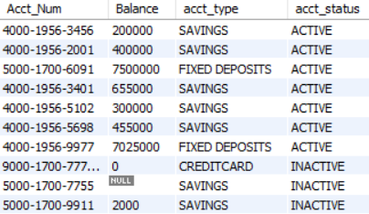
Subquery Existence Test using EXISTS
In subquery, ‘yes’ is a constant value
Internally, the subquery returns true or false when the record is available

Slide 29
Subquery Quantified Test
Quantify test means “validating many records ”
Several times, multiple records are returned from subquery. Usually there is a one-many relationship between main query and subquery
In such cases, the main query satisfies the condition if at least “one single record” of main Query matches with matches with “any of the multiple records” of subquery.

Slide 30
Subquery Quantified Test using ANY
In the next example:
The main Query tries to retrieve all of the given account transactions if at least one transaction is happened beyond any of the holidays
“>” or “<” range operator along with “ANY” walks through of all of the account transactions
ANY quantifies that if atleast one transaction is beyond holiday then the main Query returns all the transaction records of the account

Slide 31
Subquery Quantified Test
SELECT
Acct_Num,
Tran_Date
FROM TRANSACTION
WHERE Acct_Num = '4000-1956-2001’ AND Tran_Date > ANY
(
SELECT Event_dt
FROM Message
WHERE event = 'Holiday'
)

Slide 32

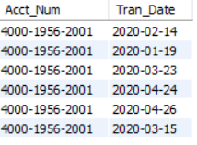
Subquery Quantified Test
Result of subquery
#subquery
SELECT Event_dt
FROM Message
WHERE event = 'Holiday'
Result of main query
#main query
SELECT Acct_Num,Tran_Date
FROM TRANSACTION
WHERE Acct_Num = '4000-1956-2001'

Slide 33
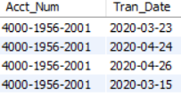
Subquery Quantified Test
SELECT
Acct_Num,
Tran_Date
FROM TRANSACTION
WHERE Acct_Num = '4000-1956-2001’ AND Tran_Date > ANY
(
SELECT Event_dt
FROM Message
WHERE event = 'Holiday'
)
Here, subquery returns holiday days from Feb,2020 to April,2020
Main query evaluates the least Holiday : Feb,2020 using ANY so that it retrieves as many transactions as possible

Slide 34


Replace ANY with IN and compare the results: Few record gets filtered and the meaning of the result gets changed
SELECT
Acct_Num,
Tran_Date
FROM TRANSACTION
WHERE Acct_Num = '4000-1956-2001’ AND Tran_Date IN
(
SELECT Event_dt
FROM Message
WHERE event = 'Holiday'
)

Slide 35
Subquery Quantified Test using ALL
Unlike ANY, ALL is used to quantify the infinite results rather than the sample
In such cases, each of the main query records satisfies the condition when it matches with every/all of results of subquery

Slide 36
Sub-Query Quantified Test
In next example:
bank transactions are retrieved by checking ALL of the bank holidays
“>” or “<” range operator along with “ALL” walks through all of the bank holidays
ALL will ensure the main query to check “each and every” subquery result

Slide 37

Quantified Test using “ALL” with “<” operator
SELECT Acct_Num,
Tran_Date
FROM TRANSACTION
WHERE Acct_Num = '4000-1956-2001' AND Tran_Date < ALL
( SELECT Event_dt
FROM MESSAGE
WHERE event = 'Holiday'
)
Here, ALL the results of subquery are considered by main query
Hence it checks for the transactions before “all of those holidays”( Refer slide 38 for details of the Queries )

Slide 38

Quantified Test using “ALL” with “>” operator
SELECT Acct_Num,
Tran_Date
FROM TRANSACTION
WHERE Acct_Num = '4000-1956-2001' AND Tran_Date > ALL
( SELECT Event_dt
FROM MESSAGE
WHERE event = 'Holiday'
)
Here, ALL the results of subquery are considered by main query
Hence it checks for the transactions after all of those holidays

Slide 39
Subquery in FROM Clause

Slide 40
Subquery in FROM Clause
Subqueries in the From Clause act like a view table derived from conditions
Subqueries as a derived form can inline with JOINs to form a main query

Slide 41
Subquery in FROM Clause
Consider the following query, the main query JOINS with a Subquery
Initially, the subquery is executed and retrieves the transactions occurred during holidays
These transactions are then used by main query using JOIN clause to retrieve Account and Transaction details
SELECT A.Acct_Num, Tran.Tran_Amount, Tran.Tran_Date
FROM ACCOUNT A
JOIN(SELECT Acct_Num, Tran_Amount, Tran_Date
FROM Transaction, Message
WHERE Tran_Date = Event_dt
AND event= 'Holiday'
) Tran
ON Tran.Acct_Num = A.Acct_Num

Slide 42
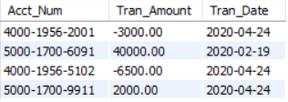
Subquery in FROM Clause
Output:

Slide 43
Nested Subqueries

Slide 44
Nested-Subqueries
A Subquery can be embedded or nested in another Subquery
Any SELECT query supports multiple subqueries nesting within one another
So each nested subquery executes independently and pass its result to next level subquery
E.g : A SELECT query consists of Subquery - A ,
then Subquery - A consists of Subquery - B, and
then the Subquery - B can consists of Subquery - C, and so on

Slide 45
MYSQL executes the low level subquery first and pass its intermediate result to its next immediate subquery.
Here in Eg, Subquery-C is executed first and pass its result to Subquery-B, and so on

Slide 46
Nested-Subqueries - Example
In the next example:
Initially, low level subquery (Evnt) returns a list of Holiday dates and pass it to its next level subquery
Next, the subquery (Tran_Evnt) uses Holiday dates returned by (Evnt) and returns transactions during the event to next level query
Finally, the main query uses records of (Tran_Evnt) subquery and joins with Account table to return Account details and Tran_Evnt subquery details.

Slide 47
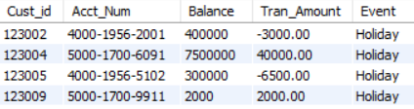
Nested-Subqueries - Example
Nested subquery:
SELECT Cust_id, A.Acct_Num, A.Balance, Tran_Evnt.Tran_Amount, Event
FROM ACCOUNT A
JOIN (SELECT Acct_Num, Tran_Amount, Event
FROM Transaction
JOIN (SELECT Event, Event_dt
FROM Message) Evnt
ON Tran_Date = Evnt.Event_dt) Tran_Evnt
ON A.Acct_Num = Tran_Evnt.Acct_Num

Slide 48
Nested-Subqueries - Example
The final result consist of:
Message table details from subquery - (Evnt)
Transactions details from subquery - (Tran_Evnt)
Account Details from Account table

Slide 49
Set Membership Test using Nested Subqueries

Slide 50
Set Membership Test Using Nested Subquery
A series of subqueries nested in one another recursively are referred by common key columns using IN operator
The Low level nested subquery is executed first and then referred by IN operator by its next level subquery
This process is repeated until the result of nested queries reaches to main query

Slide 51
Set Membership Test Using Nested Subquery
SELECT Acct_Num, Tran_Amount, Channel, Tran_date
From Transaction
WHERE Acct_Num IN (SELECT Acct_Num
FROM ACCOUNT
WHERE Balance > 0 AND Cust_Id IN (SELECT Cust_Id
FROM CUSTOMER
)
)
First, the innermost nested subquery consists of customer details which is then referred by its immediate account subquery using IN operator
Secondly, the Account table details are evaluated and the final account numbers to main Transaction query

Slide 52
Set Membership Test Using Nested Subquery
SELECT Acct_Num, Tran_Amount, Channel, Tran_date
From Transaction
WHERE Acct_Num IN (SELECT Acct_Num
FROM ACCOUNT
WHERE Balance > 0 AND Cust_Id IN (SELECT Cust_Id
FROM CUSTOMER
)
)
Finally, the transaction details are retrieved by checking in ACCOUNT and CUSTOMER table using IN operator and nested subqueries

Slide 53
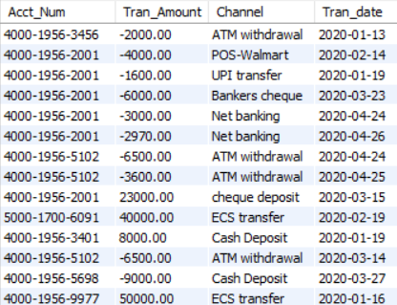
Set Membership Test Using Nested Subquery
Output
The final result consists of only Transaction table details
Unlike JOINS , set operator (IN) cannot bring the column results from nested subqueries

Slide 54
Set Comparison Test Using Nested Subquery

Slide 55
Set Comparison Test Using Nested Subquery
In a recursive nested subqueries, comparison operators includes “>” , “<” , are used to compare a range of subquery results and filters the outer query results

Slide 56
Set Comparison Test Using Nested Sub-Query
SELECT *
FROM CUSTOMER
WHERE Cust_Id IN (SELECT Cust_Id
FROM ACCOUNT
WHERE Acct_Num IN
(SELECT Acct_Num
FROM Transaction
WHERE Tran_Date > (SELECT MAX(Event_dt )
FROM Message)
)
)
Here, the set operators (IN) and “>” are used for evaluating the nested subqueries
The low level nested subquery returns a scalar(single) value - recent Holiday

Slide 57
Set Comparison Test Using Nested Sub-Query
SELECT *
FROM CUSTOMER
WHERE Cust_Id IN (SELECT Cust_Id
FROM ACCOUNT
WHERE Acct_Num IN
(SELECT Acct_Num
FROM Transaction
WHERE Tran_Date > (SELECT MAX(Event_dt )
FROM Message)
)
)
“>” operator expects only single value, hence we applied MAX function to return recent Holiday
Later, the IN operator evaluates transaction details after the recent Holiday

Slide 58

Set Comparison Test Using Nested Sub-Query
The output displays the customer details from main query, and the result is: customers who did transactions after Holiday
Note: IN operator cannot return the column values unlike JOINS nested subqueries

Slide 59
Subqueries with the ‘WITH’ Clause

Slide 60
Subqueries with the ‘WITH’ Clause
Subqueries written in the WITH Clause plays a factoring role
Factoring means , the WITH Clause serves subquery results in the Main-Query wherever it is referenced
Once the WITH clause is executed , the same subQuery result can be used for multiple times without execution
WITH clause plays a major role in complex queries when there is a need for calling the subqueries for multiple times

Slide 61
Subqueries with the ‘WITH’ Clause
WITH I_RATE AS
(SELECT Acct_type, rate FROM Interest )
SELECT A.Acct_num, I_RATE.Acct_type, I_RATE.rate
FROM ACCOUNT A
JOIN I_RATE
ON A.Acct_type = I_RATE.Acct_type
The WITH clause Query is referenced with I_RATE acts like a re-usable dataset and can be invoked for any number of times in the FROM clause or any other Sub-queries
The Acct_type of ACCOUNT table joins with acct_type of I_RATE derived table to derive the Interest rate

Slide 62
Subqueries with the ‘WITH’ Clause
WITH I_RATE AS
(SELECT Acct_type, rate FROM Interest )
SELECT A.Acct_num, I_RATE.Acct_type, I_RATE.rate
FROM ACCOUNT A
JOIN I_RATE
ON A.Acct_type = I_RATE.Acct_type
So that Each account will be assigned with interest rate based on its Acct_type including SAVINGS and RECURRING DEPOSITS

Slide 63
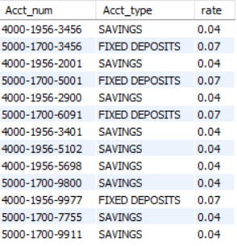
Subqueries with the ‘WITH’ Clause
Output:

Slide 64
Subqueries in the Having Clause

Slide 65
Subqueries in the ‘HAVING’ Clause
Having Clause condition filters the grouped results of the Main Query
SubQuery in the Having Clause returns the derived values dynamically to satisfy the condition
This concept helps to compare the grouping results with other grouped results.

Slide 66
Subqueries in the ‘HAVING’ Clause
Select Branch, Product, SUM(Estimated_profit) as Profit
FROM Profit_Loss
GROUP BY Branch, Product
HAVING SUM(Estimated_profit) >( SELECT AVG(estimated_profit)
FROM Profit_Loss )
The main query is trying to compare the branches whose actual profit ( calculated ) is higher than the minimum profit across the bank
The Having Clause filters the branches with least earned profit with help of subquery result

Slide 67
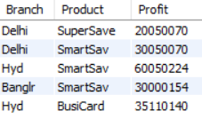
Subqueries in the ‘HAVING’ Clause
Output:
The products that are returned with profit that is more than the average profit of ALL products at various branches
The objective is to know which products returned high profit than the average profit of all products profit

Slide 68
Correlated Subqueries in the ‘HAVING’ Clause
In our previous example, subquery is independently and dynamically executed in HAVING clause
Here , the SubQuery in the Having Clause can also correlates with non grouping fields selected in the Main query
So that each result of the main query is conditionally retrieved based on the each record of subquery

Slide 69
Correlated Subqueries in the ‘HAVING’ Clause
SELECT Branch, P1.Product, SUM(Estimated_profit) AS Profit
FROM PROFIT_LOSS P1
GROUP BY Branch, P1.Product
HAVING SUM(Estimated_profit) > (SELECT AVG(Estimated_profit)
FROM PROFIT_LOSS P2
WHERE P2.Product = P1.Product)
Here, for each individual product, branch level profit is verified with overall organization level profit
The main query retrieves total- profit of each product at branch
Since the subquery is correlated with main query, the subquery is executed with an input from main query, and returns average of profit per each product

Slide 70
Correlated Subqueries in the ‘HAVING’ Clause
SELECT Branch, P1.Product, SUM(Estimated_profit) AS Profit
FROM PROFIT_LOSS P1
GROUP BY Branch, P1.Product
HAVING SUM(Estimated_profit) > (SELECT AVG(Estimated_profit)
FROM PROFIT_LOSS P2
WHERE P2.Product = P1.Product)
The execution of the subquery is repeated for all the corresponding inputs from main query
Having clause will conditionally filters the records of main query

Slide 71
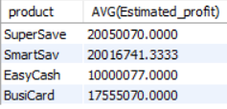
Correlated Subqueries in the ‘HAVING’ Clause
Subquery result only:
SELECT p2.product, AVG(Estimated_profit) FROM PROFIT_LOSS P2
group by p2.product;
Here, The subquery returns the “average of estimated profit" per each “product” across the company. ( includes ALL the branches )
The result is then compared with main Query

Slide 72
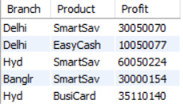
Correlated Subqueries in the ‘HAVING’ Clause
Example-2 Output:
The main query retrieves “SUM of profit” of each product at branch level
The results returned from main Query are then filtered in the HAVING clause
In Having clause, the branch level profit is verified against organization level average profit

Slide 73
Scalar Valued Expression

Slide 74
Scalar Valued Expression
Scalar Value is a single column value or a single record used as one dimension
In a scalar valued expression, the result of one dimensional subquery is cross joins with all of the Main Query records

Slide 75
Scalar Valued Expression
A select query when returns a single record , it is said to be one dimension, if the query returns multiple records, then it is two dimension as it consists of rows and columns

Slide 76
Scalar Valued Expression using Subquery
Select Acct_Num, tran_date ,
CASE WHEN Tran_Date =
( Select MAX(Event_dt) From Message )
THEN 'HOLIDAY'
ELSE 'WORKING DAY' END As Event
From Transaction
where Tran_Date > "2020-03-23"
The scalar value expression is the subquery enclosed in another SELECT Query as a derived value
Here MAX (Holiday) a single value returned from subQuery dynamically as a derived single value
This scalar Query is executed for each record returned by the main Query

Slide 77
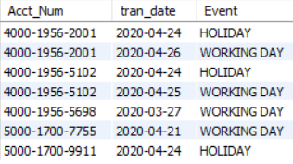
Scalar Valued Expression using Subquery
The scalar value subquery expression returns 2020-04-24.
Each record returned by TRANSACTION table compares its tran_date against 2020-04-24 , and displays if its Holiday or Working day as per CASE statement.

Slide 78
Summary

Slide 79
Summary
Subqueries are written to separate the complexity of logic
Subqueries performs the same way like JOINS but improves the performance of overall query execution
Subqueries written on tables with less records gives better performance
Subqueries can be written anywhere in the SELECT , FROM and WHERE and HAVING clauses of outer SQL query
Subqueries can be written in another subquery
Easy for debugging the subquery

Slide 80
Summary
Always use WITH clause when there is a necessary to invoke the subquery for multiple times in differents part of the query
Subqueries correlates with outer query by joining the common key columns
EXISTS Operator validates the subquery results to return true or false and filters the main query results
IN Operator lookup on the values returned by Subquery and pass the outer query condition
ANY/ALL Operators quantifies by walking through all of the subquery results with outer query results.

Slide 81
Thank You

