Slide 1
Data Integrity

Slide 2
Agenda
What is Data Integrity
Classification
ACID Properties
Normalization
Constraints on Relation
Referential Integrity

Slide 3
What is Data Integrity?
According to data management community and data Governance,
Integrity of data ensures an appropriate lineage of business entities in the data flow process.
Data Integrity
- Ensures smooth business flow of business.
- It is the key aspect of design of data flow process.
- It ensures the consistency of the data through entire project life cycle. It means the data should be relevant across the business.

Slide 4
What is Data Integrity?
In order to establish the data lineage, organization should
Receive accurate data as if the records are not ignored without any flaws. Hence the loss of data costs to organization.
Consistency of data flow across business processes.
So, None of the entities(tables) are not struck in the middle of the business process due invalid or irrelevant data.
Data generated should be reliable within business units. So that the data is consistent when one business unit shares the data with other business unit.

Slide 5
Loss of Data integrity results in
Audit penalty by data governance.
Costs associated to unused data maintenance in billions due to additional storage.
Consuming of additional RAM memory by SQL programs running on the data.
Purchase of additional disk space either in standalone or cloud environments.
Analytics may show inappropriate results.

Slide 6
Loss of Data integrity results in
Quality control is an overhead
Inappropriate decision making when multiple strategic reports are generated without any quality of data

Slide 7
Data Integrity is classified as:
1. Row level integrity
2. Column level integrity
3. Referential integrity

Slide 8
Row level integrity
Each row in the table is referenced by unique values, and avoids conflicts with other rows.
This unique identifier is normally known as primary key of the table
Example : CUSTOMER table uses single column Cust_Id as the unique identifier
Select * from CUSTOMER where Cust_Id=123001

Slide 9
Column level integrity
Every attribute or Column of a table held a business meaning.
It consists of metadata means an information of a column. The information of the column explains the meaning and purpose of the column defined in the table and how it is later referenced across the organization.
In order to achieve this, the data that is stored in a column is adhere to the same format and definition.
This includes data type, size, range of possible values
E.g: Cust_Id data-type is integer which accepts only integer values.

Slide 10

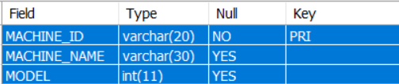
Column level integrity
SELECT * FROM EQUIPMENT.
DESC EQUIPMENT
In this table,
MODEL column will not accept Alphabets because it is defined as an Integer.

Slide 11

INSERT into EQUIPMENT values
( 'MAC03' , 'SPINNING' , ‘Nineteen’ )
Column level integrity - ensures to insert correct values according to its datatype. So the below statement will successfully insert the record.
INSERT into EQUIPMENT Values ( 'MAC03' , 'SPINNING' , 2019)

Slide 12
Referential Integrity
Referential Integrity -
Ensures consistency of records between two related tables.
It establishes relationships between two different tables using referencing columns.
It sets up a parent child relationship between two tables.
So the child table always references the parent table.
At the same time, the parent table prevents entering a row in child table.
Establishing a Parent - child relationship between tables is achieved by defining the tables using - FOREIGN KEY and PRIMARY KEY.

Slide 13

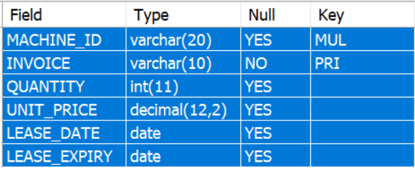
Defining Foreign Key to show referential Integrity
#Set up a Foreign key
ALTER TABLE LEASE
ADD FOREIGN KEY (MACHINE_ID )
REFERENCES EQUIPMENT (MACHINE_ID)
MACHINE_ID defined as MUL, means the field can accept duplicate values, but the values should already present in its parent Column in Equipment table

Slide 14
Here Foreign Key will not allow INSERT or UPDATE a record in the child table for which there is no existing record in parent table.
E.g:
INSERT INTO LEASE VALUES
( 'MAC04' , 'INV004' ,7 , 20100, '2019-04-01' , '2022-04-01' ) ,

Slide 15
Root cause and resolution
Error: Can't ADD OR UPDATE a child row:
The MACHINE_ID: MAC04 is not present in EQUIPMENT - parent table.
Hence, the LEASE - child table cannot insert the record with MACHINE_ID: MAC04 to generate a new invoice .
Fix the problem:
Insert a record first in EQUIPMENT table to ensure the machine is ready, then you can take a lease .
Step1:
INSERT INTO EQUIPMENT Values ( 'MAC04' , 'SPINNING' , 2019 ) ;
Step2:
INSERT INTO LEASE VALUES
( 'MAC04' , 'INV004' ,7 , 20100, '2019-04-01' , '2022-04-01' ) ;

Slide 16
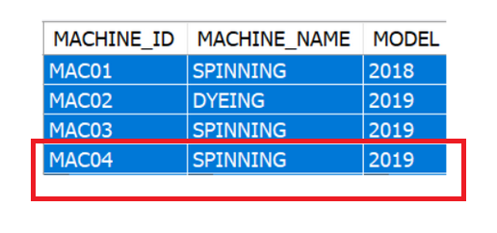
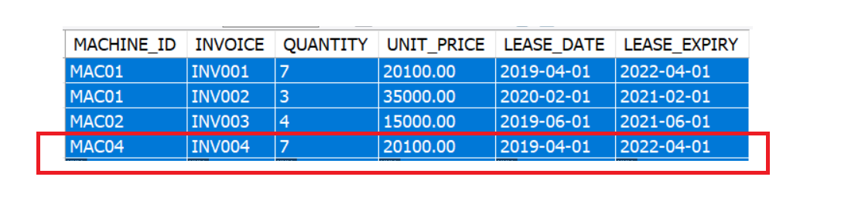
Records
Equipment
LEASE

Slide 17
Now let's delete an existing record from EQUIPMENT table and see if its corresponding matching records on child table is automatically deleted or not
DELETE from EQUIPMENT
where MACHINE_ID = 'MAC01';
Similarly , You can delete a row from Parent table because child row is existing in a table.

Slide 18
ACID Properties

Slide 19
ACID Properties
A transaction is a single logical unit of work which acts on the database contents
The database state is in tandem with every transaction to ensure the data integrity
Hence , in a transaction processing, database application follows the standard four properties to ensure a smooth flow of the business

Slide 20
ACID Properties
Atomicity
Consistency
Isolation
Durability

Slide 21

Atomicity
Atomicity:
Complete the data transaction by 100% otherwise retain the original status.
Ex: An account holder - “A” intends to debit $1000 from his account and credit account holder - “B” for sum of $1000.
An atomicity here to ensures individual accounts are debited and credited successfully.
In case of any transaction failure, retain the original account balances.

Slide 22

Consistency
Consistency:
Consistency of data ensures the data is not leaked in any case of success or failure of transactions.
Ex: “A” debits 2000$ to “B”, but “B” is credited with 1000$ only. Hence, B lost $1000.
Here the transaction is success but not consistent.
Database Application should always ensure the transformation rules are consistent without loss to actual data.

Slide 23
Isolation
Isolation:
Database application ensures every transaction is individual, secured and is hidden from other transactions.
Ex: Transaction of “A” debits 2000$ to “B” is invisible to any others.
Similarly, transaction of “B” crediting 2000$ from “A” is invisible to any others.
Here the transactions that are debit of “A” and credit of B is invisible and will not let others to interfere and leak the data during transaction and do not provide room for un-ethical hacking.

Slide 24
Isolation
Isolation:
Database application ensures every transaction is individual, secured and is hidden from other transactions.
The transactions are serialized to avoid below conflicts when occurring at same time.
Ex: Edward has balance of $ 5000 but he has given two cheques to Richard and Sharma for a sum of $3000 and $2700.
In reality, Edward’s deficit balance is $700.
Isolation of transactions helps to prevent such malfunctions in real time bank transactions.

Slide 25

Durability
Durability:
Data should be persistent after before and after a transaction.
Ex: Edward has account balance of $4500 and swipes $2000 for purchasing product in an Amazon. All of sudden network goes down and the order is not fulfilled but money is debited.
To ensure durability of data, the database maintains the state of data before and after transaction.
Hence, Edward’s transaction can be successful or it can be reversed.

Slide 26
Normalization

Slide 27
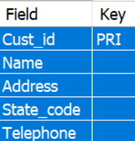
Functional Dependency
All the non-key Columns of a table are said to be dependent on Primary key, which uniquely identifies the rows in a table.
For example:
Consider a CUSTOMER table with attributes:
Cust_Id, Name, Address, State, Telephone.
Here Cust_Id is a primary Key, which uniquely identifies the remaining columns.
Hence, the non-key columns are said to be functionally dependent on Primary Key.

Slide 28
Normalization
Normalization is the process of organizing the data attributes with their relationships
Normalization minimizes the redundancy of data rows
Normalization minimizes the dependency of columns.
It eliminates the undesirable characteristics like Insertion, Update and delete of anomalies( flaws).
Normalization divides the larger table into the smaller tables and establishes entity-relationship among those tables.

Slide 29
Normalization
Normalization is evolved into several stages over a period of time.
Normal Form | Description
1NF | A relation is in 1NF if it contains an atomic value.
2NF | A relation will be in 2NF if it is in 1NF and all non-key attributes are fully functional dependent on the primary key.
3NF | A relation will be in 3NF if it is in 2NF and no transition dependency exists.
4NF | A relation will be in 4NF if it is in Boyce Codd normal form and has no multivalued dependency.
5NF | A relation is in 5NF if it is in 4NF and not contains any join dependency and joining should be lossless.

Slide 30
First Normal Form (1NF)
A table is said to be in First Normal Form, when it follows the following 4 rules:
A column/attribute in a table should consists of a scalar atomic value
All the values stored in a column should have same business term
All the columns in a table should be represented with unique names
The order of rows and columns doesn’t matter

Slide 31
First Normal Form (1NF) - Example
One of the branches of a bank is piling up with entries by adding multiple branches with different IFSC codes.
E.g: One city keep opening multiple branches in different areas, and trying finds difficulty in building relationship between columns and rows, and failed to store record of each branch details separately.
Hence 1-NF resolves such problems by decomposing the multi-valued attribute phone_number in bank_branches table

Slide 32
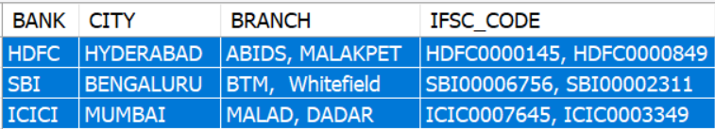
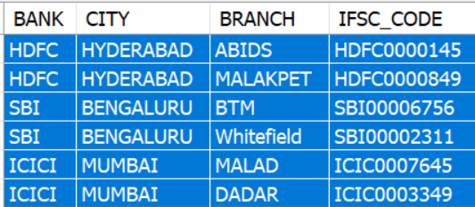
Normalization before and after 1 - NF
SELECT * from ALL_BANKS /* before 1 - NF , it is multi- valued in one column */
Select *from BANKS
In 1- NF, Multi-values are placed in different rows

Slide 33
Second Normal Form (2NF)
All non-key & independent attributes are fully functionally dependent on
the primary key.
2NF is evolutioned after 1NF , and handled the redundancy of data effectively
Below rules are followed to achieve 2NF
In 2NF, the data must be in 1NF

Slide 34
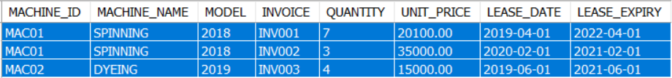
A table before 2-NF
Select * from Equipment_Lease
In this example, two problems arises while generating Invoice.
Redundancy:
Whenever a new Invoice is generated for a Machine,
a new record is inserted into table by repeating machine Name, Machine Id, model Numbers .
Dependency:
Here the other columns related to Invoice are made dependent on machines. Hence there is too much dependency.
Let us see how 2-NF solves the problem

Slide 35
A table before 2-NF
Defining CUSTOMER_details table:
Candidate/composite key : [ MACHINE_ID, INVOICE]
Lease_date, lease_expiry, Quantity, price columns are partially dependent on Candidate key.
To achieve 2-NF,
- Split the table into two, split the candidate key into two primary keys.
- Make the non-key columns fully dependent on respective primary keys.

Slide 36
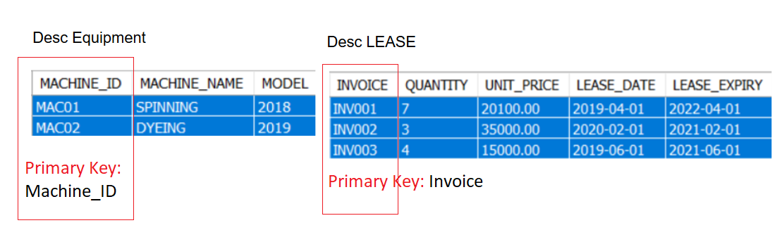
Tables after 2-NF

Slide 37
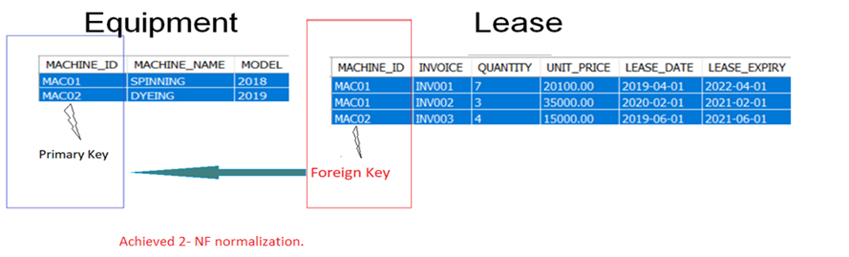
2-NF with referential integrity
Later after 2 - NF, add referential integrity using Foreign Key and primary key relationship.

Slide 38
Third Normal Form (3-NF):
To achieve 3-NF
The attributes of a table should already be in 2-NF, so full functional dependency was achieved already in 2- NF.
If any non-prime have transitive dependency, this is resolved with 3 - NF.
Transitive dependency is like attribute - A depends on attribute - B, then attribute - B depends on attribute - C and so on

Slide 39
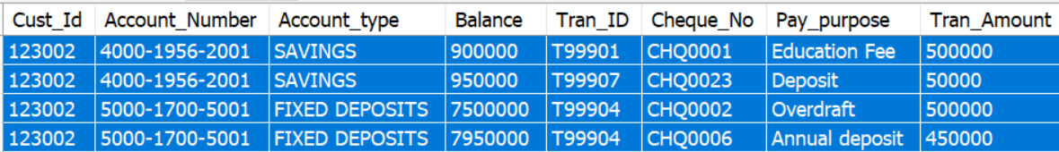
ACCOUNT_TRANSACTION : ( Before 3- NF)
SELECT * from ACCOUNT_TRANSACTION
In this table,
- Tran_amount , cheque_No , Pay_purpose dependent on Tran_id
- Tran_id is dependent on Account_Number
- Account_Number is dependent on Cust_id
- All non-prime attributes (Tran_amount , cheque_No , Pay_purpose )
are transitively dependent on super key(Cust_ID).
Hence violating the rule of third normal form.

Slide 40
3- NF
In order to achieve 3 - NF,
Split the ACCOUNT_TRANSACTION table into two
1. ACCOUNT
2. TRANSACTION
Eliminate transitive dependency (Tran_amount , cheque_No , Pay_purpose ) on Cust_Id
Resolve the redundancy of Data by using 3- NF

Slide 41
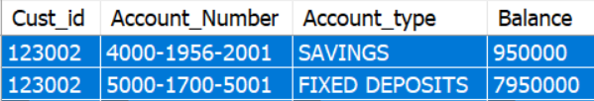
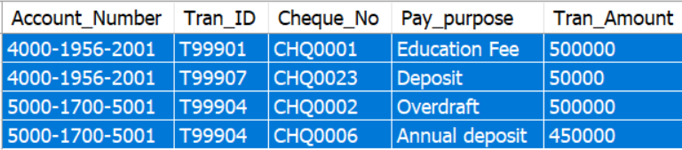
After 3- NF
Select * from ACCOUNT
Select * from Transaction

Slide 42
Boyce-Codd Normal form (BCNF)
BCNF resolves problems related to redundancy of data appeared in 3-NF
A 3 - NF table is split into DIMENSION and FACT tables and solves the problem of 3 - NF
3- NF issue arises when multiple sub-transactions appeared for single transaction.

Slide 43
After BCNF
To normalize using BCNF, we will create dimension and facts tables.
The Fact table data consists of unique records. E.g : Account and its corresponding Cheque issued details.
Dimension table consists of break up details of cheque. E.g:
Dimension:
A cheque is issued for payment of an Education fee. But the cheque is further divided the sum of money into fees, tax , cess amount . All of these are dimensions of single transaction.
Fact :
The high level records consists of cheque Number and its corresponding account.

Slide 44
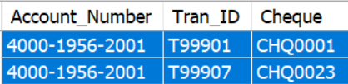
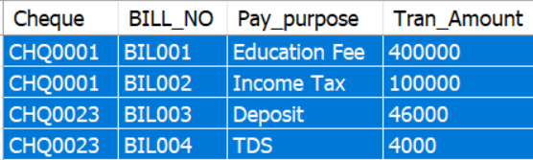
After BCNF
Select * from TRAN_DETAILS
Select * from CHEQUE_DETAILS

Slide 45
Constraints on Single Relation

Slide 46
Constraints on Single Relation
SQL Constraints are the rules used to limit the type of data that can go into a column/table
Constraints ensure the accuracy and integrity of the data inside the column/table
Constraints can be divided into the following two types,
Column level constraints: Limits only column level data values
Table level constraints: Limits complete table dataset

Slide 47
Constraints on Single Relation
Following are the most used constraints on Single relationship that are applied to Columns in a single table NOT NULL, DEFAULT
Other constraints like below will be discussed later.
UNIQUE
PRIMARY KEY
CHECK

Slide 48
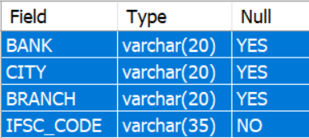
NOT NULL:
NOT NULL constraint restricts a column from having a NULL value
After applying NOT NULL constraint to column, you cannot pass a null value into that column
EX: ALTER TABLE BANKS Modify IFSC_CODE varchar(35) NOT NULL;
IFSC_CODE is changed its NULL property from “YES” to “NO” .
It means IFSC_CODE value must not be blank.

Slide 49

NOT NULL:
insert into BANKS values
('HDFC', 'HYDERABAD', 'KOTHAPET', NULL)

Slide 50
Column Check constraints

Slide 51
CHECK Constraint
CHECK constraint conditionally validates the column values before insertion of the record, and prevents from any unwanted entry of record.
ALTER table TRANSACTION ADD CHECK (
abs(Tran_Amount) < 2000000 ) ;
The table ensures that transaction amount is not exceeding more than the 2000000/- for any new entry of transaction.
Try:
Insert into TRANSACTION values
( '5000-1700-5001', 'T99305' , 'CHQ0022' , 'Cash Withdraw' , 2000009 ) ;

Slide 52
Entity Integrity

Slide 53
Entity Integrity
Entity Integrity ensures the rows are consistently receives the values without nulls and duplicates
To ensure the entity integrity, a primary key / UNIQUE without NULLS are defined on table columns
These constraints serves as a unique and non-null identifier for rows in the table

Slide 54
Uniqueness Constraints

Slide 55
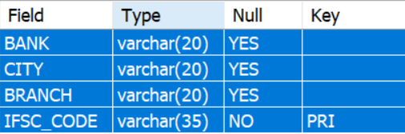
Uniqueness Constraints
UNIQUE constraint ensures a column will only have unique values
Eg:
ALTER TABLE BANKS ADD UNIQUE ( IFSC_CODE );
Along with Not NULL,
UNIQUE constraint added to IFSC_CODE will prevent adding duplicate values .

Slide 56

Uniqueness Constraints
Select * from BANKS
Try :
Insert into BANKS values
('HDFC', 'HYDERABAD', 'ABIDS' , 'HDFC0000145')

Slide 57
PRIMARY KEY:
Primary key constraint is defined on a column and it uniquely identifies each record in a table
A Primary Key by default creates an Index on a column. An index key is used for search records based on conditions
ALTER TABLE ACCOUNT ADD PRIMARY KEY (Account_Number) ;

Slide 58
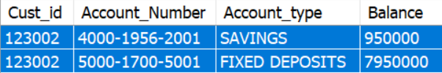
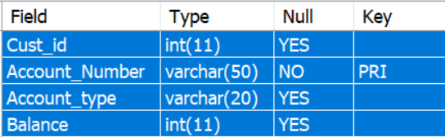
PRIMARY KEY:
Try :
INSERT INTO ACCOUNT VALUES
(123002, '4000-1956-2001', 'SAVINGS', 950000 );
Select * from ACCOUNT
Desc ACCOUNT

Slide 59
Referential Integrity Problems

Slide 60
Referential Integrity Problems
Enforcing referential integrity will cause limitations to its referenced tables on DML operations such as Insert, Delete and Update
Referential integrity constraints decreases the performance of DML operations as the SQL engine should refers to both the table which is being updated and as well as referenced tables

Slide 61
Referential Integrity problems
Referential integrities are overhead when exporting the tables from one database to other database
Problems like foreign key should be disabled and enabled after exporting
re-enabling foreign keys lost data integrity as it will not scan appropriately

Slide 62
Delete and Update Rules

Slide 63
Delete and Update Rules
Recapping :-
Foreign key constraints always references a primary or unique key
A foreign key value when assigned with NULL doesn’t references any primary key value in another table
But if foreign key has any valid value, then it must have an associated value in primary key
During any DML operation on Parent tables , there are different rules that effect on associated values in child tables

Slide 64
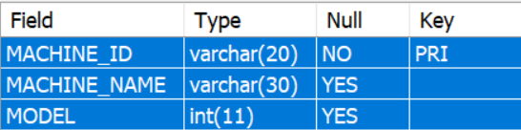
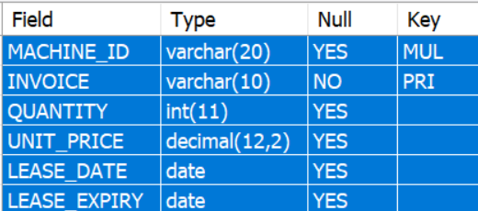
Rules on Updating Foreign Key
When updating foreign key column with a value that is not present in primary key column, it violates the referential integrity
Desc EQUIPMENT
Foreign Key ( MUL ) in LEASE table is referring Primary Key in EQUIPMENT .
Desc LEASE

Slide 65

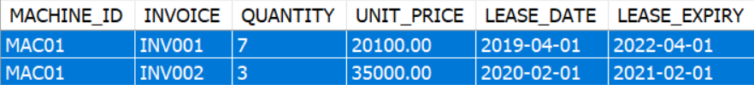
Rules on Updating Foreign Key
Primary Key table:
SELECT * FROM EQUIPMENT WHERE MACHINE_ID = 'MAC01'
Foreign key table
SELECT * FROM LEASE WHERE MACHINE_ID = 'MAC01'
Now, try updating the Foreign Key column value

Slide 66
Trying to update Foreign key
Try : update existing MACHINE_ID = 'MAC01' in LEASE table.
Update LEASE set MACHINE_ID = 'MAC09' where MACHINE_ID = 'MAC01'

Slide 67
Rules on Updating Primary Key
When updating Primary key column with a value that is not present in foreign key column, and violates the referential integrity
Trying to update Primary Key
Update EQUIPMENT
set MACHINE_ID = 'MAC09' where MACHINE_ID = 'MAC01'

Slide 68
Rules on deleting Primary Key records
Delete of a record in a parent table that is referenced by child’s foreign key columns
However, delete of a record in child table doesn’t effect in parent table
Trying to delete parent table record that is being referenced by foreign key
Try:
Delete from EQUIPMENT where MACHINE_ID = 'MAC01'

Slide 69
Cascaded, Deletes and Updates

Slide 70
Cascading:
To overwrite the DML rules on referential integrity fields, CASCADE is issued on the table having foreign key column
So that changes to parent table records are automatically reflected in child table
Cascading can be done for two types of DML statements
UPDATE CASCADE
DELETE CASCADE

Slide 71
ON UPDATE CASCADE
Before CASCADE
Update EQUIPMENT
set MACHINE_ID = 'MAC09' where MACHINE_ID = 'MAC01'
/* Drop the identified Lease foreign key in the above Error */
ALTER TABLE LEASE DROP FOREIGN KEY lease_ibfk_1 ;
/* Add foreign key again */
ALTER TABLE LEASE ADD
FOREIGN KEY(MACHINE_ID ) REFERENCES EQUIPMENT (MACHINE_ID ) ON UPDATE CASCADE;

Slide 72
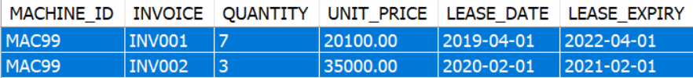
ON UPDATE CASCADE
Before Update
SELECT * FROM LEASE WHERE MACHINE_ID = 'MAC01'
/* Update */
Update EQUIPMENT
SET MACHINE_ID = 'MAC09' where MACHINE_ID = 'MAC01'

Slide 73
ON DELETE CASCADE
Before CASCADE
Delete from EQUIPMENT where MACHINE_ID = 'MAC99'
/* Drop the identified Lease foreign key in the above Error */
ALTER TABLE LEASE DROP FOREIGN KEY lease_ibfk_1 ;
/* Add foreign key again */
ALTER TABLE LEASE ADD
FOREIGN KEY(MACHINE_ID ) REFERENCES EQUIPMENT (MACHINE_ID )
ON UPDATE CASCADE
ON DELETE CASCADE ;

Slide 74


ON UPDATE CASCADE
Before Update
SELECT * FROM EQUIPMENT WHERE MACHINE_ID = 'MAC02’
SELECT * FROM LEASE WHERE MACHINE_ID = 'MAC02’
/* Delete */
DELETE FROM EQUIPMENT WHERE MACHINE_ID = 'MAC02'
SELECT count(*) FROM LEASE WHERE MACHINE_ID = 'MAC02'

Slide 75
Referential cycles

Slide 76
Cycle of Referential Integrity constraints
In a parent and Child table relationship,
the primary key of child table references the primary key of the parent table.
At same time, primary key of parent table references the primary key of the child table.
So they form a loop of referential integrity constraints across the parent & child tables using their respective keys.

Slide 77
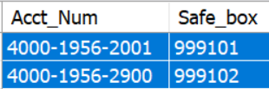
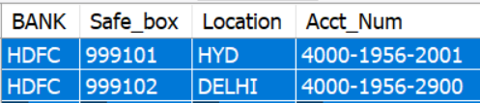
Example
Select * from ACCT_LOCKER
Acct_Num: primary Key
Select * from BANK_LOCKER
Safe_box : primary Key

Slide 78
Deferred Constraints

Slide 79
Deferred Constraints
During large volume of transactions involving multiple dependencies, it is often difficult to process data efficiently due to the restrictions imposed by the constraints
In order to override such constraints, to some extent DEFERRED constraints came into existence

Slide 80
Example
Update of a primary key (PK) which is referenced by foreign keys (FK)
In a primary key - foreign key relationship tables, parent table cannot update its primary key as it violates the referential integrity
Similarly, child table cannot update its foreign key which may violates its parent table.
The status is NOT DEFERRED and is default by SQL engine

Slide 81
Example
Overriding the NON DEFERRED constraints with DEFERRED constraints
These DEFERRABLE keyword can be defined in two ways
One INITIALLY IMMEDIATE and other as INITIALLY DEFERRED
INITIALLY IMMEDIATE updates the records directly onto database
INITIALLY DEFERRED do not updates the records directly onto database rather it keeps the records in Logs . So that they can commit onto database later

Slide 82
Example
ALTER TABLE ACCOUNT_TRANSACTIONS
ADD constraint ACCOUNT_tran_init_imm
FOREIGN KEY (Acct_Num) REFERENCES
ACCOUNT(Account_NUMBER) DEFERRABLE INITIALLY
IMMEDIATE;
ALTER SESSION SET CONSTRAINTS = DEFERRED;

Slide 83
Trying to update Foreign key
Update `ACCOUNT_balance_det`
SET Acct_Num = '9999-9999-9999' where account_number = '4000-1956-3456'
Defer works are primarily used for Cyclic Foreign Keys under a scenario like
Inserting a record in one table expects the record present in other table .

Slide 84
Trying to update Foreign key
Usually the below insert will not work as they are referenced each other with primary - foreign keys
Alter session as Deferred to allow insertions
ALTER SESSION SET CONSTRAINTS = DEFERRED;
Insert into ACCOUNT_Locker values ( '4000-1956-2900' , 999102 ) ;
Insert into Bank_Locker values ( 999102 , 'DELHI', '4000-1956-2900' ) ;

Slide 85
Thank You

