Slide 1
Subqueries with Joins and Advanced Aggregate Functions

Slide 2
Agenda
Subqueries and Joins
Advanced Aggregate Function
Rank()
Dense_Rank()
Percent_rank()
LAG() & LEAD() Function
First_Value()
Last_Value()
NTILE()
CUME_DIST()
Recursive Query Expression

Slide 3
Subqueries and Joins
Subquery and JOIN perform the execution of queries similarly and retrieves the same output but varies with below features

Slide 4
Subqueries and Joins
Subqueries separate the complex logic from the main query whereas JOINs enclose all the logic in the main query
Subqueries can be used along with JOINS in many ways and will see with examples
Calculations can be done in the subquery and return as single value whereas JOIN query performs the calculation in main SELECT query
Priority of filtering the records in a table is possible via subquery, whereas filtering the records is managed automatically by JOIN query

Slide 5

Subqueries and Joins
The resultant output of the SubQuery and JOIN is same
Subquery
JOIN Query
Select Acct_Num, Tran_Amount
FROM Transaction
WHERE Tran_Date in
(Select Event_dt
FROM Message
WHERE Event_dt between '2020-04-01' and '2020-06-01' );
Select Acct_Num, Tran_Amount
FROM Transaction, Message
WHERE Tran_Date = Event_dt AND Event_dt between '2020-04-01' and '2020-06-01'

Slide 6
Row-valued Expression

Slide 7
Row values are specified together with a series of column values
The Row values are expressed in several ways
A list of scalar/column values separated by comma and parenthesized
Retrieving a set of two or more column results from database
Row-valued Expression

Slide 8
These Row values are used in many contexts like:
In DML statements like INSERT
In comparison expressions of WHERE clause
Refer subquery results in another query using comparative operators like
<, <=, >, >=, =, <>, IS, IS NOT, IN, NOT IN, BETWEEN,.
Row-valued Expression

Slide 9
Row value expression in an INSERT statement:
Here, multiple rows can be inserted using one single INSERT statement
Whereas other RDBMS still expects to INSERT statement for each row
Row-valued Expression
INSERT INTO CUSTOMER VALUES
(123009, 'Renee', '3305-1, San-Fran', 'SFO', 1677617700 ),
(123010, 'Holly', '3225-2, Concord', 'NJ' , 1673547700 );

Slide 10
Row value expression in an equality comparison
Here multiple columns ( cust_id, Address) are assigned with its corresponding values respectively, in order to select rows from the CUSTOMER table
Row-valued Expression
SELECT * FROM CUSTOMER WHERE (Cust_Id, Address) = (123010 ,'3225-2, Concord')

Slide 11
Row value expression in a subquery referred by Select or update statements:
The main query of Account table is using multiple columns to search its corresponding rows in the subquery using IN operator
Row-valued Expression
SELECT *
FROM ACCOUNT
WHERE (ACCT_NUM, BALANCE ) IN (SELECT ACCT_NUM, TRAN_AMOUNT
FROM TRANSACTION )

Slide 12

Data type like integer, character & date format should match when the columns of main Query are compared with subquery used in an IN operator

Slide 13
Rules for row - valued expression using INSERT statement:
NULLS are accepted in columns of VALUES expression
Columns in VALUES clause will not support default values which were defined at table level
When an INSERT statement is need for inserting huge number of rows, it is advised to use import methods from a file to table

Slide 14
Rules for row - valued expression using IN operator and JOIN clauses
Indexes of single columns of row valued expressions become unused when these are represented in JOINS

Slide 15
Query Expressions

Slide 16
Query expression defines search criteria of a pattern from a string of characters.
These expressions can be used in WHERE clause conditions to filter the rows based on matching patterns.
Analytics uses these expressions to retrieve the text at granular level. So that these expressions identifies the partial text entries.
Sometimes the expressions detect the patterns based on vowel sounds. So that users can identify the words with different meaning but same pronunciation.
Query Expression

Slide 17

LIKE clause identifies the rows based on a partition of pattern matching
Query Expression
SELECT * FROM CUSTOMER WHERE Name LIKE 'Ja%';
Wild character ‘%’ is used along with LIKE clause to retrieve all records with customer Name having prefix ‘Ja……’

Slide 18

SOUNDEX() - Function used to identify the word with different meaning but same pronunciation
Query Expression
SELECT SOUNDEX('JACOB') , SOUNDEX( 'JAKOB');
It best helps analytics to understand people’s native language influence on few words

Slide 19
INSTR() - Function used to identify the position of a small portion of pattern in a complete string
E.g : SELECT INSTR('Enterprise Data Analytics' , 'Data')
Output: 12
REPLACE() - Replace Data with Functional in below string
E.g : SELECT REPLACE('Enterprise Data Analytics', 'Data', 'Functional')
Output: Enterprise Functional Analytics
Query Expression

Slide 20
CAST() - Function is used to change one data type to other data type
E.g: Change type of Char to Date
SELECT CAST('2003-01-01' AS DATE )
Here the date is in character format and CAST() function is used to change the data type to date which is system understandable format
Query Expression

Slide 21
CONVERT() - This function also works similar to CAST , while CAST is ANSI function, CONVERT is used in commercial RDBMS
E.g: Change type of Char to Date
SELECT CONVERT ('2003-01-01' , DATE )
Query Expression

Slide 22
Advanced Aggregate Functions

Slide 23
Many RDBMS provides Analytical functions to perform complex operations and evaluate the results efficiently
Analytical functions reduces the use of JOINS as these perform many self join operations on same database table
Analytical functions are otherwise called as windowing or Online Analytical Processing (OLAP) functions
Advanced Aggregate Functions

Slide 24
The Window/ Analytical function uses OVER() clause to calculate aggregate results on group of rows based on candidate key
The aggregate result thus produced from group of rows is again shared for each row in the group
This is an advanced feature of GROUP BY clause by sharing aggregate result at row level
Advanced Aggregate Functions

Slide 25
Reporting shows the comparison between current record entry with aggregate result
Build statistics on the cumulative results rather than aggregate results
More granular level of cost controlling in Financial organization whereas strategic reports are usually generated by GROUP by clauses as they show overall financial performance
Advanced Aggregate Functions - Benefits

Slide 26
The ranking functions assign a rank for each row in an ordered group of rows
The rank is assigned to rows in a sequential manner
The assignment of rank to each of the rows always start with 1 for every new partition
There are 3 types of ranking functions supported in MySQL-
rank()
dense_rank()
percent_rank()
Window Functions - Ranking

Slide 27
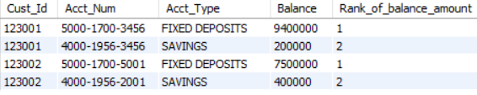
Displays the rank for each record based on highest value of a desired column by calculating on group of rows divided by corresponding candidate key
SELECT Cust_Id, Acct_Num, Acct_Type, Balance,
RANK() OVER( PARTITION BY Cust_Id ORDER BY Balance desc ) AS Rank_of_balance_amount
FROM ACCOUNT
WHERE Cust_Id in ( 123001 , 123002 )
Rank() Function

Slide 28
In this example, Over() clause groups the rows based on candidate key: CUST_ID
For each group of rows, “order by” clause sorts the column: Balance in a descending order
Rank() is a open-closed bracket function that gives the rank for all balances maintained by customer in different accounts
Rank() Function

Slide 29
Display similar rank for equal values in a column
# Insert a record for this example
INSERT INTO ACCOUNT VALUES
(123004, '5000-1899-6092','FIXED DEPOSITS' , 7500000 , 'ACTIVE' , 'S' ) ;
# Example :
SELECT Cust_Id, Acct_Num, Acct_type, Balance,
RANK() OVER(PARTITION BY Cust_Id ORDER BY Balance desc ) AS Rank_of_balance_amount
FROM ACCOUNT
WHERE Cust_Id in ( 123004 )
Rank() Function

Slide 30

Output:
For Cust_Id: 123004 , there are equal balance amounts for two of its FIXED DEPOSIT accounts in the descending order
Hence the same rank - (1) is assigned for both the FIXED DEPOSIT accounts, but skipped the rank -(2). and assigns rank - (3) for the next balance in descending order
Rank() Function

Slide 31
Rank() function will keep skipping the subsequent ranks based on the count of similar column values
No. of Ranks skipped = No. of gaps between similar column values

Slide 32
Dense_rank displays the rank based on highest value of a desired column, but it preserves the rank for next following record without skipping
SELECT Cust_Id, Acct_Num, Acct_type, Balance,
DENSE_RANK() OVER (PARTITIoN BY Cust_Id ORDER BY Balance desc) AS Dense_rank_of_balance
FROM ACCOUNT
WHERE Cust_Id = 123004
Dense_Rank() Function

Slide 33

Output:
In this example, Dense_Rank() function assigns the same rank - (1) when the balance : 7500000 is identified same for two different accounts. But it preserved the rank - (2) without skipping it
So, the Dense_rank() will not skip any rank
Dense_Rank() Function

Slide 34
While the partitioned rows are in ascending order, the percent_rank () calculates the percentage of rank basis on formula: (rank - 1) / ( rows - 1)
Eventually, all of the rows in a partition shares a range of fraction from 0 - 1
Percent_Rank() Function
#Insert record
INSERT INTO ACCOUNT VALUES
( 123004 ,'5000-8800-9977', 'FIXED DEPOSITS', 755000, 'ACTIVE', 'S' )
#Example
SELECT Cust_Id, Acct_Num, acct_type, Balance, PERCENT_RANK()OVER ( PARTITION BY Cust_Id ORDER BY balance) AS Percent_rank_of_balance FROM ACCOUNT
WHERE Cust_Id = 123004

Slide 35
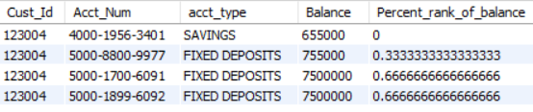
Output:
Percent_Rank() Function

Slide 36
Percent_rank() also skips the rank percentage when identified with duplicate values
Percent_Rank() Function
#Insert record
INSERT INTO Account VALUES(123004,'6000-3300-9222', 'FIXED DEPOSITS', 9025300, 'ACTIVE', 'S')
#Example:
SELECT Cust_Id, Acct_Num, acct_type , balance , percent_rank() OVER( Partition by Cust_Id order by balance ) AS Percent_rank_of_balance
FROM Account
WHERE Cust_Id = 123004

Slide 37
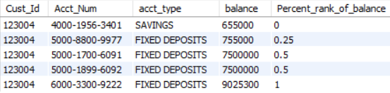
Output:
Percent_Rank() Function

Slide 38
In a normal select query , all records are interpreted serially; Sometimes there is a need to look back and forth while you are retrieving the current record in SELECT query
LAG() and LEAD() Function
SELECT Cust_Id, Acct_Num, Acct_Type , Balance ,
LAG (Balance) OVER(ORDER BY Balance) previous_balance,
LEAD(Balance) OVER (ORDER BY Balance) next_balance
FROM Account
WHERE Cust_Id = 123004

Slide 39
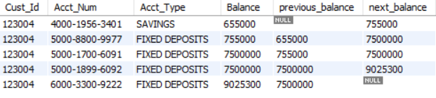
Output:
In this example, the current record shows its previous record balance and its next record balance
‘previous _balance’ is Null if no records exist. Similarly, next_balance is Null if there are no further records
LAG() and LEAD() Function

Slide 40
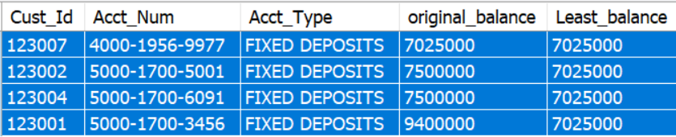
FIRST_VALUE () function analyzes the results of analytical expression which is defined as OVER(),
and then returns the first value from the ordered set of rows.
Here, OVER() expression is defined with Order clause only.
E.g :
Select Cust_Id, Acct_Num, Acct_Type, Balance original_balance,
FIRST_VALUE (Balance) OVER( order by Balance ) Least_balance
FROM Account
where acct_type = 'FIXED DEPOSITS'
In this example, the original balance of the ACCOUNT table is placed in an order in OVER() expression.
Later , the first_Value () has chosen the least balance out of all FIXED DEPOSITS, and displayed it across all records in total output.
FIRST_VALUE() using order by

Slide 41
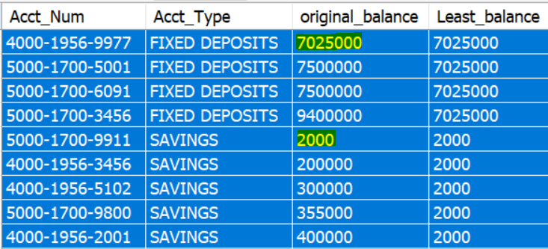
FIRST_VALUE () function analyzes the results of analytical expression which is defined as OVER(),
and then returns the first value from the ordered set of rows.
Here, OVER() expression is defined with partition by and Order by clauses
E.g :
Select Acct_Num, Acct_Type, Balance original_balance,
FIRST_VALUE (Balance)
OVER( partition by Acct_type order by balance) Least_balance
FROM Account
where balance > 0 ;
FIRST_VALUE() using Partition and order clauses

Slide 42
In this example,
Initially, all of the table rows are partitioned into FIXED DEPOSITS and SAVINGS using ACCT_TYPE column.
Secondly, the two partitioned rows that are FIXED DEPOSITS and SAVINGS are ordered separately based on their respective balance values.
- Finally, the first_Value () is applied on the individual partitioned rows and chooses the least balance from each of partition and displays it across the partitioned rows.
FIRST_VALUE() using Partition and order clauses

Slide 43
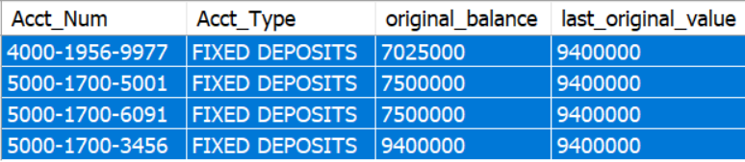
FIRST_VALUE () function analyzes the results of analytical expression which is defined as OVER(),
and then returns the last value from an ordered set of rows.
Here OVER() expression is defined with Order clause and additionally it uses a range of values.
E.g:
Select Acct_Num,
Acct_Type, Balance AS original_balance,
LAST_VALUE(Balance)
OVER( order by Balance
RANGE BETWEEN
UNBOUNDED PRECEDING AND
UNBOUNDED FOLLOWING ) AS last_original_value
FROM ACCOUNT
WHERE Acct_type = 'FIXED DEPOSITS';
LAST_VALUE() using Range of values in a row order

Slide 44
In this example,
Initially, all of the table rows are ordered by using Balance column values.
Secondly, RANGE between unbounded PRECEDING and FOLLOWING is used to define the range of values that are returned in an ordered set of rows.
Finally, the last_Value () choses the last value from the range in an order set of rows and then assigns the last value across each record in the total output.
LAST_VALUE() using Range of values in a row order

Slide 45
FIRST_VALUE () function analyzes the results of analytical expression which is defined as OVER(),
and then returns the last value from an ordered set of rows.
Here OVER() expression is defined with Order clause and additionally it uses a range of values.
E.g:
Select Acct_Num,
Acct_Type, Balance AS original_balance,
LAST_VALUE(Balance)
OVER( Partition by ACCT_TYPE order by Balance
RANGE BETWEEN
UNBOUNDED PRECEDING AND
UNBOUNDED FOLLOWING ) AS part_last_value
FROM ACCOUNT
WHERE balance > 0
LAST_VALUE() using partition and Range order

Slide 46
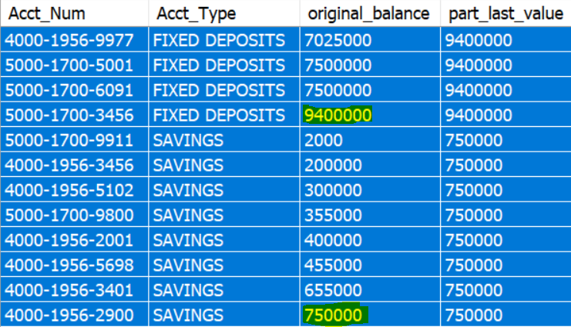
In this example,
Initially, all of the table rows are initially partitioned by ACCT_TYPE and then ordered by using Balance column values.
Secondly, RANGE between unbounded PRECEDING and FOLLOWING is used to define the range of values that are returned in an ordered set of rows.
Finally, the last_Value () choses the last value from the range in an order set of rows from each partitions: FIXED DEPOSITS and SAVINGS, and then displays the last value across each record in the partition.
LAST_VALUE() using partition and Range order

Slide 47
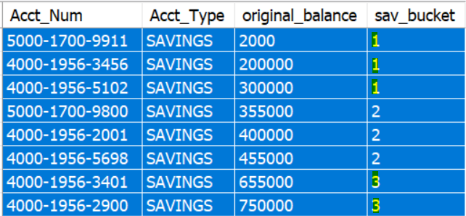
NTILE () function analyzes the results of analytical expression which is defined as OVER().
NTILE () splits the total records into predefined number of buckets.
E.g:
Select Acct_Num,
Acct_Type, Balance AS original_balance,
NTILE(3)
OVER( order by Balance
) AS sav_bucket
FROM ACCOUNT
WHERE Acct_type = 'SAVINGS' and balance > 0 ;
Here,
NTILE is defined with “3” by the developer.
The last bucket - 3 is created with remaining left over records after all the rows are divided equally by Ntile value -3 .
NTILE() categorize the records into buckets

Slide 48
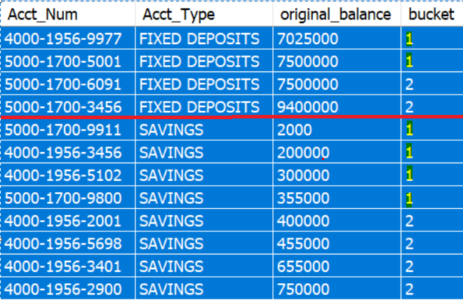
NTILE () splits the total records into predefined number of buckets within each sorted partition results in OVER() expression.
E.g:
Select Acct_Num,
Acct_Type, Balance AS original_balance,
NTILE(2)
OVER( partition by ACCT_TYPE
order by Balance
) AS bucket
FROM ACCOUNT
WHERE balance > 0 ;
Here, the buckets are created within the partitioned rows: FIXED DEPOSITS and SAVINGS
NTILE() with partitioning clause

Slide 49
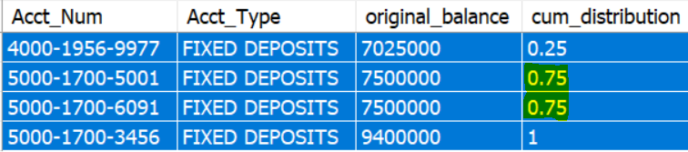
Distribution of records means - the percentage of a record occupied in the total record set.
Cumulative distribution means , the cumulative percentage of records from first to current row is calculated out of total result.
E.g:
Select Acct_Num,
Acct_Type,
Balance AS original_balance,
CUME_DIST()
OVER( order by Balance ) AS cum_distribution
FROM ACCOUNT
WHERE acct_type = 'FIXED DEPOSITS';
Here, the first record has occupied 25% , and the 2nd and 3rd record values are same.
Hence it displays 75% for both the records . Otherwise 2nd record is displayed as 50%.
CUME_DIST() - Cumulative distribution

Slide 50
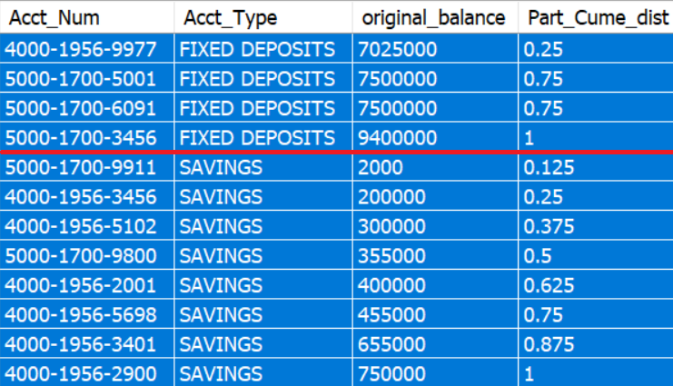
Cumulative distribution means , the cumulative percentage of records from first to current row is calculated in a partitioned result set.
E.g:
Select Acct_Num,
Acct_Type,
Balance AS original_balance,
CUME_DIST()
OVER( partition by ACCT_TYPE
order by Balance ) AS Part_Cume_dist
FROM ACCOUNT
WHERE balance > 0;
Here, cumulative distribution is calculated for each partition : FIXED DEPOSIT and SAVINGS.
CUME_DIST() - Cumulative distribution for partitions

Slide 51
Grouping functions can be used by Window functions to retrieve aggregate results and compare against each of the rows in a group
Aggregate Functions with Window Functions
SELECT Cust_Id, Acct_Num, Acct_Type, Balance, SUM(Balance) OVER ( partition by Cust_Id ) AS customer_level_balance
FROM ACCOUNT
WHERE CUST_ID in ( 123001, 123002 , 123004)

Slide 52
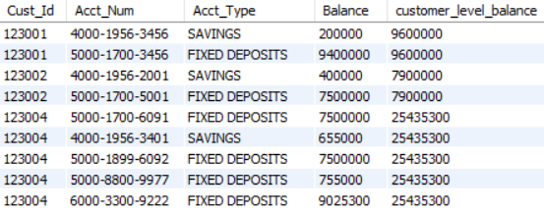
Output:
In this example, SUM is grouping function calculates aggregate sum of balance for each Cust_Id. This aggregate SUM result is displayed for each row and is useful for further analytics
Aggregate Functions with Window Functions

Slide 53
Similarly other grouping functions like below can be used along with analytical functions:
AVG()
MIN()
MAX()
Aggregate Functions with Window Functions

Slide 54

Analytical functions are widely used in organizations ,because it reduces the number of calls to the same table. Especially when there is a need for SELF Join
The performance of the Query is high because it consumes less CPU utilization for mapping of rows between tables. However, it depends on the business logic
Cumulative calculations are also performed in GROUP by clauses, but it is difficult move across the rows among the group

Slide 55
Cross-Tab and Relational Tables

Slide 56
Cross tabulation of relational database displays the columns as rows and rows as columns
Hence cross - table is multi-dimensional structure of rows and columns which can pivot the rows vertically and columns horizontally
This kind of multi - dimensional structured / cross table displays strategic reports with summarized data
Cross-Tab and Relational Tables

Slide 57
The cross table can display grand totals for columns, rows, or for the whole measure
It can also display subtotals for columns, or show images on the horizontal or vertical axis
Cross-Tab and Relational Tables

Slide 58
Cross - tabular calculation is the form presenting the count of transactions in a tabular form
Especially, it is used for developing trend reports with aggregate reports
Cross-Tab and Relational Tables
SELECT monthname(T.Tran_Date) as "Month",
count(case when T.Channel= 'ATM Withdrawal' THEN 1 END) ATM_transaction,
count(case when T.Channel = 'UPI transfer' THEN 1 END) UPI_transaction,
count(case when T.Channel = 'Net banking' THEN 1 END) net_banking,
count(case when T.Channel = 'Bankers cheque' THEN 1 END) bankers_cheque,
count(case when T.Channel = 'ECS transfer' THEN 1 END) ECS_transfer,
count(case when T.Channel = 'Cash Deposit' THEN 1 END) Cash_deposit
FROM Transaction T
GROUP BY month(T.Tran_Date)

Slide 59
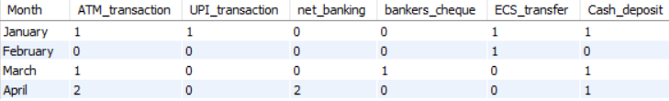
Output:
In this example, bank is measuring the total number of transactions done through each channel in various months
Cross-Tab and Relational Tables

Slide 60
Recursive Query Expression

Slide 61
To report hierarchical structured data
The recursive queries follows a chain process of identifying the relationships between the relevant columns
The query expression is defined with a sub - query using RECURSIVE clause
This query iterates between main query and the sub-query with predefined number of times
There should be a terminating condition to recursive expression
Recursive Query Expressions

Slide 62
Generate the report showing hierarchical family relationship between the customers
Recursive Query Expressions
Create following table for this exercise
CREATE TABLE CUSTOMER_HOUSEHOLD
( Cust_Id INT, NAME VARCHAR(20), PARENT_NAME VARCHAR(20));
INSERT INTO CUSTOMER_HOUSEHOLD VALUES
(123000, 'GEFF', NULL ),
(123001, 'MARK', 'GEFF' ),
(123002, 'CHARLIE' , 'MARK' ) ,
(123003, 'CRISTY' , 'MARK' ) ,
(123004, 'SARAH', 'GEFF' ),
(123005, 'ROBERT' , 'SARAH') ,
(123006, 'ANDY' , 'SARAH') ;

Slide 63
WITH RECURSIVE Family ( NAME, PARENT_NAME, Hierarchy) AS
(SELECT Name, Parent_name, CAST(Name AS CHAR(200))
FROM CUSTOMER_HOUSEHOLD
WHERE Parent_Name IS NULL
UNION ALL
SELECT ch.Name, ch.Parent_Name, CONCAT(cf.Hierarchy, ",", ch.name)
FROM Family cf
JOIN CUSTOMER_HOUSEHOLD ch
ON cf.name = ch.parent_name)
SELECT * FROM Family ORDER BY Hierarchy;
Recursive Query Expressions

Slide 64
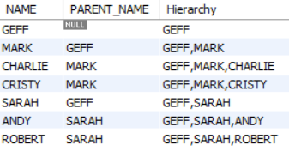
Output:
WITH RECURSIVE is the clause
The query expression is defined with a sub - query using RECURSIVE clause
This query iterates between main query and the sub-query with predefined number of times
There should be a terminating condition to recursive expression
Recursive Query Expressions

Slide 65

Thank You

