Slide 1
Introduction to DBMS

Slide 2
Agenda
Introduction to DBMS and RDBMS
Key attributes
Introduction to SQL
Data Types
SQL Commands
- DDL
- DML
- DQL
- Select Statements

Slide 3
What is DBMS?
DBMS stand for Database Management Systems
These are systems to store, retrieve or ,sometimes, manipulate data
Developed to handle large amount of data

Slide 4
Why DBMS?
Consider a bank that maintains customer’s account details, employee details, bank device details, etc.
This details needs to be stored in such a way that it can be added, deleted, updated and retrieved from one place
DBMS is a software designed for this type of operations

Slide 5
RDBMS

Slide 6
What is RDBMS?
RDBMS stand for Relational Database Management Systems
RDBMS allows to store, retrieve or manipulate data, but in a more efficient way than DBMS
Apart from rows and columns the RDBMS table has following components
Domain
Instance
Schema
Keys

Slide 7
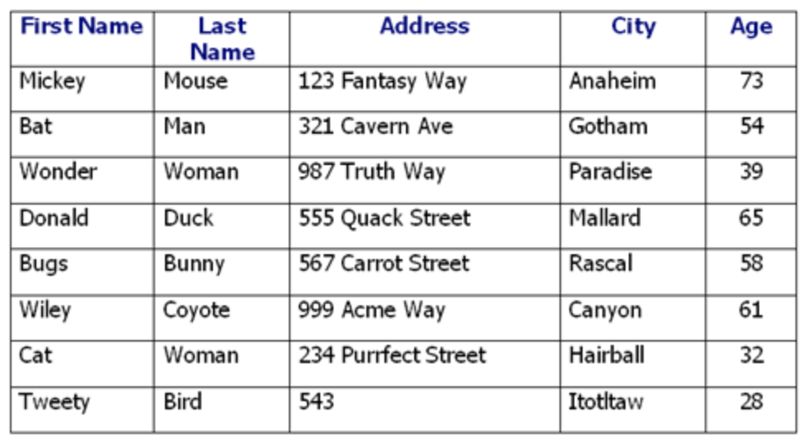
A database table
A database consists of one or more tables
A table is the most significant component in an RDBMS
A table is where all data is stored
A table constitutes of rows & columns
Each column represents attributes of the entity

Slide 8
A record in a table
Each row in a table is a record/tuple
Each record is all of the information for each object, say a person or a product

Slide 9
A column in a table
Each column in a table is an attribute
This gives one piece of information about the attribute. For example, last name of a customer

Slide 10
Keys
A key is a data item (a column or a set of column) to uniquely identify a record in a table
It is used to fetch a single or a set of records from a table
Keys can also provide several types of useful constraints. For example, a unique key constraint can help avoid enter a duplicate value

Slide 11
Keys
A database supports various types of keys. Some of them are
Candidate key
Primary key
Foreign key
Unique key
Alternate key

Slide 12
Structured Query Language (SQL) Basics

Slide 13
SQL Introduction
The commands available in SQL can be broadly categorised as follows:
Data Definition Language (DDL)
Data Manipulation Language(DML)
Data Query Language (DQL)
Data Control Language (DCL)
Transactional Control Language (TCL)

Slide 14
Types of SQL Commands
SQL Commands
DDL
Data Definition Language
DML
Data Manipulation Language
DQL
Data Query Language
DCL
Data Control Language
TCL
Transactional Control Language
Create
Insert
Select
Grant
Commit
Roll Back
Alter
Update
Revoke
Save point
Drop
Delete
Set Transaction
Truncate

Slide 15

Types of SQL Commands
SQL Commands
DDL
Data Definition Language
DML
Data Manipulation Language
DQL
Data Query Language
DCL
Data Control Language
TCL
Transactional Control Language
Create
Insert
Select
Grant
Commit
Roll Back
Alter
Update
Revoke
Save point
Drop
Delete
Truncate
Set Transaction

Slide 16
Data Definition Language (DDL)

Slide 17
Data Definition Language (DDL)
A database is a collection of many tables, and a database server can hold many of these databases
Database Server —> Databases —> Tables (defined by columns) —> Rows
Databases and tables are referred to as database objects
Any operation, such as creating, modifying, or deleting database objects, is called Data Definition Language (DDL)

Slide 18
Data Definition Language (DDL)
DDL is used to create a new schema as well as to modify an existing schema
The typical commands available in DDL are:
CREATE
ALTER
DROP
TRUNCATE

Slide 19
Create Database

Slide 20
DDL - CREATE DATABASE- Syntax
The CREATE DATABASE statement is used to create a new SQL database
Syntax:
CREATE DATABASE databasename;
The semicolon character (;) is a SQL statement terminator
To create tables in the database you need to first select the database. Use the following syntax to select the database:
USE databasename;

Slide 21
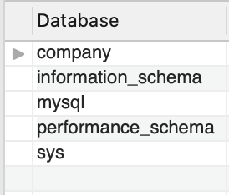
DDL - CREATE DATABASE - Example
We will create a database called company
CREATE DATABASE company;
Use SHOW DATABASES to check if the database company has been CREATED
The database company is now created
Default system databases

Slide 22
Drop Database

Slide 23
DDL - DROP DATABASE - Syntax
The DROP DATABASE statement is used to drop an existing SQL database
Syntax:
DROP DATABASE databasename;
Database name

Slide 24
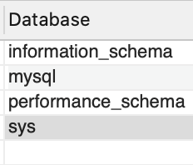
DDL - DROP DATABASE - Example
The following SQL statement drops the existing database "company":
DROP DATABASE company;
Use SHOW DATABASES or EXEC SP_DATABASES to check if the database company has been DROPPED
We see the database company is now dropped

Slide 25
Create Tables

Slide 26
Prerequisites for Creating Tables
To create and maintain table, you need a database
While defining columns in a table, you should mention:
the name of the columns,
datatype (integer, floating point, string, and so on), and
default value (if any)
Let’s take a look at data types before we create table

Slide 27
Data Types

Slide 28
Built - in Data Types
Numeric: TINYINT, SMALLINT, MEDIUMINT, INT, BIGINT, and BIT
Floating numbers: DECIMAL, FLOAT, and DOUBLE
Strings: CHAR, VARCHAR, BINARY, VARBINARY, BLOB, TEXT, ENUM, and SET
Date and Time: DATE, TIME, DATETIME, TIMESTAMP, and YEAR

Slide 29
Every relational database has its own maximum and minimum size limit for different data types, you don’t need to remember the limit. Idea is to have the knowledge of what data type to be used in a specific scenario

Slide 30
Numeric - Data Types
Datatype | From | To
Bit | 0 | 1
Tinyint | 0 | 255
Smallint | -32.768 | 32.767
mediumint | -8388608 | 8388607
int | -2,147,483,648 | 2,147,483,647
bigint | -9,223,372,036,854,775,808 | 9,223,372,036,854,775,807

Slide 31
Floating Numbers
Datatype | From | To
Decimal | -10^38 +1 | 10^38 -1
Float | -1.79E + 308 | 1.79E + 308

Slide 32
Strings
Datatype | Description
CHAR | Fixed length with maximum length of 8,000 characters
VARCHAR | Variable length storage with maximum length of 8,000 characters
BINARY | Fixed length with maximum length of 8,000 bytes
VARBINARY | Variable length storage with maximum length of 8,000 bytes
BLOB | For binary large objects
TEXT | Variable length storage with maximum size of 1GB data

Slide 33
Date and Time
Datatype | Description
DATE | Stores date in the format YYYY-MM-DD
TIME | Stores time in the format HH:MI:SS
DATETIME | Stores date and time information in the format YYYY-MM-DD HH:MI:SS
TIMESTAMP | Stores number of seconds passed since the Unix epoch (‘1970-01-01 00:00:00’ UTC)
YEAR | Stores year in 2 digit or 4 digit format. Range 1901 to 2155 in 4-digit format. Range 70 to 69, representing 1970 to 2069.

Slide 34
CREATE TABLE - Syntax
The CREATE TABLE statement is used to create a new table in a database
Syntax:
CREATE TABLE table_name (
column1 datatype,
column2 datatype,
column3 datatype,
....);
The column parameters specify the names of the columns of the table
The datatype parameter specifies the type of data the column can hold (e.g. varchar, integer, date, etc.).

Slide 35
CREATE TABLE - Example
We will create a customers table, which will hold the customers information
The table will have the following columns in it
CustomerID
FirstName
LastName and
Country

Slide 36
CREATE TABLE - Example
We will create a table “customers” in the company database. Select the database ‘company’ using USE company command
CREATE TABLE customers(
CustomerId int,
first_name varchar(20),
last_name varchar(20),
country varchar(20)
);
It is declared as an integer since it contains only integers
first_name, last_name, and country: They contain strings, so they are defined as varchar

Slide 37
Drop Table

Slide 38
DROP TABLE - Syntax
The DROP TABLE statement is used to drop an existing table in a database
Syntax:
DROP TABLE table_name;

Slide 39
Be careful before dropping a table. Deleting a table will result in loss of complete information stored in the table!!!!

Slide 40
DROP and TRUNCATE TABLE - Example
The following SQL statement drops the existing table "company":
DROP TABLE customers;
The TRUNCATE TABLE statement is used to delete the data inside a table, but not the table itself
TRUNCATE TABLE customers;

Slide 41
Data Manipulation Language (DML)

Slide 42
Data Manipulation Language (DML)
As a data analyst, the majority of your work will focus on insight generation, and you will be working with DML commands
The typical commands available in DML are:
INSERT
UPDATE
DELETE

Slide 43
INSERT

Slide 44
SQL INSERT - Syntax
The INSERT INTO statement is used to insert new records in a table
It is possible to write the INSERT INTO statement in two ways
The first way specifies both the column names and the values to be inserted
Syntax:
INSERT INTO table_name (column1, column2, column3, ...)
VALUES (value1, value2, value3, ...);

Slide 45
SQL INSERT - Syntax
Another way to insert values can be in the following manner where we do not use the column names:
Syntax:
INSERT INTO table_name VALUES (value1, value2, value3,...);
Make sure the order of the values is in the same order as the columns in the table

Slide 46
UPDATE

Slide 47
SQL UPDATE - Syntax
The UPDATE statement is used to modify the existing records in a table
Syntax:
UPDATE table_name
SET column1 = value1, column2 = value2, ...
WHERE condition;

Slide 48
Be careful when updating records in a table! Notice the WHERE clause in the UPDATE statement. The WHERE clause specifies which record(s) that should be updated. If you omit the WHERE clause, all records in the table will be updated!

Slide 49
DELETE

Slide 50
SQL DELETE - Syntax
The DELETE statement is used to delete existing records in a table
Syntax:
DELETE FROM table_name WHERE condition;

Slide 51
Be careful when deleting records in a table! Notice the WHERE clause in the DELETE statement. The WHERE clause specifies which record(s) should be deleted. If you omit the WHERE clause, all records in the table will be deleted!

Slide 52
Data Query Language (DQL)

Slide 53
SELECT Statement - Syntax
The SELECT statement is used to retrieve data from a table
The data returned is stored in a result table, called the result-set
Syntax:
SELECT column1, column2, … FROM table_name;

Slide 54
SELECT Statement - Syntax
column1, column2, ... are the field names of the table you want to select data from
If you want to select all the fields available in the table, use the following syntax
SELECT * FROM table_name;

Slide 55
WHERE Clause- Syntax
The WHERE clause is used to filter records
The WHERE clause is used to extract only those records that fulfill a specified condition
Syntax:
SELECT column1, column2, … FROM table_name WHERE condition;

Slide 56
The WHERE clause is not only used in SELECT statement, it is also used in UPDATE, DELETE statement, etc.!

Slide 57
Operators in the WHERE Clause
The following operators can be used in WHERE clause
Operator | Description
= | Equal
> | Greater than
< | Less than
>= | Greater than or equal
<= | Less than or equal

Slide 58
Operators in the WHERE Clause
Operator | Description
<> | Not equal. In some versions of SQL the operator may be written as !=
BETWEEN | Between a certain range
LIKE | Search for a pattern
IN | To specify multiple possible values for a column

Slide 59
By default, The SQL Keywords are case-insensitive (SELECT, FROM, WHERE, AS, etc.) but are usually written in all capitals. However, MySQL has a configuration option to enable or disable it

Slide 60
Missing Data

Slide 61
Checking Missing Data
The SQL NULL is the term used to represent a missing value
A NULL value in a table is a value in a field that appears to be blank.
You must use the IS NULL or IS NOT NULL operators to check for a NULL value

Slide 62
Checking Missing Data
Consider the following Employee table having the records as shown below
ID | NAME | AGE | ADDRESS | SALARY
1 | Kellie | 32 | California | 2000
2 | Pete | 25 | Texas | 1500
3 | Popy | 23 | Boston | 2000
4 | Sam | 25 | Florida
5 | Jhon | 27 | Hawaii

Slide 63
Is Not Null Operator
Syntax:
SELECT ID, NAME, AGE, ADDRESS, SALARY FROM Employee
WHERE SALARY IS NOT NULL;
ID | NAME | AGE | ADDRESS | SALARY
1 | Kellie | 32 | California | 2000
2 | Pete | 25 | Texas | 1500
3 | Popy | 23 | Boston | 2000
Output:

Slide 64
Is Null Operator
Syntax:
SELECT ID, NAME, AGE, ADDRESS, SALARY FROM Employee
WHERE SALARY IS NULL;
Output:
ID | NAME | AGE | ADDRESS | SALARY
4 | Sam | 25 | Florida
5 | Jhon | 27 | Hawaii

Slide 65
More Basic Operations - ALTER, DROP, RENAME

Slide 66
The Alter Query
Sometimes we need to incorporate changes to an already existing tables. For example, renaming a field, changing the data-type, etc
The alter command is used to make modification in an existing database/table
Alter command is generally used with clauses such as change, modify, add, drop

Slide 67
The Alter Query - Change Clause
To make changes in the column’s definition we use the Change clause
The change clause allows you to:
Change the name of the column
Change the column data type
Change column constraints
Syntax:
ALTER TABLE table_name CHANGE old_column_name new_column_name data type;

Slide 68
The Alter Query - Change Clause
Changing Column Definition
The ALTER TABLE command is used to specify the change in the structure of a table
This is followed by the CHANGE clause that tells the MySql server that we want to change the column name
The CHANGE clause is followed by an existing column name that needs to be changed
And finally, we mention the new definition (new name, new data type, new constraint(optional))

Slide 69
The Alter Query - Modify Clause
The Modify clause allows you to:
Modify Column Data Type
Modify Column Constraints
Syntax:
ALTER TABLE table_name MODIFY current_column_name data type constraint;

Slide 70
Modify clause CANNOT be used to rename a column

Slide 71
The Alter Query - Change Clause
Modifying Column Definition
The ALTER TABLE command is used to specify the change in the structure of a table
This is followed by the MODIFY clause that tells the MySql server that we want to modify a column
The MODIFY clause is followed by an existing column name that needs to be changed
And finally, we mention the new definition of that column (new data type, new constraint(optional))

Slide 72
Difference between Change and Modify Clause
If you have already created your MySQL database, and decide after the fact that one of your columns is named incorrectly, you can simply rename it using CHANGE
MODIFY does everything CHANGE can, but without renaming the column

Slide 73
The Alter Query - Add Clause
The Add clause allows you to:
Add a new column to an existing table
Add primary key constraint to an existing column

Slide 74
The Alter Query - Add Clause
Adding a new column to a table
To add a new column to an existing table, we use the ADD COLUMN clause with the ALTER command in the following way
Syntax:
ALTER TABLE table_name ADD COLUMN column_name

Slide 75
By default, the ADD clause adds a column at the end of the table. Use the AFTER keyword to add a column at a particular position in a table
For example: To add a ‘Date_of_Birth’ column after ‘last_name’ column in the table Customer, use the following query :
ALTER TABLE Customer ADD Date_of_Birth date AFTER ‘last_name’;

Slide 76
The Alter Query - Drop Clause
Dropping a column from the table
Suppose you no longer need a column from a table for your analysis
In this scenario we use the ALTER command with the DROP clause to remove a column from the table
Syntax:
ALTER TABLE table_name DROP COLUMN column_name

Slide 77
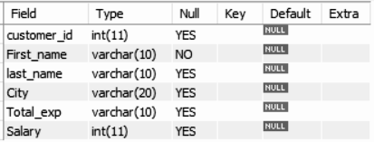
The Alter Query - Drop Clause
Consider a table Customer with below fields:
Here, we don’t need the column ‘Salary’ from the table

Slide 78
The Alter Query - Drop Clause
Use below alter query to drop the ‘Salary’ column from the table Customer
ALTER TABLE Customer DROP COLUMN Salary;
Use describe Customer to check if the column has been drop from the table

Slide 79
Revisiting The Drop Query
The DROP query allows you to:
Delete a database
Delete an existing table from the database
Syntax to delete an existing database:
DROP DATABASE database_name
Syntax to delete an existing table in a database:
DROP TABLE table_name

Slide 80
The Rename Query
The rename command is used to change the name of an existing database table to a new name
Renaming a table does not make it to lose any data is contained within it
Syntax:
RENAME TABLE current_table_name TO new_table_name

Slide 81
Thank You

