Slide 1
Fake News Detection using Deep Learning

Slide 2
Project Goal
Build a model to classify news articles as fake or real
Use machine learning and deep learning methods
Compare baseline and LSTM performance

Slide 3
Why This Problem Matters
Fake news spreads quickly online
Misinformation affects public opinion
Automatic detection helps improve information reliability

Slide 4
Dataset
Dataset: Fake and Real News Dataset (Kaggle)
Approximately 45,000 articles
Features: title, text, subject, date
Target: fake or real news

Slide 5
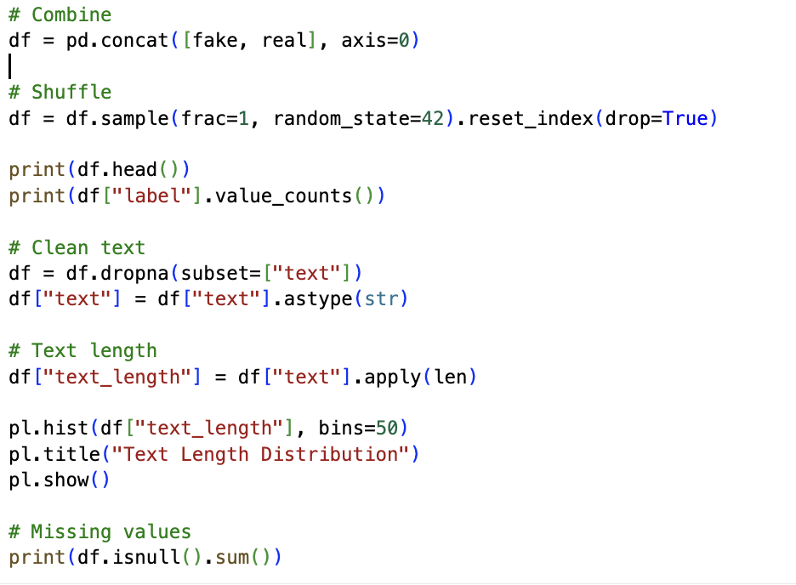
Data Preprocessing
Removed missing values
Cleaned text data
Converted text to lowercase
Applied tokenization and padding

Slide 6

Baseline Model
Model: Logistic Regression
Feature extraction using TF-IDF
Fast and effective baseline approach
Achieved strong classification performance

Slide 7

Deep Learning Model
Model: LSTM (Long Short-Term Memory)
Embedding layer + LSTM + Fully Connected layer
Used Adam optimizer and CrossEntropyLoss
Trained on padded text sequences

Slide 8
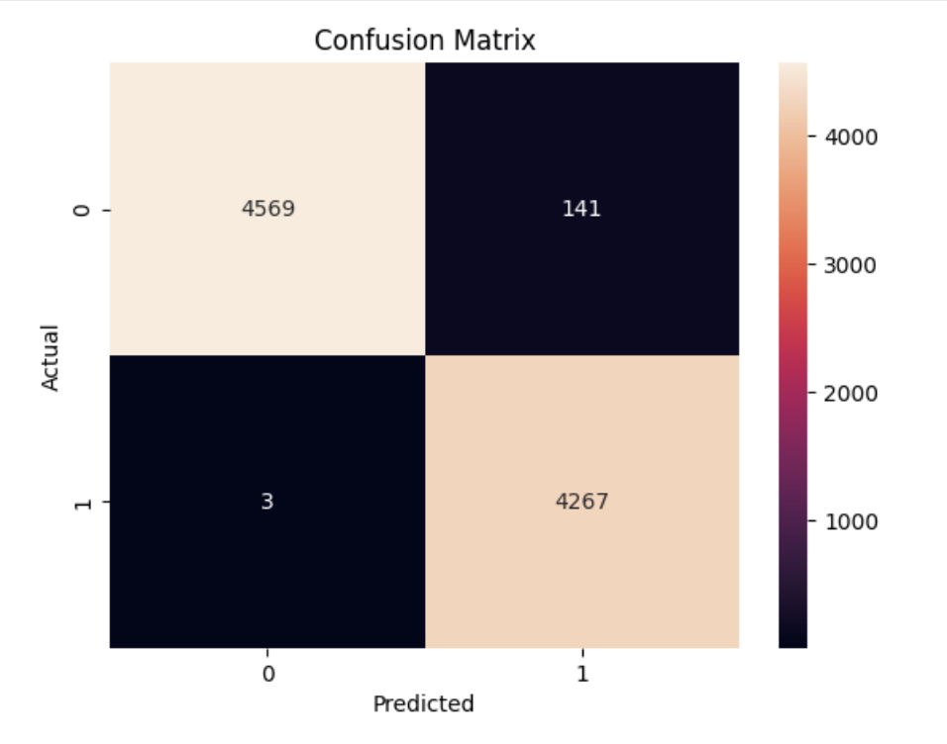
Results
Baseline Accuracy: ~98%
LSTM Accuracy: ~98%
Deep learning slightly improved performance
F1-score also increased

Slide 9
Error Analysis
Some errors occurred on long articles
Ambiguous language affected predictions
Mixed real/fake patterns confused the model

Slide 10
Conclusion
The project successfully implemented a full ML pipeline
LSTM give same result as the baseline model

