Slide 1
FitClub - Production-Ready SRE
Midterm Project: Observability Stack for a Custom Web Application
Nurlybek Nurzhan
Introduction to SRE • April 2026
Docker Swarm • Prometheus • Grafana • Node.js • MongoDB

Slide 2
Project Overview
FitClub is a fitness management platform built in Web Technologies course.
What FitClub does:
• Browse & filter fitness programs (strength, cardio, yoga...)
• Log personal workouts with sets, reps, weight
• Leave ratings & comments on programs
• Admin panel: full CRUD for programs & workouts
• JWT-based authentication (register / login)
SRE Objective:
• Transform a working app into an observable, production-ready system
• Define reliability targets (SLO) with real math
• Separate monolith into isolated containers
• Build live dashboards showing Golden Signals
• Create automated alerts for failure scenarios
Tech Stack:
• Frontend: HTML5, CSS3, Vanilla JS, Bootstrap 5.3
• Backend: Node.js (ESM), Express.js 4.18
• Database: MongoDB 7 (local Docker container)
• Auth: JWT tokens, bcryptjs
• Monitoring: Prometheus, Grafana, Node Exporter
• Orchestration: Docker Swarm (2 replicas each)

Slide 3
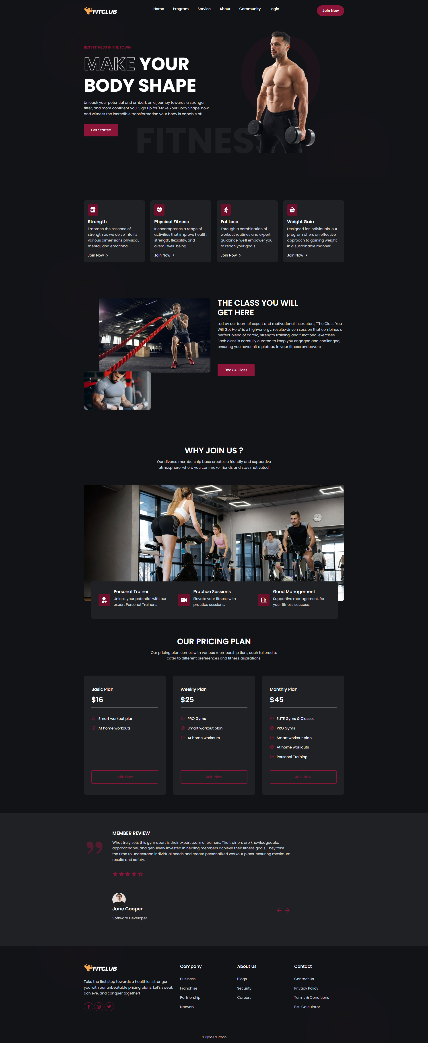
Frontend - Nginx Container (Port 80)
Architecture:
• Served by Nginx Alpine container
• Completely separated from backend
• Static HTML / CSS / Vanilla JS
• Bootstrap 5.3 + jQuery 3.6
• API calls go to backend:5000
• 2 replicas via Docker Swarm
Pages:
• Landing page (home)
• Programs - browse & filter
• Community - workout logger
• Login / Register
• Admin panel (JWT protected)
• About & Service pages

Slide 4
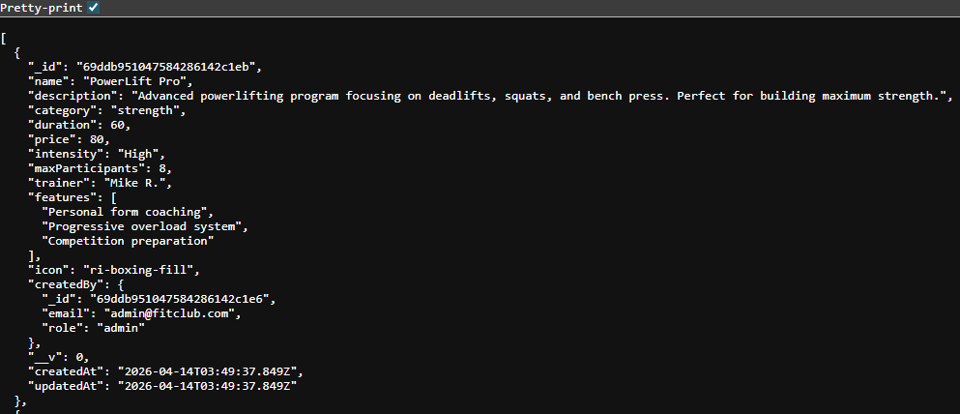
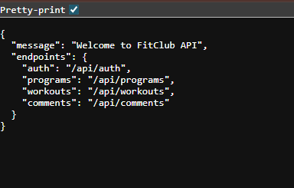
Backend - Node.js API Container (Port 5000)
Architecture:
• Node.js ESM + Express.js
• MVC pattern (Models / Controllers / Routes)
• Completely separated from frontend
• MongoDB connection via Mongoose
• JWT auth middleware
• prom-client /metrics endpoint
• 2 replicas via Docker Swarm
API Endpoints:
• POST /api/auth/register & /api/auth/login
• GET/POST/PUT/DELETE /api/programs
• GET/POST/PUT/DELETE /api/workouts
• GET/POST/DELETE /api/comments
• GET /metrics (Prometheus scrape target)

Slide 5
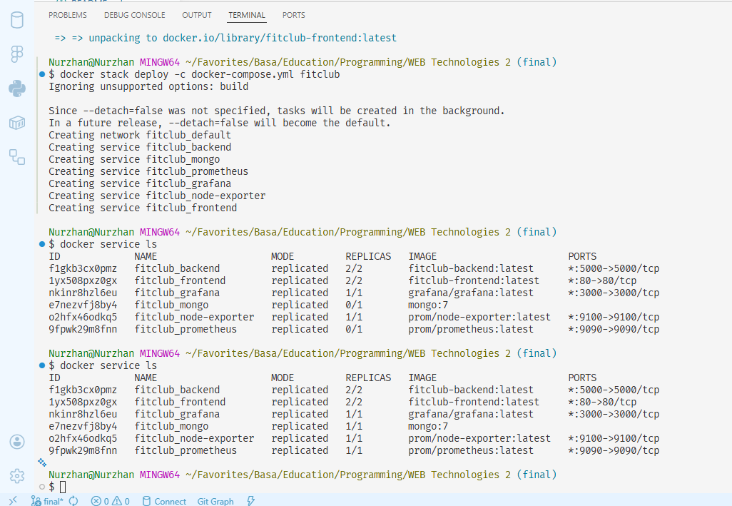
Containerization & Docker Swarm (+10 Bonus)
6 Isolated Services:
• frontend - Nginx:alpine - port 80 - 2 replicas
• backend - Node20:alpine - port 5000 - 2 replicas
• mongo - mongo:7 - internal - 1 replica
• prometheus - prom/prometheus - port 9090 - 1 replica
• grafana - grafana/grafana - port 3000 - 1 replica
• node-exporter - prom/node-exporter - 9100 - 1 replica
Deployment Commands:
• docker swarm init
• docker build -t fitclub-backend ./backend
• docker build -t fitclub-frontend ./frontend
• docker stack deploy -c docker-compose.yml fitclub
• docker service ls -> all 6 services UP

Slide 6
Custom Reliability Targets - SLI, SLO & Error Budget
SLI 1 - Program Browse Availability
• Metric: % of GET /api/programs returning HTTP 200 in < 500ms
• SLO: 99.5% over 30 days
• Error Budget:
• 43,200 min × 0.5% = 216 minutes / month
• -> App can be slow for max 3h 36min/month
SLI 2 - Auth Service Reliability
• Metric: % of POST /api/auth/login NOT returning HTTP 500
• SLO: 99.9% over 30 days
• Error Budget:
• 43,200 min × 0.1% = 43.2 minutes / month
• -> Auth can fail for max 43 min/month
Why These SLIs?
• Program browsing is the #1 user action - if slow, users leave immediately.
• Authentication is a gateway - if broken, zero users can log in or use protected features.
• Both are directly measurable by Prometheus via http_requests_total and http_request_duration_seconds.
• SLOs are realistic: 99.5% allows planned maintenance; 99.9% reflects criticality of auth.

Slide 7
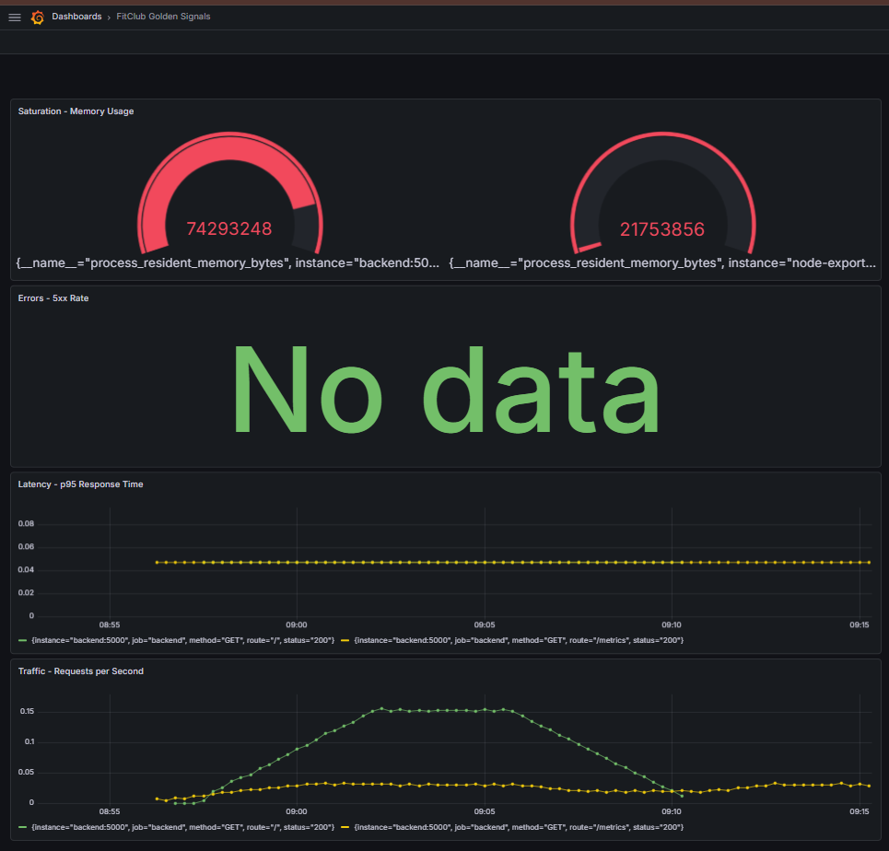
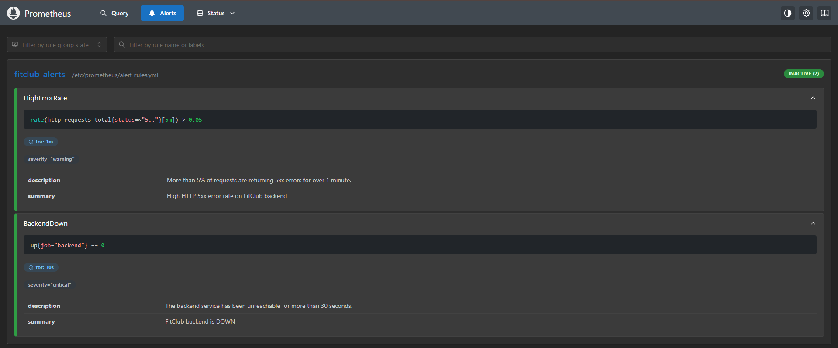
Observability - Prometheus, Grafana & Alerting
4 Golden Signals Dashboard:
• Traffic - rate(http_requests_total[5m])
• Latency - histogram_quantile(0.95, ...)
• Errors - rate(http_requests_total{status=~'5..'}[5m])
• Saturation - process_resident_memory_bytes
Alert Rules (alert_rules.yml):
• WARNING - HighErrorRate
• 5xx rate > 5% for 1 minute
• CRITICAL - BackendDown
• up{job=backend}==0 for 30 seconds
• -> Both fired simultaneously when
• backend scaled to 0 replicas ✓

