Slide 1

Final Exam
Topic: Clinic
Subject: WEB Technologies(Front End)
Group: SE-2225
Students: Adilbekov Batyrkhan, Nurmukhammed Darkhanbai
Supervisor: Abdraimova Bibigul

Slide 2

This is our logo & favicon. It represents our relation to health, that health at first is our nature and lifestyle.

Slide 3
N&B Clinics
We decided to take the clinic as the idea of the project, and called it simply N&B (the first letters of our names).
The main colors are sky blue and white. Green inserts were also used.
Our navbar have 6 buttons, each button is clickable.

Slide 4
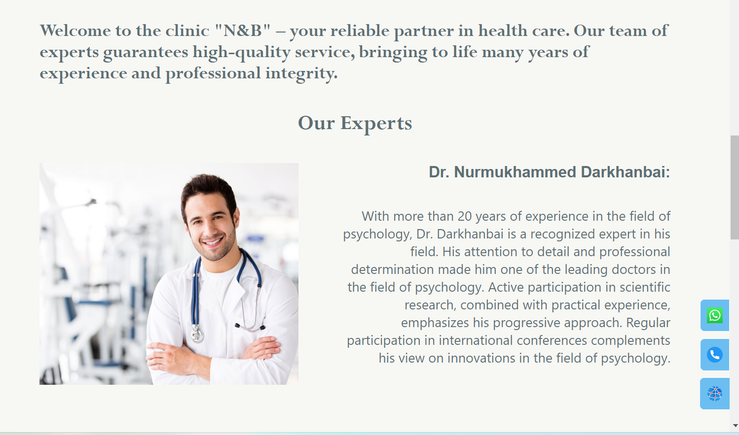
About us. As You see, our website is fully adaptive.

Slide 5
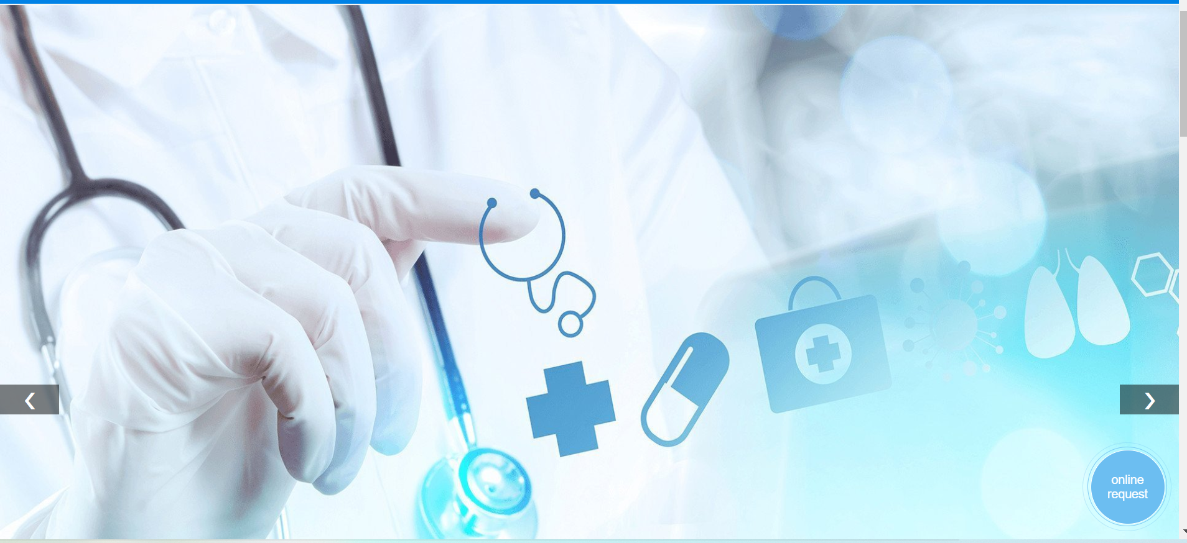
Carousel-part

Slide 6
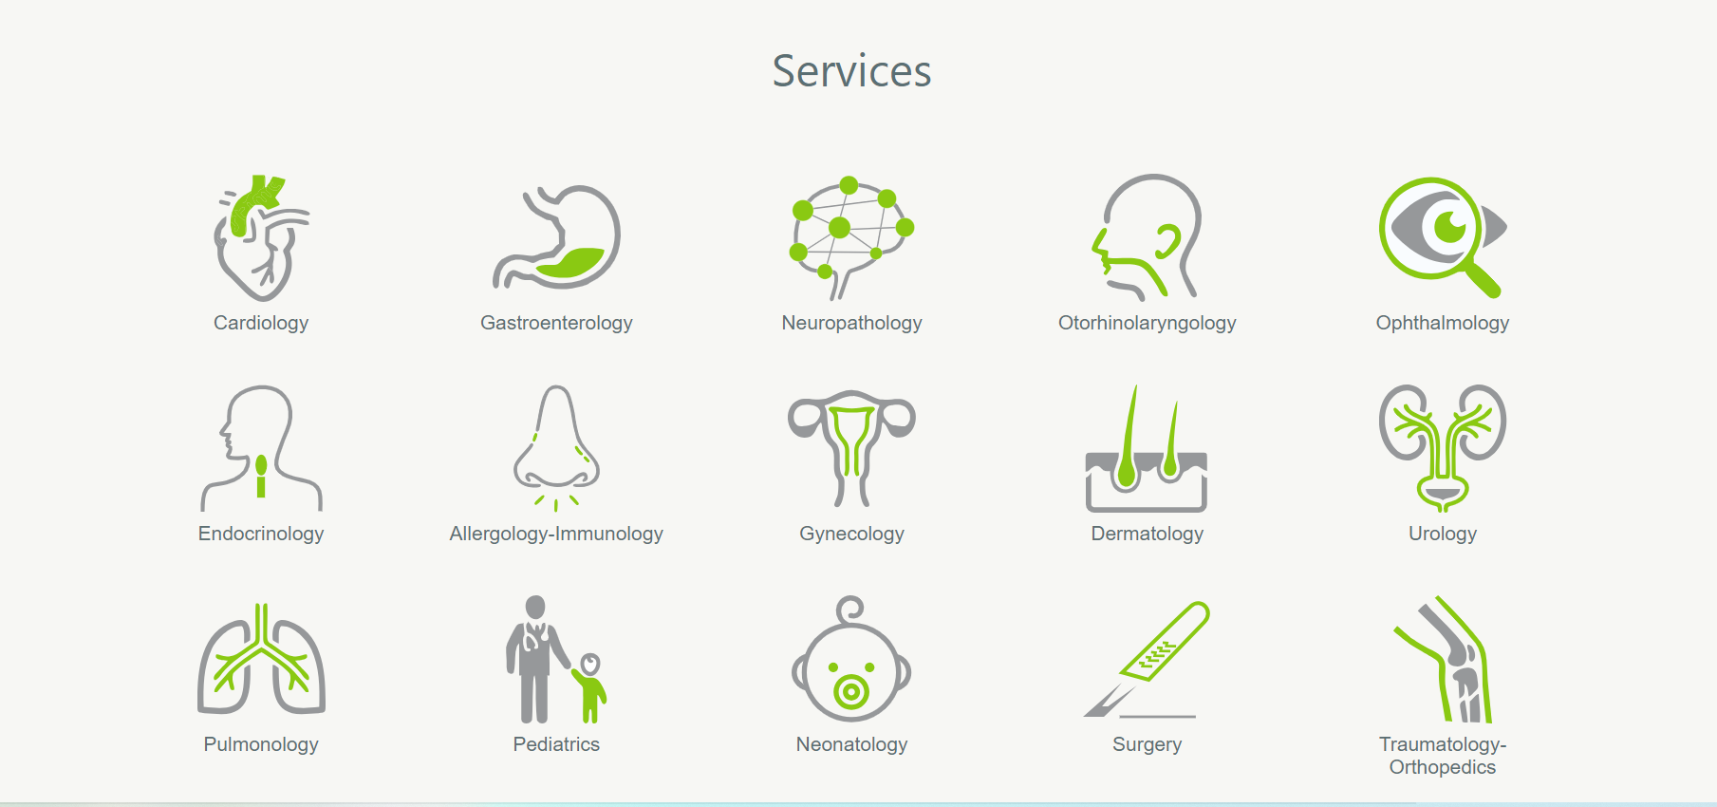
List of our services

Slide 7
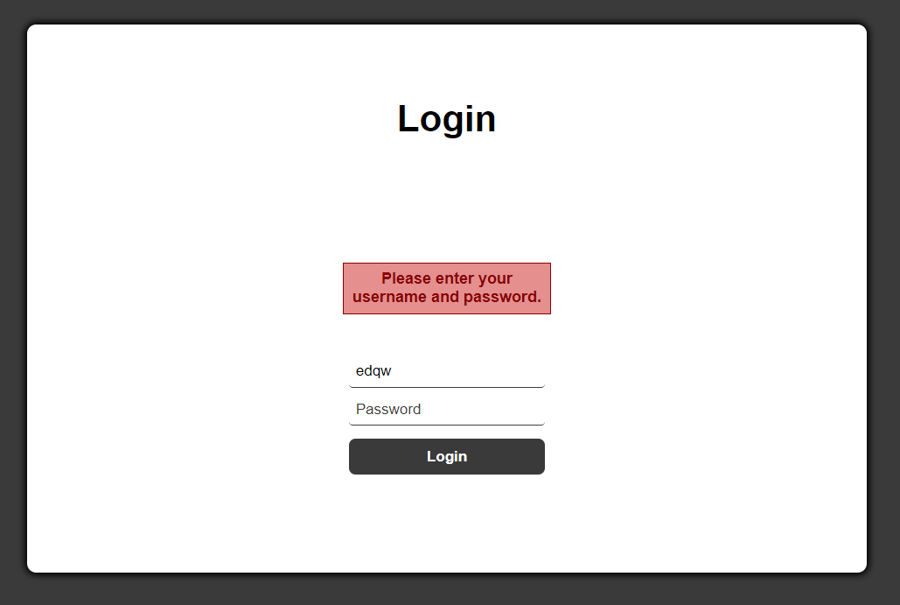
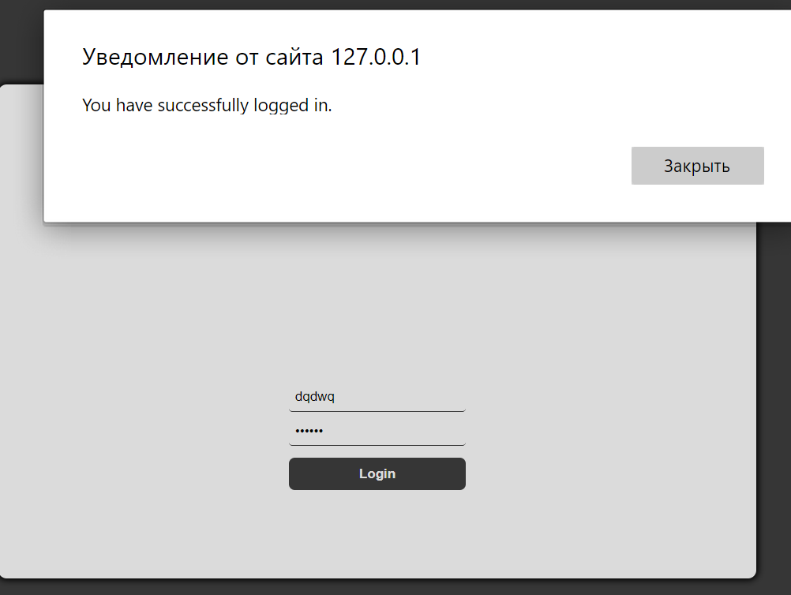
Login part. If username or password not entered that will be message of error. If entered, You can see a success-message.

Slide 8

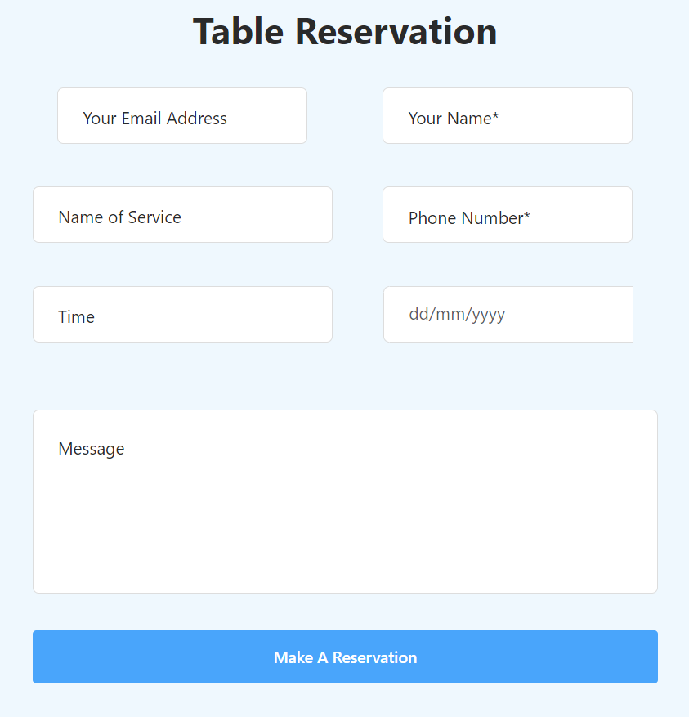
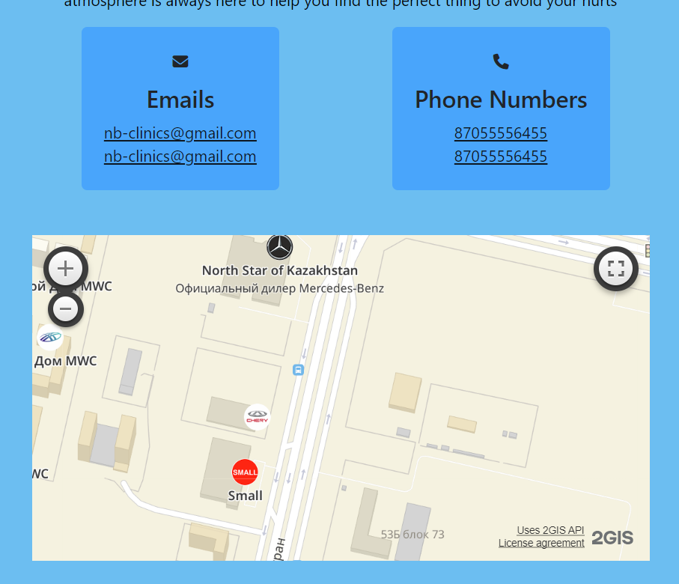
We have online request button that direct us to table reserva-
-tion which work with JS-function. And there are a map.

Slide 9
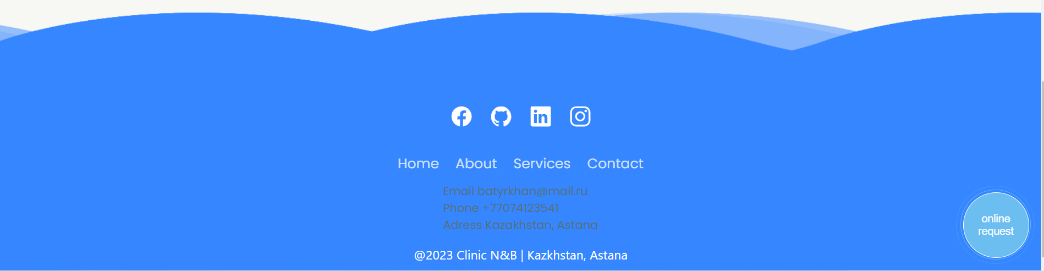
Our Footer part. As You can see, this is cycled animation by CSS properties. And each of this buttons have sound while we click on it.
Sounds written by JS-function.

Slide 10

Thank you for attention!

