Slide 1
Accreditation Canada International (ACI)
Critical care Standards
(PICU&PHD)

Slide 2


Slide 3



ACI accreditation; 2016
Gold
Platinum
builds on the elements of quality and safety, and emphasizes key elements of
FAMILY-centred care
Involving family and staff in decision-making
elements of safety and quality improvement
focuses on the achievement of quality by monitoring outcomes, using evidence and best practice to improve services, and benchmarking with peer organizations to drive system-level improvements.
Diamond
Notes:
Legend Levels
Gold addresses basic structures and processes linked to the foundational elements of safety and quality improvement. Platinum builds on the elements of quality and safety, and emphasizes key elements of client-centred care, creating consistency in the delivery of services through standardized processes, and involving clients and staff in decision-making. Diamond focuses on the achievement of quality by monitoring outcomes, using evidence and best practice to improve services, and benchmarking with peer organizations to drive system-level improvements.

Slide 4
What is ROP?
Evidence-based practices addressing high priority areas important for Quality & Safety

Slide 5
Required Organisational Practices
Safety culture
Communication
Medication Use
Work life/Workforce
Infection control
Risk assessment

Slide 6
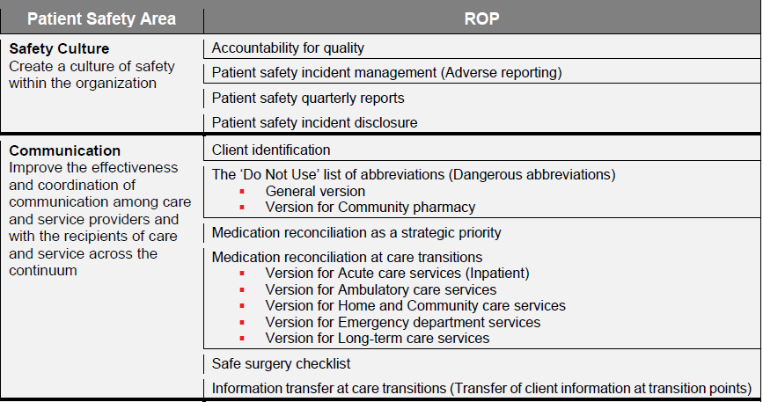

Slide 7
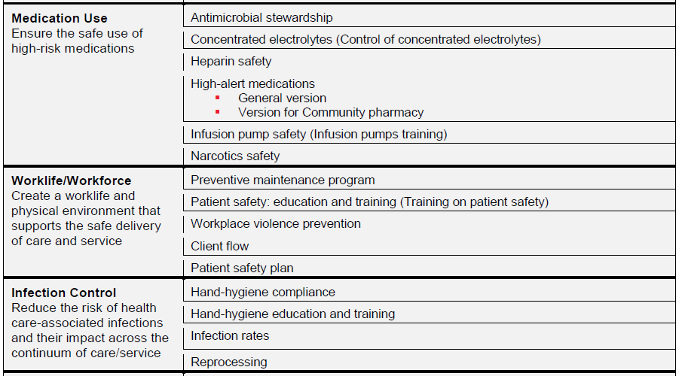

Slide 8
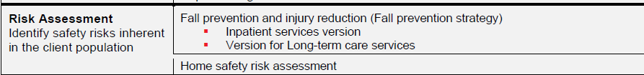


Slide 9
Platinum ROP
Transfer of clients information at transition points
Antimicrobial stewardship
Heparin Safety
High alert medications
Narcotics safety
Antibiotics prophylaxis during surgery

Slide 10
Hand hygiene compliance
Safe injection practices
Falls prevention strategy
Home safety risk assessment
Pressure ulcer prevention

Slide 11
Gold critical care
Critical care consent
Clients and families are provided with information about how to file a complaint or report violations of their rights.
Organ tissue donation
Fire safety and evacuation plan
Quiet time

Slide 12
Platinum Critical care
A comprehensive nutritional assessment
CLABSI &VAP prevention
Sedation policy
Delirium & withdrawal prevention
Infusion pump training
Fall & pressure ulcer prevention
Holistic approach of Psychosocial assessment

Slide 13
Platinum critical care
Daily rounds are conducted by the team in partnership with family.
Restraint policy
Screening for hypo/hyper glycemia
catheter-associated urinary tract infection prevention
Sepsis bundle

Slide 14
Platinum critical care
Support for the family, team members, and other clients is provided throughout and following the death of a client.
Spiritual care
Transport safety
Parents presence and involvement with care- family centered care
An assessment of the client’s palliative and end-of-life care needs

Slide 15
Diamond critical care
Outreach team ( PRRT, Home ventilation )
Transition planning, with input from clients and families.
Medication reconciliation is conducted in partnership with clients and families

Slide 16

Questions?

