Slide 1
HYPERAMMONEMIA

Slide 2
-- Is a metabolic condition characterized by elevated levels of ammonia, a nitrogen-containing compound, in the blood
-- Ammonia is a potent neurotoxin
-- Is a life-threatening condition that can lead to brain injury or death

Slide 3
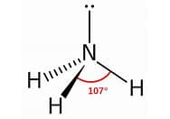
What is ammonia?
NH3
A major source of nitrogen
Breakdown product of protein metabolism
Converted to urea in the liver by series on enzymatic processes – “the urea cycle”

Slide 4
AMMONIA
(LIVER)
PROTEIN
AMINO ACID
AMMONIA + CO2
CARBAMOYL PHOSPHATE
CITRULLINE + ASPARTATE ATP
ORNITHINE
ARGININE
ARGINOSUCCINATE
UREA (KIDNEY)
URINE
FUMERATE

Slide 5

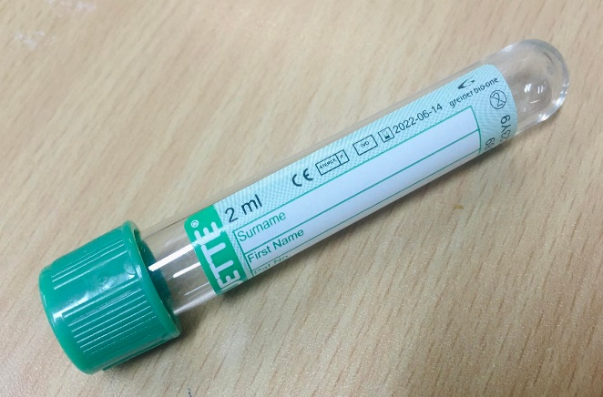
How to measure ammonia?
1ml free flowing Green Tap sample
Urgent sample on ice
Call MO
Call lab

Slide 6
Normal Blood Ammonia Levels According to Age Groups
Age Group | μmol/L | μg/dL
Newborns (arterial cord blood) | 50–159 | 85–271
Infants and children | 24–48 | 41–82
Adults (female) | 11–48 | 19–82
Adults (male) | 15–55 | 26–94

Slide 7
What causes Hyperammonemia?
Severe Liver disease
- Cirrhosis
- Acute liver failure (ALF)
Decrease Blood flow in the liver
Urea Cycle disorder
Renal Failure
Reye Syndrome

Slide 8
Hyperammonemia may also be seen with
Gastrointestinal Bleeding
Muscle exertion
Tourniquet use
Certain drugs including alcohol, barbiturates, diuretics, valproic acid, and narcotics
Cigarette smoking

Slide 9
Clinical Presentation

Slide 10
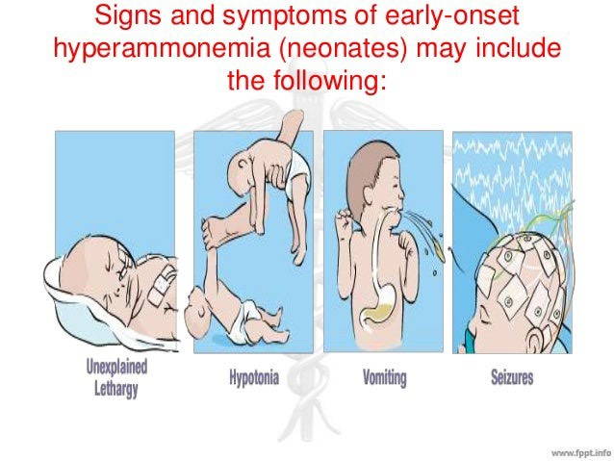

Slide 11
Signs and symptoms of early-onset hyperammonemia (neonates) may include the following:
- Lethargy
- Irritability
- Poor feeding
- Vomiting
- Hyperventilation, grunting respiration
- Seizures

Slide 12
Signs and symptoms of late-onset hyperammonemia (later in life) may include the following:
- Intermittent ataxia
- Intellectual impairment
- Failure to thrive
- Gait abnormality
- Behavior disturbances
- Epilepsy
- Recurrent Reye syndrome
- Protein avoidance
- Rarely, episodic headaches and cyclic vomiting

Slide 13
Laboratory Tests
- Arterial blood gas analysis (ABG)
Serum amino acid levels
Lactate
Blood c/s if sepsis is suspected
- Urinary orotic acid levels
- Urinary ketone tests
- Plasma and urinary organic acid levels
- Enzyme assays
- DNA mutation analysis: Method of choice to confirm the diagnosis of urea cycle disorders

Slide 14
Imaging studies
The following imaging studies may be used in evaluating patients with hyperammonemia:
- Neuroimaging:
CT or MRI of the brain
- MR spectroscopy

Slide 15
Emergency Management
Supportive care
- Reduce further catabolic stress
- Reduce energy expenditure
- Prevent secondary complication
- Supportive care on parenteral (TPN) intake of calories
Cessation of protein and/or nitrogen intake
Hemodialysis

Slide 16
Pharmacotherapy
Medications used in the treatment of hyperammonemia:
Antiemetics
- Ondansetrone, Granisetrone & etc
Lactulose
Antibiotics
Nitrogen Scavenger drugs
L-Arginine

Slide 17
Nitrogen Scavenger Drugs
Drugs | Loading dose over 90 mins | Maintenance dose over 24 hours | Sodium content of the daily maintenance
Sodium Benzoate | 250 mg/ kg | 250 mg/ kg | 3.5 mmol/kg/day
Sodium Phenylbutyrate | 250 mg/ kg | 250 mg/ kg | 2.8 mmol/kg/day
Arginine | 200 mg/ kg | 200 mg/ kg | NIL

Slide 18
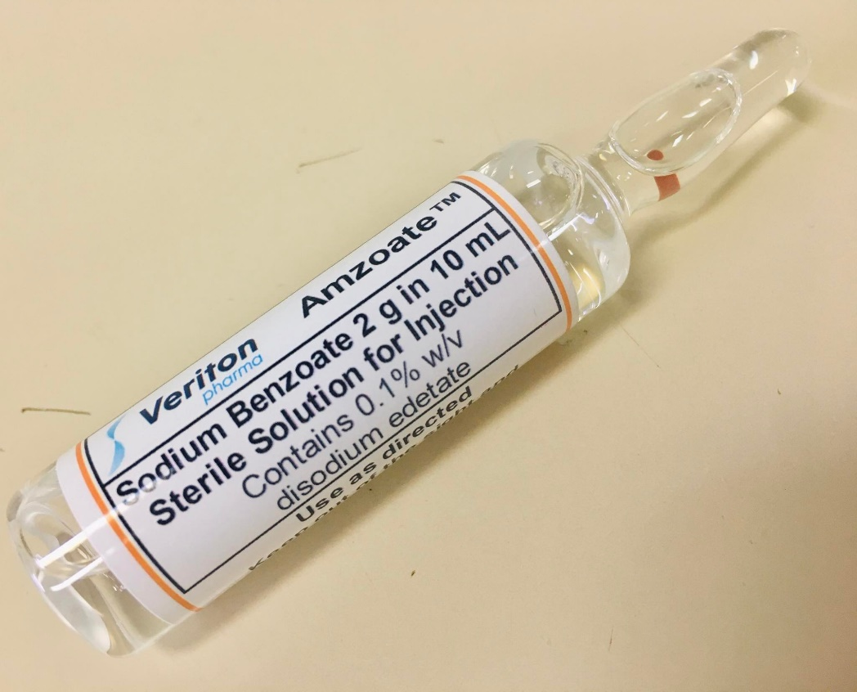
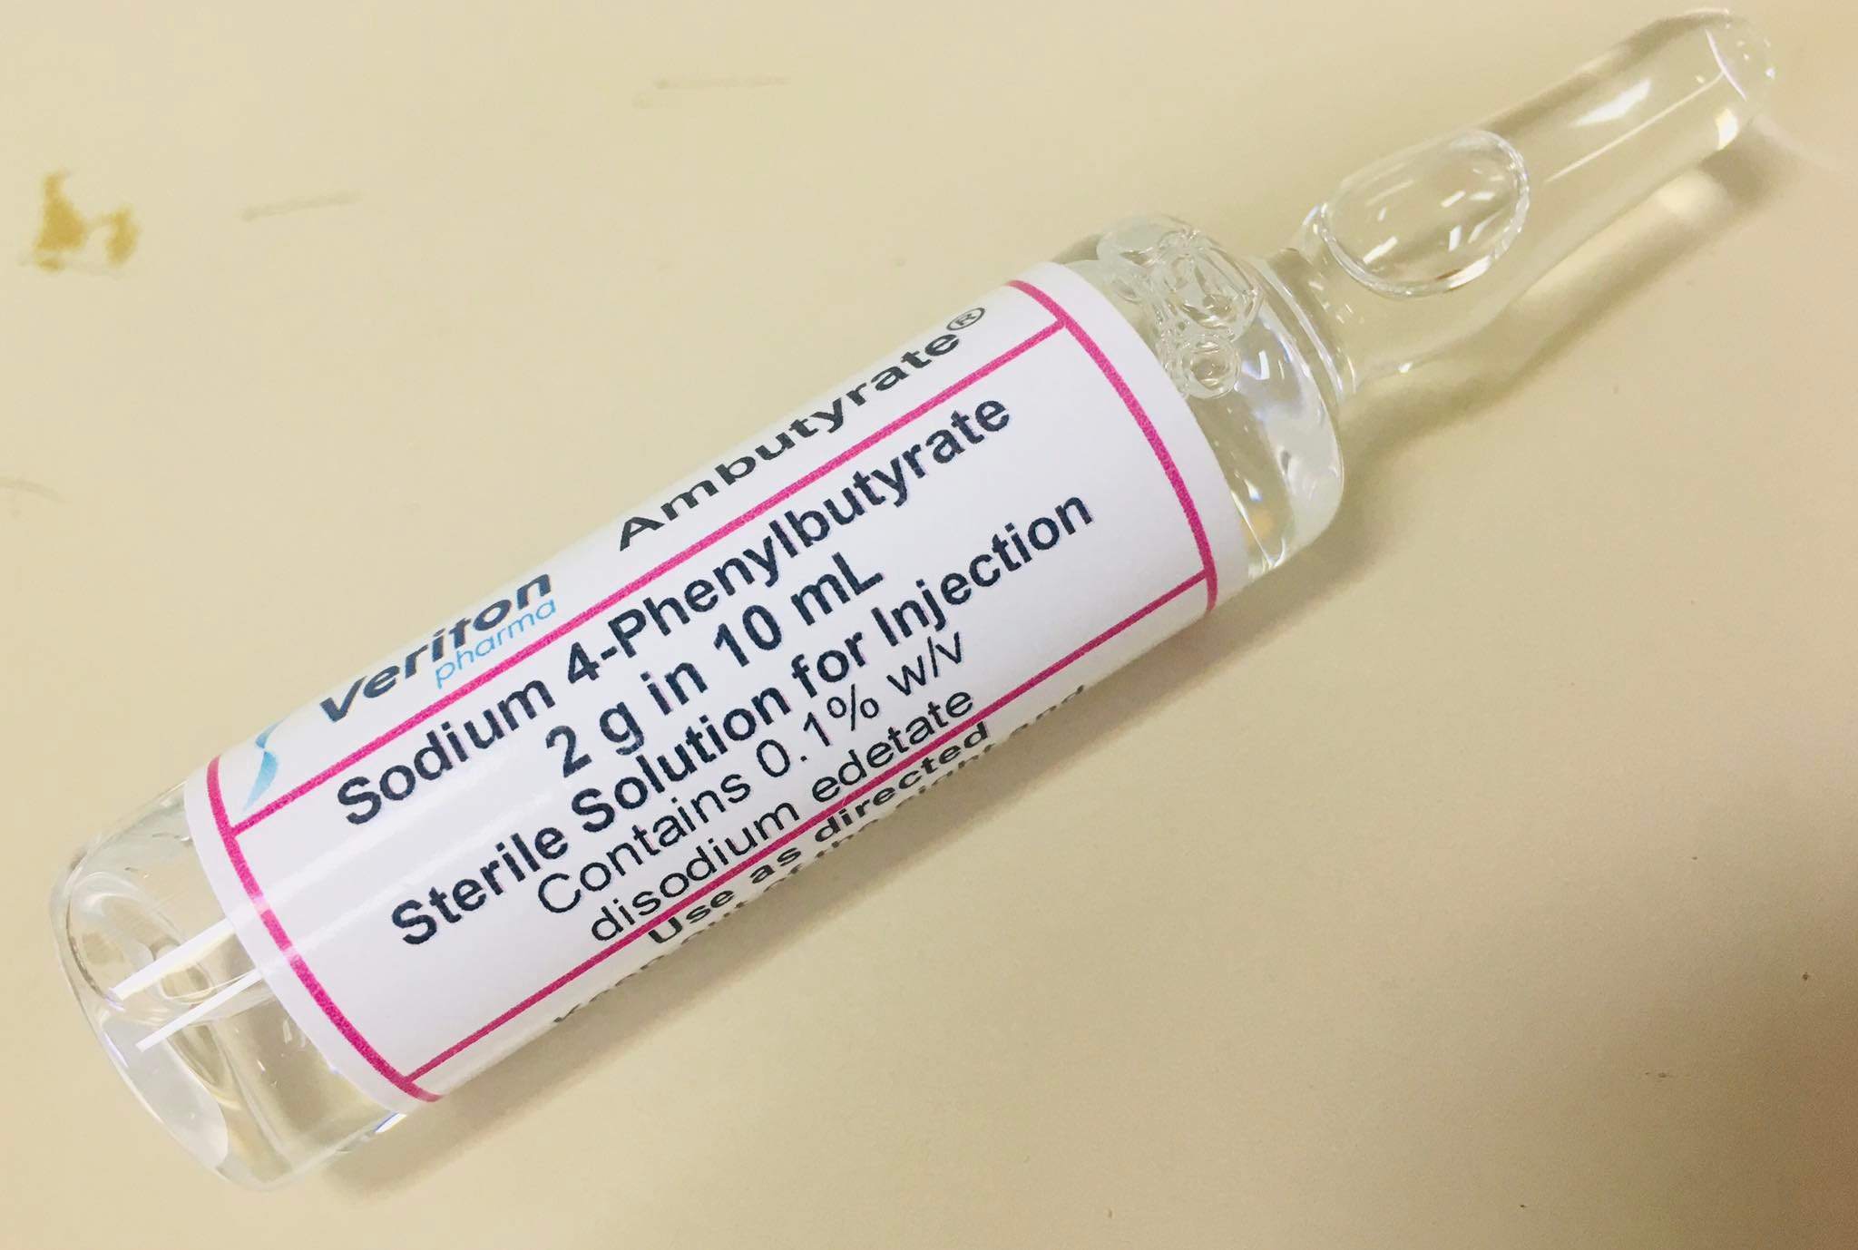
Nitrogen Scavenger Drugs

Slide 19
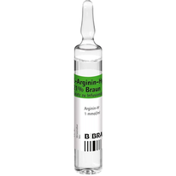
Arginine

Slide 20
It is assumed that the patient will be given Na Benzoate and Na Phenylbutyrate at full dose, therefore use D10%.
These drugs should be given as soon as possible as continuous intravenous infusions.
Can be given together
Maximum dose -- 2.5 gms of each drug

Slide 21
Nitrogen Scavenger Drugs Preparation
Na Benzoate and Na Phenylbutyrate
- can be mixed in 1 syringe to make
Total Volume (TV) of 50 ml
Diluted in D10%
Arginine
Separate syringe
Total Volume of 50 ml in D10%
The three medication can be given in 1 line via 3-way to run for 90 mins

Slide 22
Thank You!

