Slide 1

And risk assessment
Deanna
Syamily
Fatema Ali
Sindhu

Slide 2
KPI
Stands for KEY PERFORMANCE INDICATOR
A measurable value that indicates progress towards a project outcome or result.
Healthcare KPI’s are important for managing the entire data spectrum of a facility, including patient care, hospital performance, and costs. They can identify ways to improve patient care services, ensure optimal and sustained hospital performance and manage cost-effectively.

Slide 3
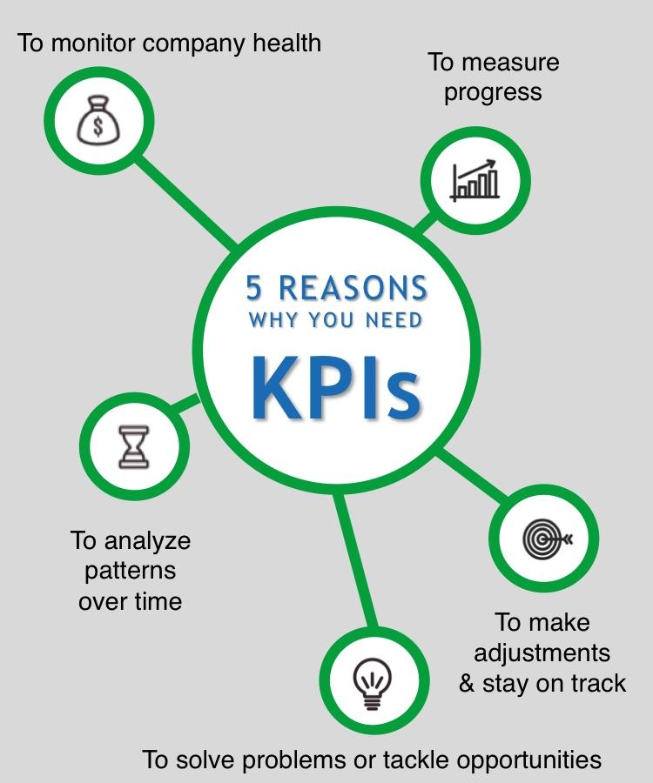
WHY WE SHOULD HAVE KPIs?

Slide 4

KPI IN PHDU
RE-ADMISSIONS WITHIN 24HOURS
Unplanned re-admissions tend to indicate a variety of issues in both treatment effectiveness and quality of care. It will also affect the hospital’s productivity and the availability of beds for new patients.
It is crucial to reduce hospital readmissions lowering operational overheads.
It is also a good indicator of how other measures are working when used in conjunction with initial treatments of KPI’s

Slide 5
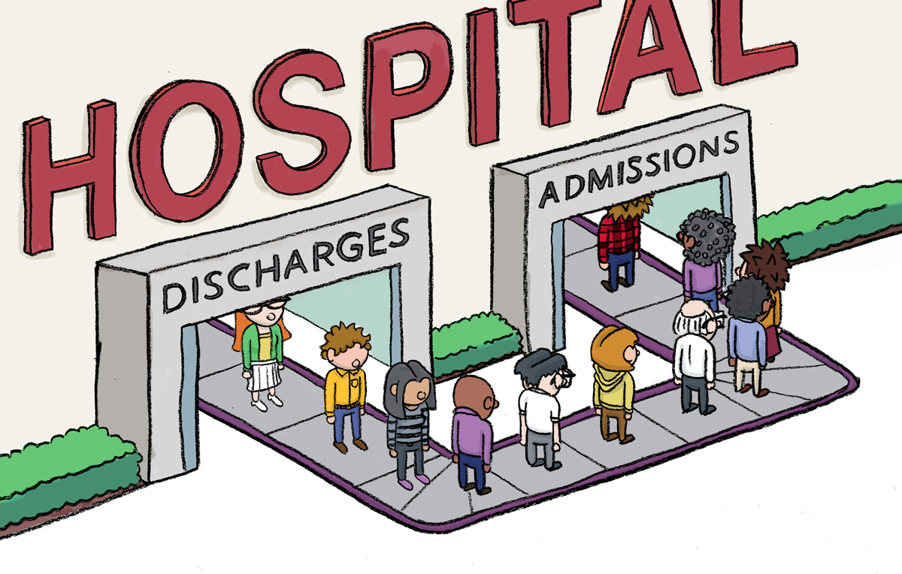
What can nurses do to prevent readmissions?
Manage medications for patients and educate on proper scheduling of medication. Enhance communications with patients so the healthcare team can identify if further care is needed to avoid readmission. Provide patient training to avoid common illnesses that often lead to hospital readmission after a previous hospital .
What are ways to reduce hospital readmissions?
Use admission, discharge, transfer (ADT) data for proper transition of care. ...
Follow up with patients after discharge. ...
Identify risk factors for readmission using EHR data. ...
Support patient medication adherence to prevent rehospitalization.

Slide 6



2. Medication Error
Any preventable event that may cause or lead to inappropriate medication use or patient harm while the medication is in the control of the health care professional.
Can use severe physical injury and possible death to patients.
It could also cause severe financial, psychological, and emotional stress to healthcare providers and organizations.
This can have a major effect on patient health, but also reputational and financial ones for the hospital and its staff.

Slide 7
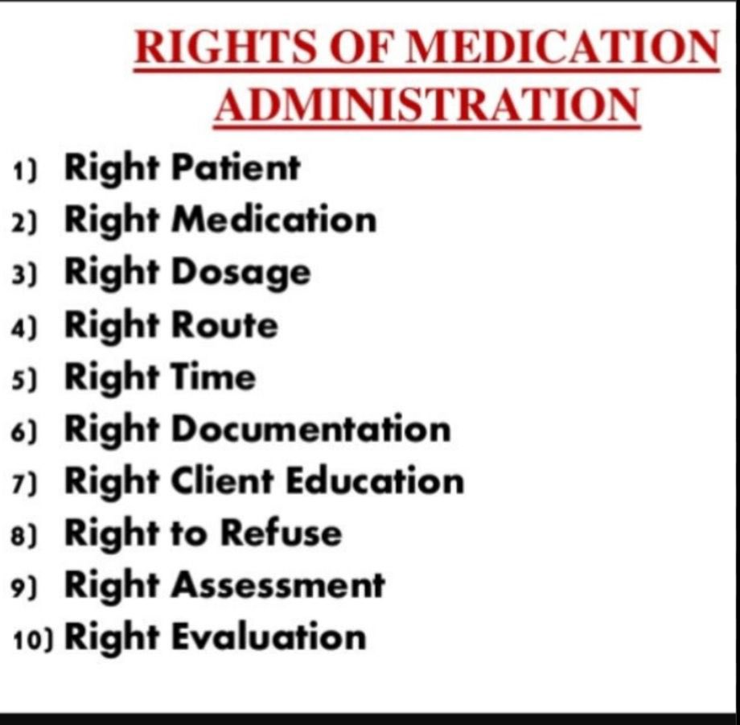
CON…
How can nurses prevent medication errors?
To safeguard against medication errors, nurses must implement the proper procedures for medication administration, including the medication rights In addition, they must complete accurate documentation once the patient receives the medication

Slide 8
4. CLABSI
Central line-associated bloodstream infection.
It is an important indicator associated with patient morbidity, mortality, and increased costs.
It occurs to these three criteria exist:
>Clinical infections- fever, rigors, altered mental status, hypotension
> Positive blood culture from a peripheral vein with any of the following:
catheter tip/segment culture that matches organism grown from blood

Slide 9
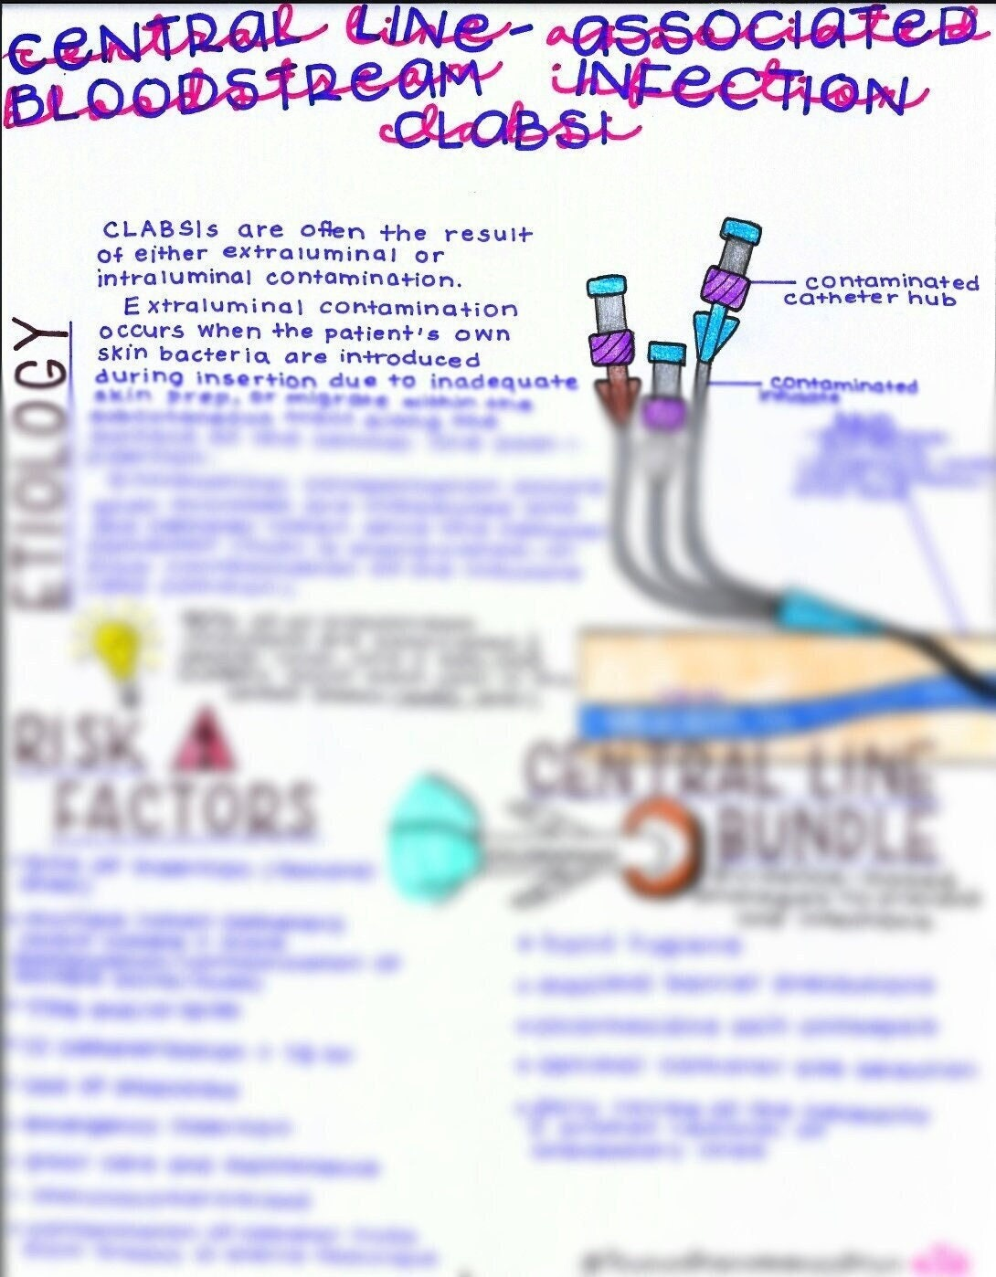
CON…
Five Evidence-Based Steps to Prevent CLABSI
Use appropriate hand hygiene.
Use chlorhexidine for skin preparation.
Use full-barrier precautions during central venous catheter insertion.
Avoid using the femoral vein for catheters in adult patients.
Remove unnecessary catheters

Slide 10
KPI in PICU
VAP (ventilator associated pneumonia) Rate
CLABCI RATE
RE ADMISSION LESS THAN 48HRS.
UNPLANNED ADMISSION
MORTALITY RATE

Slide 11
KPI IN GENERAL WARD
PERITONITIS RATE
TUNNeled INFECTION
STAFF SATSFACTION
Discharge timing
CLABSI RATE
PATIENT SATSFACTION
RISK OF FALL

Slide 12
KPI

Slide 13
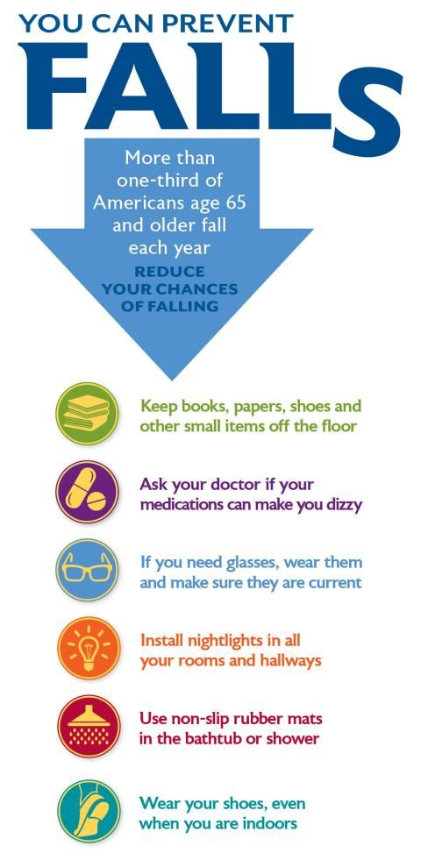
FALL PREVENTION AND INJURY REDUCTION
Fall prevention includes any action taken to help reduce the number of accidental falls suffered by susceptible individuals, such as the elderly (idiopathic) and people with neurological disorders as well as pediatrics.
I

Slide 14
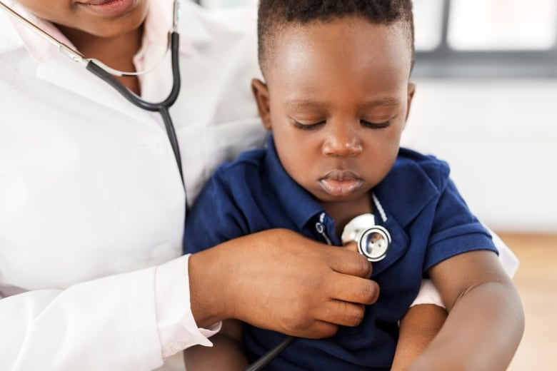
IN PATIENT SERVICES
To prevent falls and reduce the risk of injuries from falling, universal precautions are implemented, education and information are provided, and activities are evaluated.
The acronym S.A.F.E. (Safe environment; Assist with mobility; Fall-risk reduction; and Engage client and family describe key strategies for universal fall precautions.
Universal interventions:
familiarize the client with the environment
Keep call buttons within reach at all times and observe clients demonstrate their use of their personal possessions within reach
Have sturdy handrails in bathrooms, rooms, and hallways
keep the bed in a low position with brakes locked; provide non-slip, well-fitting footwear to clients; use night lights or supplemental lighting, keep floor surfaces clean and dry; clean up all spills promptly; keep care areas uncluttered.

Slide 15
Cont…
Effectiveness can be evaluated through a variety of means, whether informal discussions, interviews, surveys, audits, or evaluation processes.
Measurement for improvement initiatives and post-fall debriefings may also help identify safety gaps and prevent the recurrence of falls or reduce injuries from falling.
Team members and volunteers are educated, and clients, families, and caregivers are provided with information to prevent falls and reduce injuries from falling.
The effectiveness of fall prevention and injury reduction precautions and education/information to prevent falls and reduce injuries from falling.

Slide 16
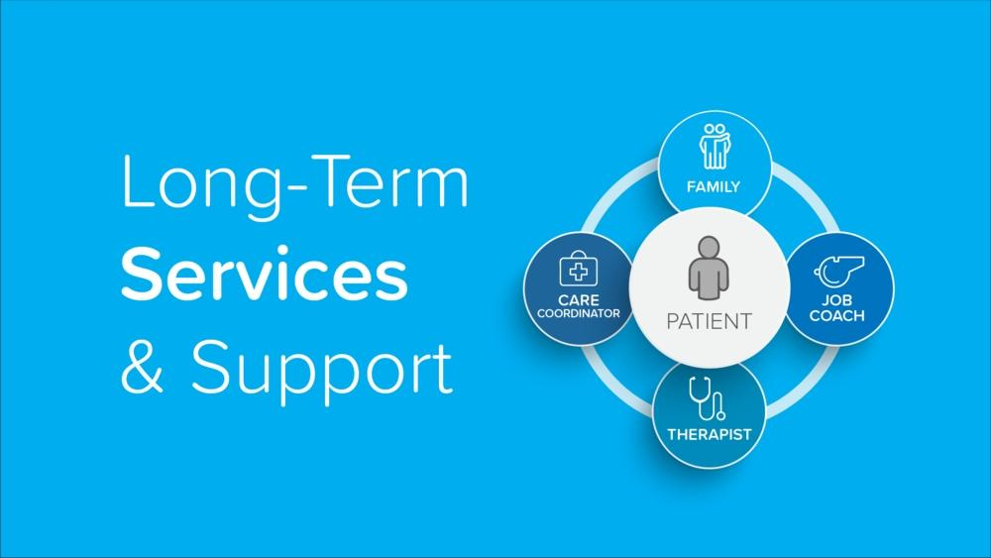
LONG-TERM CARE SERVICE
Reducing falls and injuries from falls can increase the quality of life, prevent loss of mobility and pain for residents, and reduce costs.
Examples of risk assessment tools appropriate for long-term care include:
1. Area Ellipse of Postural Sway
2. Berg Balance Test
3. Mobility Fall Chart
4. STRATIFY (St. Thomas Risk Assessment Tool in Falling Elderly Inpatients.

Slide 17
Cont….
Recommendations for preventing fracture in long-term care can include vitamin D supplementation, use of hip protectors, exercise, multifactorial interventions, and pharmacologic therapies.
Measurement for improvement initiatives and post-fall debriefings may also help identify safety gaps and prevent the recurrence of falls or reduce injuries from falling.

Slide 18
HOME SAFETY RISK ASSESSMENT
The home safety risk assessment includes a review of internal and external physical environments; chemical, biological, fire and falls hazards; medical conditions requiring special precautions; client risk factor and emergency preparedness.
The home safety risk assessment is regularly updated and used to improve services provided to the client.

Slide 19
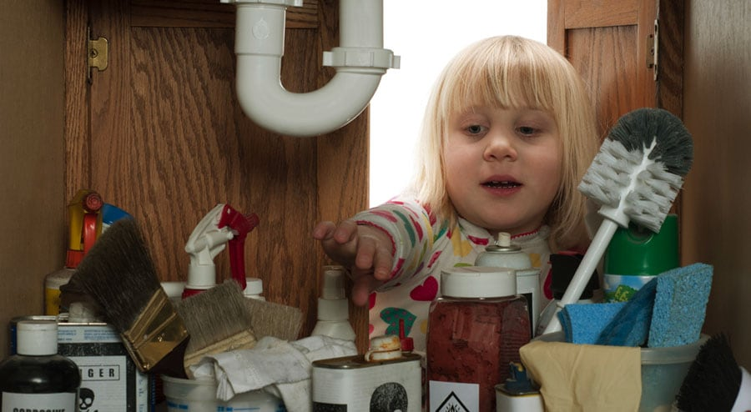
What Are The Steps To Be Taken When Carrying Out Home Assessment To Ensure Safety?
To have a safe home, carrying out assessment cannot be ignored. It is important to ensure that the assessment is done in the right way. Deciding on which way to carry out an assessment may be a challenge and also tedious. However, there are five steps that can guide you while carrying out home assessment.
Step 1: Identify Hazards At Home
Step 2: Determine Who May Be Harmed By The Hazard And How
Step 3: Introduce Safety Measures
Step 4: Have A Record On Your Findings

Slide 20
PRESSURE ULCER PREVENTION
Pressure ulcers have a significant impact on the client’s quality of life resulting in pain slower recovery, and increased risk of infection.
Ulcers have a significant impact on clients’ quality of life resulting in pain slower recovery, and increased risk of infection. Pressure ulcers are also associated with increased length of stay, cost, and mortality. Effective pressure ulcer prevention strategies can reduce the incidence of pressure ulcers and are an indication of higher quality care and services.

Slide 21
Cont..
Effective pressure ulcer prevention starts with a validated risk assessment scale, such as:
The Braden Scale for Predicting Pressure Sore Risk
The Norton Pressure Sore Risk Assessment Scale
InterRAI Pressure Ulcer Risk Scale (long-term care)
The Waterlow Score
The Gosnell Scale
The Knoll Scale
SCIPUS (Spinal Cord Injury Pressure Ulcer Scale

Slide 22
following tips can be used to help prevent the development of pressure ulcers.
1 RISK ASSESSMENT. ... 2 SKIN. ... 3 SKIN CARE. ... 4 MOISTURE. ... 5 INCONTINENCE. ... 6 NUTRITION. ... 7 POSITION/MOBILITY. ... 8 ERGONOMICS

Slide 23

SUICIDE PREVENTION
Suicide is a global health concern. Every year more than 800, 000 people die by suicide, according to the World Health Organization. Many of these deaths could be prevented by early recognition of the signs of suicidal thinking and offering appropriate intervention.

Slide 24
venous Thromboembolism (VTE) Prophylaxis
Venous thromboembolism (VTE) is the collective term for deep vein thrombosis (DVT) and pulmonary embolism (PE).
TE is a serious and common complication for those in hospital or undergoing surgery. The incidence of VTE can be reduced or prevented by identifying clients at risk and providing appropriate, evidence-informed thromboprophylaxis The widespread human and financial impact of thromboembolism is weil-documented. VTE is associated with increased client mortality; it is the most common preventable cause of hospital death. Appropriate evidence-informed thromboprophylaxis reduces cost and median length of stay.
There are many evidence-based clinical practice guidelines that recommend thromboprophylaxis for large groups of clients or for specific subgroups that are very useful and generally reflect the accepted standard of practice.
Medical and surgical clients at risk of venous thromboembolism (deep vein thrombosis and pulmonary embolism) are identified and provided with appropriate thromboprophylaxis.

Slide 25
Skin and Wound Care
An interprofessional and collaborative approach is used to assess clients who need skin and wound care and provide evidence-informed care that promotes healing and reduces morbidity and mortality.
Wound healing is a complex process that depends on the client (e.g., co-morbidities, age, nutritional status, etc.), the type of skin and wound, the client's environment (e.g., cleanliness, social support, mobility aids, etc.), and what type of care is provided. Many wounds can be prevented through proper skin care and preventive measures
Once they have occurred, most wounds can be healed through proper assessment, accurate diagnosis, appropriate treatment, and proper self-care. Appropriate care can reduce client suffering (e.g., intractable pain, infection, amputation, hospital admission, reduced quality of life) and save lives. Clients who need skin and wound care are a high-volume service (more than one-third of all home care clients need wound care) and wounds are costly to health care systems.

Slide 26
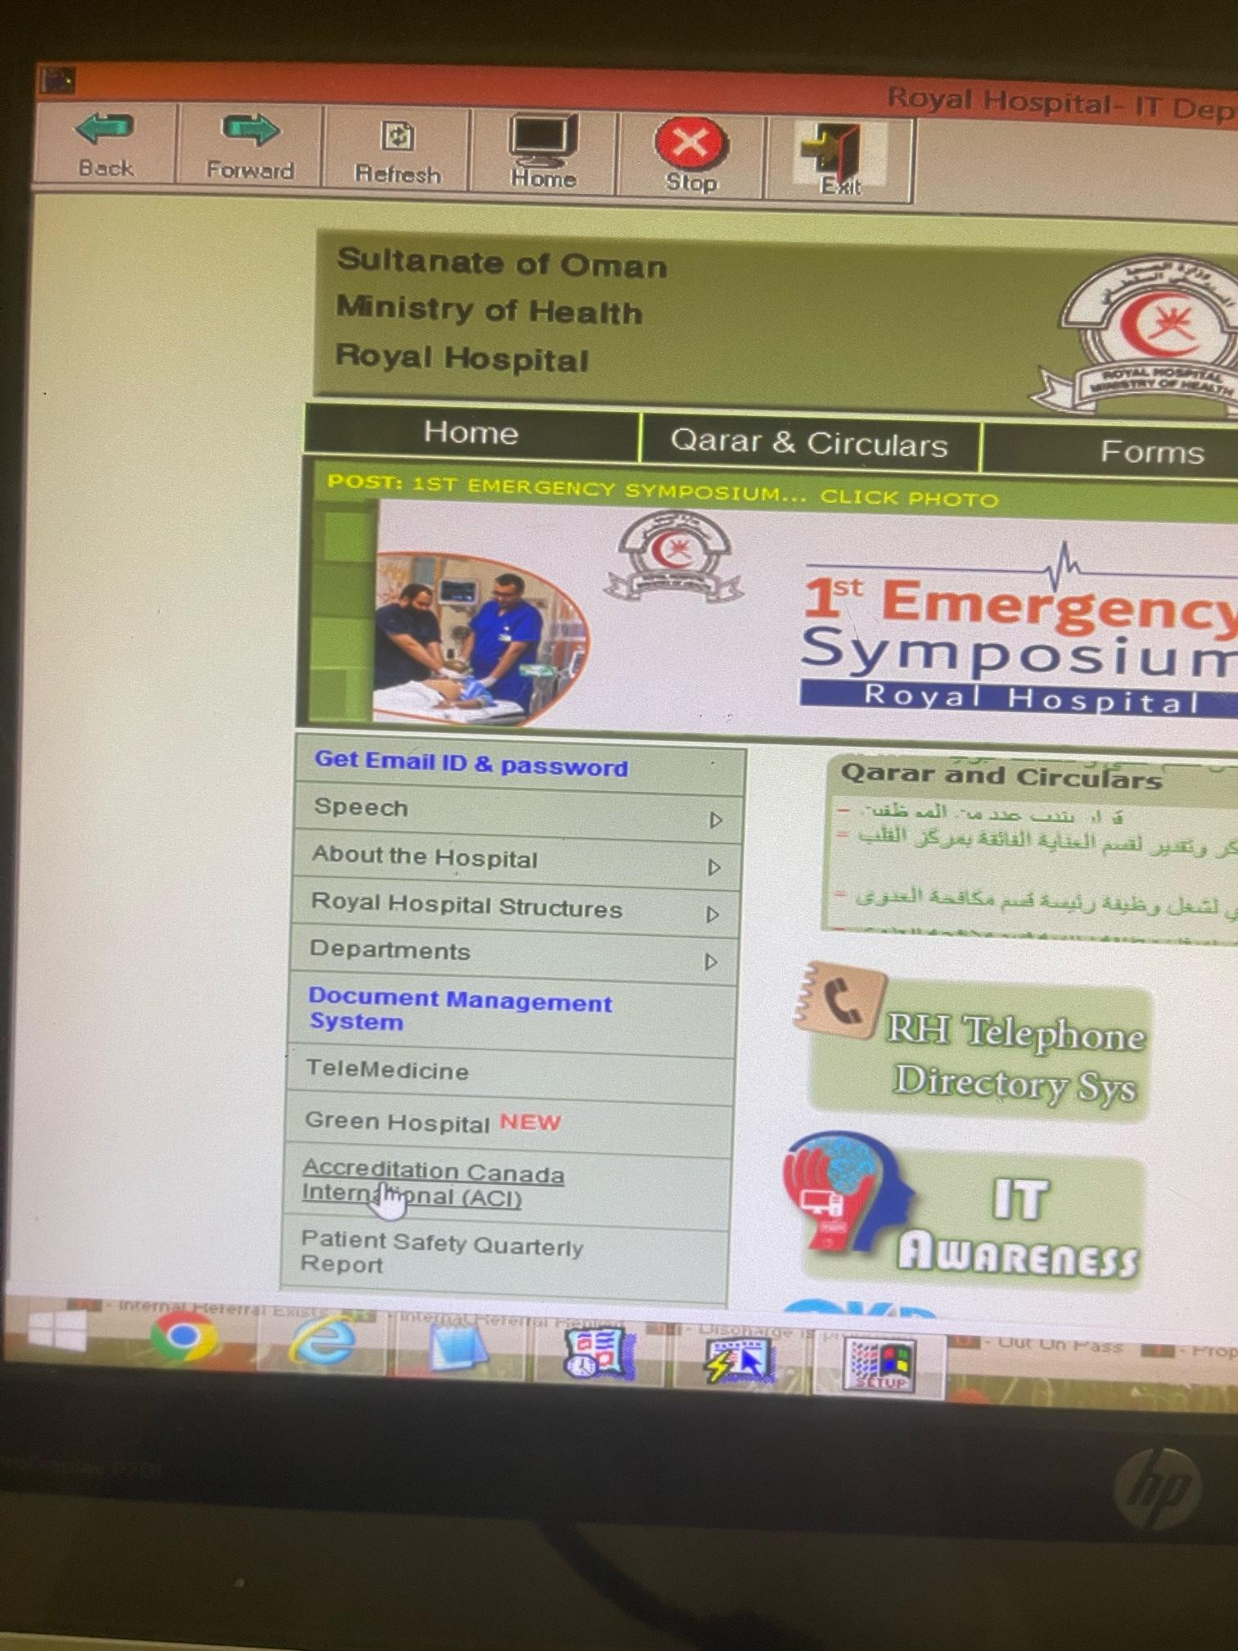
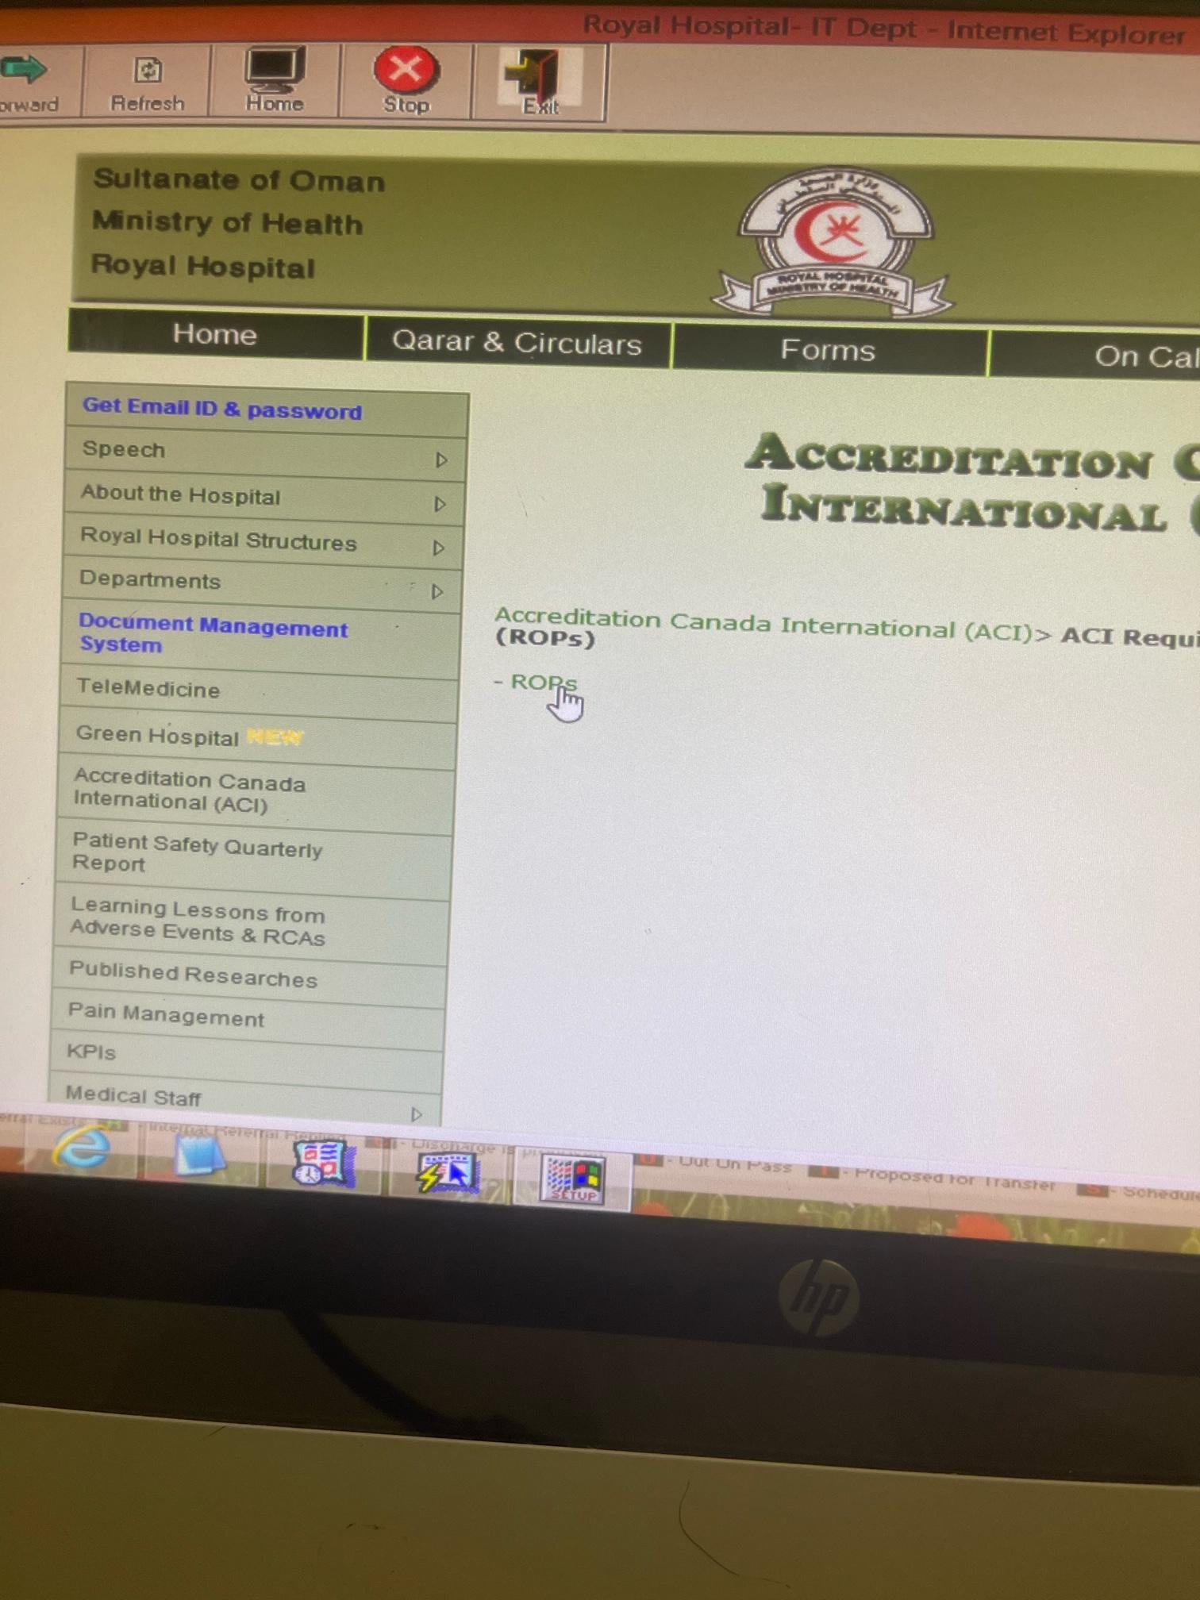
Risk assessment in royal portal

Slide 27
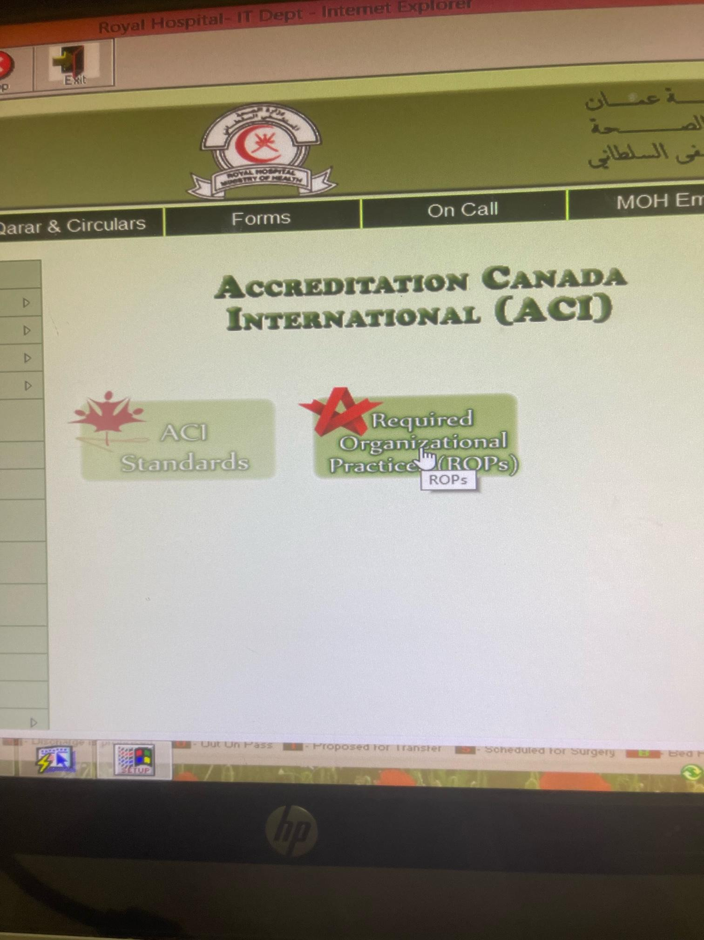
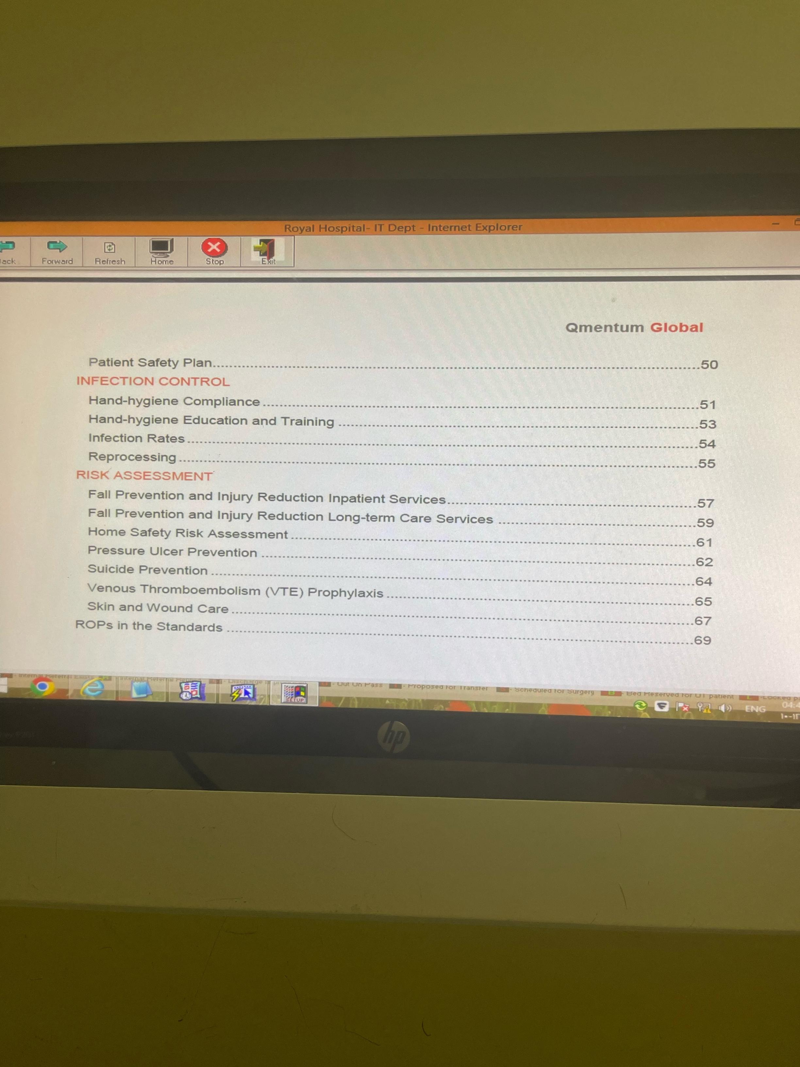
Risk assessment in royal portal

Slide 28


