Slide 1
TOPICs:
MDRO
RSV
Reporter:
Genaline Canete

Slide 2
M-D-R-O
Multi-drug Resistant Organism
When to screen the patient?
When to re-screen?
How to collect swab?
PPE to use

Slide 3
MDRO - Multi-drug Resistant Organism
A bacterial strain that is resistant to 1 or more antimicrobial drugs
MRSA | Methicillin Resistant Staphylococcus Aureus
CRE | Carbapenem -Resistant Enterobacteriaceae
MDR-A | Multi-drug Resistant Acinetobacter
VRE | Vancomycin -Resistant Enterococcus
MDR-P | MDR-Pseudomonas
ESBL | Extended Spectrum Beta- Lactamase
C. AURIS | Candida Auris

Slide 4
WHEN TO SCREEN THE PATIENT?
During admission
MRSA | ACENITOBACTER/CRE
1.Admitted in other hospital w/in past 3 months– all cases | 1. Admitted in other hospital w/in past 3 months– all cases
2. Coming from hospital abroad w/in 6 months - all cases | 2. Coming from hospital abroad w/in 6 months – all cases
3.High risk cases, admitted in RH w/in 3 months | 3.High risk cases, admitted in RH w/in 3 months
4.Admitted in Intensive Care Units | 4.Admitted in Intensive Care Units
5. Any high risk patient (CVC, wound, tracheostomy, gastrostomy, urinary catheter | 5. Any high risk patient (CVC, wound, tracheostomy, gastrostomy, urinary catheter
6.If undergoing liver & cardiac surgery, CAPD, Hemodialysis

Slide 5
VRE | Candida Auris
1. All patients coming from other hospital | 1. All patients coming from other hospital w/in the past 4 weeks
2. Admitted to Oncology Ward | 2. Hospitalized abroad
3. Admitted to Nephrology Ward , on Dialysis | Patients coming from Khoula Hospital, to do rectal swab for Candida auris
4. Known previous VRE +
5 .Patient on Hemodialysis or Peritonial Dialysis

Slide 6
Direct admission from other hospital :
If URGENT admission with unknown screening result patient can be accepted and screening to be done here in RH. And to place the patient in contact precaution if admitted in critical areas (PICU, PHD, NICU, AICU, MHD) till the result released. If the result is +, continue contact isolation precaution as per policy
If NON-URGENT admission result is a MUST before accepting the patient, accordingly bed can be arrange if isolation or not If result from referring hospital is (-) standard precautions should be applied. If result is (+), referring hospital should fax the result to the concerned area of admission

Slide 7
Transferring patient to other hospital
Patient can be screened before shifting to other hospital if they are not on antibiotics and not known to have been colonized/infected with MDROs.
In case the patient is still on antibiotics, inform the receiving hospital that the screening is not indicated

Slide 8
WHEN TO RE-SCREEN ?
MRSA + | Upon admission, ask mother if decolonization done at home? if “yes” , to re-screen. If “no” or “incomplete”, no need to re-screen. Complete Decolonization –bath given BID x 7 days Document the reason why it was not done
CRE + | After 6 months from + result
VRE + | Rescreening is done monthly for chronic frequently admitted patient
 | ------ NOTE -----
 | Screening/ re-screening should not be done if patient on antibiotic. After antibiotic to wait for 72 hours, then to repeat screening

Slide 9
Sites to swab?
Specimen | MRSA | MDRA/CRE | VRE
Culture (charcoal) | Nasal, axilla, groin | Throat & rectal | Rectal swab
 | Tracheostomy site | Tracheostomy site
 | ET secretion (ventilated pt.) | ET secretion (ventilated pt.)
 | Wound (if present) | Wound (if present)
PCR (red top) | Nasal swab (Only for cases posted for urgent cardiothoracic surgery | -----NONE---- | ---NONE---
Urine culture sterile container | Urine (catheterized patient) | Urine (catheterized patient)

Slide 10
HOW TO COLLECT SWAB?
MRSA screening:
Nasal swab | Insert the swab into the first nostril next to the nasal septum. Rotate the swab against the anterior nasal mucosa for 3-5 seconds. Use the same swab, repeat it to the other nostril.
Axillary and Groin swabs | Clean the site first with Normal Saline to remove debris Pre-moisten the swab with sterile Normal Saline before swabbing Use the same swab for identical sites: ---one swab for both axilla ---and one swab for both inguinal areas.

Slide 11
CRE, MDRAB, VRE screening:
Throat swab | Rotate the swab against the tonsillar area and pillars of the fauces for 3-5 seconds.
Rectal swab | Rotate the swab against the external orifice. If visible stool is not obtained on the swab, insert it few cm into the rectum until visible stool is obtained.

Slide 12
GENERAL PROCEDURE IN COLLECTING SWAB:
Before collecting, explain the procedure to the patient/parents. Provide privacy and comfort. Do hand hygiene and wear disposable gloves Swab wounds/skin lesions/incisions/ulcers or central line exit site if present with separate swabs. Carefully place used swab back into transport tube, and secure. All swabs collected should be correctly labeled with patient sticker or hospital number, screened site and MDRO code (MRSA, CRE, MDRAB, VRE, C.auris….etc) for screening Make sure that the patient is not on antibiotic for the last 72 hours.

Slide 13

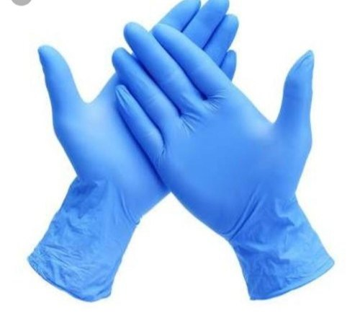

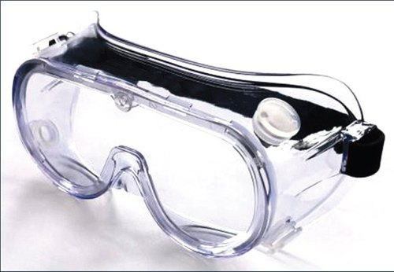

PPE FOR MDRO
1. Gown 2. Surgical mask 3. Gloves
4. Face shield or goggle if there ‘s a risk of splashing of blood and body fluids .

Slide 14
Things to remember:
Any patient screened for MDRO should be isolated till result is released
Any patient positive or suspected for MDRO should follow contact isolation policy .
Isolation precaution can be done by placing patient in single room
or cohort when single room is not available and where several patients with same confirmed organism eg. MRSA
Treat all body fluid as potentially infectious
Dispose waste according to hospital policy adhering aseptic technique when requiring

Slide 15
Admission :
“Contact Isolation sign” to put outside
patient’s room/ bed.
Keep equipment and supplies in the area to a minimum eg. Iotion, shampoo.
Shifting :
If patient for shifting to ward, inform the
receiving ward that the patient is isolation.
An isolation form must be filled by the doctor prior to shifting.

Slide 16
After discharging/shifting patient:
Terminal cleaning of the room must be done
Curtain to be removed before cleaning.
Nurses must clean all medical and nursing
equipments and cables with appropriate
disinfectant .
Remove equipments from the IV stand. Then to be removed from the room to allow cleaning and disinfect room/bed thoroughly.
Curtain:
Curtain must be changed on termination of isolation and every 2 weeks if isolation continues longer 2 weeks.

