Slide 1
R S V
Respiratory Syncytial Virus

Slide 2
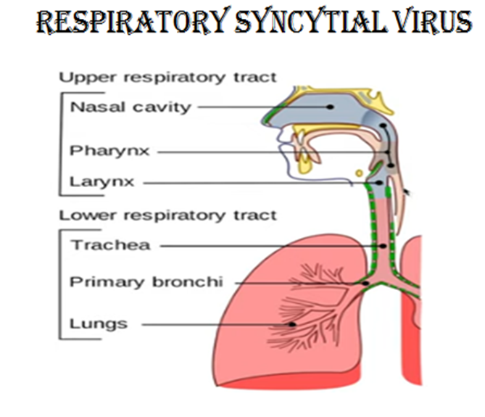
RSV is the most common cause of upper and lower Respiratory Tract Infection

Slide 3
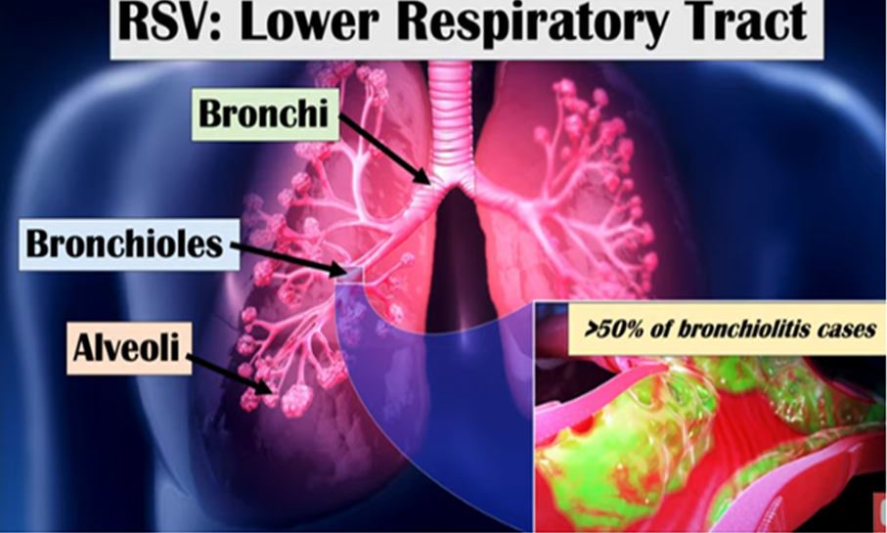
RSV is the most common cause of LRTI like Bronchiolitis and Pneumonia in Infant and children less than 2 years old. And it commonly occurs during winter. And hospitalization is higher in premature infants and less than 6 months old babies.

Slide 4
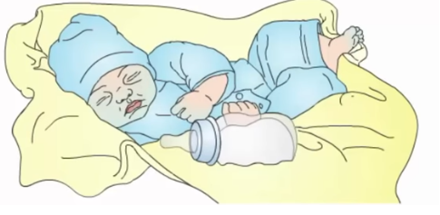
Signs & Symptoms of RSV:
Most commonly appear about 2-6 days after exposure to the virus. RSV usually causes mild cold-like signs and symptoms.
In infants --symptoms maybe
cough
colds
irritability
decreased activity
decreased oral intake,
lethargy
In severe cases
In some children may have:
Fever
Severe cough
Wheezing
Tachypnea or difficulty of breathing
Cyanosis

Slide 5
RSV Transmission:
RSV is easily spread by:
physical contact.
Touching
Kissing
shaking hands
touching contaminated objects like table, crib
droplets
During coughing or sneezing
Suctioning of secretions
RSV can survive several hours on hands and infected areas

Slide 6
HOW IS PCR NASAL SWAB COLLECTED
Nasal swab | Insert the swab into the first nostril next to the nasal septum. Rotate the swab against the anterior nasal mucosa for 3-5 seconds. Use the same swab, repeat it to the other nostril.

Slide 7
Treatment and Management of RSV
Depends on symptoms, age and severity of the condition .
IV fluid- for hydration
Suctioning - to clear the airway
NGT feeding - if not contraindicated
Ventilation - maybe simple O2 nc, to hfnc, to NIV -if pt. is very sick and distress
Medication
Nebulization
Antipyretic – if with fever
Antiviral – TAMIFLU – given only after RSV swab collected.
-TAMIFLU -- is indicated for influenza virus.
-- not effective with RSV
-- does not treat other flu-like viral infections like RSV
-- once RSV result is +, to stop Tamiflu

Slide 8


