Slide 1

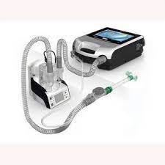
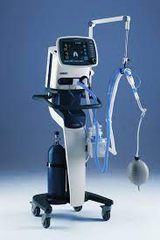
NIV and HFNC weaning protocol
Samah AL-Yahamdi

Slide 2
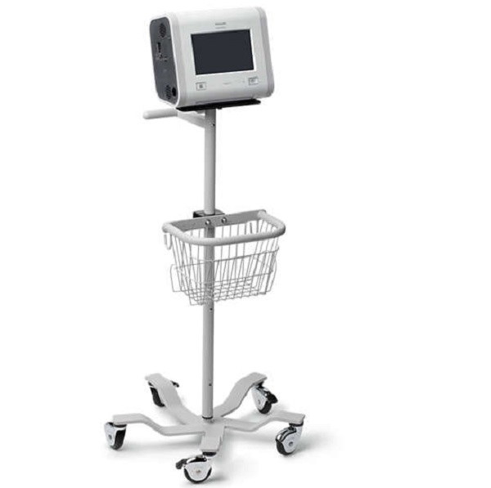
Non-invasion ventilation(NlV)and high flow nasal cannula (HFNC) are used as mods of respiratory treatment in the pediatric population. They are initiated as first line respiratory support patients with respiratory distress.

Slide 3
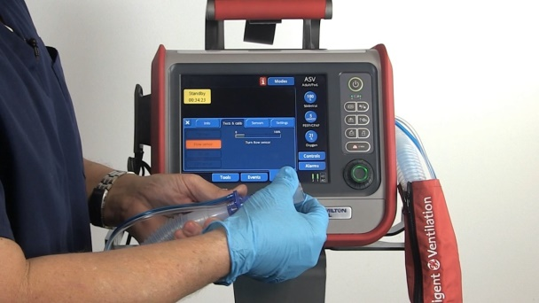
Advantages over invasive ventilation include: 1-preserving spontaneous respiratory effort 2-Reducing acute lung injury related to invasive ventilation. 3-Reducing need for sedation and analgesia. 4-Reducing risk of ventilator associated pneumonia.

Slide 4
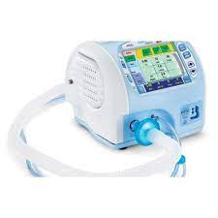
Indication for non-invasive ventilation use:
1-Childern presenting with respiratory distress with/ without abnormal blood gas results ( PH < 7.3, pco2 50-60mmhg with spo2 <92% in RA).
2-Upper airway obstruction such as sleep apnea or post extubation stridor.
3-Apnea with Consideration of early ventilation mechanical ventilation of patients apnea or significant apnea.

Slide 5
Contraindations for use of NIV:
1-Need for immediate airway intubation for peri-arrest situations.
2-Significant hemodynamic instability and inotropic need.
3-Encephalopathy and inability to control airway and secretions.
4-Recurent apnea.
5-ARDS with severe hypoxia.
6-Recent abdominal surgery including unrepaired trachea-esophageal diaphragmatic hernia.

Slide 6
initiation and monitoring of NIV:
The indication of initiation of NIV should be reviewed with attending consultant. It is advised to start with lower pressure on NIV settings with gradual increase to allow the patient . the patient should be continuously monitored for heart rate, respiratory rate and oxygen saturation.
It is a must that frequent and regular physical assessment are carried for signs of deterioration or improvement. Most of the responders to NIV show response within the initial 2 hours of start NIV. However, some of the patients may have delayed response. Children with clinical response improve with regard to their respiratory effort, heart rate, oxygen saturation and gas exchange. Pediatric ICU team should be in patients with significant respiratory distress on presentation and in patients with no clinical response following the initial 2 hours of treatment or eat signs of significant respiratory distress or failure.

Slide 7
For initiation and monitoring
NIV interface:
The interfaces in use are nasal masks , oro _ nasal masks and total face masks. An ideal interface should be comfortable, has minimal air leak around the mask and cause minimal claustrophobia(irritability).
The interface selection should be individualized but, the following suggestions are to be considered:
Nasal masks/nasal prongs: They are used for neonates and small infants. Aim to minimize the leak from mouth with use of pacifier.
Oro-nasal interfaces and total face masks : for older infants and children

Slide 8
NIV devices in use:
Available devices include NIV devices such as trilogy and conventional ICU ventilators. NIV modes include CPAP where fixed continuous positive pressure is used throughout the respiratory cycle and BIPAP mode which use 2 different pressure. Pressure on BIPAP mode include IPAP or PIP ( inspiratory positive pressure) representing peak inspiratory pressure and EPAP( expiratory positive pressure) representing positive airway pressure during expiration. There is minimum difference of 4 between IPAP and EPAP to generate effective tidal volume.

Slide 9
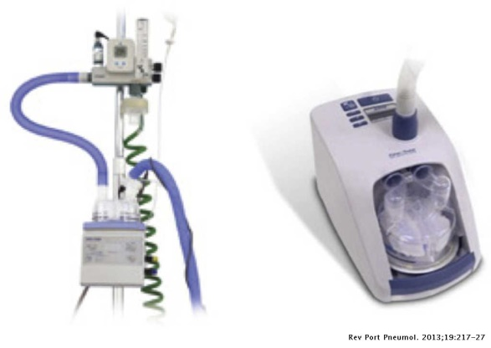
Caring for a child on NIV:
Infants and children on NIV should have continuous monitoring of their vital signs with appropriate nursing ration to ensure adequate delivery of care.
Medical and nursing care should include the following:
* use of artificial tears every 4-6hours when face masks are used to prevent dryness of eyes.
*Use of nasogastric feeding tube for air decompression.

Slide 10
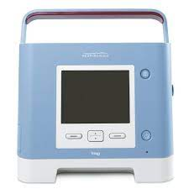
Weaning of NIV: weaning is initiated once the child's respiratory improves.

Slide 11
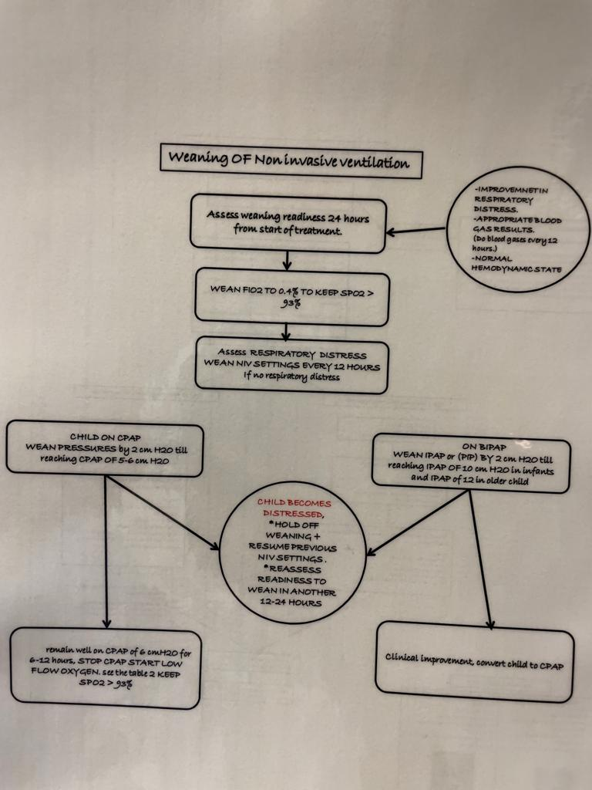

Slide 12
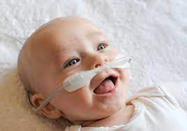
High flow nasal cannula treatment: HFNC delivers a humidified oxygen and gas mixture heated to approximately 34*c, allowing higher air flow rates exceeding 2L/minute . These feature enable the delivery of air flow equal greater than the inspiratory flow of a spontaneously patient. The use of HFNC has board indications, including different causes of respiratory distress. Overall ,HFNC is most common used among children with bronchiolitis and pneumonia. In this instuation, we reserve use of HFNC for infants and children with milder respiratory distress.

Slide 13
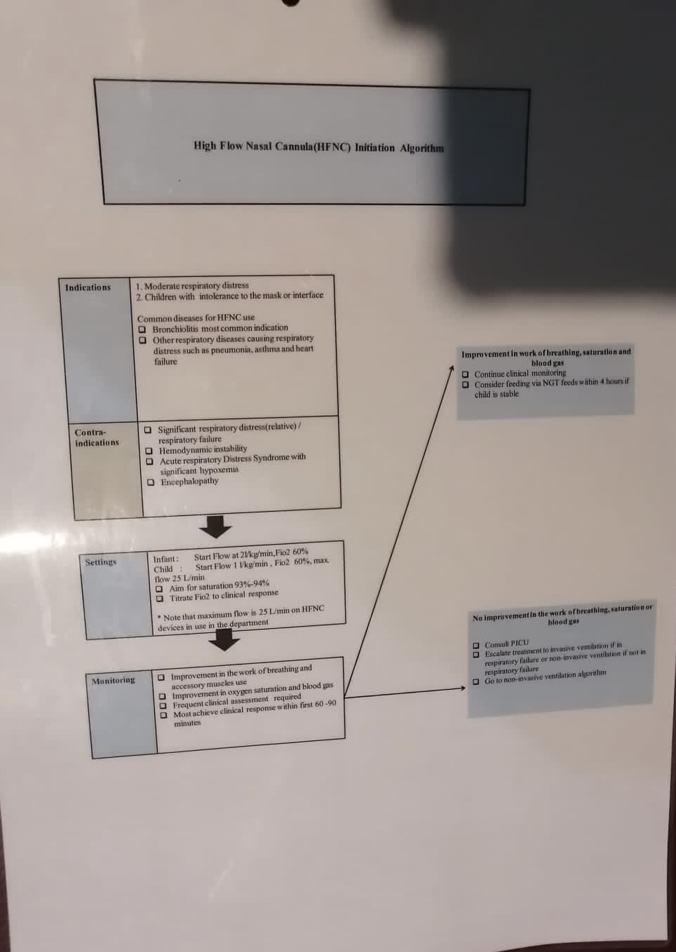

Slide 14
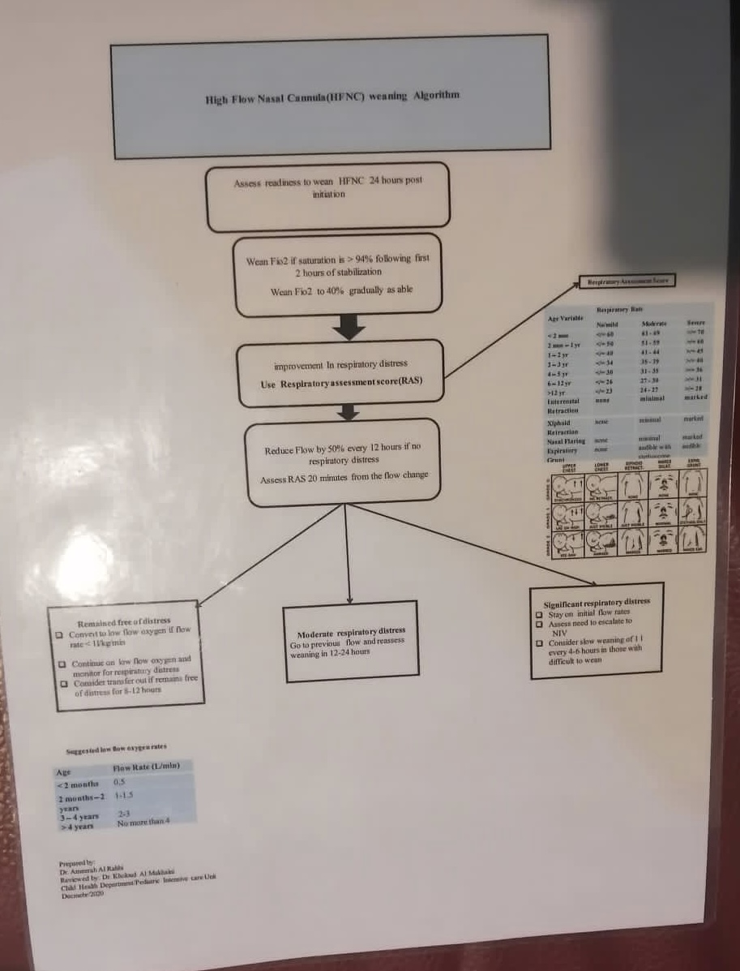

Slide 15


