Slide 1


Slide 2
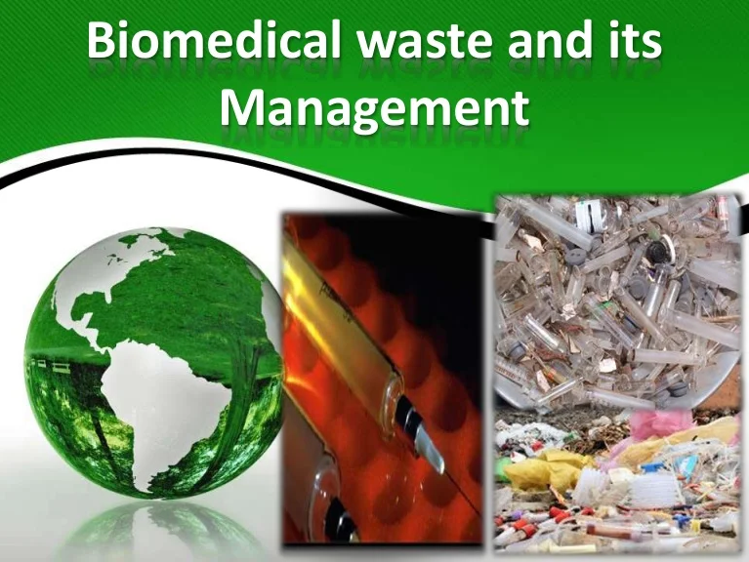
Anumol Unni
PHDU
STAFF ID 90235

Slide 3


Slide 4
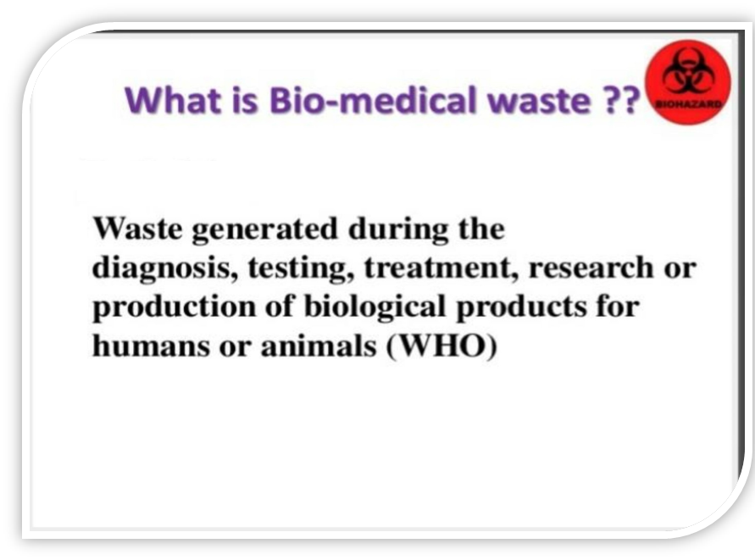


Slide 5
PURPOSE OF POLICY
To provide a safe working environment for the patient, staff and public and reduce waste disposal volumes and cost without compromising health care standards and to ensure compliance of all health care workers to the appropriate management of wastes especially for those who are likely to be exposed to hazardous materials.

Slide 6
DEFINITION
Waste disposal policy provided the method for handling transporting and disposing infectious waste to ensure cost reduction and safety of HCWs, sanitation workers and the general public.

Slide 7
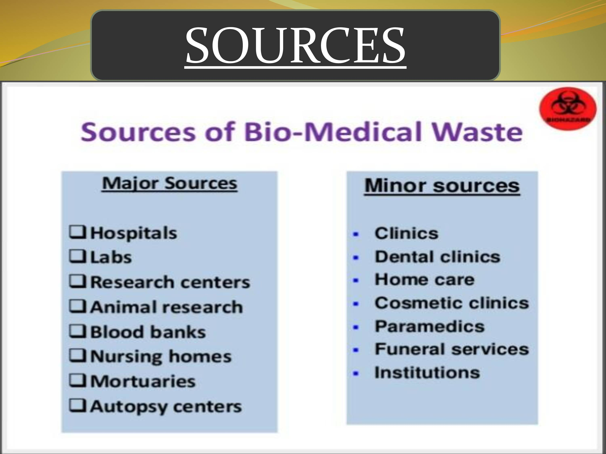

Slide 8
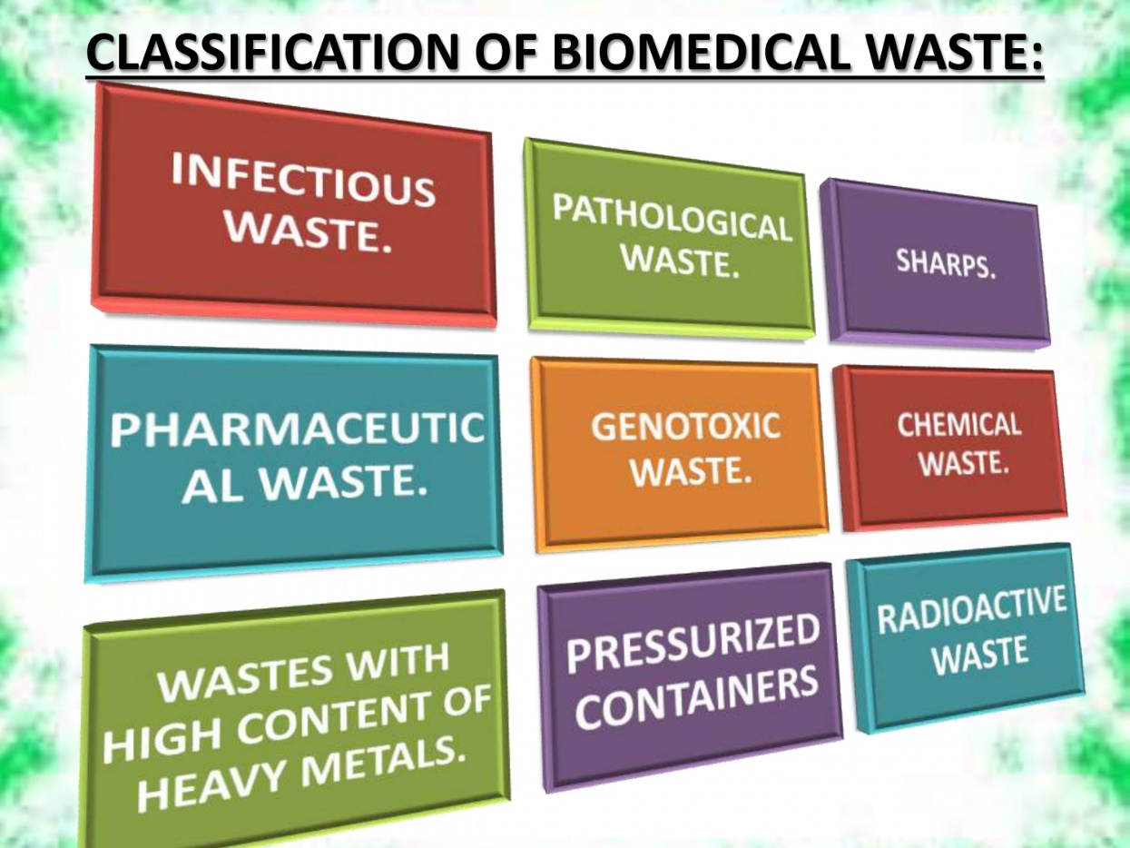


Slide 9

CLASSIFICATION OF BIOMEDICAL WASTE:
1. INFECTIOUS WASTE:
Waste contaminated with blood and other bodily fluids (e.g. from discarded diagnostic samples),
cultures and stocks of infectious agents from laboratory work (e.g. waste from autopsies and infected animals from laboratories),
or waste from patients with infections (e.g. swabs, bandages and disposable medical devices);

Slide 10
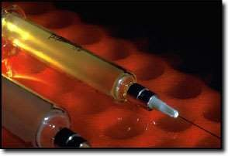
2.PATHOLOGICAL WASTE:
It consists of tissues,
parts,
organs, human
body
fetuses, and
blood, and body fluids.

Slide 11
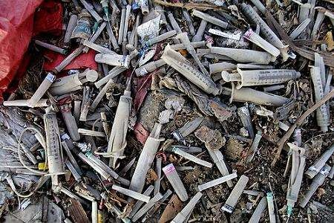
3. SHARPS:
These are the items that could cause cuts or puncture wounds, including;
Needles,
Scalpel and other blades,
Knives,
Infusion sets,
Saws,
Broken glass, and nails.

Slide 12




4.PHARMACEUTICAL WASTE:
It includes expired, unused, spilt, and contaminated
Pharmaceutical products,
Drugs,
Vaccines, and sera

Slide 13


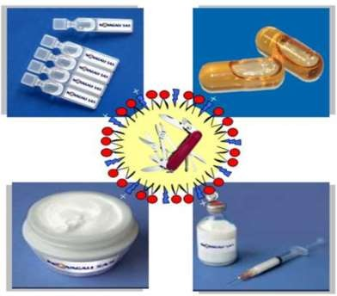
5. GENOTOXIC WASTE:
highly
Genotoxic waste is hazardous and may have;
Mutagenic,
Teratogenic, or
Carcinogenic properties.

Slide 14
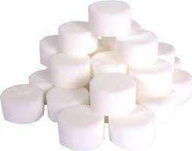
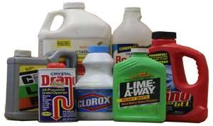

6. CHEMICAL WASTE:
It consists of discarded
Solid,
Liquid, and
Gaseous chemicals

Slide 15









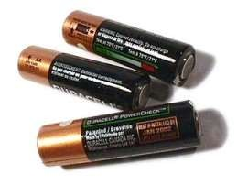
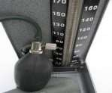
7. WASTES WITH HIGH CONTENT OF HEAVY METALS:
It represents a subcategory of hazardous chemical waste, and is usually highly toxic.
It includes
Batteries,
Broken thermometer,
Blood-pressure gauges.

Slide 16




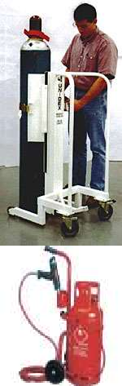

8. PRESSURIZED CONTAINERS:
Many types of gas are used in health care, and are often stored in pressurized cylinders, cartridges, and aerosol cans.
Most common gases used in health care includes:
Anesthetic gases
Ethylene oxide
Oxygen
Compressed air

Slide 17

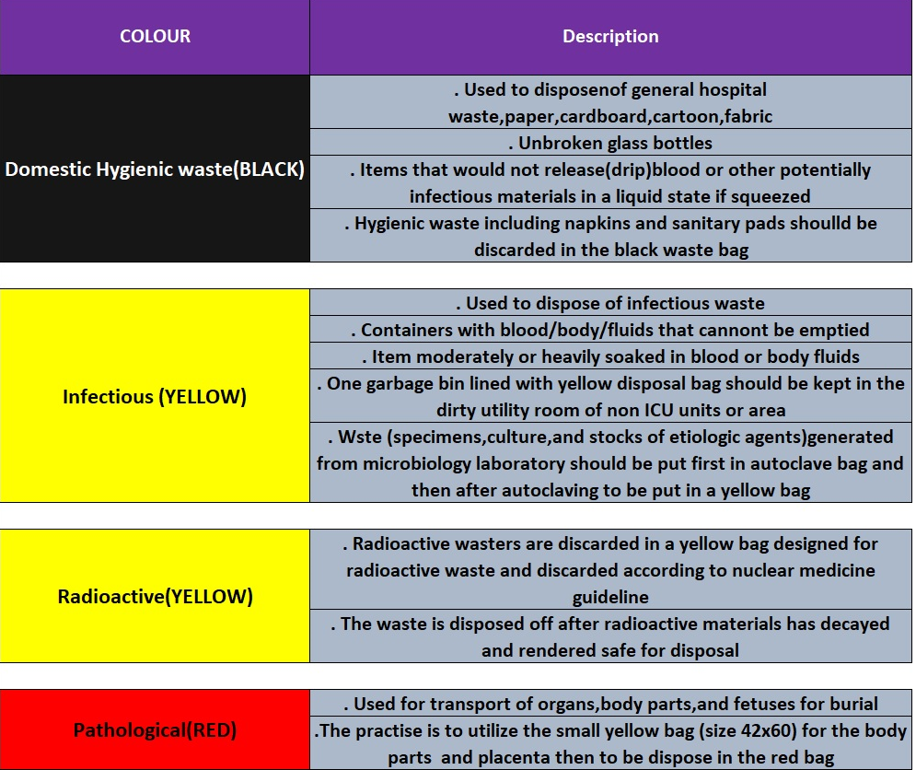
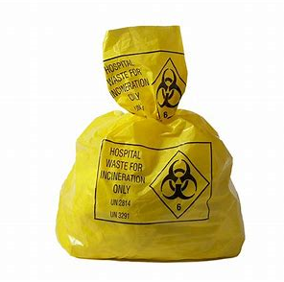
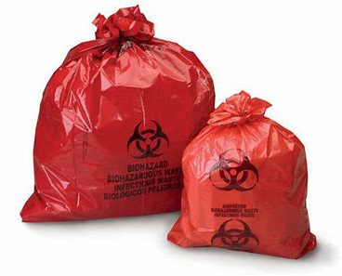
Colour Coding & Methods of disposal of bio-medical waste and their segregation

Slide 18
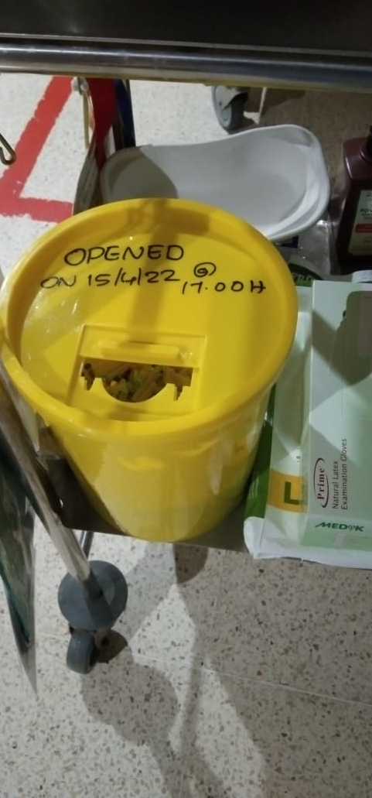
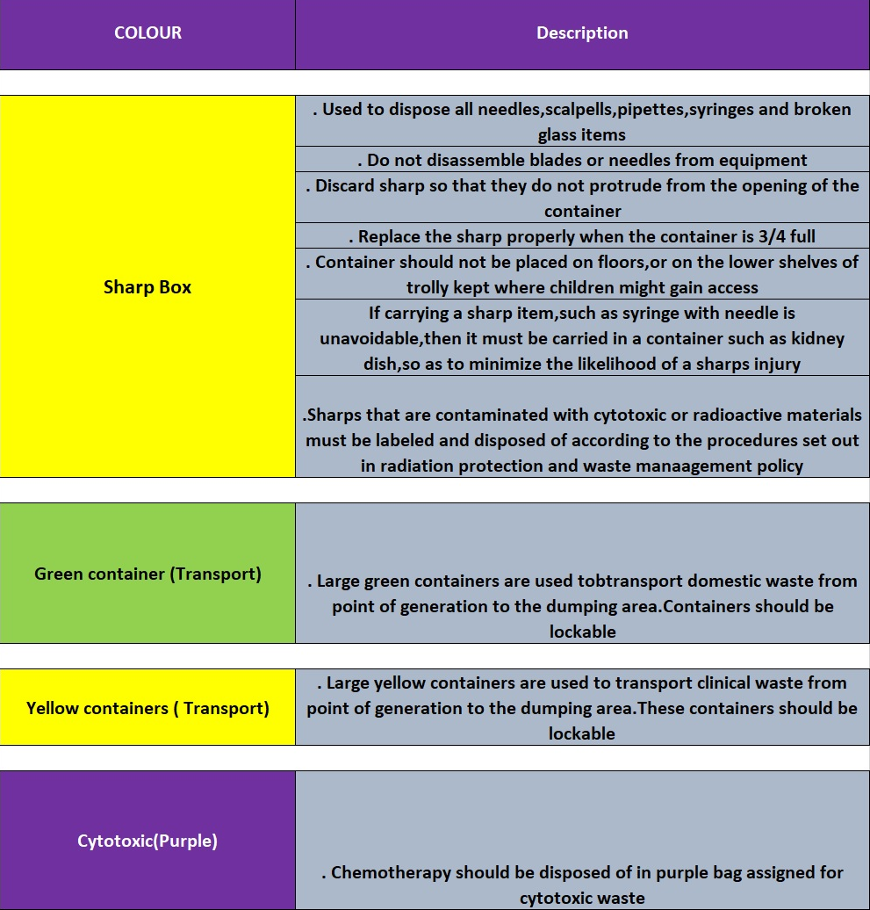
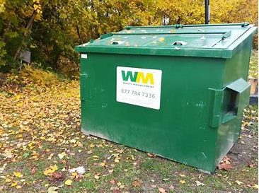
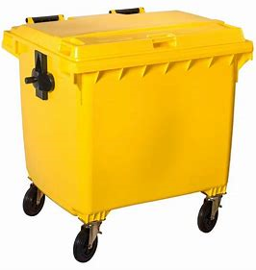
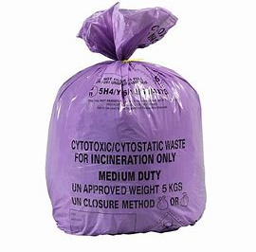
Colour Coding & Methods of disposal of bio-medical waste and their segregation

Slide 19
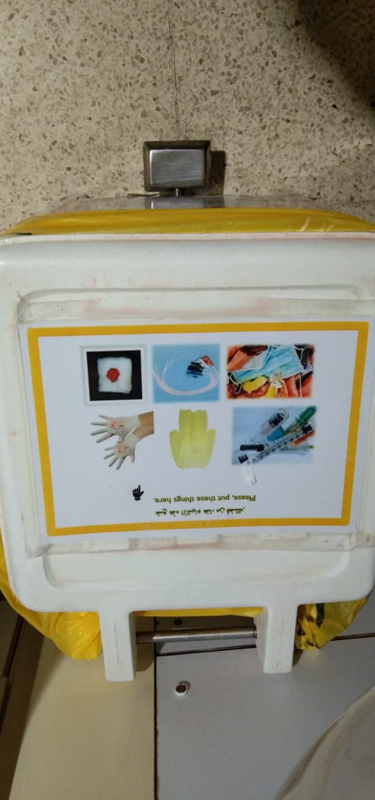
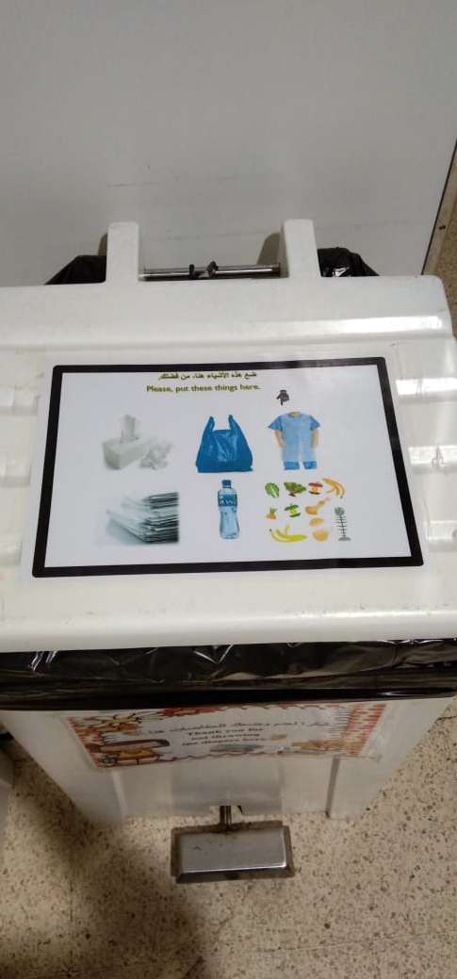
Waste box located PHDU

Slide 20
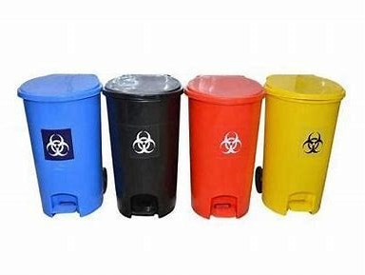
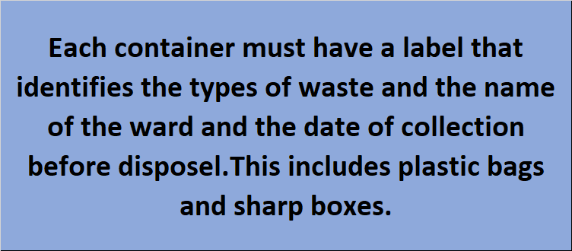
Container Labeling

Slide 21

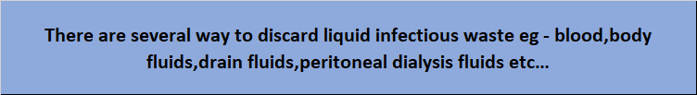
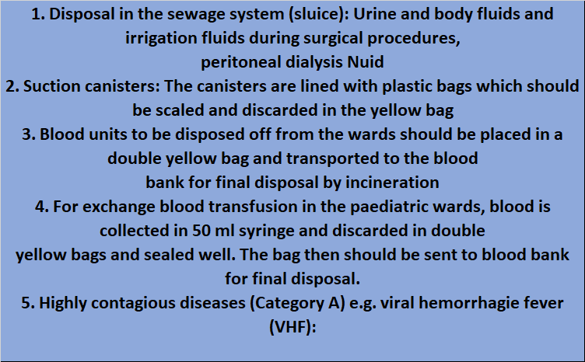
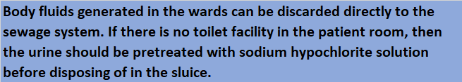

Slide 22
Housekeeping services should:
Pick up waste at least once per day and as needed.
Handle bags at the top so that the bags do not come in contact with the body.
Do not use hands to compress (squeeze) waste in containers/bags.
Tie bags securely before placing them in a temporary holding area such as a dirty utility room.
Do not store waste bags in hallways or corridors.
Dispose sharp box when it is ¾th full.
Fasten the cover of a full sharps container securely before removing.
Decontaminate disposal bins/containers or frames when visibly soiled and leaned weekly with hospital- approved disinfectant.
Decontaminate carts used for transporting waste within the hospital daily using a hospital-approved disinfectant solution.
Use leak-proof carts that are readily cleanable to transport infectious waste from the point of generation or storage to the point of disposal and treatment.
Place yellow bags in a holding area for incineration.
Pick up and discard broken glass using a mechanical device such as forceps or a brush and dustpan.
Broken glass should never be handled with gloved or non-gloved hands.

Slide 23
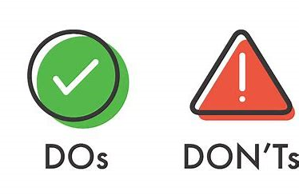
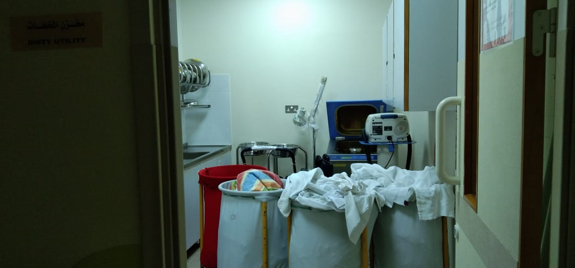
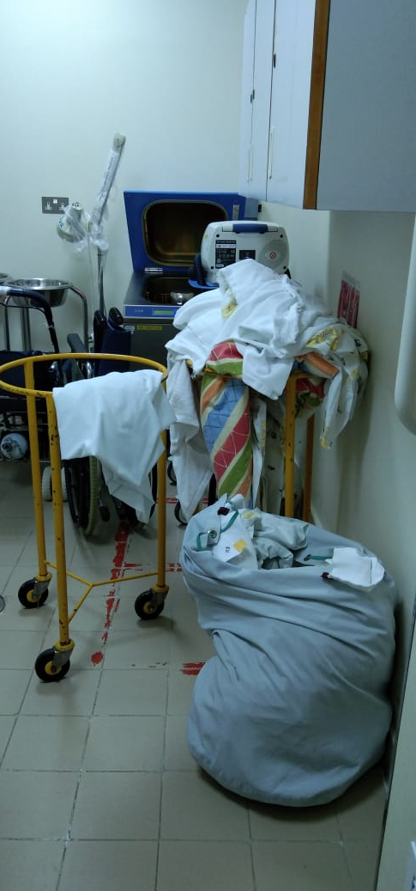

Slide 24
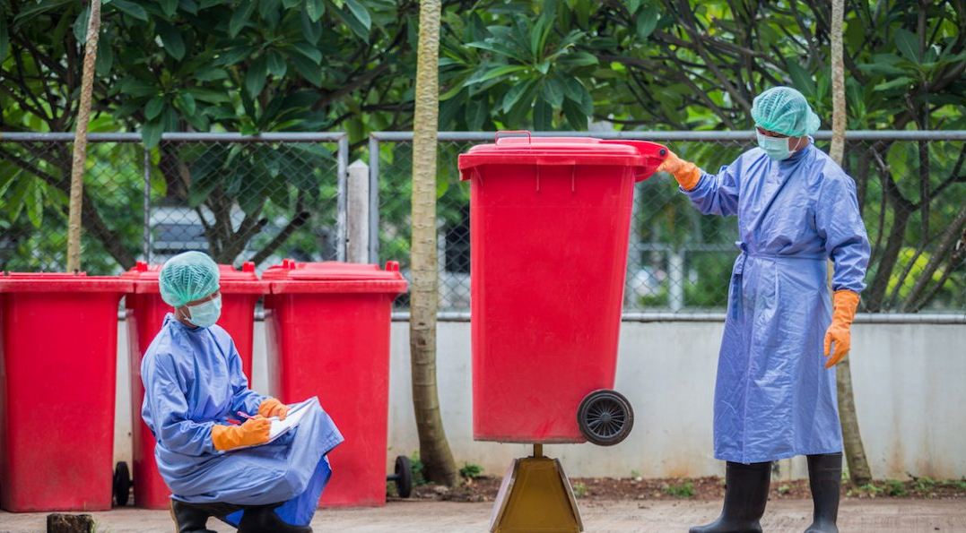
STORAGE & TRANSPORT
Storage facility at Royal hospital is outside the building, locked and a sign posted at the entrance.
There is restriction of access to this area.
During movement of wastes segregation must be maintained and the batch of waste managed according to the component with the highest level of risk.
The staff should wear gloves during transport Waste
On-site transport of waste is usually from the initial storage point to an assembly storage or treatment area by means of trolleys, which have a solid base and bounding to contain spills. Trolleys used for the movement of clinical wastes are designed to prevent leakage, easily cleaned and minimize manual handling
Waste collection rounds should be performed so as to minimize housekeeping hazards associated with the storage of waste at ‘user’ sites .

Slide 25
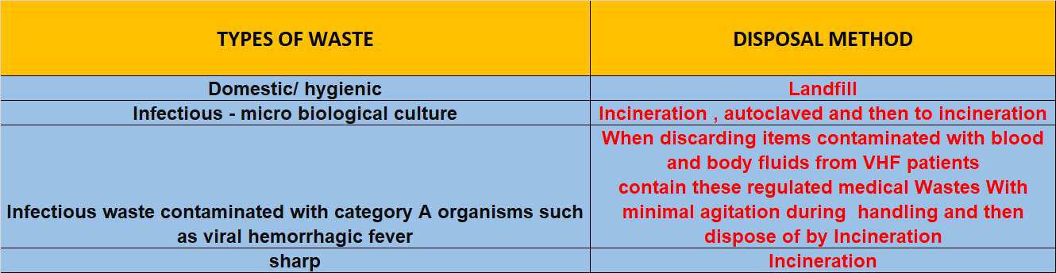
DISPOSEL OF WASTE

Slide 26
FOR MORE INFORMATION REFFER :
ROYAL PORTAL
DOCUMENT MANAGEMENT SYSTEM
SEARCH DOCUMENTS
TYPE WASTE

Slide 27
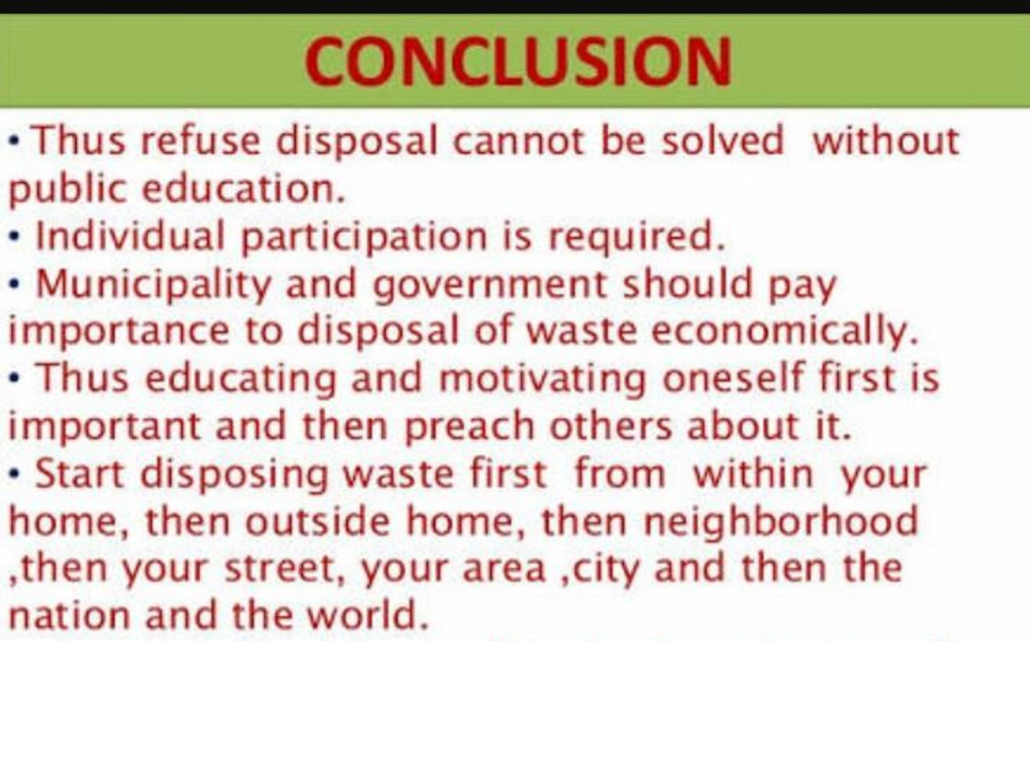

Slide 28


Slide 29


