Slide 1
Voıce gender analysıs
Nurselİ bal
201611656
Çankaya Unıversıty department of computer engıneerıng

Slide 2
Content of presentatıon
Speech and Voice
Software Environment
Voice Data
Preprocessing
Classification Methods
Workflow
Results

Slide 3
Speech and voıce
Speech and voice undentifies people.
We can understand emotions from voice melody and speech.

Slide 4
Software envıronment
I used Orange software environment.
Easy to implement
Fast

Slide 5
Voıce data
20 different attributes
1 label as male and female
Attributes are numeric, the label is categorical
Classification methods will be used.
Application areas are speech emotion recognition, human to machine interaction, muting sounds for a gender, and etc.
From Kaggle (https://www.kaggle.com/)

Slide 6
Preprocessıng
Preprocessing is a technique to prepare our data.
2 techniques have been used.
Ranking for feature selection
Outliers to clean the outliers.

Slide 7
Classıfıcatıon methods
After preprocessing, we are ready to classify.
4 classification methods have been used.
SVM
Random Forest
kNN
Naive Bayes

Slide 8
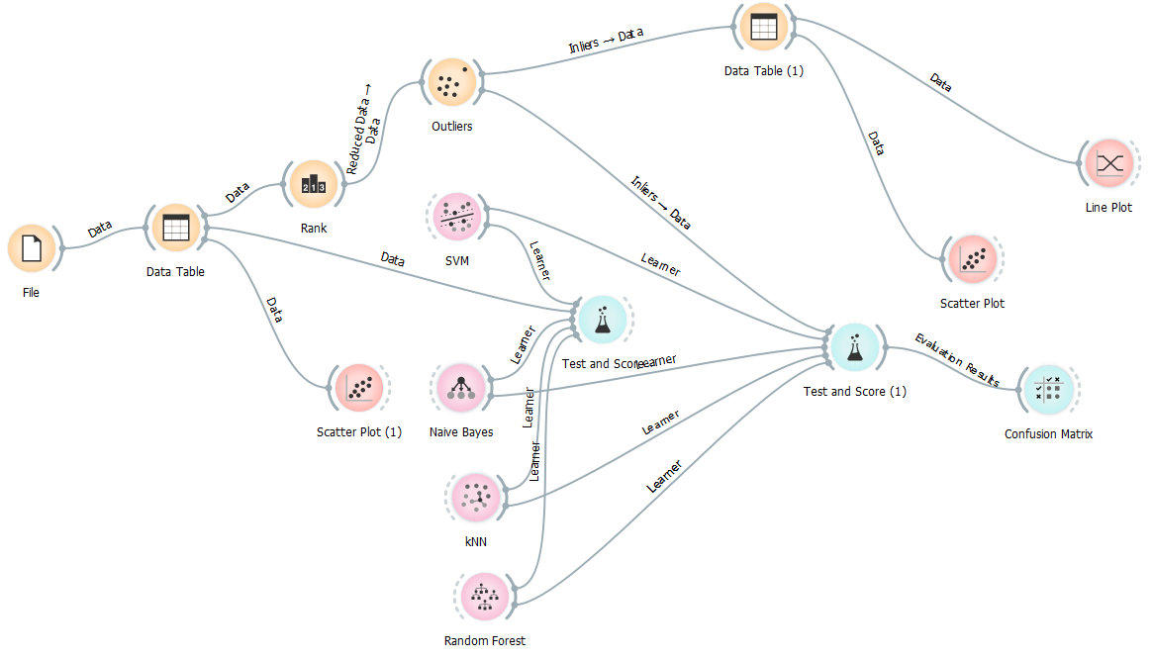
Workflow

Slide 9
Results
After classification, we have results
Classification metrics results: CA(Accuracy Classification Score), Precision, Recall have been used.
CA gives the results from unseen records.

Slide 10
Results cont’d
Scores
Scores
Scores
Scores
Scores
Before Preprocessıng
After preprocessıng
Model | Train time [s] | Test time [s] | CA | Precision | Recall
kNN | 0.272 | 0.173 | 0.7196969696969697 | 0.7204085157835645 | 0.7196969696969697
SVM | 2.401 | 0.079 | 0.9738005050505051 | 0.9738837964374766 | 0.9738005050505051
Random Forest | 0.755 | 0.050 | 0.9753787878787878 | 0.9753856087237248 | 0.9753787878787878
Naive Bayes | 0.246 | 0.035 | 0.8873106060606061 | 0.8932706631361563 | 0.8873106060606061
Model | Train time [s] | Test time [s] | CA | Precision | Recall
kNN | 0.090 | 0.088 | 0.9864690721649485 | 0.986532722347536 | 0.9864690721649485
SVM | 0.454 | 0.026 | 0.9890463917525774 | 0.9890532114400742 | 0.9890463917525774
Random Forest | 0.271 | 0.034 | 0.9851804123711341 | 0.9851994539154811 | 0.9851804123711341
Naive Bayes | 0.082 | 0.013 | 0.9774484536082474 | 0.9776721148160527 | 0.9774484536082474

Slide 11
Results Cont’d Confusıon matrıx result of knn
Confusion matrix of kNN before the preprocessing
Confusion matrix of kNN after the preprocessing
 |  | Predicted
 |  | female | male | ∑
Actual | female | 1102 | 482 | 1584
 | male | 393 | 1191 | 1584
 | ∑ | 1495 | 1673 | 3168
 |  | Predicted
 |  | female | male | ∑
Actual | female | 755 | 11 | 766
 | male | 5 | 781 | 786
 | ∑ | 760 | 792 | 1552

Slide 12
Results Cont’d Confusıon matrıx result of Naıve bayes
Confusion matrix of Naive Bayes before the preprocessing
Confusion matrix of Naive Bayes after the preprocessing
 | Predicted
 |  | female | male | ∑
Actual | female | 1308 | 276 | 1584
 | male | 86 | 1498 | 1584
 | ∑ | 1394 | 1774 | 3168
 | Predicted
 |  | female | male | ∑
Actual | female | 746 | 20 | 766
 | male | 6 | 780 | 786
 | ∑ | 752 | 800 | 1552

Slide 13
Results Cont’d Confusıon matrıx result of SVM
Confusion matrix of SVM before the preprocessing
Confusion matrix of SVM after the preprocessing
 | Predicted
 |  | female | male | ∑
Actual | female | 1531 | 53 | 1584
 | male | 53 | 1531 | 1584
 | ∑ | 1584 | 1584 | 3168
 | Predicted
 |  | female | male | ∑
Actual | female | 753 | 13 | 766
 | male | 5 | 781 | 786
 | ∑ | 758 | 794 | 1552

Slide 14
Results Cont’d Confusıon matrıx result of random forest
Confusion matrix of Random Forest before the preprocessing
Confusion matrix of Random Forest after the preprocessing
 | Predicted
 |  | female | male | ∑
Actual | female | 1549 | 35 | 1584
 | male | 35 | 1549 | 1584
 | ∑ | 1584 | 1584 | 3168
 | Predicted
 |  | female | male | ∑
Actual | female | 761 | 5 | 766
 | male | 6 | 780 | 786
 | ∑ | 767 | 785 | 1552

Slide 15
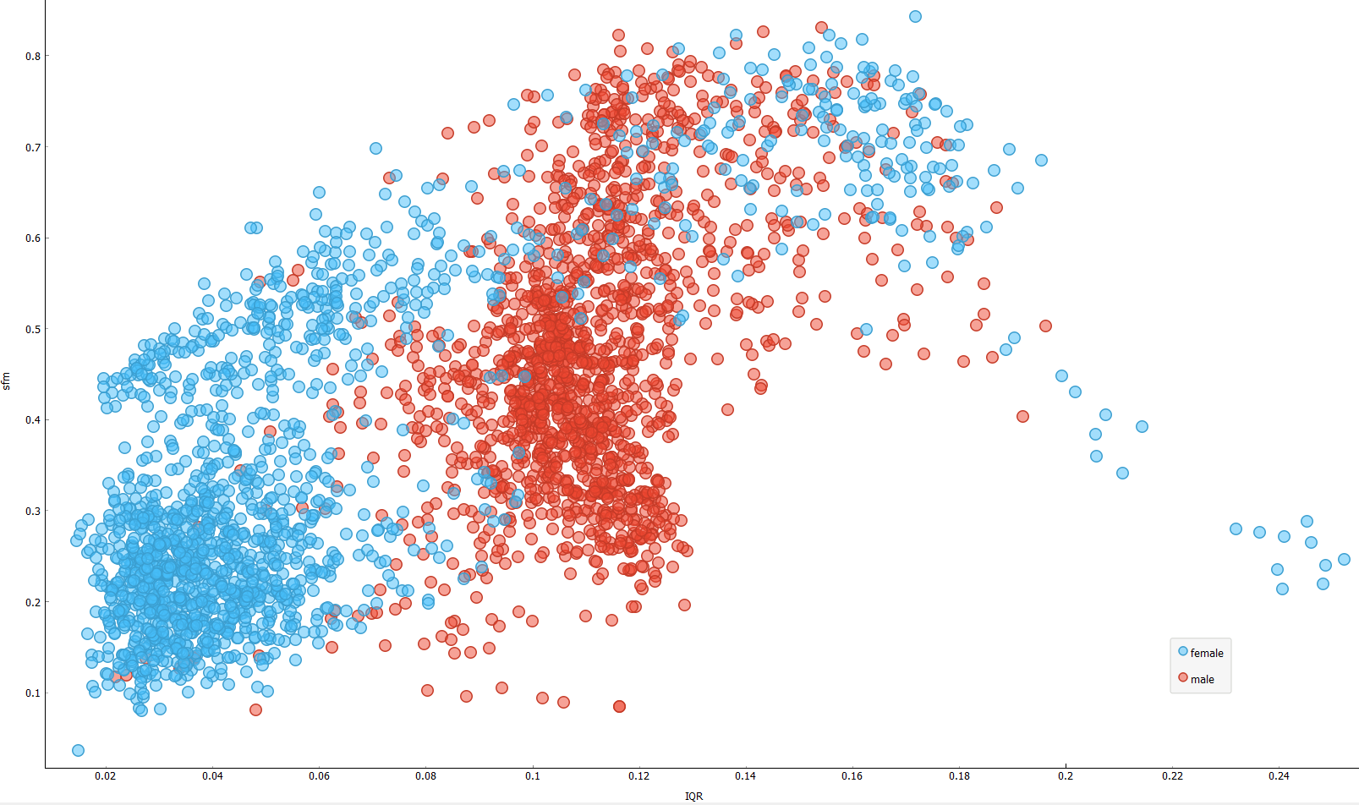
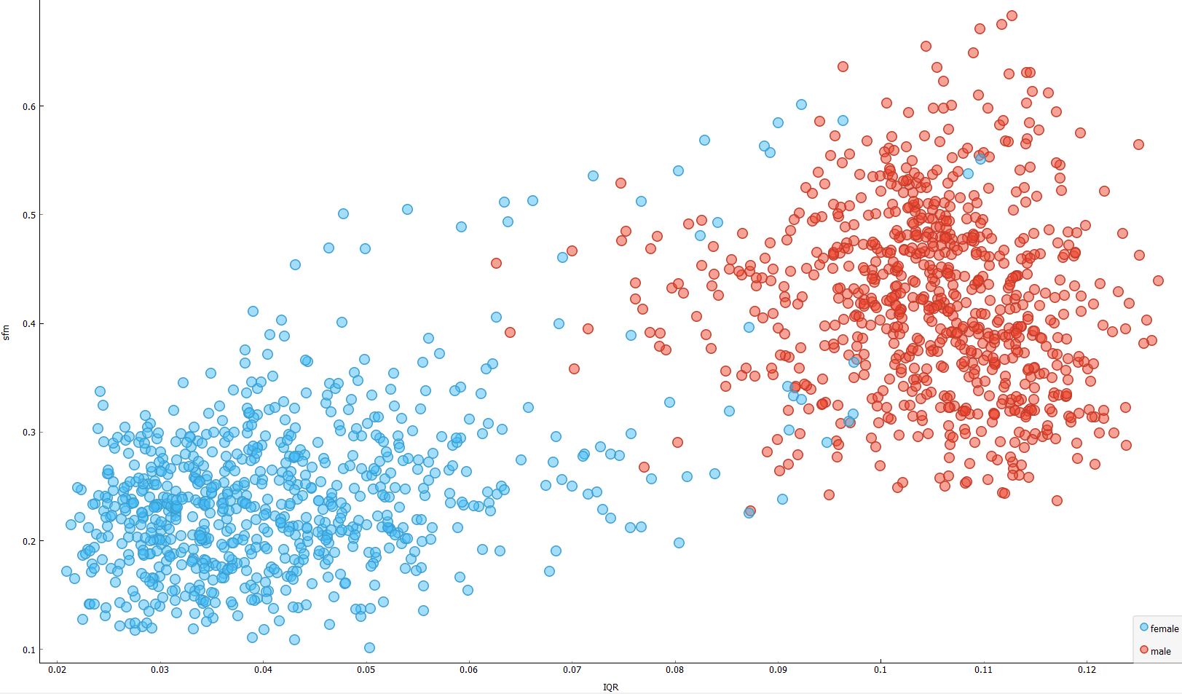
Results Cont’d Vısualızatıon results
After preprocessıng
before preprocessıng

Slide 16
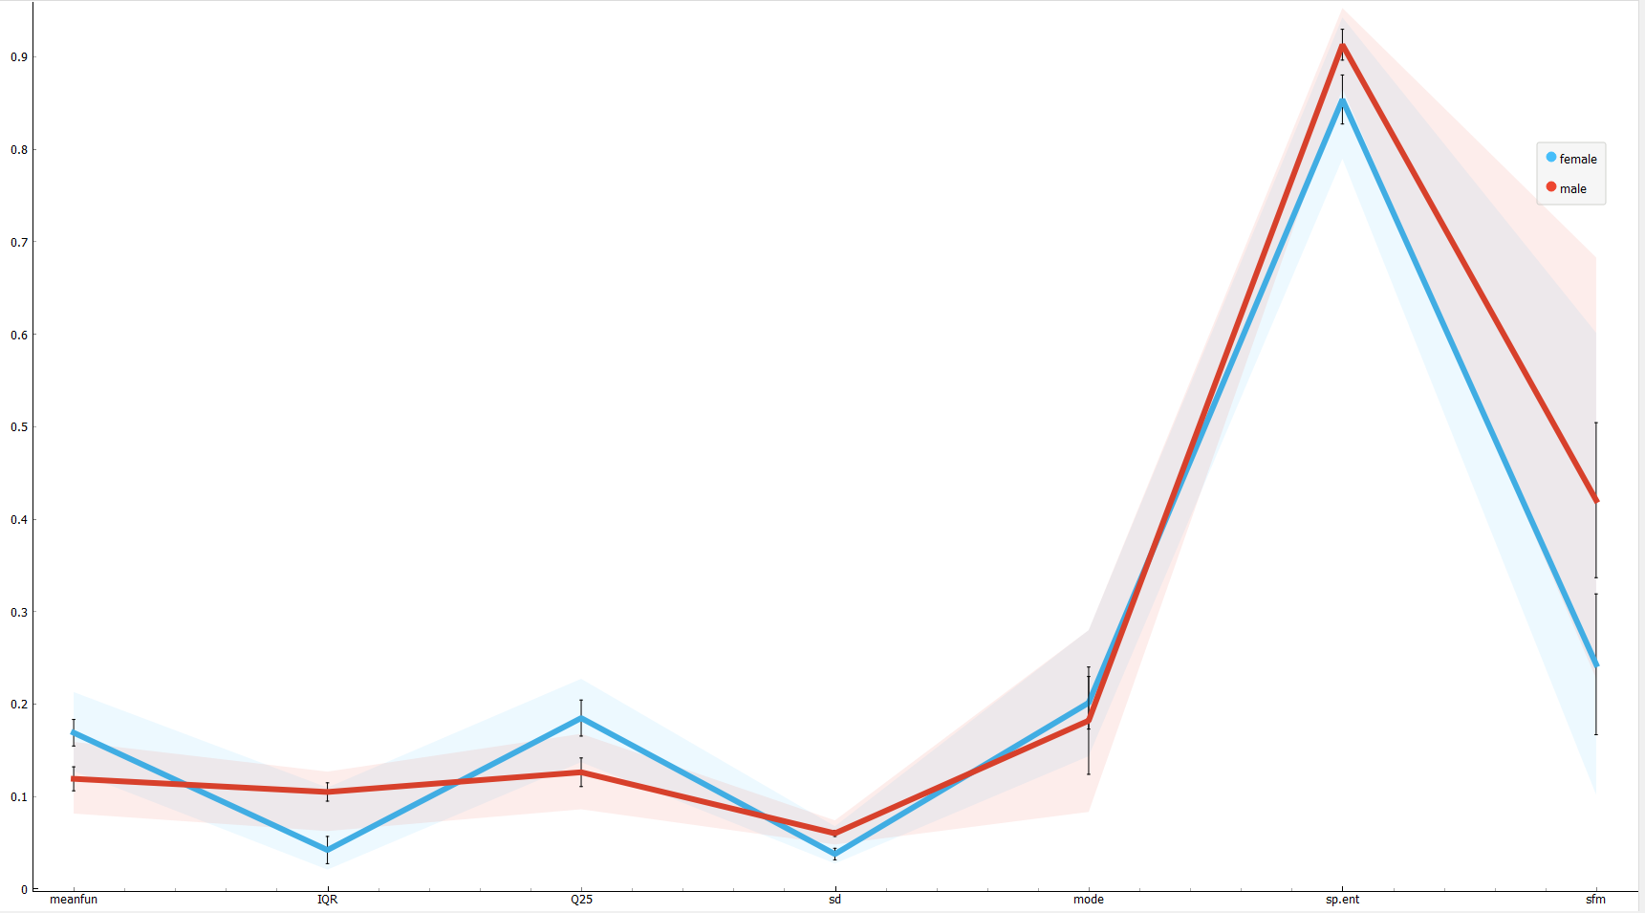
Results Cont’d Lıne plot Vısualızatıon of all features Used after Feature Selectıon

Slide 17
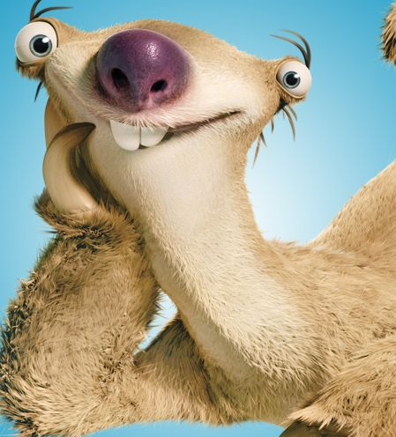
THANKS FOR LISTENING
ANY QUESTIONS?

