Slide 1

SOLID Adventure Game
Project Overview
This project is a refactored version of a monolithic adventure game, following SOLID principles to improve modularity, scalability, and maintainability.

Slide 2
Folder Structure
1
📂 SOLID-Refactored-AdventureGame
2
3
│ ├── 📂 items
│ │── 📂 docs
│── 📂 src
│ │ ├── ItemManager.java
│ ├── image_diagram.docs
│ ├── 📂 player
│ │ ├── GoldCoin.java
│ ├── SOLID-Refactoring-Report.pdf
│ │ ├── Player.java
│ │ ├── ​HealthElixir.java​
│ ├── 📂 combat
│ │ ├── MagicScroll.java
│ │── README.md
│ │ ├── ​CombatManager.java​
│ ├── 📂 level
│ ├── 📂 enemies
│ │ ├── ​LevelManager.java​
│ │ ├── ​Enemy.java​
│ ├── 📂 score
│ │ ├── ​Skeleton.java​
│ │ ├── ​ScoreManager.java​
│ │ ├── Zombie.java
│ ├── MainGame.java
│ │ ├── ​Vampire.java​

Slide 3





SOLID Principles Applied
Single Responsibility Principle (SRP)
Open/Closed Principle (OCP)
Dependency Inversion Principle (DIP)
Liskov Substitution Principle (LSP)
Each class has only one responsibility (separate classes for Player, Enemy, Items, Combat, Levels, and Score).
New enemies and items can be added without modifying existing code (using IEnemy and IItem interfaces).
CombatManager depends on IEnemy, not specific enemy classes, making it flexible.
Zombie, Vampire, and Skeleton can replace Enemy without breaking the game.
Interface Segregation Principle (ISP)
Split IEnemy and IItem instead of using one large interface.

Slide 4
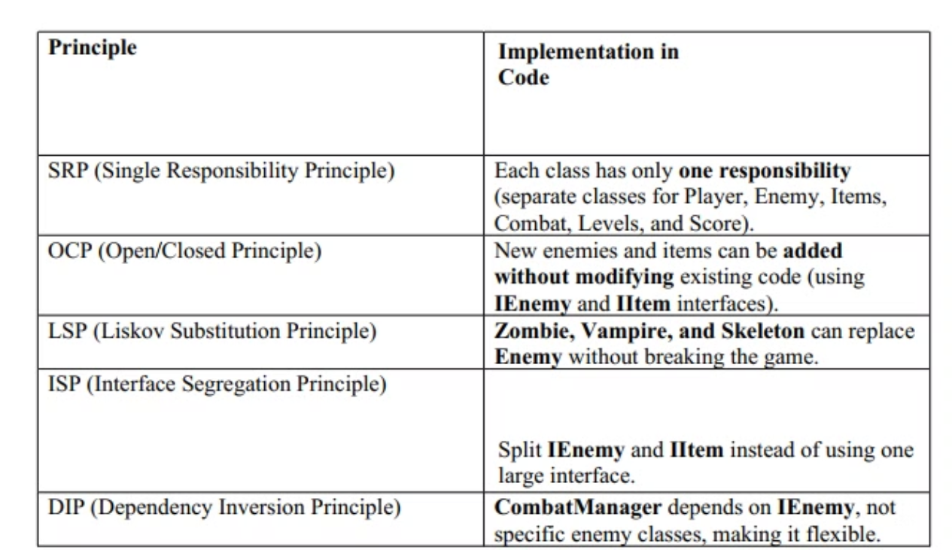
Applied SOLID Principles

Slide 5
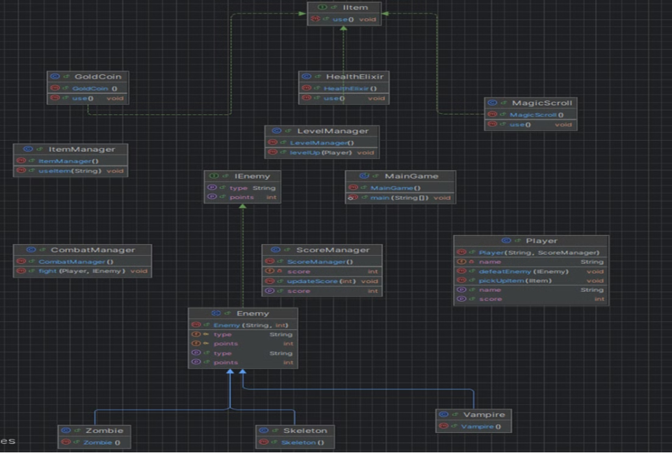
Diagram

