Slide 1
My favorite TV series
Omurgaziev Nursultan all rights reserved ©️

Slide 2
Vince gilligan and his movieverse
Vince Gilligan is an american screenwriter renowned for Breaking Bad and Better Call Saul series.
His best projects:
Breaking Bad
Better Call Saul
El camino: Breaking Bad
Many others

Slide 3
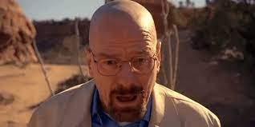
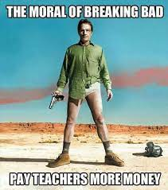
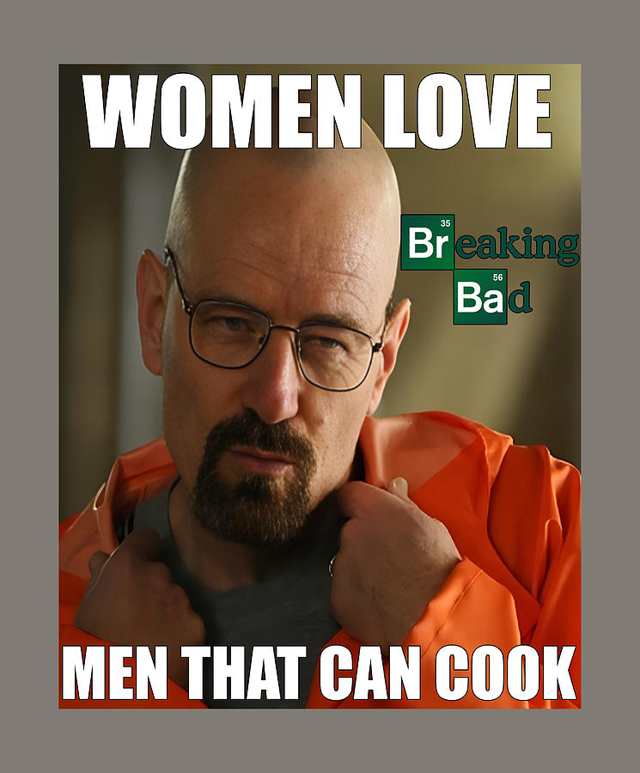
Breaking Bad
An over graduated chemistry teacher diagnosed with inoperable lung cancer turns to manufacturing and selling methamphetamine with a former student to secure his family's future. It takes up the topics of morality, turning into devil and selfishness, freedom and our society in general, being alive. The slogan is: live free or die.

Slide 4
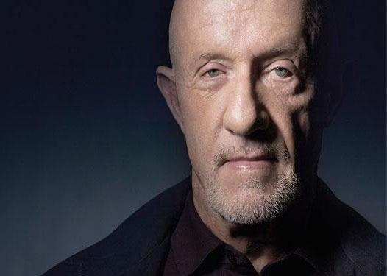
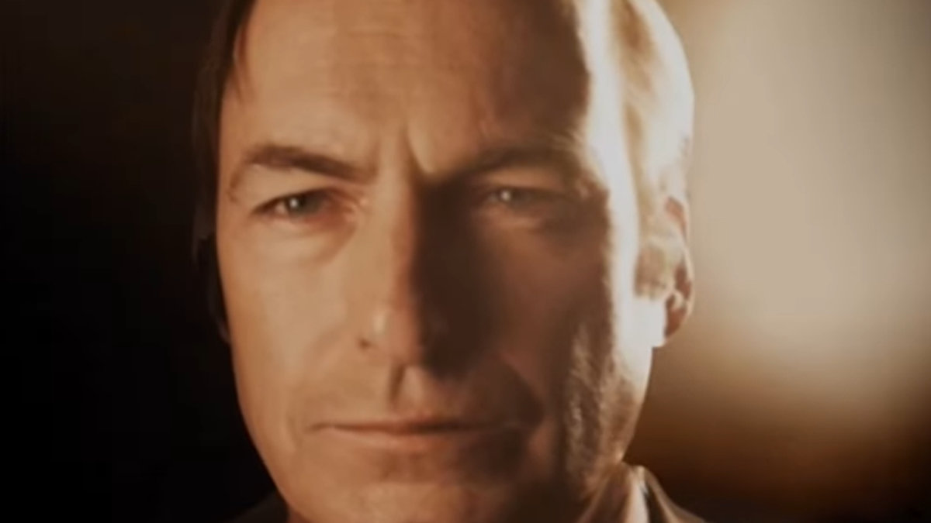
Better Call Saul
This Emmy-nominated prequel to "Breaking Bad" follows small-time attorney Jimmy McGill as he transforms into morally challenged lawyer Saul Goodman. The main topic is morality, Nurture vs Nature, about what’s bad and good. It shows that this terms can be ambiguous.

Slide 5
Why BB and BCS?
There are many reasons to watch the whole gilliganverse.
Character deepness
Writing and storytelling
It keeps you in suspense
Cinematic quality
Morality topics

Slide 6
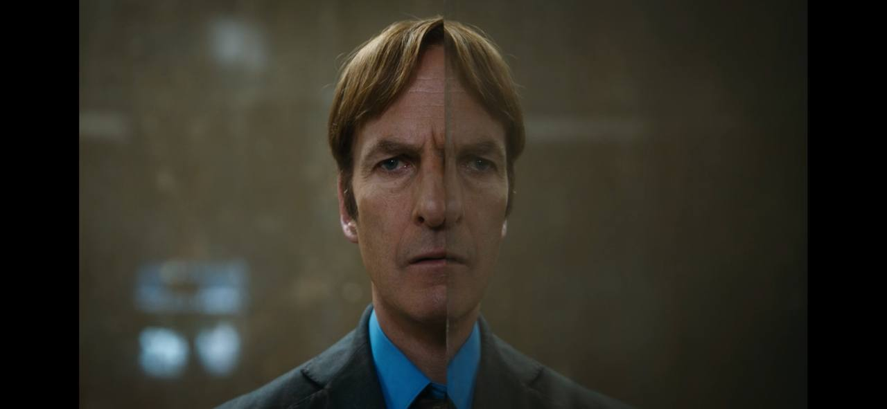
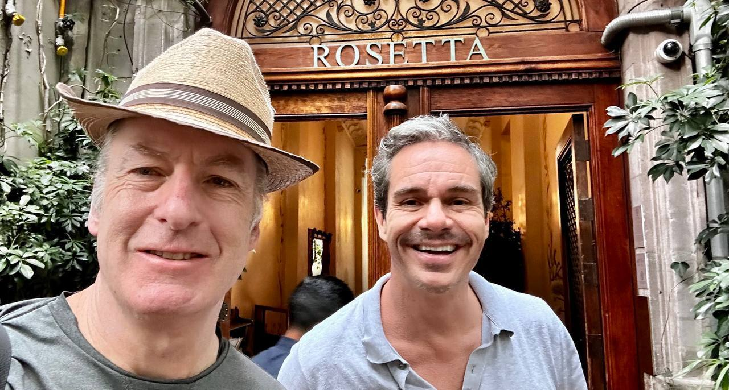
Thank me for your attention!

