Slide 1
Smart Home: The Future of Living
Welcome to our exploration of the smart home revolution! In this presentation, we'll dive into the key components, benefits, and emerging trends that are shaping the future of living. Nursultan X Ali all rights reserved

Slide 2

What is a Smart Home?
Connected Devices
Automated Functionality
A smart home integrates various devices and systems that can be controlled and monitored remotely.
Smart homes automate tasks like lighting, temperature, and security to enhance convenience and efficiency.

Slide 3
Key Components of a Smart Home
Smart Devices
Home Automation
Intelligent appliances, lighting, and climate control systems that can be managed through a central hub or mobile app.
Integrated systems that automate tasks like scheduled lighting, temperature adjustments, and security monitoring.

Slide 4
Benefits of a Smart Home
Convenience
Energy Efficiency
Smart home technology streamlines daily tasks and provides remote control of devices.
Automated systems optimize energy usage, resulting in cost savings and a smaller environmental footprint.

Slide 5
Smart Home Automation
Voice Control
Mobile Integration
Smart speakers and virtual assistants allow for hands-free control of various home functions.
Smartphone apps provide remote access and management of smart home devices.

Slide 6
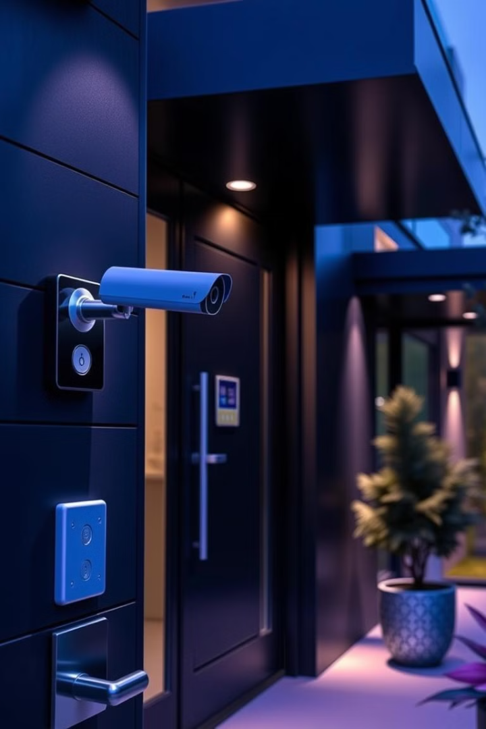
Smart Home Security
Surveillance
Access Control
Smart security cameras and sensors monitor activity and provide real-time alerts.
Smart locks and doorbells enable remote control and monitoring of entry points.
Emerging Smart Home Trends
1
AI Assistants
Advancements in artificial intelligence will enhance the capabilities of virtual assistants.
2
Sustainable Design
Smart homes will incorporate eco-friendly features like renewable energy and water conservation.
3
Integrated Wellness
Smart home technologies will focus on improving occupant health and well-being.

Slide 7





The Future of Smart Homes
1
Seamless Integration
2
Proactive Automation
3
Personalized Experience
4
Enhanced Sustainability
5
Improved Well-being

Slide 8
Thank you for your attention mf

