Slide 1
Data Visualization
Classification of heart disease
Professor: Alexander Pak
Masters:
Adilova Bakhyt
Zhumabay Yerdaulet
Zhantileuov Nursultan

Slide 2
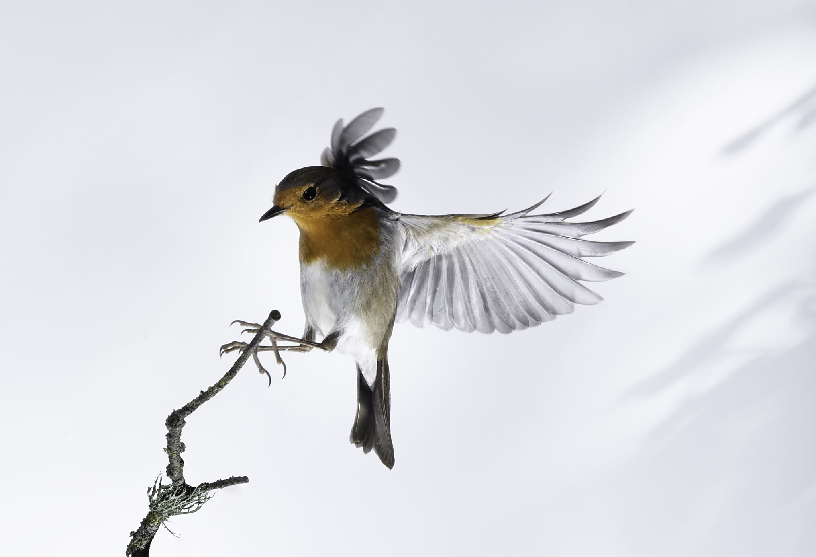
Context
Character level training to generate bird images from Caltech-UCSD Birds-200-2011 (CUB-200-2011) dataset using WGAN-GP architecture

Slide 3
Dataset Description
CUB-200-2011 is an extended version of CUB-200, a challenging dataset of 200 bird species. The extended version roughly doubles the number of images per category and adds new part localization annotations. All images are annotated with bounding boxes, part locations, and at- tribute labels. Images and annotations were filtered by mul- tiple users of Mechanical Turk.

Slide 4
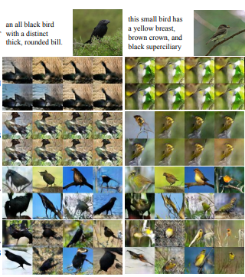
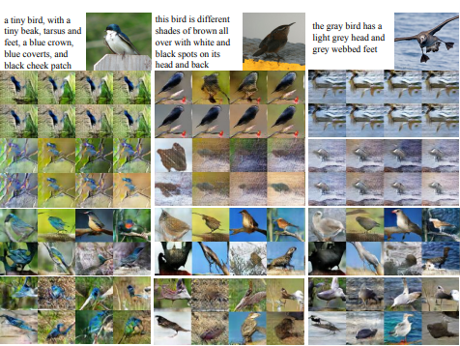
Caltech-UCSD Birds-200-2011 (CUB-200-2011) dataset

Slide 5
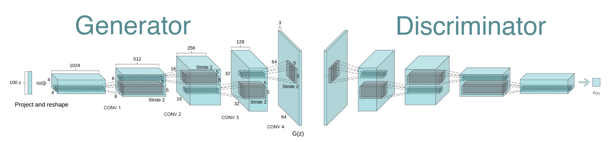
WGAN-GP
Note: We deploy a trained GAN model to make sure that any user with any device can generate the bird image

Slide 6
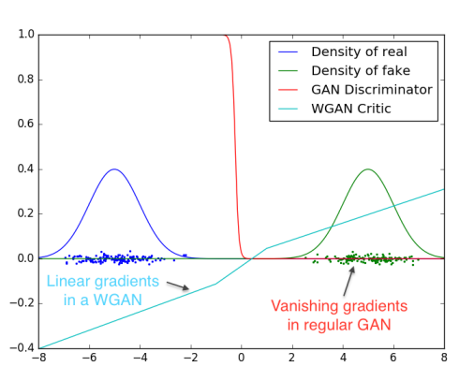
Background
Density Plotting after each generation of the bird image according to the input text, which may be helpful to compare the differences between real and generated images by plotting, and calculating wasserstein distance

Slide 7
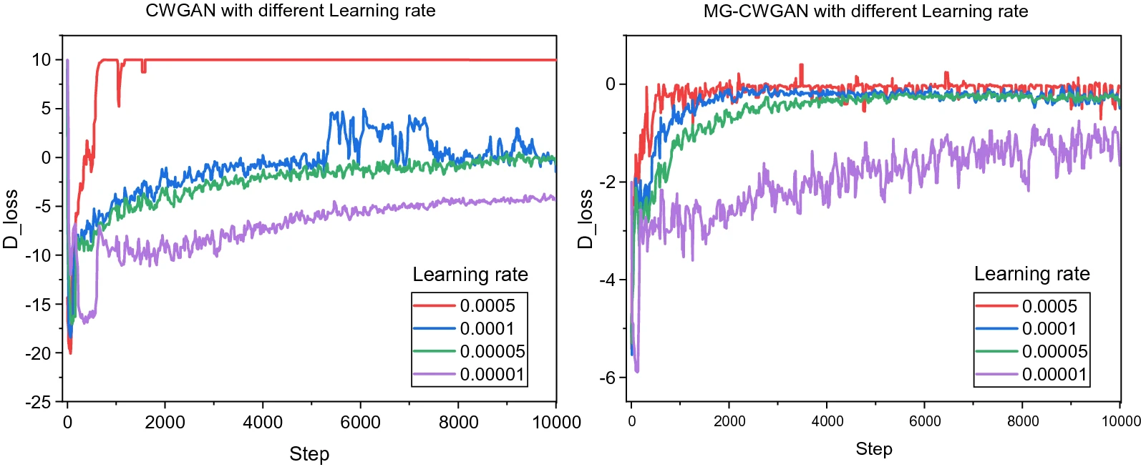
We are not going to visualize evaluate by mistake changing the hyperparameters of the model, because it requires a huge amount of resources and time, the GAN architecture is very sensitive to the hyperparameters, so at the first iteration, it becomes clear that the model cannot learn from the set parameters.

Slide 8

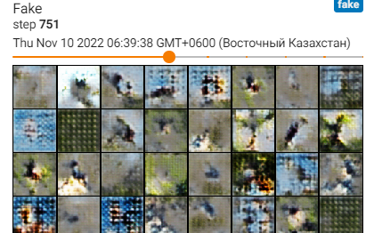
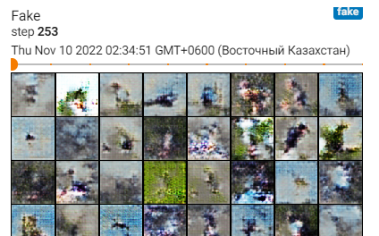
We have three metrics to evaluate the model:
1. Loss
2. Wasserstein distance
3. Visual results.

