Slide 1
SSc-MIM
Building the map, validating it, and characterising SSc endotypes
Construction · validation (gates + patient data) · endotype use case
Nathan Foulquier — LBAI, UMR 1227 Inserm · CHU de Brest

Slide 2
CONTEXT
The map in one screen
568
molecular species
308
mechanistic reactions
133
SSc-specific reactions
197
patient donors
A curated, SBGN/SBML disease map for dcSSc skin fibrosis.
Five modules — M1 IFN · M2 TGF-β/fibrosis · M3 EndoMT · M4 cytokines · M5 B-cell/autoreactivity — draining into 6 phenotype endpoints.
Topology is literature-curated; patient single-cell data is layered on to validate it and read it out.
This talk: how it is built, how it is validated (two ways), and how it can characterise patient endotypes.
SSc-MIM · construction → validation → endotypes
2

Slide 3
PART I
Building the map
Literature-curated topology, assembled and annotated — not inferred from omics.

Slide 4
CONSTRUCTION
From literature to an integrated map
Scope
Reactome import
Harmonise & dedup
Integrate
SSc curation (gated)
Annotate PMID/ECO
QC
→
→
→
→
→
→
Backbone (blue)
Canonical pathways imported from Reactome (IFN-I, TGF-β/PDGF, NOTCH1, IL-6), harmonised to HGNC, de-duplicated, merged into one SBML map.
SSc-specific layer (coral)
133 hand-curated reactions Reactome cannot hold (autoantibodies, SSc cell states, crosstalk) — added only through gated discovery (Part II).
M1 IFN 19 M2 fibrosis 58 M3 EndoMT 27
M4 cytokine 11 M5 B-cell 10 xt 8
6 endpoints: myofibroblast · ECM · vascular · IFN/ISG · autoantibodies (autoreactivity) · mRSS.
Rule: every entity reaches an endpoint in ≤6 steps (0 violations).
SSc-MIM · construction → validation → endotypes
4

Slide 5
PART II
Validating the map
Two complementary axes: (A) gated against fabrication, (B) grounded in real patient data.

Slide 6
VALIDATION
Two complementary axes
A · Is every edge real?
B · Does it hold in patients?
Edge-discovery protocol: nothing enters the curated map speculatively.
Five automated gates (G0–G4), G2 = verbatim-quote grounding.
Contradiction detector + advisory AI verdicts + citation-integrity sweep.
Binding human ratification by the expert/co-author.
Four single-cell datasets (197 donors) re-analysed from raw counts.
Per-donor pseudobulk → mixed-effects DEG → map coverage.
AUCell → per-patient module activation profile.
Result: 81.3% coverage; type-I IFN validated in SSc skin.
SSc-MIM · construction → validation → endotypes
6

Slide 7
VALIDATION · A (1/2)
Gate strategy — the edge-discovery protocol
Governing rule: the curated map is never written speculatively.
1
Stage — candidate edge in a staging file — with a verbatim sentence from the source paper
2
Fetch — cache the source text (Europe PMC OA / abstract)
3
Gate — run the five G0–G4 gates → PASS / FLAG / REJECT
4
Ratify — a human sets decision = promote (default = held)
5
Promote — only PASS + promote enter the map — tagged, reversible
SSc-MIM · construction → validation → endotypes
7

Slide 8
VALIDATION · A (2/2)
The five gates (G0–G4)
Gate | Check | On failure
G0 schema | required fields present; type in controlled vocabulary | REJECT
G1 HGNC | every gene entity is an official HGNC symbol | REJECT (alias→FLAG)
G2 grounding | supporting quote is a verbatim substring of the source text | REJECT — keystone
G3 novelty | gene pair not already an SSc reaction; not a forward Reactome pair | REJECT (dup) / FLAG
G4 evidence | numeric PMID present; corpus text available (SSc context) | FLAG
If the quote is not literally in the paper, the edge is rejected.
Self-test: a fabricated negative-control edge (FOXP3→COL1A1, invented quote + decoy PMID) must REJECT on every run.
Then: contradiction detector · AI verdicts (128 validate / 5 caution) · citation sweep (28 wrong PMIDs fixed, re-verified vs PubMed) · human ratification.
SSc-MIM · construction → validation → endotypes
8

Slide 9
VALIDATION · B (1/4)
Grounding in patient data — the datasets
197 donors (121 SSc / 76 HC) across skin, lung and blood — re-analysed from raw GEO files; citations verified on PubMed.
GEO | Reference (verified) | Tissue | Donors (SSc/HC) | Cells
GSE195452 | Gur C et al. Cell 2022;185:1373 | Skin (multiome) | 154 (97 / 57) | 100 538
GSE138669 | Tabib T et al. Nat Commun 2021;12:4384 | Skin | 22 (12 / 10) | 64 211
GSE128169 | Morse C et al. Eur Respir J 2019;54:1802441 | Lung (ILD) | 13 (8 / 5) | 67 516
GSE210395 | GEO — no linked publication | PBMC | 8 (4 / 4) | 34 619
Skin cohorts give the fibroblast-subset resolution that M2/M3 model; lung (SSc-ILD) + PBMC extend beyond skin.
Raw archives SHA-256-pinned in data/MIRROR.md for a reproducible input envelope (Zenodo mirror).
SSc-MIM · construction → validation → endotypes
9

Slide 10
VALIDATION · B (2/4)
Per-donor pseudobulk — the right unit of replication
Tens of thousands of cells, but only 4–13 patients per dataset. The question is about patients, not cells.
group cells by (donor × cell_type)
row[gene] = Σ raw counts over cells
→ one pseudobulk count row per (donor, cell type).
NB GLM (pydeseq2) ~ condition
+ Benjamini-Hochberg FDR (q=0.05)
Raw counts (not log) — the NB GLM models depth & overdispersion itself.
The problem: pseudoreplication
Cells from one patient are not independent (same genotype, biopsy, batch).
Testing per-cell treats them as thousands of samples → inflated power, false positives.
The fix
Rebuild one bulk-like profile per patient → the unit of replication becomes the patient.
Trade-off: fewer but robust hits; a valid, reproducible inference. The same pseudobulks feed AUCell.
SSc-MIM · construction → validation → endotypes
10

Slide 11
VALIDATION · B (3/4)
AUCell — label-free module activation scoring
“Are a module’s genes concentrated among this patient’s most highly-expressed genes?” If yes → the module is on.
Rank all genes by expression (rank 1 = highest).
Walk the top T (top ~5%); recovery curve R(r) = # module genes with rank ≤ r.
AUC = Σ R(r), normalised to [0,1]
High AUC → module genes cluster at the top → module active.
Output: a 4-module activation vector per patient.
Why — no double-dipping
Scores each donor against the pre-specified module gene set (from the curated map), blind to the SSc/HC label.
Avoids the circularity of weighting by the same SSc-vs-HC contrast you then test.
Rank-based → robust
Depends only on gene order, not absolute values → insensitive to scale, depth, normalisation.
This per-patient vector is exactly what powers the endotype use case (Part III).
SSc-MIM · construction → validation → endotypes
11

Slide 12
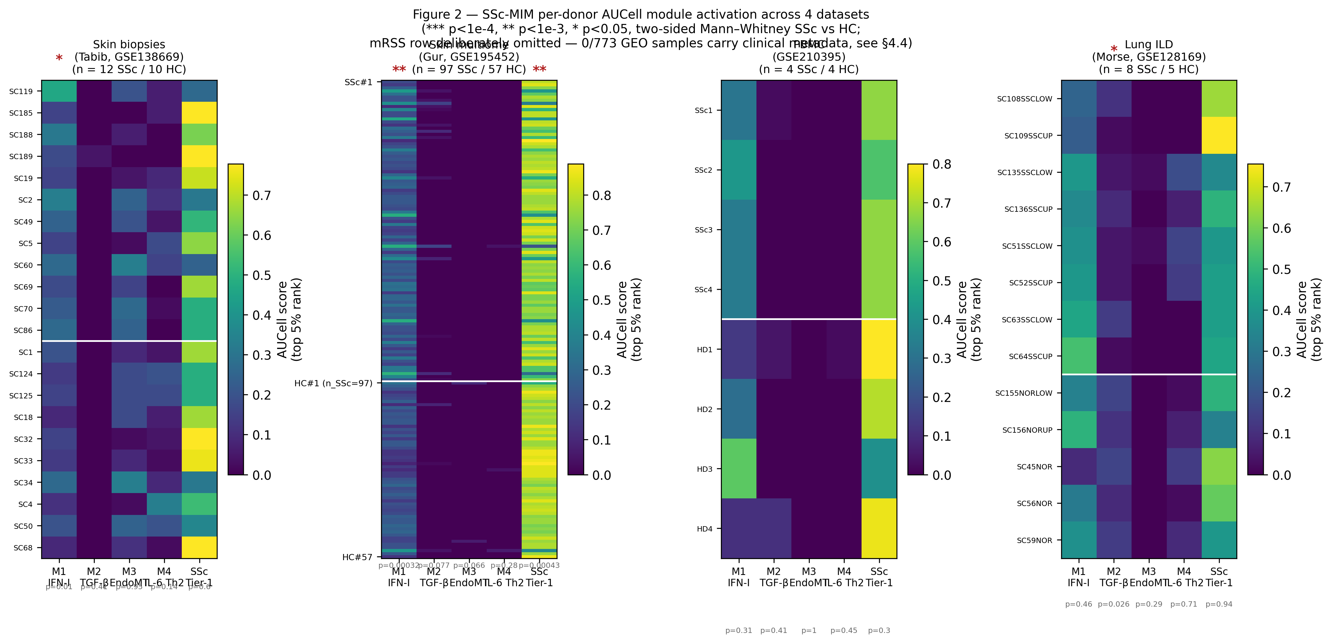
VALIDATION · B (4/4)
What the data shows
81.3%
of detectable map species seen in patient data
Coverage by module
M1 84% · M2 88% · M3 75% · M4 74% · M5 94% — the curated biology is largely measurable.
Biological validation
Type-I IFN (M1) significantly elevated in SSc skin: Gur p=3.2e-4, Tabib p=0.011.
Annotation validated
CellTypist agreement κ=0.92, ARI=0.70 vs marker labels.
Per-donor AUCell module scores, SSc vs HC.
SSc-MIM · construction → validation → endotypes
12

Slide 13
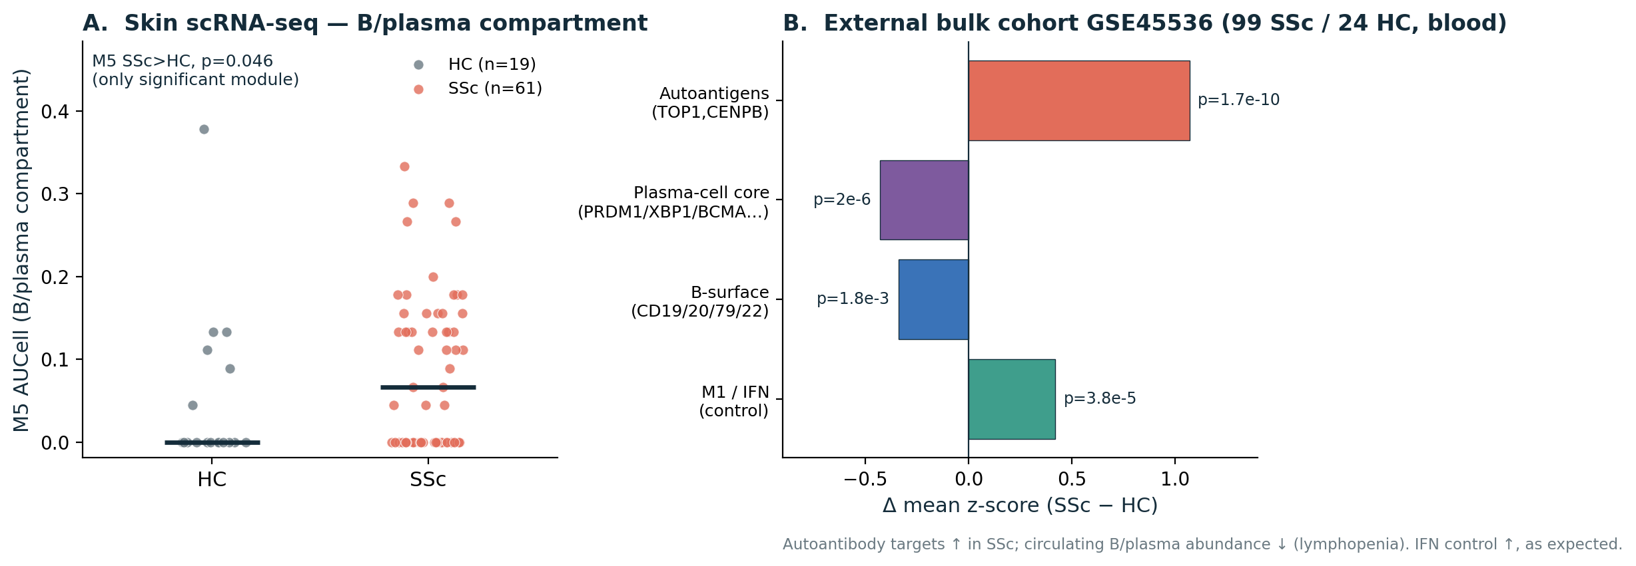
VALIDATION · MODULE M5
Validating a new module: B-cell / autoreactivity
The old M4 mixed cytokines with B-cell/autoreactivity → split into M4 (cytokine) + M5 (B-cell).
Internal (skin scRNA-seq)
Scored on the B/plasma compartment: M5 up in SSc (p=0.046), the only significant module → specific.
External (GSE45536, blood)
99 SSc / 24 HC: M5 separates groups (p=1.3e-4); autoantigens TOP1/CENPB ↑ (p=1.7e-10); circulating B abundance ↓.
IFN control ↑ in SSc in both — method validated.
SSc-MIM · construction → validation → endotypes
13

Slide 14
PART III
Toward endotypes
Using the validated map to characterise patient subgroups — mechanistically.

Slide 15
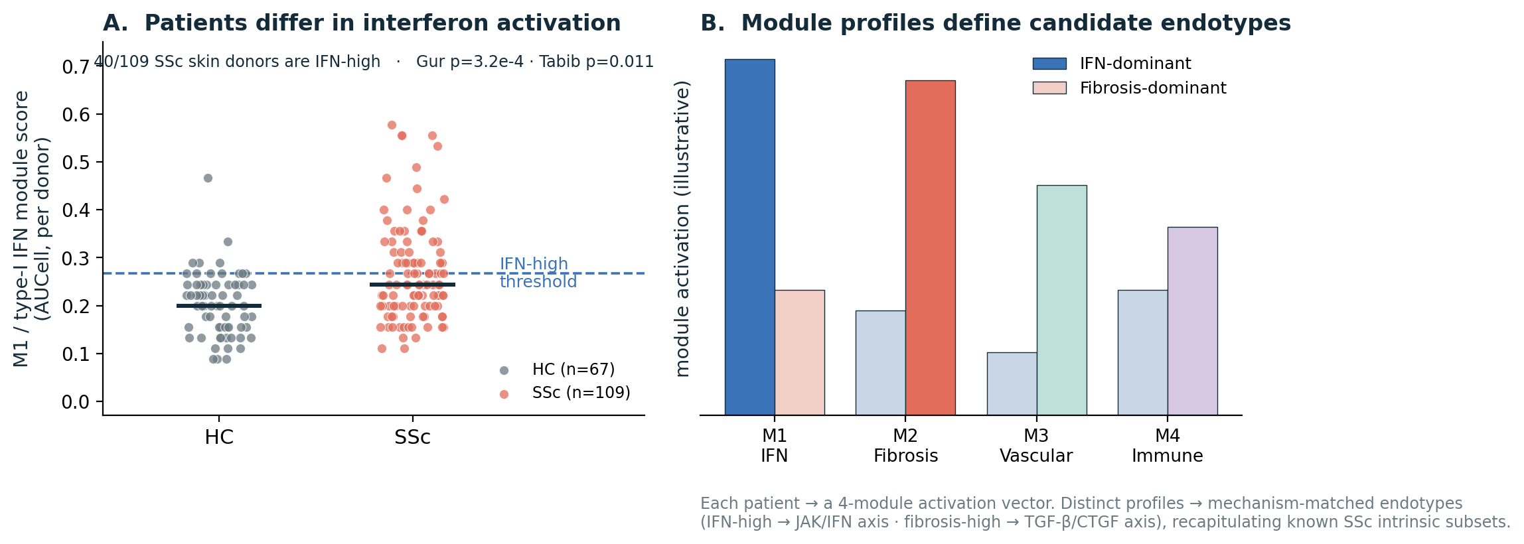
ENDOTYPES
Patients already differ in module activation
Each patient = a 4-module activation vector (Part II-B).
IFN activation is not uniform: 40/109 SSc skin donors are IFN-high, others are not (reproducible Gur + Tabib).
Distinct module profiles → candidate mechanism-matched endotypes (IFN-dominant vs fibrosis-dominant).
Recapitulates the known SSc intrinsic subsets (inflammatory ↔ M1/M4, fibroproliferative ↔ M2).
SSc-MIM · construction → validation → endotypes
15

Slide 16
USE CASE
You arrive with 3 patient clusters — what the map gives you
Project any patient grouping onto the map — same pipeline (AUCell + per-cluster DEG + MINERVA overlay), your labels.
YOUR CLUSTERS
Cluster 1
AUCell — score each cluster on the 5 modules (M1–M5 + Tier-1).
Per-cluster differential expression mapped onto map species → which reactions light up.
MINERVA overlay — colour the map by each cluster (any label, no new method).
Cluster 2
→
Cluster 3
WHAT YOU GET BACK — per cluster
Module fingerprint
a 4-module activation vector — e.g. cluster 2 IFN-high, cluster 3 fibrosis-dominant.
Mechanistic hypotheses
the lit-up sub-circuits that distinguish each cluster — e.g. STING→IRF3 vs TGF-β→SMAD3→collagen.
Candidate targets
active druggable hubs per cluster → a cluster-matched therapy hypothesis to test.
SSc-MIM · construction → validation → endotypes
16

Slide 17
In one line
A curated map, gated against fabrication, validated in patients — and ready to type them
Construction
Literature backbone + 133 gated SSc-specific reactions → one SBML map (568 sp / 308 rx).
Validation A — gates
G0–G4 + G2 grounding + human ratification: no edge without a verbatim source.
Validation B — data
4 datasets, 197 donors; per-donor pseudobulk + AUCell; 81.3% coverage; IFN validated in SSc skin.
Endotypes
Project your patient clusters → per-cluster module fingerprint, mechanistic hypotheses, candidate targets.

