Slide 1
Building the SSc-MIM
Construction approach, datasets, and the interaction-validation process
Technical companion to the SSc-MIM overview
Nathan Foulquier — LBAI, UMR 1227 Inserm · CHU de Brest
Detailed reference: docs/SSc_MIM_construction_and_validation.md

Slide 2
PHILOSOPHY
Three governing principles
1. Deterministic curation
Explicit rules (Mazein 2023 + Disease Maps conventions) so two curators produce the same map. HGNC names, fixed compartments, fixed reaction granularity.
2. Never written speculatively
No edge enters the curated map without a verbatim source quote that passes automated gates AND human ratification.
3. Topology is curated, not learned
Mechanisms come from the literature; patient omics ground, validate and read out the map — they never define its structure.
SSc-MIM · Construction, data & validation
2

Slide 3
STANDARDS
Notation, format & naming conventions
Notation & format
CellDesigner v4.4 · SBGN Process Description glyphs.
SBML Level 2 Version 4 + CellDesigner annotations.
MI2CAST-compliant annotation on every reaction.
Identifiers (HGNC-anchored)
gene/protein → HGNC symbol (TGFB1, SMAD3)
proteoform → symbol+state (SMAD3@S423)
complex → A:B:C (SMAD2:SMAD3:SMAD4)
phenotype → phenotype_<slug>
One reaction per ligand–receptor binding event.
One reaction per kinase–substrate pair (residues collapsed into a state-variable list).
Transcription as TF → mRNA(target), one per target.
Fixed compartment vocabulary (20): extracellular, ECM, plasma membrane, cytosol, nucleus, ER, endosome, mitochondrion, cell-type prefixes…
SSc-MIM · Construction, data & validation
3

Slide 4
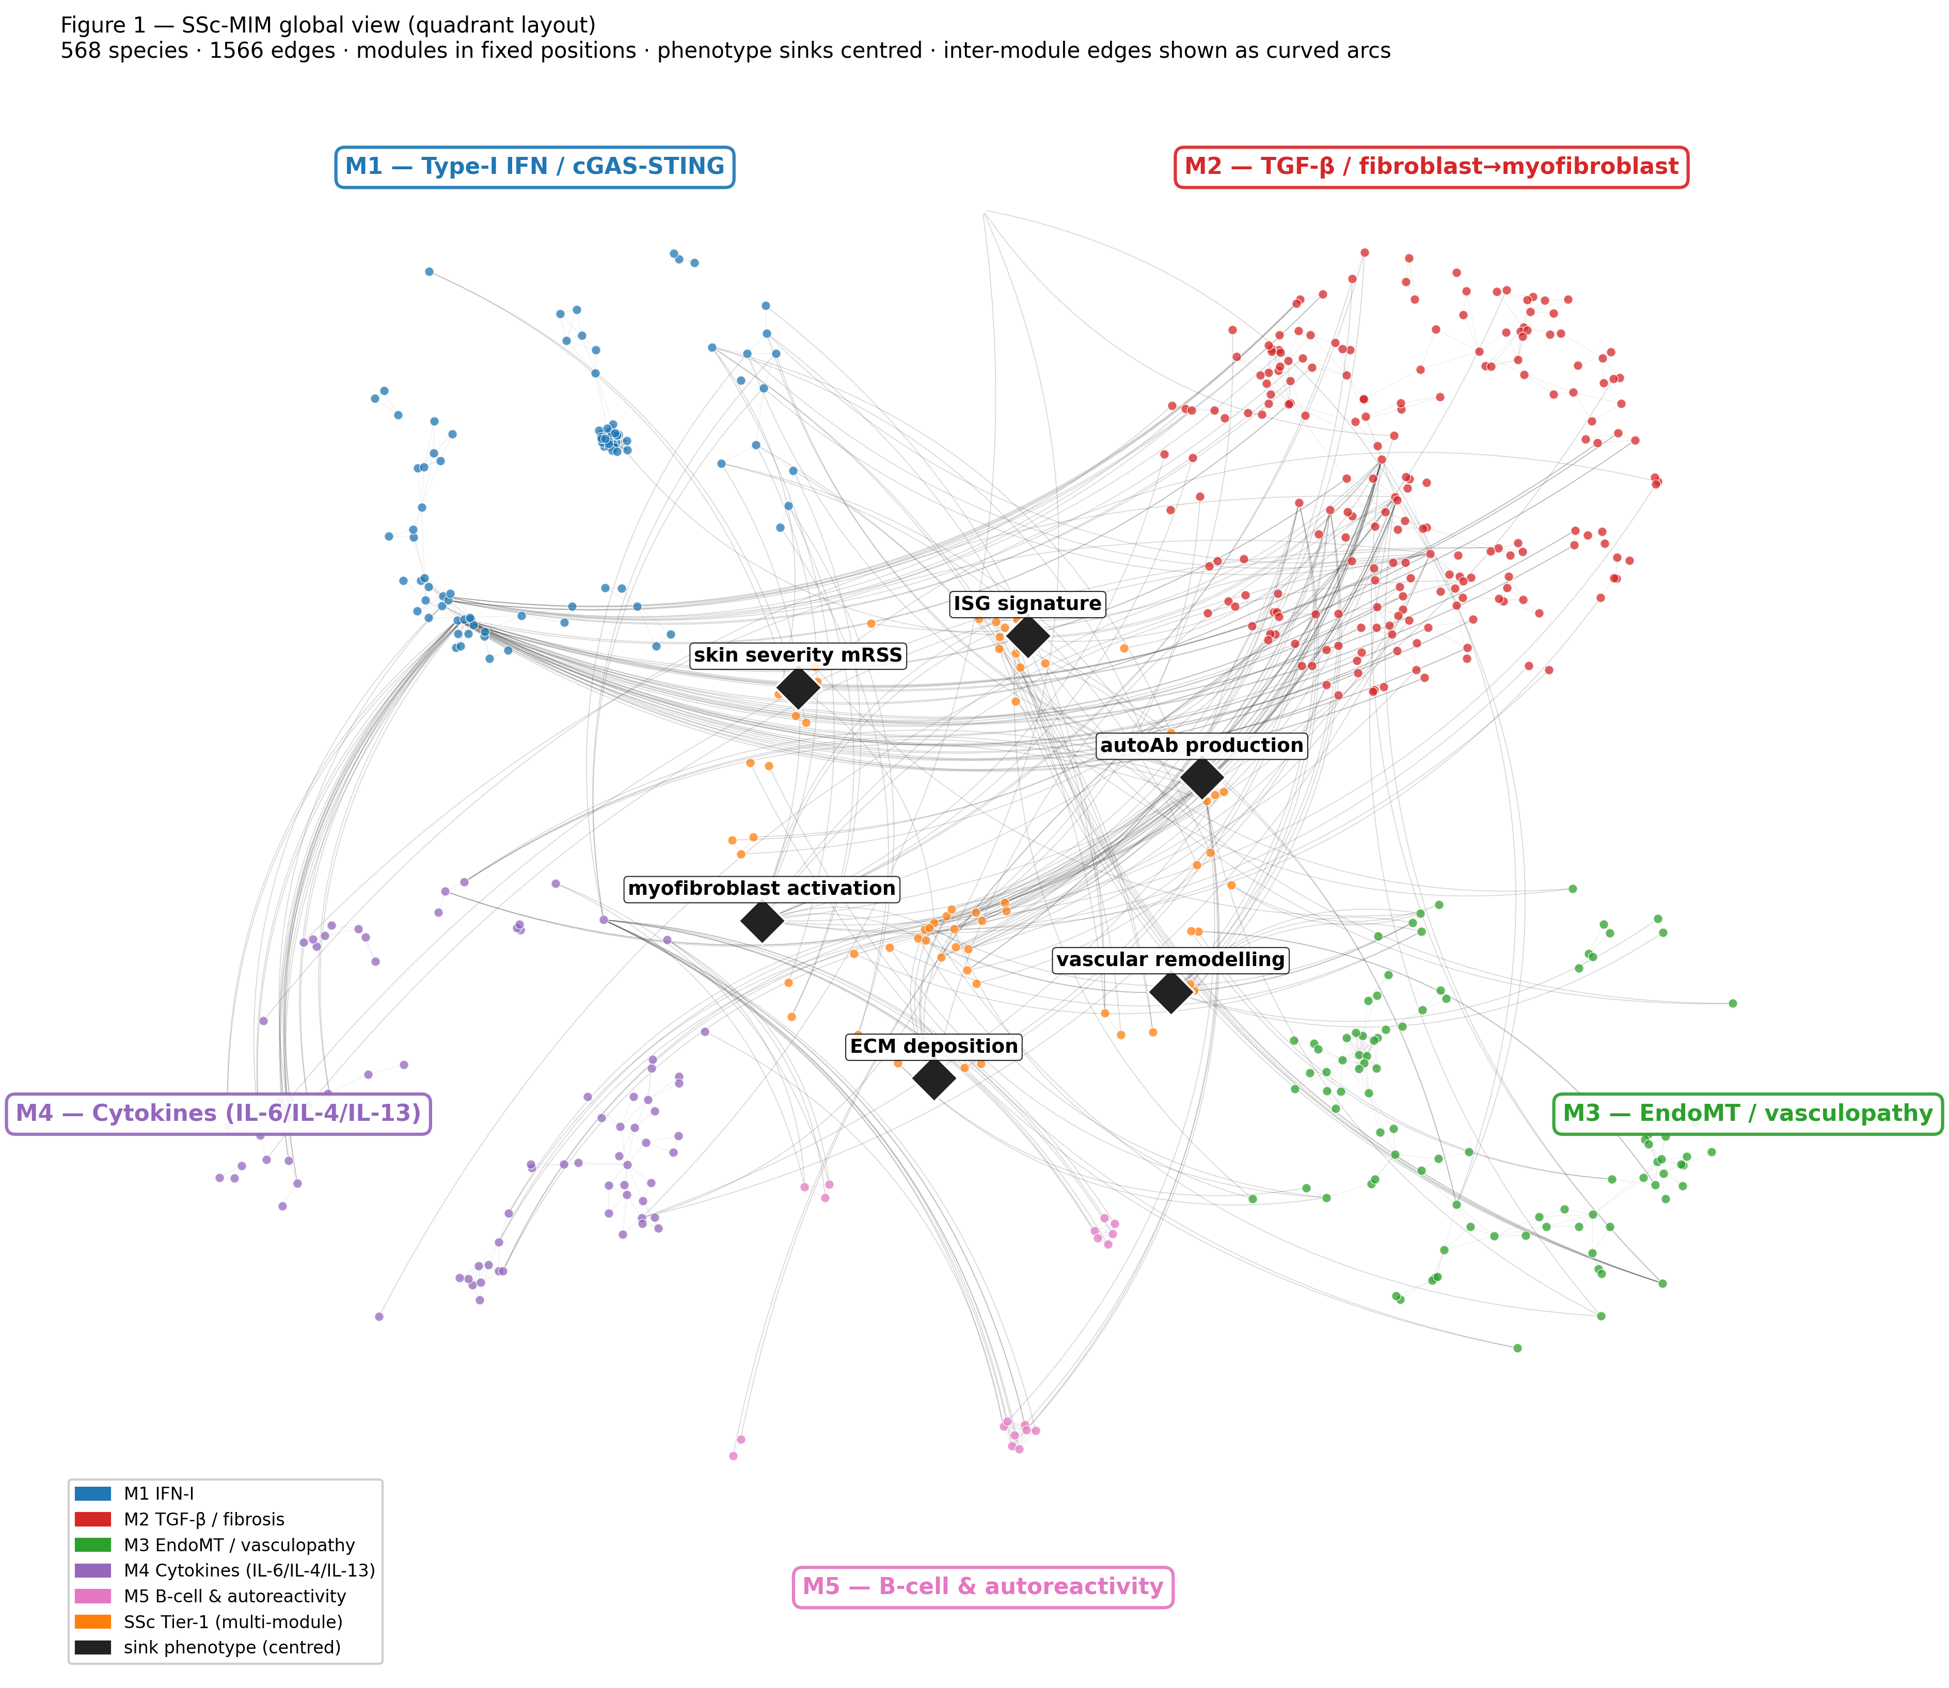
ARCHITECTURE
Modules, crosstalk & phenotype sinks
M1 Type-I IFN · 19 reactions
M2 TGF-β / fibrosis · 58
M3 EndoMT / vasculopathy · 27
M4 Cytokines IL-6/IL-4/IL-13 · 11
M5 B-cell & autoreactivity · 10
crosstalk · 8
Six phenotype endpoints (disease outputs): myofibroblast activation · ECM/collagen deposition · vascular remodelling · type-I IFN/ISG signature · autoantibody production (autoreactivity) · skin severity (mRSS).
Modelling rule: every entity reaches an endpoint in ≤ 6 steps — verified, 0 violations (make sink-check).
SSc-MIM · Construction, data & validation
4

Slide 5
PIPELINE
From literature to a released map
Scope
Reactome import
Harmonise & dedup
Integrate
SSc curation (gated)
Annotate PMID/ECO
QC gates
Release GitHub+Zenodo
→
→
→
→
→
→
→
Blue = backbone assembly · coral = SSc-specific layer · teal = QC & release.
Each stage is a scripted, reversible step (make targets) with linters and CI — re-running from raw inputs reproduces the map.
The whole automated lane runs end-to-end with make auto .
SSc-MIM · Construction, data & validation
5

Slide 6
STEP 1–4
Reactome backbone import & integration
Import canonical pathway scaffolds
M1 type-I IFN · M2 TGF-β (pilot R-HSA-2173789) + PDGF · M3 NOTCH1 (R-HSA-1980143) · M4 IL-6.
Post-process & harmonise
Decode + classify reaction types; rename entities to HGNC; de-duplicate species shared across modules.
Integrate
Merge harmonised module XMLs into one SBML map. Mine embedded PMIDs; auto-fill the bibliography via NCBI E-utils.
reactome_pilot.py (pilot)
post_process_reactome (harmonise)
harmonise_imports.py (harmonise)
integrate_modules.py (integrate)
extract_pmids_*.py (pmids)
bib_lookup.py (bib-lookup)
Backbone = 159 reactions; gives canonical structure, but propagates curator-inference ECO by default.
SSc-MIM · Construction, data & validation
6

Slide 7
STEP 5
The SSc-specific curation layer — the novel content
133 hand-curated reactions Reactome cannot structurally hold (autoantibodies, SSc cell states, GWAS-function, clinical crosstalk). Sourced from a systematic 77-paper worklist (24 themes) + co-author full-text PDFs.
Provenance | n | Meaning
original-curation | 40 | hand-curated (human-original)
fulltext-verified | 27 | AI-extracted, verbatim-grounded
ai-discovery (gated) | 48 | via G0–G4 pipeline
claude-reclassify | 10 | cell-state → conceptual bridge
claude-lit-mine | 8 | mined, abstract-verified
M2 58 M3 27 M4 21
M1 19 crosstalk 8
Every AI-touched row is tagged, reversible (one TSV row), and carries its grounding quote in notes.
126 / 133 carry a primary PMID.
SSc-MIM · Construction, data & validation
7

Slide 8
EVIDENCE
Provenance & graded evidence
The honest denominator: separate the imported backbone from the genuinely SSc-specific layer.
Layer | Rxns | PMID | Exp. ECO
Reactome backbone | 159 | 99% | 0
SSc-specific | 133 | 95% | majority
ECO code | Evidence | n
0000314 | direct assay | 73
0000033 | traceable author stmt | 27
0000270 | expression pattern | 20
0000305 | curator inference | 9
others (353/315) | interaction / mutant | 4
122 confirmed · 6 phenotype_aggregation (definitional sinks) · 4 conceptual_bridge · 1 to_complete (POSTN, under expert review).
make evidence-lint fails CI if any SSc reaction is left untriaged — no undeclared inference debt.
SSc-MIM · Construction, data & validation
8

Slide 9
VALIDATION (1/3)
Adding an interaction: the edge-discovery protocol
Governing rule: the curated map is never written speculatively.
1
Stage
Candidate edge in staging TSV — with a verbatim supporting sentence from the source paper.
Candidates never touch the curated TSV until promoted.
Quality over volume — 12 grounded edges beat 40 shaky ones.
Disease-specific only — content Reactome cannot hold.
One quote → one edge.
Every promoted edge is one removable TSV row.
2
Fetch
Cache source text (Europe PMC OA full text / abstract).
3
Gate
Run G0–G4 automated gates → validation_report.tsv.
4
Ratify
A human sets decision = promote (default = held).
5
Promote
Only PASS + promote rows enter the map — tagged, reversible.
SSc-MIM · Construction, data & validation
9

Slide 10
VALIDATION (2/3)
Five automated gates (G0–G4)
Gate | Check | On failure
G0 schema | required fields present; type in controlled vocabulary | REJECT
G1 HGNC | every gene entity is an official HGNC symbol (HGNC REST) | REJECT (alias→FLAG)
G2 grounding | supporting quote is a verbatim substring of the source text | REJECT — keystone
G3 novelty | gene pair not already an SSc reaction; not a forward Reactome pair | REJECT (dup) / FLAG
G4 evidence | numeric PMID present; corpus text available (SSc context) | FLAG
If the quote is not literally in the paper, the edge is rejected — the core defence against fabricated biology.
Self-test: a fabricated negative-control edge (cand_negctrl, FOXP3→COL1A1, invented quote + decoy PMID) must REJECT on every run; it is hidden from the reviewer app.
SSc-MIM · Construction, data & validation
10

Slide 11
VALIDATION (3/3)
Layered QC beyond the gates
Structural
SBML L2V4 validation in CI · sink-connectivity (≤6 steps) · CellDesigner-loadability · MINERVA preflight.
Contradiction detector
Flags any gene pair given opposite polarities by different sources → human arbitration. 0 unresolved.
AI verdict pass
Read each interaction's deciding quote + support/contrary abstracts → validate / revise / caution. Now 128 validate · 5 caution.
Citation-integrity sweep
Caught 28 reactions citing an unrelated PMID; every replacement re-verified vs live PubMed. No PMID cited from memory.
Reviewer app
Offline swipe-deck over 143 interactions: verbatim quote, dossier, module map, advisory verdict; decisions export to CSV/JSON.
Human ratification
Binding step: the expert/co-author adjudicates the biology. AI proposes & self-gates; the human decides.
SSc-MIM · Construction, data & validation
11

Slide 12
DATA
Four public single-cell datasets
197 donors (121 SSc / 76 HC) — skin, lung, blood — re-analysed from raw GEO files. Citations verified against PubMed.
GEO | Reference (verified) | Tissue | Donors (SSc/HC)
GSE195452 | Gur C et al. Cell 2022;185:1373 | Skin (multiome) | 154 (97 / 57)
GSE138669 | Tabib T et al. Nat Commun 2021;12:4384 | Skin | 22 (12 / 10)
GSE128169 | Morse C et al. Eur Respir J 2019;54:1802441 | Lung (ILD) | 13 (8 / 5)
GSE210395 | GEO — no linked publication | PBMC | 8 (4 / 4)
Skin cohorts (≈100k + 64k annotated cells) give the fibroblast-subset resolution that M2/M3 model.
Lung (SSc-ILD) + PBMC extend the map beyond skin. Raw archives SHA-256-pinned in data/MIRROR.md (Zenodo mirror).
SSc-MIM · Construction, data & validation
12

Slide 13
DATA → MAP
How the datasets are used
1
2
3
4
5
Re-process
scanpy QC, Leiden clustering, cell-type annotation from raw counts.
Pseudobulk DEG
Per-donor pseudobulk; SSc-vs-HC mixed-effects NB GLM + BH-FDR (q=0.05).
Map onto species
Match DE genes to map species → coverage.
Score per donor
AUCell → each patient = a 4-module activation vector.
Overlay
60 MINERVA overlays colour the map by cluster/dataset.
81.3%
of detectable map species seen in patient data
Per-module coverage: M1 84% · M2 88% · M3 75% · M4 74% · M5 94%.
M1 / type-I IFN significantly up in SSc skin (Gur p=3.2e-4; Tabib p=0.011).
Cell-type labels validated with CellTypist (κ=0.92, ARI=0.70). Data grounds the map — it does not define its topology.
SSc-MIM · Construction, data & validation
13

Slide 14
DATA METHOD (1/2)
Per-donor pseudobulk — the right unit of replication
Tens of thousands of cells, but only 4–13 patients per dataset. The biological question is about patients, not cells.
group cells by (donor × cell_type)
row[gene] = Σ raw counts over cells
→ one pseudobulk count row per (donor, cell type).
Then DEG on the pseudobulks
NB GLM (pydeseq2) ~ condition
+ Benjamini-Hochberg FDR (q=0.05)
Raw counts (not log) — the NB GLM models depth & overdispersion itself.
The problem: pseudoreplication
Cells from one patient are not independent (same genotype, biopsy, batch).
Testing per-cell treats them as thousands of samples → inflated power, many false positives (reviewer R2-M1).
The fix
Rebuild one bulk-like profile per patient → the unit of replication becomes the patient, the correct level for SSc-vs-HC.
Trade-off: fewer, more robust hits. Less cell-level granularity, but a valid, reproducible inference — and the same pseudobulks feed AUCell.
SSc-MIM · Construction, data & validation
14

Slide 15
DATA METHOD (2/2)
AUCell — label-free module activation scoring
“Are a module’s genes concentrated among this patient’s most highly-expressed genes?” If yes → the module is on.
Rank all genes by expression (rank 1 = highest).
Walk the top T (top ~5%); recovery curve R(r) = # module genes with rank ≤ r.
AUC = Σ R(r), normalised to [0,1]
High AUC → module genes cluster at the top → module active.
Output: a 4-module activation vector per patient (+ a Z-score for triangulation).
Why — no double-dipping
v1.0 weighted expression by the SSc-vs-HC sign, then tested SSc-vs-HC → circular (reviewer R2-M2).
AUCell scores each donor against the pre-specified module gene set (from the curated map), blind to the SSc/HC label.
Rank-based → robust
Depends only on the order of genes, not absolute values → insensitive to scale, depth, normalisation.
Feeds the SSc-vs-HC contrasts (M1 IFN p=3.2e-4 in skin) and the endotype workflow (per-cluster module fingerprints).
SSc-MIM · Construction, data & validation
15

Slide 16
REPRODUCIBILITY
Scripted, tested, containerised, citable
Scripted pipeline
make auto runs the whole lane; make lint / validate run every content + SBML linter.
Tested + CI
pytest suite (no data needed); GitHub Actions: validate_sbml, lint, scripts-smoke, figures.
Containerised
Dockerfile + workflow pin the environment for end-to-end reproduction.
Provenance & metadata
RO-Crate manifest, MIRIAM injection for BioModels, CITATION.cff + .zenodo.json.
Input-data mirror
data/MIRROR.md + .sha256 — SHA-256-pinned GEO archives (Zenodo mirror).
Release
GitHub + Zenodo DOI at git tag v1.0; make release pre-flights.
SSc-MIM · Construction, data & validation
16

Slide 17
In one sentence
A literature-curated map, gated against fabrication, grounded in real patient data
Backbone from Reactome → harmonised → integrated into one SBML map (568 sp / 308 rx / 20 comp).
133 SSc-specific reactions added only through G0–G4 gates + human ratification — no edge without a verbatim source.
Four single-cell datasets (197 donors) ground the map: 81.3% coverage, type-I IFN validated in SSc skin.
Fully scripted, tested, containerised and citable (Zenodo DOI, BioModels-ready).
Detailed reference: docs/SSc_MIM_construction_and_validation.md

