Slide 1
SSc-MIM
A curated, SBGN-compliant Molecular Interaction Map of
skin fibrosis in diffuse cutaneous systemic sclerosis
Nathan Foulquier — LBAI, UMR 1227 Inserm · Centre de Données, CHU de Brest
Expert biology review session · June 2026
github.com/Nurtal/IDT_SSc_map

Slide 2
WHY
Systemic sclerosis lacks a mechanistic map
The disease
Systemic sclerosis (scleroderma) — autoimmune fibro-inflammatory disease: progressive skin & organ fibrosis, vasculopathy, immune dysregulation.
Highest mortality of any rheumatic disease — and no disease-modifying therapy is approved.
The gap
Curated disease maps exist for rheumatoid arthritis (RA-map), Sjögren, COVID-19, Parkinson…
None exists for SSc. Its core molecular circuits are scattered across the literature, never assembled into one model.
Build the first SSc disease map, focused on dcSSc skin fibrosis.
Standards-based, fully sourced, citable (GitHub + Zenodo DOI).
Layered with real patient single-cell data — an analysis substrate, not just a diagram.
SSc-MIM · Molecular Interaction Map of skin fibrosis in dcSSc
2

Slide 3
CONCEPT
What is a Molecular Interaction Map?
A computable, standards-based diagram of the molecular events driving a disease — species (genes, proteins, complexes, phenotypes) connected by mechanistic reactions.
SBGN
Systems Biology Graphical Notation — an unambiguous visual grammar for biology
CellDesigner
The editor the map is built in; exports standard SBML (machine-readable)
MI2CAST
Annotation standard: every reaction carries its evidence, source PMID & ECO code
Reproducible
Public repo, scripted pipeline, Docker, continuous-integration validation
SSc-MIM · Molecular Interaction Map of skin fibrosis in dcSSc
3

Slide 4
OVERVIEW
The SSc-MIM at a glance
568
molecular species
308
mechanistic reactions
20
cell & tissue compartments
5
biological modules
133
hand-curated SSc-specific reactions
~360
PubMed references mined & filled
197
patients (121 SSc / 76 HC) across 4 single-cell datasets
Built in CellDesigner, validated as SBML (0 errors in CI), annotated to MI2CAST, and released openly. Topology comes from the literature; patient data is layered on top to ground and read out the map.
SSc-MIM · Molecular Interaction Map of skin fibrosis in dcSSc
4

Slide 5
CONSTRUCTION
How the map was built
Topology is literature-derived and fully sourced — it is not inferred from the omics data.
1
2
3
4
5
Scope
Define 5 modules + 6 phenotype endpoints; Tier-1 entity tables set the boundaries.
→
Backbone import
Canonical pathways from Reactome (IFN-I, TGF-β/PDGF, NOTCH1, IL-6); harmonised & de-duplicated across modules.
→
SSc curation
133 SSc-specific reactions hand-added from a 77-paper worklist + co-author full-text PDFs; each MI2CAST-annotated.
→
Assemble
Wire everything in CellDesigner into one SBML map: 568 species / 308 reactions / 20 compartments.
→
QC gates
SBML validation in CI, grounding gate (no unsourced edges), contradiction detector, AI verdict + citation sweep.
A computable, fully-sourced map where every edge is traceable to a verified reference — ready for analysis and expert review.
SSc-MIM · Molecular Interaction Map of skin fibrosis in dcSSc
5

Slide 6
STRUCTURE
Five biologically coherent modules
M1 — Type-I interferon cGAS–STING, RIG-I/MAVS, TLR3/7/9 → IRF3/7 → ISG signature. The innate-immune ignition.
M2 — TGF-β & fibrosis Latent TGF-β → SMAD2/3 → fibroblast→myofibroblast, collagen & ECM. The fibrotic core.
M3 — EndoMT & vasculopathy Endothelin, Notch, NO/sGC, HIF → endothelial-to-mesenchymal transition & vascular remodelling.
M4 — Cytokines (IL-6 / IL-4 / IL-13) IL-6/STAT3 + IL-4/IL-13/STAT6 → fibroblast/ECM. The Th2 cytokine axis.
M5 — B-cell & autoreactivity BCR, CD19/20, BAFF–BCMA, plasma-cell TFs → autoantibodies. SSc autoreactivity.
+ a crosstalk layer wiring the modules (e.g. IL-6→SMAD3, IFN-I→fibroblast). M5 split from the old M4; validated (p=0.046 skin, p=1.3e-4 blood).
SSc-MIM · Molecular Interaction Map of skin fibrosis in dcSSc
6

Slide 7
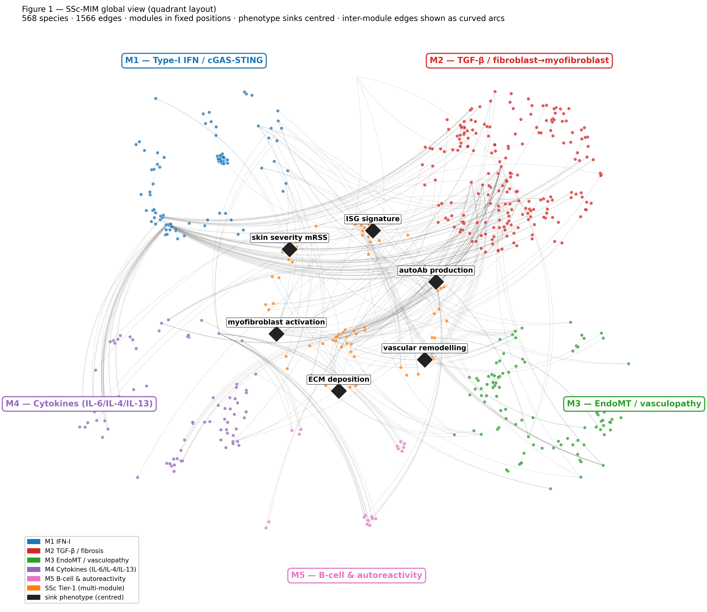
THE MAP
One integrated, modular network
Each quadrant is one module; nodes are species, edges are mechanistic reactions.
Hubs that emerge from network analysis match known SSc biology: TGF-β:receptor, SMAD3–SMAD4, ISG signature, PDGFR.
The same SBML file drives the figure, the analysis, and the online viewer.
SSc-MIM · Molecular Interaction Map of skin fibrosis in dcSSc
7

Slide 8
DESIGN PRINCIPLE
From molecules to disease phenotypes
The map is built around six phenotype “endpoints” — the biological and clinical outputs of the disease. Modelling rule: every disease-relevant entity must reach an endpoint in ≤ 6 steps (verified: 0 violations).
Myofibroblast activation
ECM / collagen
Vascular remodelling
Type-I IFN / ISG signature
Auto- antibodies
Skin severity (mRSS)
4 canonical biological sinks + autoantibody production (SSc autoreactivity, M4) + skin severity (clinical readout).
It turns a static drawing into a testable model: a perturbation anywhere has a traceable path to a clinical readout.
It makes the scope explicit and reviewable — exactly what we want expert biologists to challenge.
SSc-MIM · Molecular Interaction Map of skin fibrosis in dcSSc
8

Slide 9
RIGOUR
Every reaction is sourced and graded
Tiered citation policy (GO-aligned)
Each reaction carries a primary PubMed ID and an ECO evidence code — experimental evidence ranked above inference.
Provenance is tracked
Every edge records where it came from: Reactome import, hand curation, or literature mining — fully auditable.
No fabricated citations — ever
A built-in grounding gate rejects any claim without a real, verifiable source (a negative-control fixture proves it works).
~360 references mined & auto-filled (title, authors, journal) via NCBI E-utils.
133 SSc-specific reactions curated from a systematic 77-paper worklist + co-author full-text PDFs.
MI2CAST-compliant annotation throughout.
SSc-MIM · Molecular Interaction Map of skin fibrosis in dcSSc
9

Slide 10
PATIENT DATA
Four public single-cell datasets
197 donors (121 SSc / 76 HC) across skin, lung and blood — all re-analysed from raw GEO files.
GEO accession | Reference (verified) | Tissue | Donors (SSc/HC)
GSE195452 | Gur C et al. Cell 2022;185:1373 | Skin (multiome) | 154 (97 / 57)
GSE138669 | Tabib T et al. Nat Commun 2021;12:4384 | Skin | 22 (12 / 10)
GSE128169 | Morse C et al. Eur Respir J 2019;54:1802441 | Lung (ILD) | 13 (8 / 5)
GSE210395 | GEO — no linked publication | PBMC | 8 (4 / 4)
Skin cohorts (Gur, Tabib) give fibroblast-subset resolution — the actors M2/M3 model; ≈100k and 64k annotated cells.
Lung (SSc-ILD) and PBMC extend the map beyond skin. Every citation above was re-checked against PubMed.
SSc-MIM · Molecular Interaction Map of skin fibrosis in dcSSc
10

Slide 11
DATA ↔ MAP
How patient data is layered on the map
1
2
3
4
Re-process
scanpy QC + cell-type annotation of each dataset from raw counts.
→
Pseudobulk DEG
Per-donor pseudobulk; SSc-vs-HC differential expression (mixed-effects NB GLM, BH-FDR).
→
Map onto species
Match differentially-expressed genes to map species → coverage.
→
Score per donor
AUCell turns each patient into a 4-module activation vector.
M1 84% · M2 88% · M3 75% · M4 74% · M5 94% — the curated biology is largely measurable.
Biological check: M1 / type-I IFN module significantly elevated in SSc skin (Gur p = 3.2×10⁻⁴; Tabib p = 0.011).
60 ready-to-load MINERVA overlays for interactive exploration.
81.3%
of detectable map species observed in patient data
SSc-MIM · Molecular Interaction Map of skin fibrosis in dcSSc
11

Slide 12
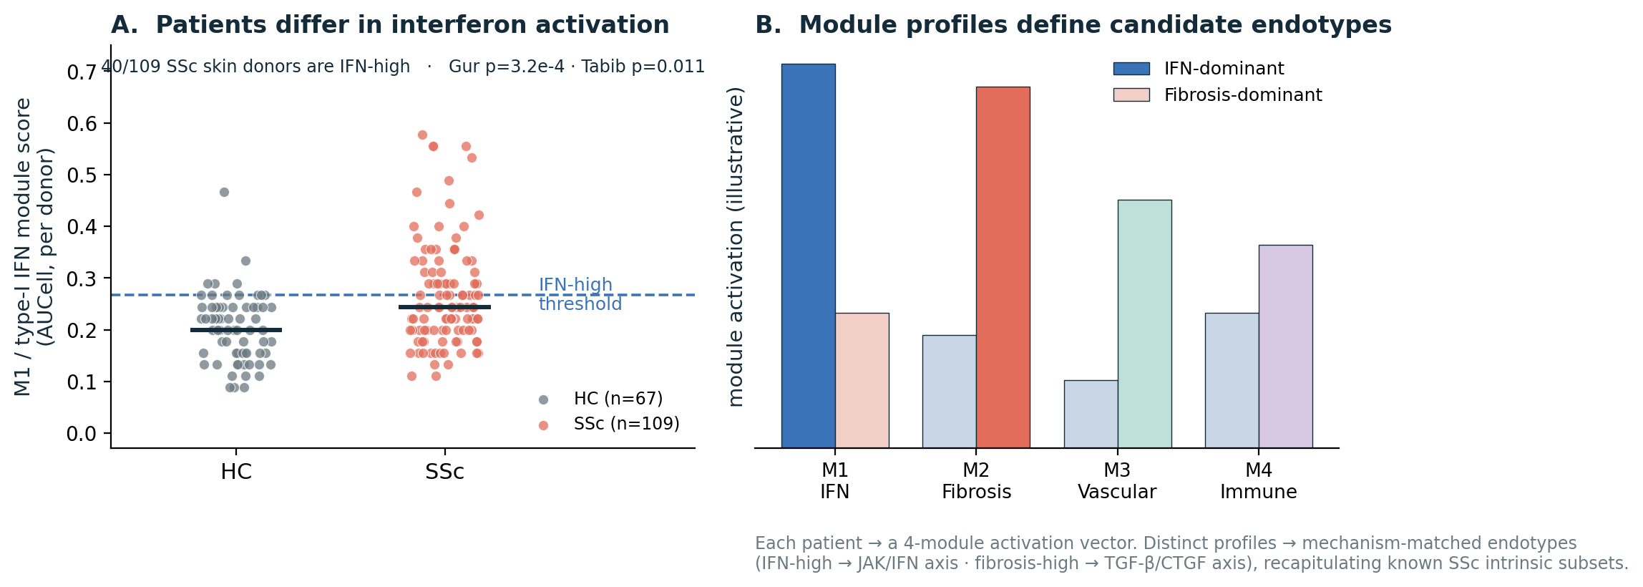
NEW DIRECTION
Toward endotypes: distinct activation profiles
The map converts each patient into a 4-module activation vector.
Real result: IFN activation is heterogeneous — 40/109 SSc skin donors are IFN-high, others are not (reproducible across Gur + Tabib).
Distinct module profiles → candidate, mechanism-matched endotypes (IFN-dominant vs fibrosis-dominant).
Recapitulates the known SSc intrinsic subsets (inflammatory ↔ M1/M4, fibroproliferative ↔ M2).
Clinical promise: module-matched therapy — IFN-high → JAK/IFN axis; fibrosis-high → TGF-β/CTGF axis.
SSc-MIM · Molecular Interaction Map of skin fibrosis in dcSSc
12

Slide 13
ENDOTYPE WORKFLOW
Bring your own patient clusters
Have 3 patient clusters? Project them onto the map and read out what mechanistically separates them — same pipeline, your labels.
YOUR CLUSTERS
Cluster 1
AUCell — score each cluster on the 5 modules (M1–M5 + Tier-1).
Per-cluster differential expression mapped onto map species → which reactions light up.
MINERVA overlay — colour the map by each cluster (any cluster label, no new method).
Cluster 2
→
Cluster 3
WHAT YOU GET BACK — per cluster
Module fingerprint
A 4-module activation vector per cluster — e.g. cluster 2 IFN-high, cluster 3 fibrosis-dominant.
Mechanistic hypotheses
The lit-up sub-circuits that distinguish each cluster — e.g. STING→IRF3 vs TGF-β→SMAD3→collagen.
Candidate targets
Active druggable hubs per cluster → a cluster-matched therapy hypothesis to test.
SSc-MIM · Molecular Interaction Map of skin fibrosis in dcSSc
13

Slide 14
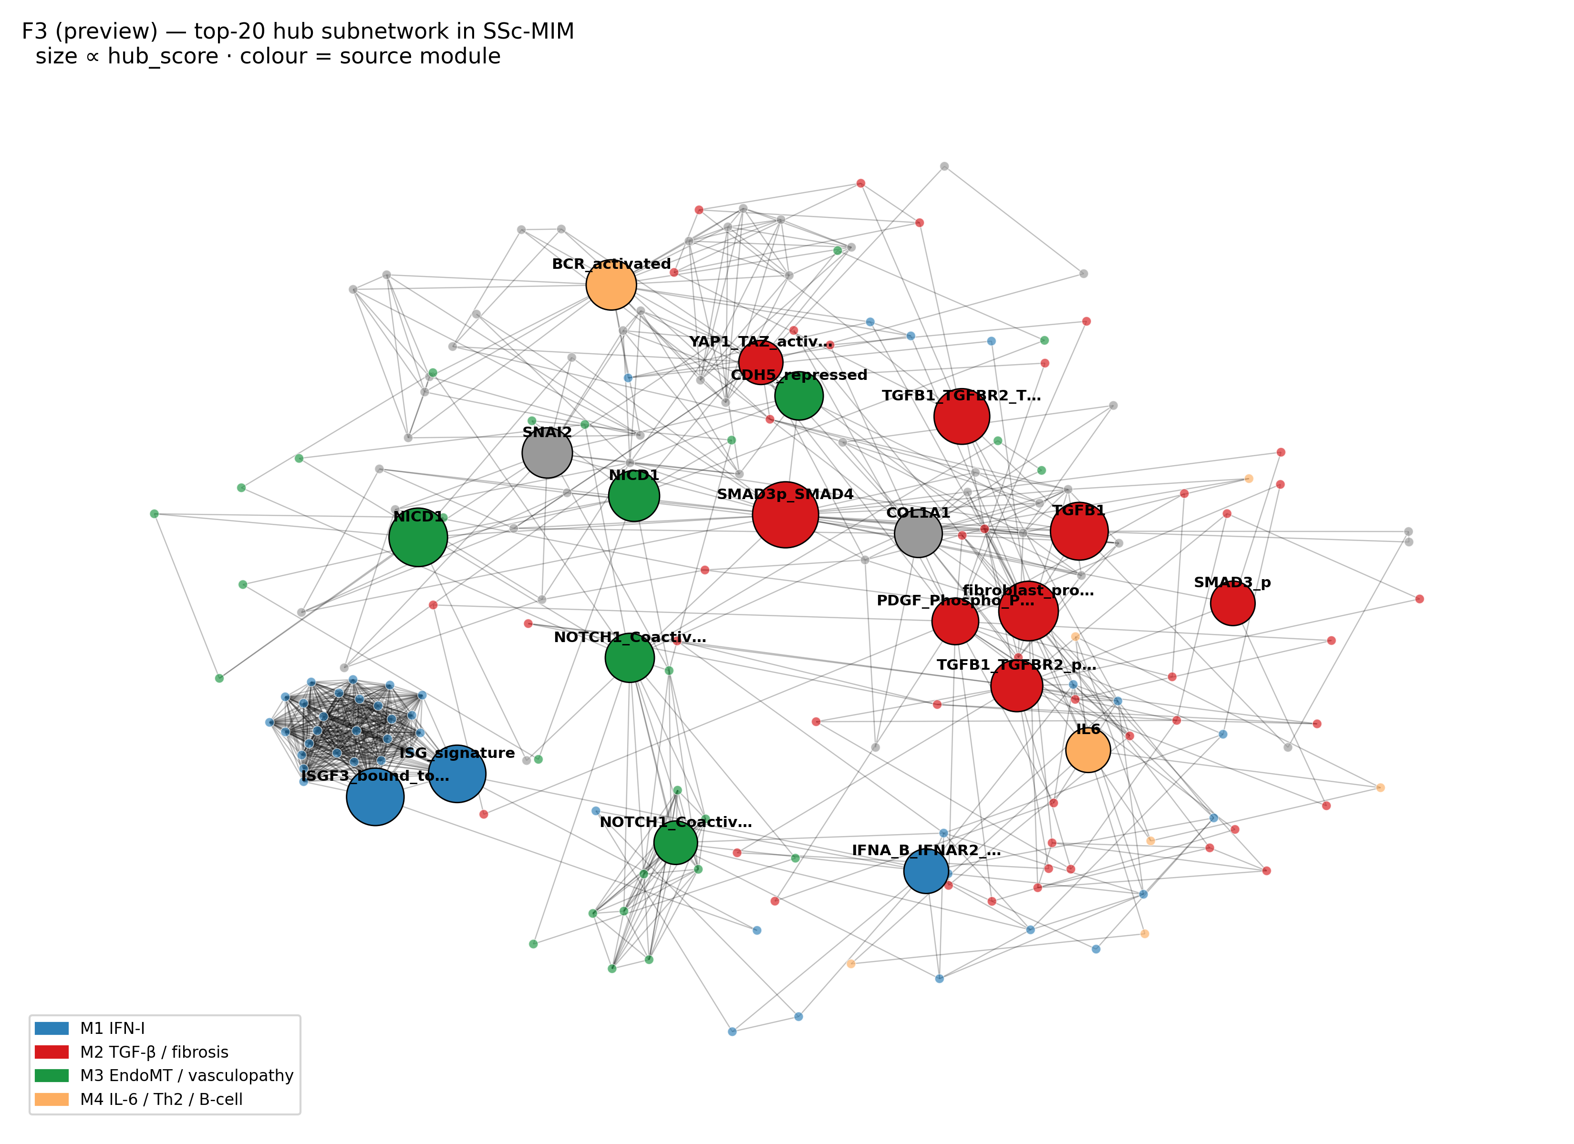
APPLICATION
A substrate for drug prioritisation
Network hubs cross-referenced with DGIdb drug–target data.
Recovers targets already in SSc trials — tocilizumab (IL-6), nintedanib, romilkimab (IL-13), pamrevlumab (CTGF/CCN2), bosentan (endothelin).
Drug table recalibrated against real SSc clinical-trial outcomes.
Shows the map can rank and rationalise repurposing candidates.
SSc-MIM · Molecular Interaction Map of skin fibrosis in dcSSc
14

Slide 15
QUALITY CONTROL
Independent verification of every interaction
143
interactions queued for expert review
128
passed automated AI verification
28
wrong source PMIDs caught & fixed
0
fabricated citations
Contradiction detector
Flags any gene pair given opposite signs by different sources, for human arbitration.
AI reviewer pass
Each interaction checked against its deciding sentence + supporting/contrary abstracts — verdict: validate / revise / caution.
Citation-integrity sweep (this week)
Found 28 reactions whose cited PMID pointed to an unrelated paper (biology canonical, reference a data-entry slip — e.g. a TGF-β reaction cited to a rubella study). Every replacement PMID was re-verified against live PubMed before applying.
SSc-MIM · Molecular Interaction Map of skin fibrosis in dcSSc
15

Slide 16
TODAY'S TOOL
An app to review the map, one interaction at a time
A swipe deck for curation
Offline, self-contained web app — one card per interaction, accept / reject / annotate.
Everything you need to decide, on the card
Regulator → target, mechanism, SSc relevance, the verbatim deciding sentence from the source article, and PubMed/DOI links.
Context before you judge
A literature dossier lists candidate supporting and “possibly contrary” references; an in-browser module map shows the neighbourhood.
Advisory AI verdict
Each card shows the AI call + rationale — filter to triage, but the human reviewer always decides.
No install, no server — open one HTML file.
Decisions saved locally; export to CSV/JSON.
Re-includes even discarded edges, so you keep full control.
Demo right after this.
SSc-MIM · Molecular Interaction Map of skin fibrosis in dcSSc
16

Slide 17
WHAT WE ASK OF YOU
Three things from expert biologists
1
2
3
Validate the scope
Do the 5 modules + 6 phenotype endpoints capture dcSSc skin fibrosis? What is missing or over-reaching?
Curate the entities
Tier-1 SSc species: what to add, remove, or promote — with PMIDs where you have them.
Adjudicate interactions
Use the review app on the 143 interactions: confirm, reject, or flag for revision.
SSc-MIM · Molecular Interaction Map of skin fibrosis in dcSSc
17

Slide 18
Where this is going
An open, citable SSc resource — and your review is the gate
v1.0 release: GitHub + Zenodo DOI (citable).
Resource paper (npj Systems Biology & Applications) — revision drafted.
Endotype stratification as the next translational step.
Expert sign-off on scope & interactions is the last binding step.
Nathan Foulquier
LBAI · UMR 1227 Inserm · CHU de Brest
github.com/Nurtal/IDT_SSc_map
Open the review app now for a live walkthrough.

