Slide 1

RankDesk
Design Thesis
Design System
Make SEO feel controlled, premium, and actionable: what changed, why it matters, and what to do next.
Premium SEO Command Center
Direction A — Rank Beacon identity
Dark-first product UI for clear SEO decisions
Canva-importable foundations, components, and screen specs

Slide 2
01 / Brand Foundations
Color System
Forest = trust/control/growth. Ember = opportunity/urgency. Ink = premium command shell.
Forest 900
Forest 700
Forest 500
Forest 100
Ember 600
Ember 100
#03311F
#0B6E4F
#4ECFA0
#E6F4EE
#E8621A
#FDF0E9
Ink 950
Cloud 50
Mist 300
Dark BG
Panel
Card
#0C1A14
#F8FCFA
#D0E5D9
#07120D
#0F2118
#132B20

Slide 3
02 / Typography
Syne + Onest + JetBrains Mono
Syne
Display / headings / metrics / wordmark
RankDesk turns SEO noise into next actions.
Onest
Body copy / navigation / controls
Readable product UI for founders, teams, and agencies.
JetBrains Mono
Ranks / URLs / keyboard hints / deltas
#04 +12 /pricing/seo-audit

Slide 4


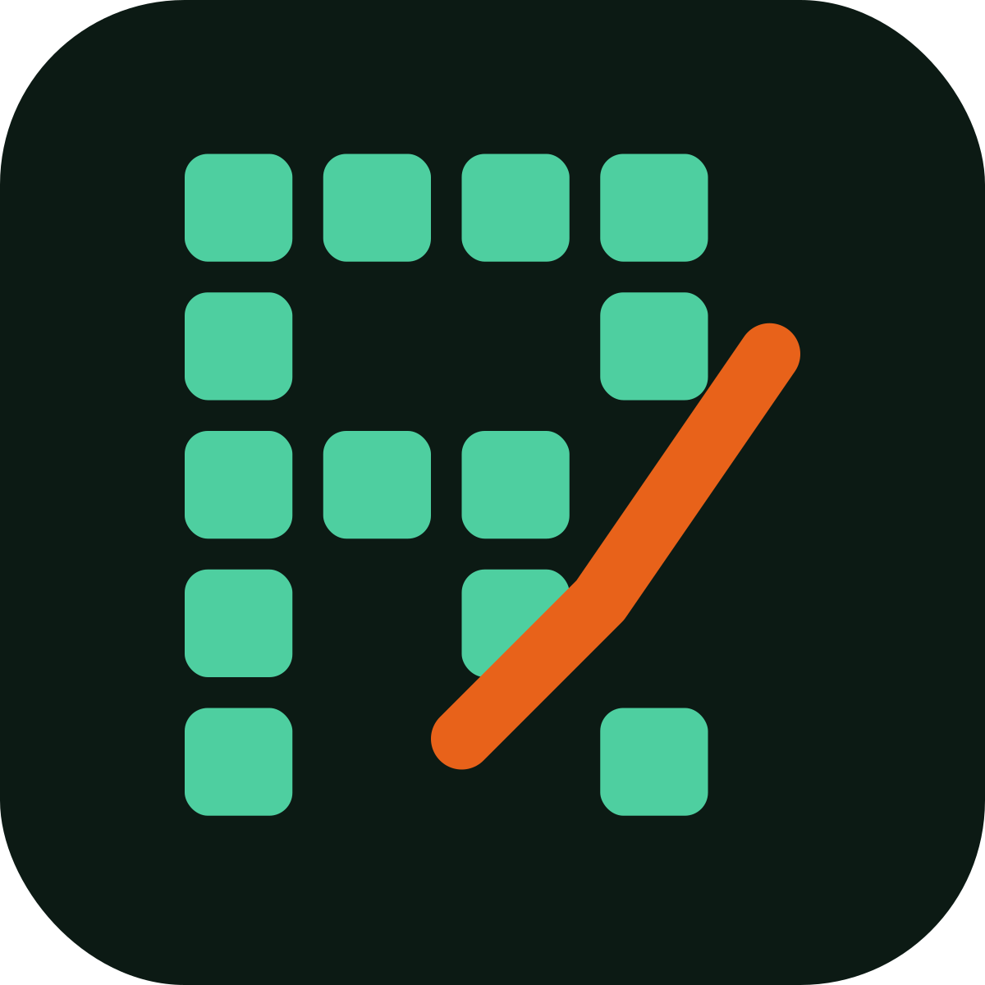


03 / Logo System
Rank Beacon is the primary route
Signal + ranking movement + command-center window + subtle R.
Primary positive
Primary reverse
Wordmark lockup
Rank Beacon Positive
Rank Beacon Reverse
Wordmark Lockup
Alternate concept
Alternate concept
Icon/favicon
Signal Matrix
Growth Desk
Favicon

Slide 5
04 / Components
Core UI Components
Buttons
Keyword table
Primary
Secondary
Opportunity
keyword
rank
Δ
intent
seo dashboard
04
+2
Commercial
KPI cards
keyword tracker
11
-3
Info
Visibility
Keywords Up
SEO Health
seo report tool
08
+5
Commercial
74
+8.2%
128
+34
91
Good
Rules: 8px radius buttons, 12px cards, mono only for rank/delta/URL data.

Slide 6
05 / Product Screen
Command Center Overview
RankDesk
Visibility
Up
Down
Health
74
128
24
91
Overview
Keywords
Visibility trend
Top Opportunities
Opportunities
Fix /seo-services title drop
Add internal links to pricing page
Refresh keyword tracker article
Reports
Settings
UX rule: answer what changed, why it matters, and what to do next.

Slide 7
06 / Screen System
Product Page Blueprints
Keyword Rankings
Opportunities
Light table-heavy page: filters, summary strip, rank/delta mono cells, selected row state.
Impact vs effort queue. Ember only marks valuable urgency, not decoration.
SEO Health
Reports
Health score ring, severity groups, affected pages, and plain-English “fix first” guidance.
Founder/client-ready summary: wins, drops, completed actions, next actions, export/share.

Slide 8
07 / Canva Build Checklist
Manual setup inside Canva
Upload SVG logo assets from assets/svg/
Create Brand Kit colors from rankdesk-canva-token-reference.json
Use Syne for headings, Onest/Aptos for UI/body, JetBrains Mono for ranks/URLs
Create pages: Cover, Logo, Foundations, Components, Product Screens, Handoff
Keep Rank Beacon as the recommended primary identity route
Use this imported deck as editable starting point + visual reference
Next Decision
Approve Rank Beacon, then Kiptoo can map this system into RankDesk code tokens later.

