Slide 1
Change Management
Lab 9

Slide 2
What Changes Are We Managing?
Software
Planned software development
team members constantly add new code
(Un)expected problems
bug fixes
Enhancements
Make code more efficient (memory, execution time)
“The only constant in software development is change”

Slide 3
Features Required to Manage Change
Backups
Timestamps
Who made the change?
Where was the change made?
A way to communicate changes with team

Slide 4
How to achieve that
Big project with multiple files
Bug fix required changing multiple files
Bug fix didn’t work
How to find the problem
Figure out which parts changed (diff)
Communicate changes with team (patch)

Slide 5
Disadvantages of diff & patch
Diff requires keeping a copy of old file before changes
Work with only 2 versions of a file (old & new)
Projects will likely be updated more than once
store versions of the file to see how it evolved over time
index.html index-2009-04-08.html index-2009-06-06.html index-2009-08-10.html index-2009-11-04.html index-2010-01-23.html index-2010-09-21.html
Numbering scheme becomes more complicated if we need to store two versions for the same date

Slide 6
Disadvantages of diff & patch
Two people may edit the same file on the same date
2 patches need to be sent and merged
Changes to one file might affect other files (.h & .c)
Need to make sure those versions are stored together as a group

Slide 7
How Do We Manage Changes?
Version Control Tools: track and control changes to files
What changes were made?
When were changes made?
Who made the changes?
Revert back to a previous version
Popular Tools: Subversion, Git, Bazaar

Slide 8
Centralized vs. Distributed VCS
Single central copy of the project history on a server
Changes are uploaded to the server
Other programmers can get changes from the server
Examples: SVN, CVS
Each developer gets the full history of a project on their own hard drive
Developers can communicate changes between each other without going through a central server
Examples: Git, Mercurial, Bazaar, Bitkeeper

Slide 9
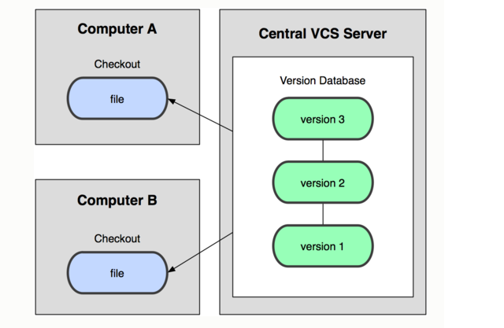
Centralized

Slide 10
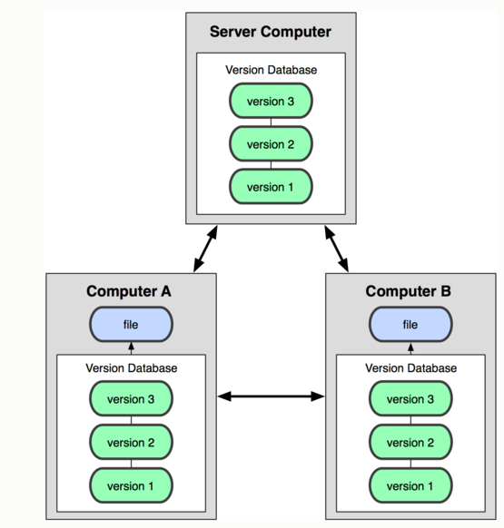
Distributed

Slide 11
Centralized: Pros and Cons
“The full project history is only stored in one central place.”
Pros
Everyone can see changes at the same time
Simple to design
Cons
Single point of failure (no backups!)

Slide 12
Distributed: Pros and Cons
“The entire project history is downloaded to the hard drive”
Pros
Commit changes/revert to an old version while offline
Commands run extremely fast because tool accesses the hard drive and not a remote server
Share changes with a few people before showing changes to everyone
Cons
long time to download
A lot of disk space to store all versions

Slide 13
Version Control Terminology
Repository
A database usually stored on a server that contains:
A set of files and directories
The full history and different versions of a project
Working Copy
A local copy of files from a repository at a specific time or revision

Slide 14
More Terminology
Check-Out
The act of creating a local working copy from the repository
Commit
The action of writing the changes made in the working copy back to the repository

Slide 15
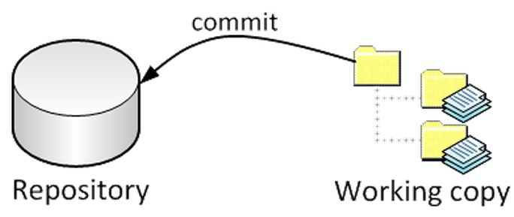
Big Picture
checkout

Slide 16
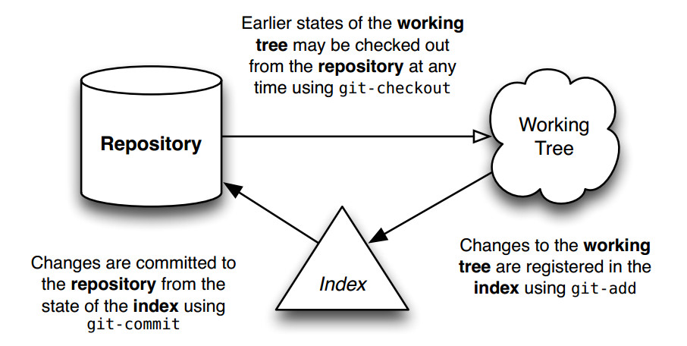
Git Workflow

Slide 17


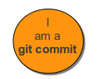

Git Architecture
git has 4 object types to implement source control:
Blobs
Like filesystem files (sequence of bytes)
Stored in .git/objects
Trees
Like filesystem directories
Can include other git trees or blobs
Commits
Created when “git commit” is executed
Points to the top-level tree of the project at the point of commit
Contains name of committer, time of commit and hash of current tree
Tags
Give names to commit objects for convenience
Include tag name, the commit referred to, tag message, tagger info
Objects uniquely identified with hashes

Slide 18
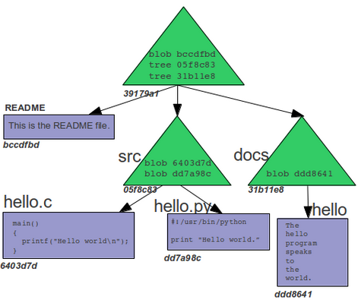
Git Object Store w/o Commits

Slide 19
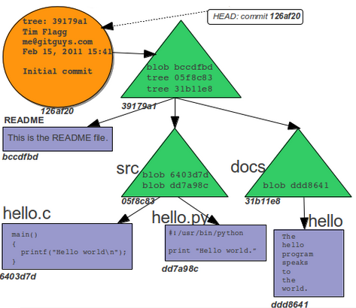
Git Object Store w/ First Commit

Slide 20
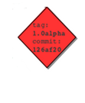
Git Object Store w/ First Commit

Slide 21
Git Architecture cont’d
head
A reference to a commit object
A repository can contain any number of heads
HEAD
Refers exclusively to the currently active (checked out) head
Branch
Refers to a head and the entire history of ancestor commits preceding that head
Master
The default head name that git creates when the repo is first created. It refers to the default branch created in the repository.

Slide 22
Some git Commands
Getting a Repository
git init //creates new repository
git clone //gets a copy of an existing repository
Commits
git add //adds files to the index
git commit // changes are added to the repo
Getting information
git help, git status, git log, git show, git diff

Slide 23
First Git Repository
$ mkdir gitroot
$ cd gitroot
$ git init
creates an empty git repo (.git directory with all necessary subdirectories)
$ echo “Hello World” > hello.txt
$ git add .
Adds content to the index
Must be run prior to a commit
$ git commit –m ‘Check in number one’

Slide 24
Working With Git
$ echo “I love Git” >> hello.txt
$ git status
Shows list of modified files
hello.txt
$ git diff
Shows changes we made compared to index
$ git add hello.txt
$ git diff
No changes shown as diff compares to the index
$ git diff HEAD
Now we can see changes in working version
$git commit –m ‘Second commit’

Slide 25
Undoing What Is Done
git checkout
Used to checkout a specific version/branch of the tree
git revert
Reverts a commit
Does not delete the commit object, just applies a patch
Reverts can themselves be reverted!
Git never deletes a commit object
It is very hard to lose data

Slide 26
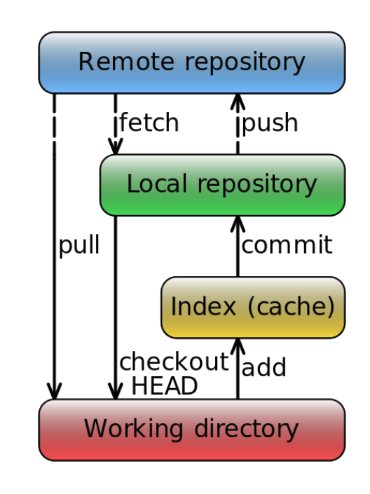
Overview
clone

Slide 27
Lab 9
GNU Diffutils uses " ` " in diagnostics
Example: diff . –
Output: diff: cannot compare `-' to a directory
Want to use apostrophes only
Diffutils maintainers have a patch for this problem called “maint: quote 'like this' or "like this", not `like this'”
Problem: You are using Diffutils version 3.0, and the patch is for a newer version

Slide 28
Backporting
Taking a certain software modification (patch) and applying it to an older version of the software than it was initially created for.

Slide 29
Steps
Installing Git
Ubuntu: $ sudo apt-get install git
SEASnet
Git is installed in /usr/local/cs/bin
Add it to PATH variable or use whole path
Make a directory ‘gitroot’ and get a copy of the Diffutils Git repository
$ mkdir gitroot
$ cd gitroot
$ git clone git://git.savannah.gnu.org/diffutils.git
3) Follow steps in lab and use man git to find commands

Slide 30
Useful Links
Git Tutorial
By topic
Git Beginner’s Tutorial
Step by step tutorial + testing terminal
Git Visual Guide
For visualizing what each command does
Git From The Bottom Up
For understanding how Git is structured and the details of how it tracks changes

