Slide 1
Verifying and Publishing a Backported Change
Homework 9

Slide 2
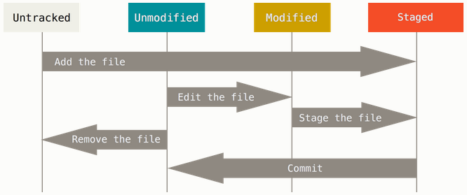
Git File Status Lifecycle
Tracked

Slide 3
Git Example
Project
games: pacman.c, pacman.h, README
Create repository to track new project
git init (creates .git dir w/ all necessary repo files)
Is the project tracked?
No, need to add files and do an initial commit
git add pacman.c pacman.h README
git commit –m “initial commit of my project”

Slide 4
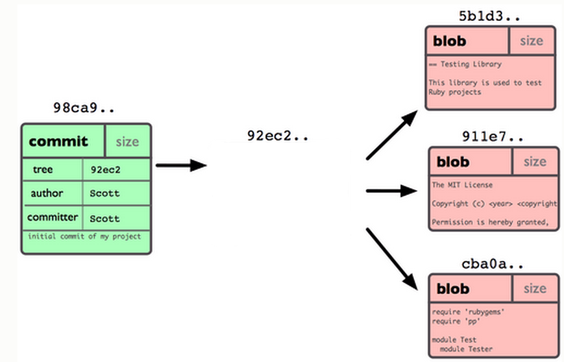
Git Repo Structure
Snapshot
tree |  | size
blob | 5b1d3 | README
blob | 911e7 | pacman.c
blob | cba0a | pacman.h

Slide 5
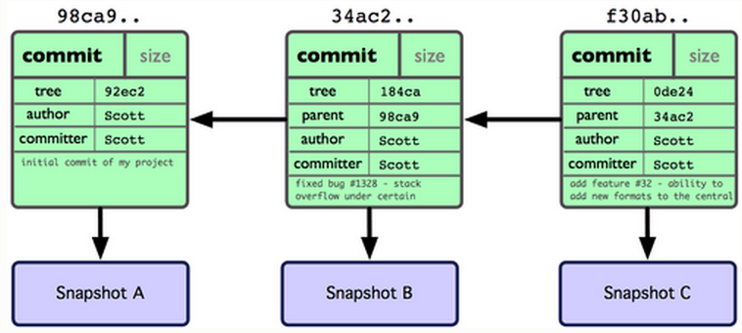
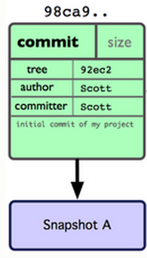
After 2 More Commits…

Slide 6
What Is a Branch?
A pointer to one of the commits in the repo (head) + all ancestor commits
When you first create a repo, are there any branches?
Default branch named ‘master’
The default master branch
points to last commit made
moves forward automatically, every time you commit

Slide 7
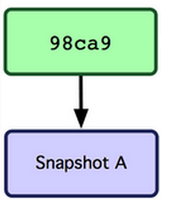
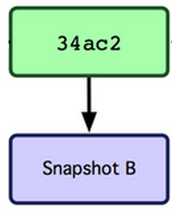
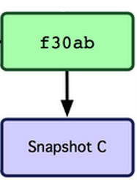
Where Is Master?
master
master

Slide 8
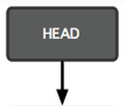
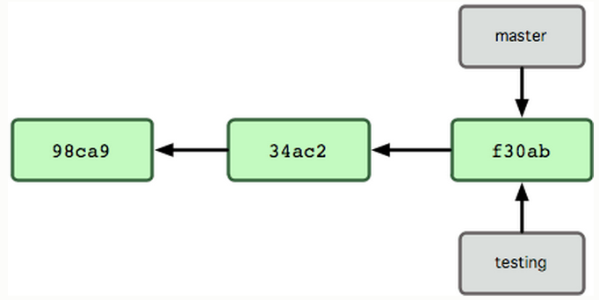
New Branch
Creating a new branch = creating new pointer
git branch testing
Where is new branch created?
Current commit
Where is current commit?
HEAD

Slide 9
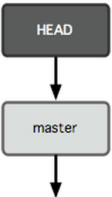
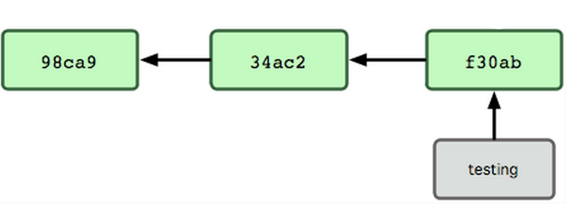
New Commit
What happens if we make another commit?
345f5

Slide 10
Switching to New Branch
Check out new branch
$ git checkout <branch_name>
$ git checkout testing

Slide 11
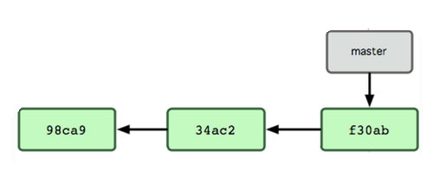

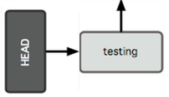
Commit After Switch

Slide 12
Why Branching?
Experiment with code without affecting main branch
Separate projects that once had a common code base
2 versions of the project

Slide 13
Merging I
master
Need to fix a bug
Create a branch
git branch bugFix
git checkout bugFix
Make some progress
Make a commit
C0
C1
C2
C3
bugFix

Slide 14
Merging II
Not done with bugFix, but need to fix
an urgent bug
Go back to master:
git checkout master
=> Create a branch & check it out
git checkout –b urgentFix
Make some progress
Make a commit
master
C4
C0
C1
C2
C3
urgentFix
bugFix

Slide 15
Merging III
When confident about fix, we can
merge it back into master
git checkout master
git merge urgentFix
git branch –d urgentFix
Fast Forward Merge
urgentFix
master
master
C4
C0
C1
C2
C3
bugFix

Slide 16
Homework 9
Publish patch you made in lab 9
Create a new branch “quote” off of version 3.0
Branch command + checkout command (git branch quote v3.0; git checkout quote)
git checkout v3.0 -b quote
Use patch from lab 9 to modify this branch
Patch command
patch –pnum < quote-3.0-patch.txt
Create Changelog entry (C-x 4 a)
Commit changes to the new branch
git add . git commit –F <Changelog file>
Generate a patch that other people can use to get your changes
git format-patch -[num] --stdout > formatted-patch.txt
Test your partner’s patch
Check out version 3.0 into a temporary branch (“partner”)
Apply patch with git am command: git am < formatted-patch.txt
Build and test with make check

Slide 17
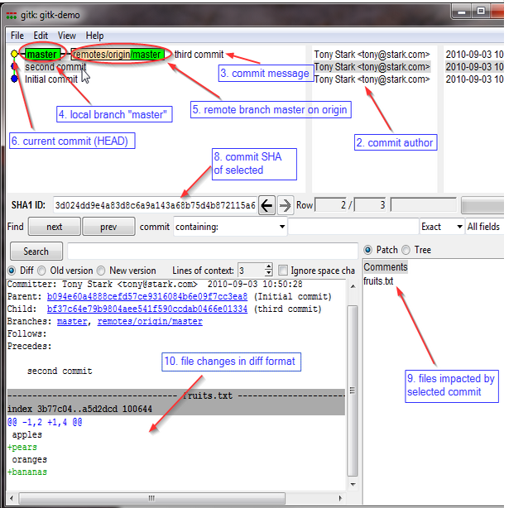
Gitk
A repository browser
Visualizes commit graphs
Used to understand the structure of the repo
Need X11 forwarding
Tutorial here

