Slide 1
Introduction to
Machine Learning
By Sarthak Mishra
BS-MS 2018
IISER Bhopal

Slide 2
Drug discovery using ChEMBL database

Slide 3
What is Machine Learning?
The systematic study of algorithms and systems that improve their knowledge or performance with experience.
“Machine learning is the science of getting computers to act without being explicitly programmed.” — Stanford University

Slide 4
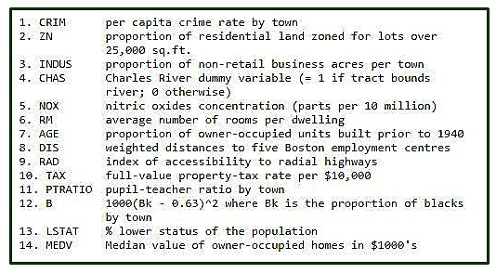
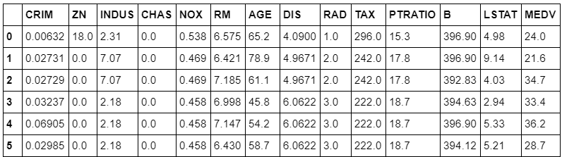
Basically, any ML problem has a dataset filled with bunch of datas.
Each data point represents a Feature.
Any ‘Real Life’ object is represented with these features.
The Machine Learning algorithm’s task is simple i.e. to search for patterns within the dataset.

Slide 5
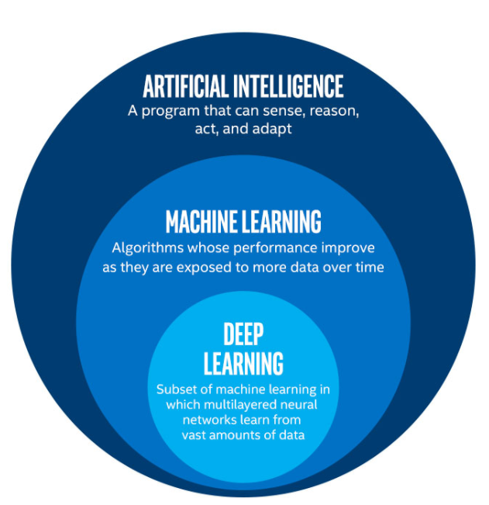
AI, ML and DL
Source: Towardsdatascience

Slide 6
AI and DL
Artificial Intelligence is the simulation of human intelligence in machines that are programmed to think like humans and mimic their actions.
So a block of code or algorithm that enables machine to mimic, develop or demonstrate the human cognition or behavior is known as AI.
Deep Learning is a subset of Machine Learning which is capable of learning Unsupervised that means without any labelled data and is completely based upon certain nodes known as Neural Networks for its tasks.
Thus it is also known as ‘Deep Neural Learning’.

Slide 7
Types of Machine Learning algorithms
Supervised Learning-
Requires human effort
Ex- Detecting fraudulent activity in credit card transactions
Unsupervised Learning-
No human effort, hence no output data.
Ex- Detecting abnormal access patterns to a website

Slide 8
Supervised Learning
Machine learning algorithms that learn from input/output pairs are called supervised learning algorithms because a “teacher” provides supervision to the algorithms in the form of the desired outputs.
Creating a dataset of inputs and outputs is often a laborious manual process but supervised learning algorithms are well understood and their performance is easy to measure.
‘Drug Discovery using ChEMBL dataset’ is Supervised Learning problem.
Detecting fraudulent activity in credit card transactions
Here the input is a record of the credit card transaction, and the output is whether it is likely to be fraudulent or not. Assuming that we are the entity distributing the credit cards, collecting a dataset means storing all transactions and recording if a user reports any transaction as fraudulent.

Slide 9
Unsupervised Learning
In unsupervised learning, only the input data is known, and no known output data is given to the algorithm.
Many successful applications of these methods, they are usually harder to understand and evaluate.
Detecting abnormal access patterns to a website
To identify abuse or bugs, it is often helpful to find access patterns that are different from the norm. Each abnormal pattern might be very different, and you might not have any recorded instances of abnormal behavior. Because in this example you only observe traffic, and you don’t know what constitutes normal and abnormal behavior, this is an unsupervised problem.

Slide 10
Some useful ML libraries
pandas
NumPy
scikit-learn
matplotlib
Deep Learning-
Keras
Tensorflow

Slide 11
pandas Library
pandas is a Python library for data wrangling and analysis.
It is built around a data structure called the DataFrame.
Simply put, a pandas DataFrame is a table, similar to an Excel spreadsheet.
pandas provides a great range of methods to modify and operate on this table.

Slide 12
NumPy
Fundamental package for scientific computing in Python.
It contains functionality for multidimensional arrays, high-level mathematical functions such as linear algebra operations and the Fourier transform, and pseudorandom number generators.

Slide 13
scikit-learn
Contains a number of state-of-the-art machine learning algorithms, as well as comprehensive documentation about each algorithm.
scikit-learn is a very popular tool, and the most prominent Python library for machine learning.
Widely used in industry and academia, and a wealth of tutorials and code snippets are available online.
scikit-learn works well with a number of other scientific Python tools.

Slide 14
matplotlib
matplotlib is the primary scientific plotting library in Python.
It provides functions for making publication-quality visualizations such as line charts, histograms, scatter plots, and so on.
Visualizing the data and different aspects of your analysis can give many important insights.

Slide 15
How to approach a ML Problem
Step 1- Gathering the Data
Read the data from csv, json etc.
Step 2- Data Pre-Processing
Check if the data has missing values.
If yes, apply basic data preprocessing operations to bring the data in a good to go format.
Step 3- Researching the model that will be best for the type of data
Check for best performing model based on pre-processed data.
Here, we decide whether to use Supervised/Unsupervised, Regression/Classification.
Step 4- Training and Testing
Now split the data into the groups of training and testing for the respective purpose.
After splitting, fit it to the most suitable model.
Here, I have used Linear Regression and Random Forest Regression.
Step 5- Evaluation and Validation
Calculate the accuracy.
Try different algorithms for the same problem to understand the difference between the accuracies.

Slide 16
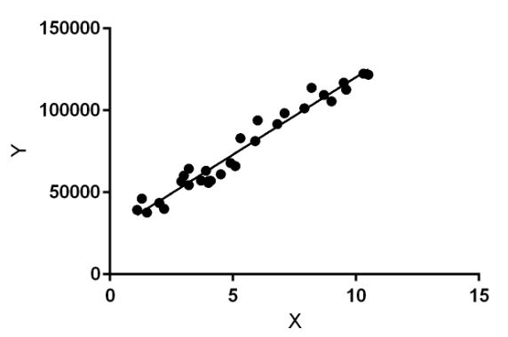
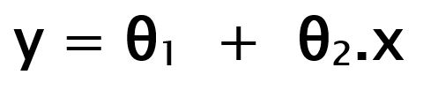
Linear Regression
Predict a dependent variable value (y) based on a given independent variable (x).
While training the model we are given :
x: input training data (univariate – one input variable(parameter))
y: labels to data (supervised learning)
θ1: intercept and θ2: coefficient of x
When training the model – it fits the best line to predict the value of y for a given value of x. The model gets the best regression fit line by finding the best θ1 and θ2 values.
Once we find the best θ1 and θ2 values, we get the best fit line. So when we are finally using our model for prediction, it will predict the value of y for the input value of x.

Slide 17
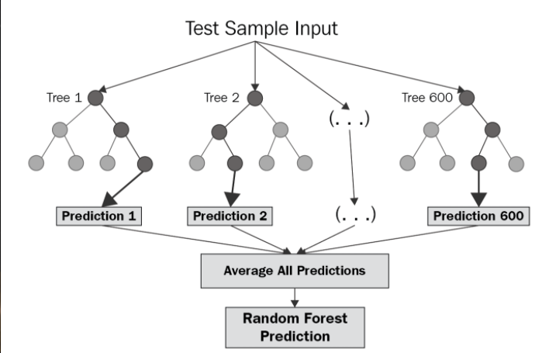
Random Forest Regression
Uses a method called Ensemble Learning which is a technique that combines predictions from multiple machine learning algorithms to make a more accurate prediction than a single model.
A Random Forest operates by constructing several decision trees during training time and outputting the mean of the classes as the prediction of all the trees.

Slide 18
References-
Introduction to Machine Learning with Python by Andreas C. Müller & Sarah Guido
https://www.kaggle.com/shreayan98c/boston-house-price-prediction
https://towardsdatascience.com/cousins-of-artificial-intelligence-dda4edc27b55
https://towardsdatascience.com/workflow-of-a-machine-learning-project-ec1dba419b94
https://www.geeksforgeeks.org/ml-linear-regression/
https://levelup.gitconnected.com/random-forest-regression-209c0f354c84

Slide 19
Now-
Drug discovery using ChEMBL database

