Slide 1
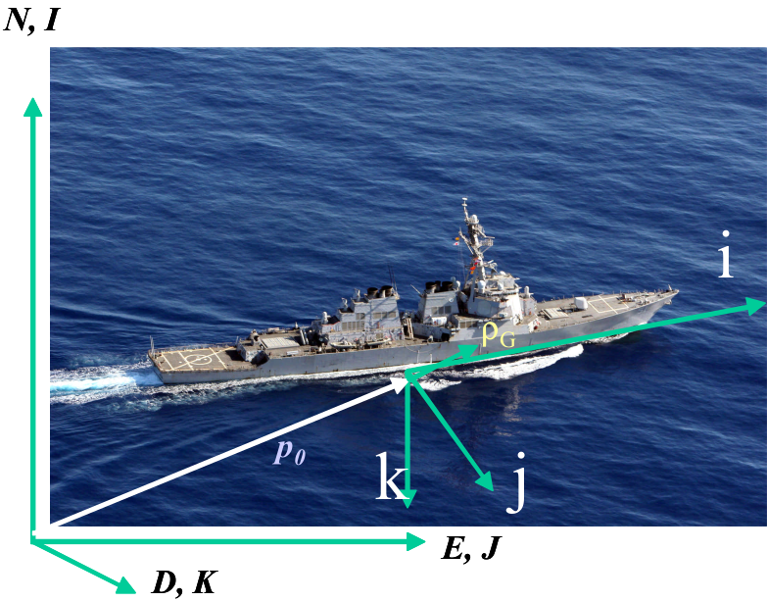
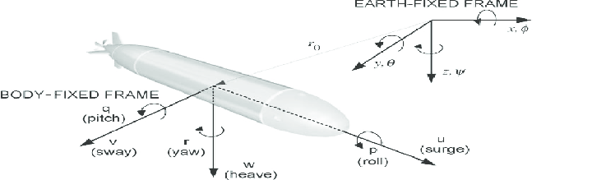
6DOF AUV Trajectory Optimization using MPC
Sarthak Mishra, Roll No. 18388
Supervisor:
Prof. João Sousa
Electrical and Computer Engineering Department
Porto University in Portugal
Co-Supervisor:
Dr. Sunil Pratap Singh
Department of Physics,
IISER Bhopal
Figure 1(left): Earth fixed and body fixed reference frame of a surface vehicle. Same coordinate system has been used for underwater vehicle study. Source: Healey course [2]
Figure 2(top): Six degrees of freedom of an AUV. Credits: ANFN controller based on differential evolution for Autonomous Underwater Vehicles

Slide 2
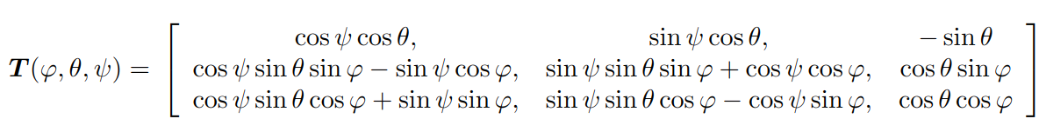
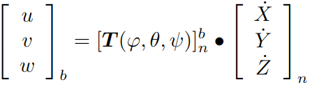
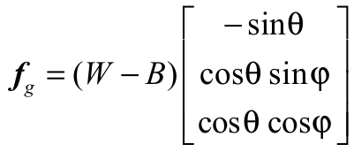
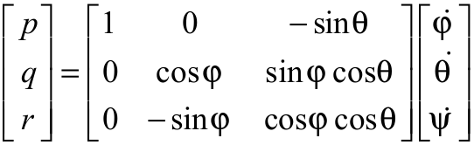
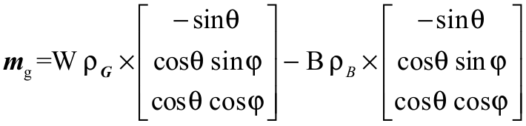
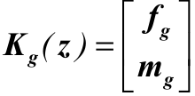
6DOF Kinematic equations of motions
Euler rotation matrix
Buoyancy and gravity effects-
The net vertical force components along the body axes, f_{g}-
Translational velocity transformation
The effects of the weight and buoyant forces as moments about the body fixed frame origin-
Angular velocity transformation
Translational EOM
The total force and moment vector along vertical axis can be written in body coordinates as
Rotational EOM

Slide 3


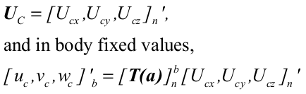
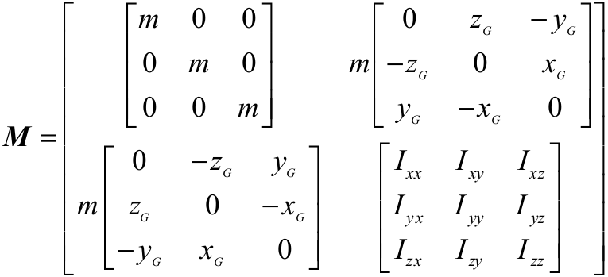

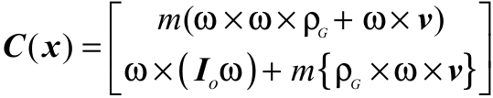
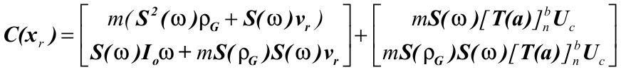
6DOF Kinematic equations of motions
Separating out the terms for inertial and non-inertial forces we get the vehicle state equations as
Ocean Current calculations
In order to account for the ocean currents, we adopt an additional coordinate frame that moves parallel to the N-E-D reference frame with the local water particles, and has some relative velocity vector with respect to the global reference frame.
where,
and
Transformation to body fixed reference frame-
M is a 6x6 mass matrix-
Net body fixed velocity of center of mass of vehicle-
The only term that changes is the non-inertial force component so that the coriolis additional force and moment terms induced by current becomes
The remaining terms on the left hand side arising from centripetal and coriolis accelerations

Slide 4
Body-Fluid Interaction
Four ideal cases. In real fluids, the hydrodynamic force on a submerged vehicle depends on-
the relative velocity between the water particles and the vehicle (the drag force); Term comes from ideal case (4)
the relative acceleration between the water particles and the vehicle (the inertia and 'added mass' terms), and
the modifications to the 'buoyant' forces resulting from water particle acceleration.
C_{a} is added mass coefficient; ρ(πc²) is the mass of displaced fluid; D is the projected area per unit length of the body exposed to the flow, for flow at high Reynolds numbers, C_{d} is commonly taken to be 2.0 and the modified square law mathematically preserves the correct sign
This is the longitudinal motion equation for an underwater vehicle in the u-direction in actual ocean environment with no other motion involved.

Slide 5
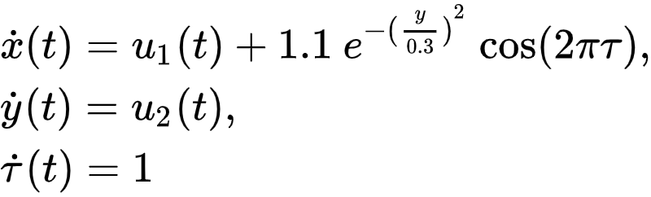
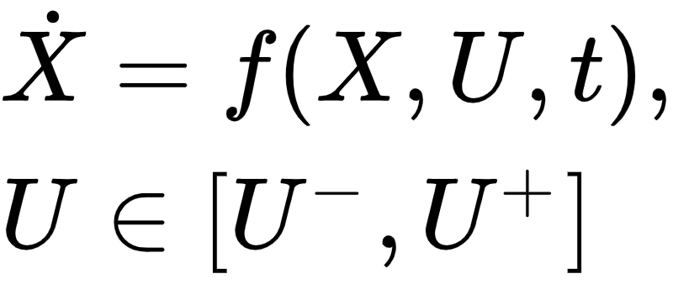
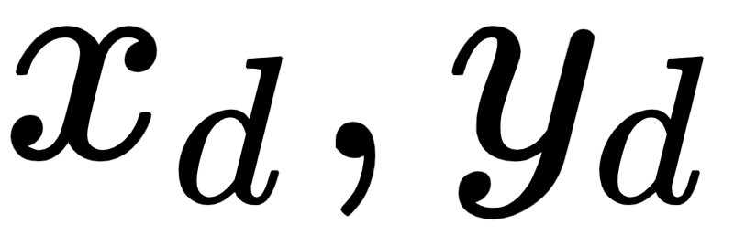
Model Predictive Control (MPC)
Kinematic model of a point-based AUV [1]
Cost function for the MPC
Subject to:
where is the prediction horizon, and are the destination coordinates.

Slide 6

Simulation results for point mass Robot
Time-varying flow field
Cross field flow with obstacle avoidance

Slide 7
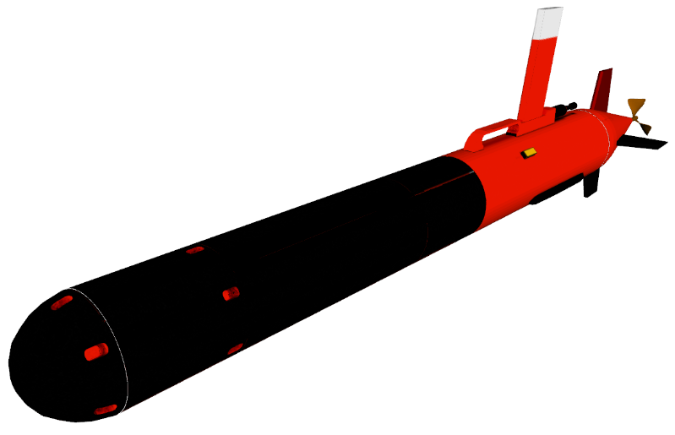
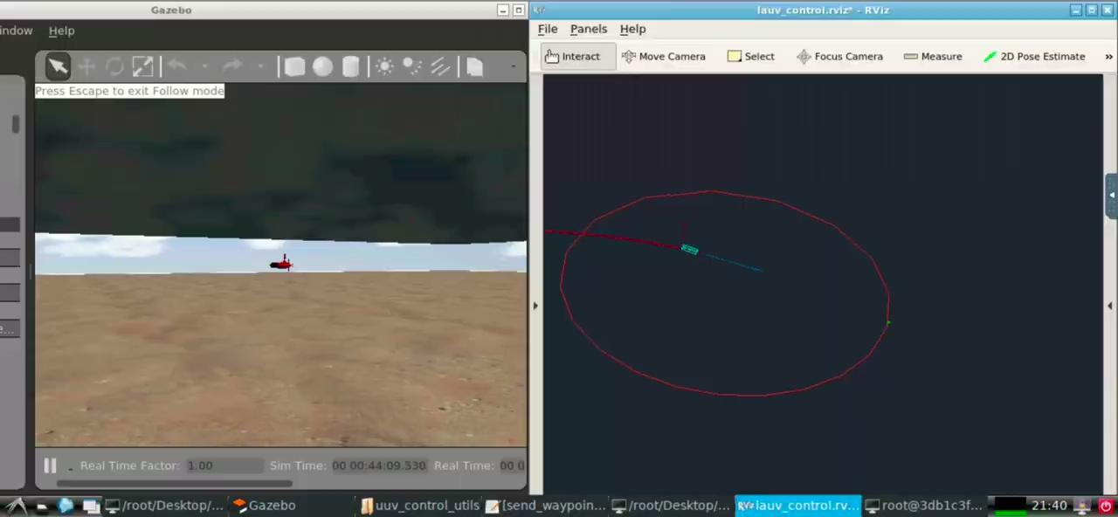
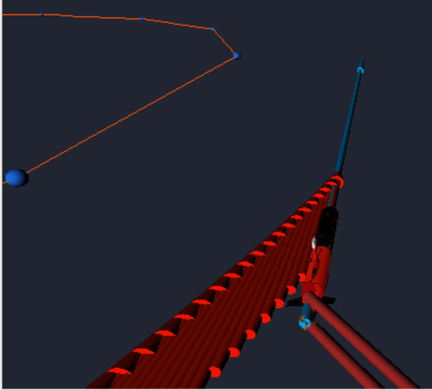
UUV Simulator
Credits: [4]
Simulation of a time-varying ocean environment and go-to-goal scheme for LAUV model[4].

Slide 8
Further Works
Replace point-based model with a complete rigid body kinematic model
Obtain an optimized trajectory for the real world AUV using MPC and a more realistic cost function
Prepare an DL based method to predict the efficient cost function
Simulate the entire system of ocean environment and vehicle in the UUV simulator

Slide 9
References
Miguel Aguiar, João Borges de Sousa, João Miguel Dias, Jorge Estrela da Silva, Renato Mendes and Américo S. Ribeiro, ”Trajectory Optimization for Underwater Vehicles in Time-Varying Ocean Flows”, IEEE/OES Autonomous Underwater Vehicle Workshop (AUV), 2018 link
Course notes on dynamics and control of marine robotic vehicles by A. J. Healey, Department of Mechanical and Astronautical Engineering Naval Postgraduate School, Monterey, California
Workshop on Optimization based Solutions for Control and State Estimation in Dynamical Systems (Implementation to Mobile Robots) link
Sousa, Alexandre, et al. "LAUV: The man-portable autonomous underwater vehicle." IFAC Proceedings Volumes 45.5 (2012): 268-274. Link
Guidance and control of Ocean vehicles by Thor I. Fossen

Slide 10
THANK YOU

