Slide 1
Internet Security Project
Group Members:
Kh. Reaz Faruk 18-37581-1
Chuity, Sanzida Mannan 17-33480-1
Mim, Fyzun Nahar 18-36446-1
Rimon, Tajbiur Shahrior 18-38341-2
Rabbi, Md Fajlay 18-38138-2

Slide 2
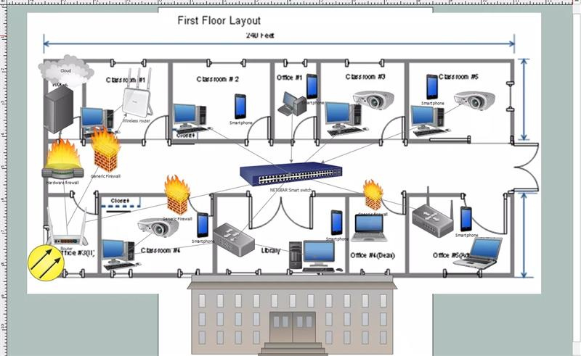
Network Architecture
First Floor:

Slide 3
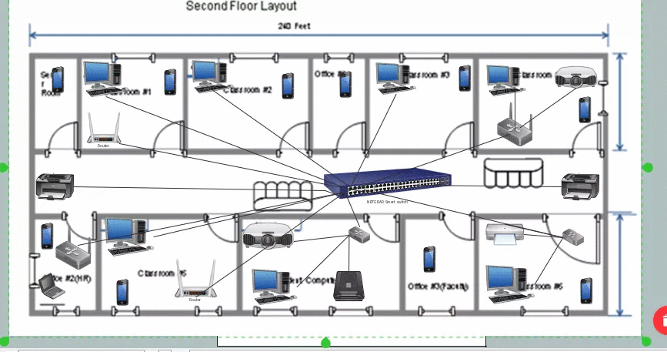
Second Floor

Slide 4
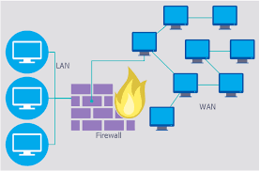
implement Local (LAN) area network security
Get an activated firewall support router
Use WPA2 encryption
Build a "Guest Network“
Add Filtering MAC Address
Secure network hardware

Slide 5
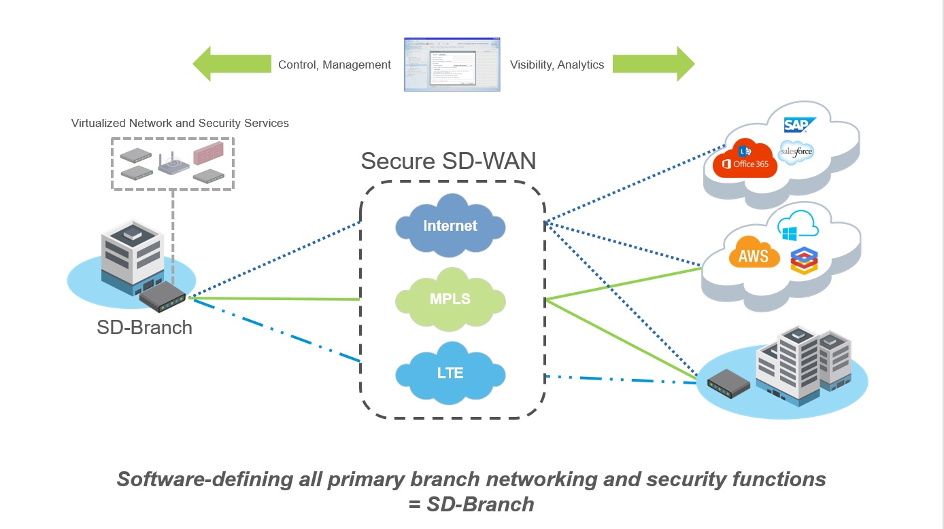
implement wide (WAN) area network security
Virtual private networks
Software-defined wide area networks (SD-WAN)
Managing mobile devices
Keeping everything updated

Slide 6
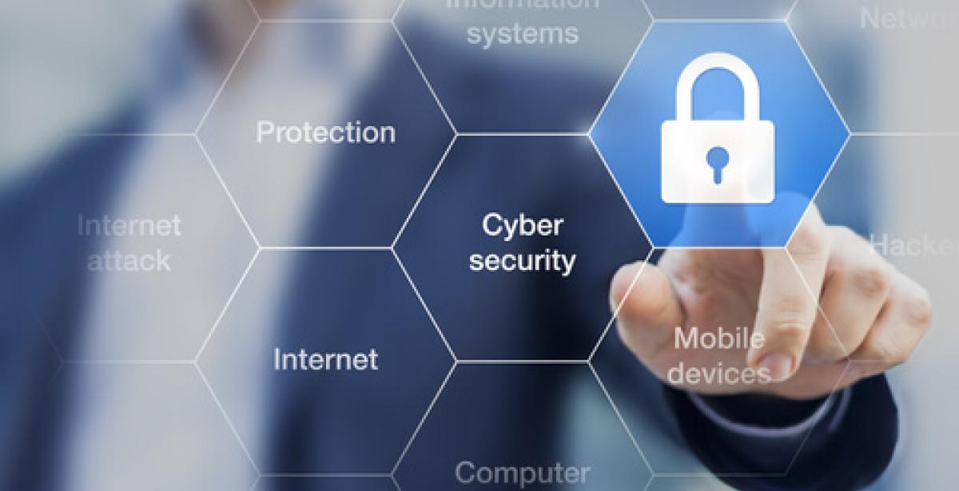
Way Of Improving Security
Connect to a Secure Network. ...
Enable and Configure a Firewall. ...
Install and Use Antivirus and Anti-spyware Software.
Remove Unnecessary Programs. ...

Slide 7
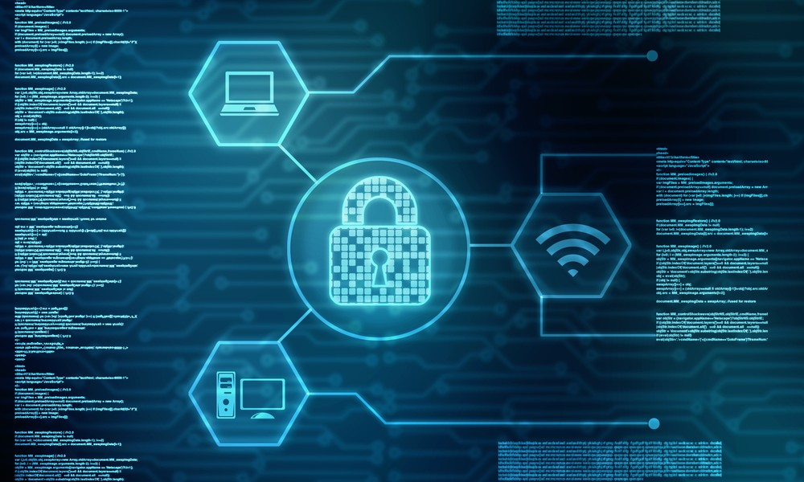
Way Of Improving Security
5. Modify Unnecessary Default Features
6. Operate Under the Principle of Least Privilege.
7. Secure Your Web Browser.
8. Apply Software Updates and Enable Future Automatic Updates

Slide 8
Thanks For Your Patience

