Slide 1

Khulna University of Engineering & Technology
Department of Computer Science and Engineering
CSE 4120 - Technical Writing & Seminar
Topic - Fake Image Detection
Instructed by
Presented by
Dr. K. M. Azharul Hasan
Professor,
Department of CSE, KUET
Sunanda Das
Assistant Professor,
Department of CSE, KUET
Nushrat Tarmin Meem
Roll: 1907083
Year: 4th
Semester: 1st
Group: B₂

Slide 2
Contents
Introduction
Literature Review
Selected Papers
Methodology
Result Analysis
Findings and Recommendations
Conclusion
References

Slide 3
Introduction
Identification of manipulated or fabricated images
Prevention of misinformation and fraud
Maintenance of Ethical Standards
Use in Social Media Platforms Security and Historical Preservation
Criminal investigations in case of Forensic Analysis

Slide 4
Literature Review
Some works [1] [2] [3] focusing on detecting the forgery clues in facial features, head poses, blinking patterns or skin colors
Detection in obvious changes [4] [5]
Limitation in case of images with mild distortion [6]
Focusing on Texture Information Modification [7] [8]
Challenging GAN or AI generated fake image detection [9]

Slide 5
Selected Papers
No | Title | Authors | Source | Year
1 | New Finding and Unified Framework for Fake Image Detection | Xin Deng, Bihe Zhao, Zhenyu Guan, Mai Xu | IEEE Signal Processing Letters, Vol. 30, 2023 | 2023
2 | Towards Universal Fake Image Detectors that Generalize Across Generative Models | Utkarsh Ojha, Yuheng Li, Yong Jae Lee | IEEE/CVF Conference on Computer Vision and Pattern Recognition (CVPR), 2023, pp. 24480-24489 | 2023
3 | Fake-image detection with Robust Hashing | Miki Tanaka, Hitoshi Kiya | IEEE 3rd Global Conference on Life Sciences and Technologies (LifeTech 2021) | 2021

Slide 6
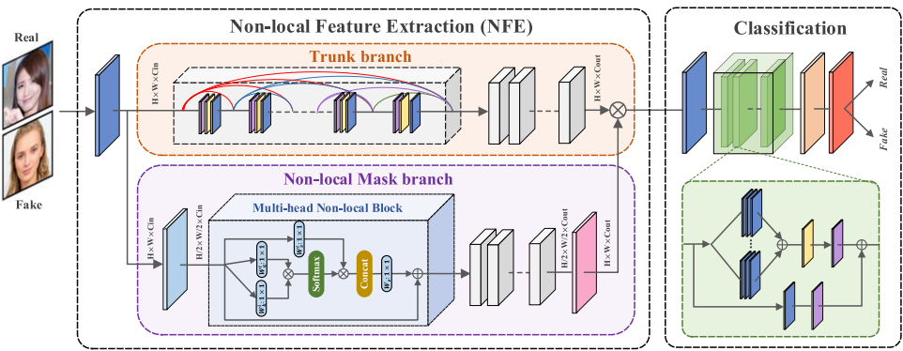
Methodology
Figure 1: NAFID network for face forgery detection (Paper 1)

Slide 7
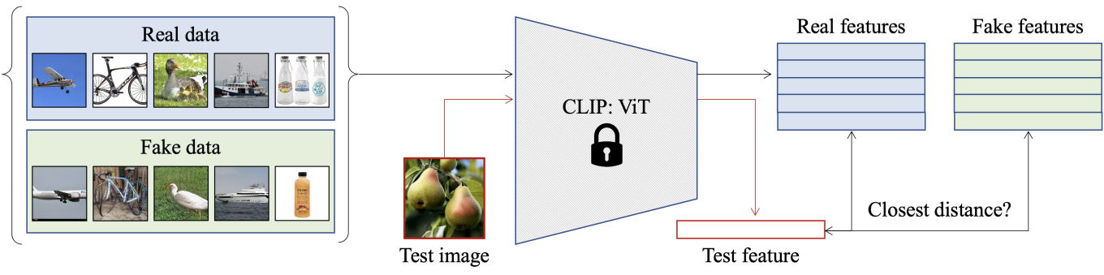
Methodology (contd.)
Figure 2: Nearest neighbors method for real-vs-fake image classification (Paper 2)

Slide 8
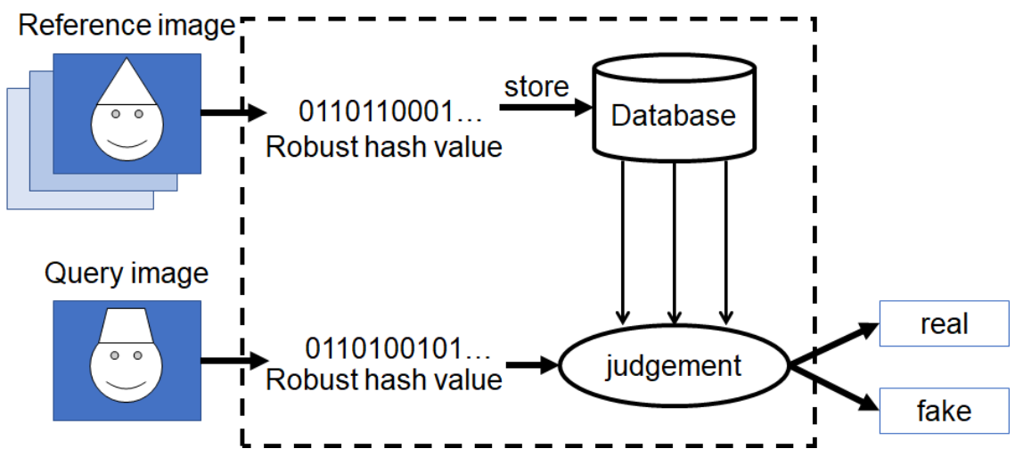
Methodology (contd.)
Store
0110110001
Robust Hash Value
Database
Reference Image
0110100101
Robust Hash Value
Judgement
Query Image
Real Vs Fake
Figure 3: Robust Hashing Method (Paper 3)

Slide 9
Methodology (contd.)
Paper 1 | Paper 2 | Paper 3
Non-local Attention based Fake Image Detection (NAFID) network | CLIP:ViT network (Visual Transformer within Contrastive Language-Image Pre-training) | Robust Hashing Method (robust hash value stored into database)
Non-local features are extracted using the NFE module | Feature Space Selection using ViT-L/14 with patch size 14x14 | Robust hash value calculated by resizing images to 128x128 pixels, applying 5x5 Gaussian low-pass filtering

Slide 10
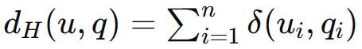
Methodology (contd.)
Paper 1 | Paper 2 | Paper 3
Probability density function (PDF) of PSNR values after denoising for real and fake images are calculated | Cosine distance is calculated to find the nearest neighbors to both real and fake feature banks | Hamming distance calculation between their hash strings where - u: reference image q: query image
ResNeXt is adopted as the classification network to distinguish real and fake images | Two simple classification methods are investigated: nearest neighbor and linear probing | Thresholding to determine if the query image is fake or not

Slide 11
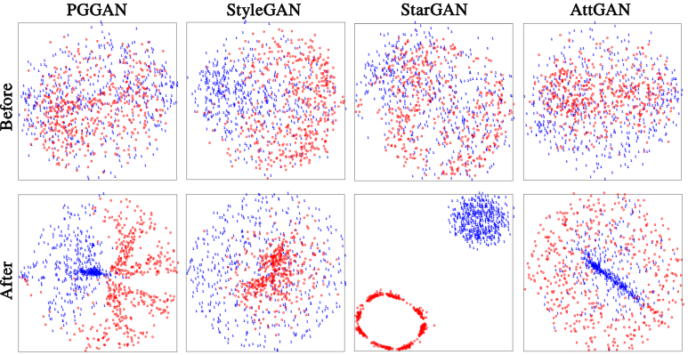
Result Analysis
Figure 4: Before and after distributions of real/fake features
visualized by t-SNE using NFE module (Paper 1)

Slide 12
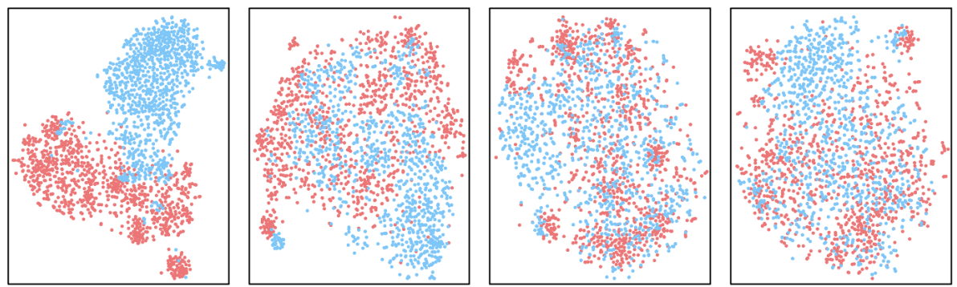
Result Analysis (contd.)
CLIP:ViT-L/14
CLIP:ResNet-50
ImageNet:ViT-B/16
ImageNet:ResNet-50
Figure 5: Before and after distributions of real/fake features visualized by t-SNE of feature space of different image encoders using nearest neighbors (Paper 2)

Slide 13
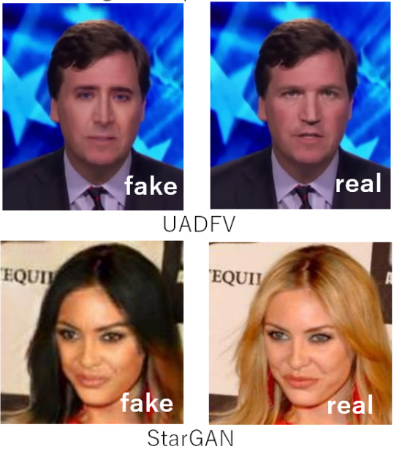
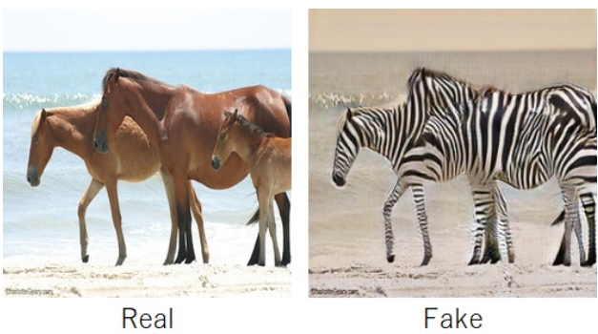

Result Analysis (contd.)
Figure 6: Some of the output results from Robust Hashing method (Paper 3)

Slide 14
Result Analysis (contd.)
Table 1: Accuracy/Average Precision (AP) of three methods
Methods | PGGAN | StyleGAN | StyleGAN2 | StarGAN | Deepfakes | CycleGAN
NAFID | 100.00 | 99.68 | 99.07 | 100.00 | 98.74 | -
CLIP:ViT | - | 97.24 | - | 99.60 | 93.09 | 99.46
Robust Hashing | - | - | - | 100.00 |  | 100.00

Slide 15
Findings and Recommendations
Findings:
From NAFID method, on compared to actual faces, artificial faces show more non-local self-similarity (Paper 1)
In case of NAFID method, evaluation on six fake face datasets with 9K training images which is quite difficult comparing to other methods (Paper 1)
Generative models trained on a range of datasets perform better in case of CLIP-ViT network (Paper 2)

Slide 16
Findings and Recommendations (contd.)
Findings:
In case of Robust hashing method, when confronted with images from unknown generative models, accuracy falls highly
NAFID method's efficiency is confirmed on multiple forgeries datasets, exhibiting a consistent high
Concerns regarding future image generation technology improvements

Slide 17
Findings and Recommendations (contd.)
Recommended Method: New Finding and Unified Framework for Fake Image Detection from paper 1 [7]
Reason:
Seeing the result analysis comparing three methods, NAFID method seems to be the optimal solution among them
NAFID Network, additional testing on bigger and more varied datasets with higher accuracy
Detected better performance than other networks in hidden Generative or AI models

Slide 18
Conclusions
Among three different approaches, Non-local Attention based Fake Image Detection (NAFID) network using NFE module is the optimal one
By employing multi-stage classification and non-local feature extraction algorithms, NAFID consistently achieves great levels of accuracy, even on challenging datasets such as StyleGAN2
NAFID has (99-100)% accuracy in most of the GAN based test cases and so it works best on GAN or AI generated images

Slide 19
Conclusions (contd.)
Robust hashing is a useful tool in the toolkit of image authentication techniques due to its resistance to frequent alterations
Together, these results demonstrate how these techniques could have a big impact on the field of picture forensics and security
But future concern still remains the same as AI based models are integrating on the field highly

Slide 20
References
[1] Y. Li, M.-C. Chang, and S. Lyu, “In ICTU Oculi: Exposing AI created fake videos by detecting eye blinking,” in Proc. IEEE Int. Workshop Inf. Forensics Secur., 2018, pp. 1–7.
[2] X. Yang, Y. Li, and S. Lyu, “Exposing deep fakes using inconsistent head poses,” in Proc. IEEE Int. Conf. Acoust., Speech, Signal Process., 2019, pp. 8261–8265.
[3] U. A. Ciftci, I. Demir, and L. Yin, “FakeCatcher: Detection of synthetic portrait videos using biological signals,” IEEE Trans. Pattern Anal. Mach. Intell., early access, Jul. 15, 2020, doi: 10.1109/TPAMI.2020.3009287.

Slide 21
References (contd.)
[4] D. Afchar, V. Nozick, J. Yamagishi, and I. Echizen, “Mesonet: A compact facial video forgery detection network,” in Proc. IEEE Int. Workshop Inf. Forensics Secur., 2018, pp. 1–7.
[5] Z. Liu, X. Qi, and P. H. Torr, “Global texture enhancement for fake face detection in the wild,” in Proc. IEEE/CVF Conf. Comput. Vis. Pattern Recognit., 2020, pp. 8060–8069.
[6] J. Li, H. Xie, J. Li, Z. Wang, and Y. Zhang, “Frequency-aware discriminative feature learning supervised by single-center loss for face forgery detection,” in Proc. IEEE/CVF Conf. Comput. Vis. Pattern Recognit., 2021, pp. 6458–6467.

Slide 22
References (contd.)
[7] M. Tanaka and H. Kiya, "Fake-image detection with Robust Hashing," 2021 IEEE 3rd Global Conference on Life Sciences and Technologies (LifeTech), Nara, Japan, 2021, pp.40-43, doi: 10.1109/ LifeTech52111. 2021.9391842.
[8] X. Deng, B. Zhao, Z. Guan and M. Xu, "New Finding and Unified Framework for Fake Image Detection," in IEEE Signal Processing Letters, vol. 30, pp. 90-94, 2023, doi: 10.1109/LSP.2023.3243770.
[9] Ojha, Utkarsh & Li, Yuheng & Lee, Yong Jae. (2023). Towards Universal Fake Image Detectors that Generalize Across Generative Models. 10.48550/arXiv.2302.10174.

Slide 23
Thank You

