Slide 1
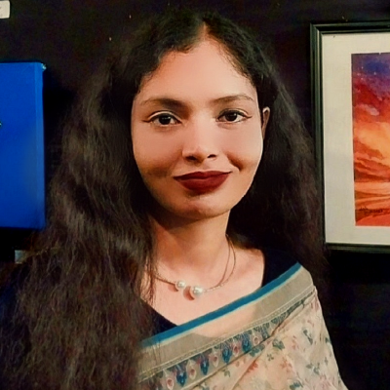
Nushrat Tarmin Meem
Currently studying at the department of CSE, KUET, final year student. Versatile software developer with expertise in web, mobile, machine learning, image processing, and database technologies.
Contact: 01782177011
Email: meem.cse.2k19@gmail.com
Github Id
https://github.com/Nushrat-Tarmin-Meem
LinkedIn Id
https://www.linkedin.com/in/nushrat-tarmin-meem-0178801b1/
Languages
Bangla
English
Hindi
Skills
C
C++
Python
Image Processing
Web Development
Android App
Ios App
Database Management
Education
B.Sc in CSE, KUET Running
HSC
VNSC 2019 GPA 5.00
SSC
VNSC 2017 GPA 5.00
Reference
Dr. Sk. Md.Masudul Ahsan
Professor
Department of CSE, KUET.
Mail: smahsan@cse.kuet.ac.bd
Relationship: Thesis Supervisor and Advisor
Thesis
Currently working on rain strike removal from images using CNNs through making a hybrid model using image processing techniques under the supervision of professor Dr. Sk. Md. Masudul Ahsan Sir, CSE, KUET. Besides, working on some projects related to image processing.
Projects Completed
Flappy Bird Game using advanced AI
https://github.com/Nushrat-Tarmin-Meem/Artificial_Intelligence_Game_Flappy_Bird
Review Paper on Fake Image Detection
https://github.com/Nushrat-Tarmin-Meem/Fake_Image_Detection_Paper_Review_Seminar
Website Design using Asp.net
https://github.com/Nushrat-Tarmin-Meem/Flower_Bouquet_Shop_Website
Take Care Android App
https://github.com/Nushrat-Tarmin-Meem/Take_Care_App
Edu Scan Android App
https://github.com/Nushrat-Tarmin-Meem/System_Project_Edu_Scan_App
Cardiac Recorder Android App
https://github.com/Nushrat-Tarmin-Meem/Cardiac_Recorder_App
Day Optimizer Ios-Swift App
https://github.com/Nushrat-Tarmin-Meem/Day_Optimizer_App
Automatic Image Drawing using Fourier Analysis
https://github.com/Nushrat-Tarmin-Meem/Image_Processing_Computer_Vision_Basics
Compiler Design New Language
https://github.com/Nushrat-Tarmin-Meem/Compiler_Project_New_Language

