Slide 1

Khulna University of Engineering & Technology
Department of Computer Science and Engineering
CSE 4128: Image Processing and Computer Vision Laboratory
Project Title: Flora (Living Flowers) Counting
Instructed by:
Dr. Sk. Md. Masudul Ahsan
Professor,
Department of CSE, KUET
Dipannita Biswas
Lecturer,
Department of CSE, KUET
Presented by:
Name: Nushrat Tarmin Meem
Roll: 1907083
Section: B
Group: B₂
Year: 4th
Semester: 1st

Slide 2

Contents
Introduction
Problem Statement
Objective
Methodology
Result Analysis
Conclusion

Slide 3
Introduction
Flower counting is the process of using image processing techniques to identify and quantify the number of flowers present in a given photograph
Isolation of flowers using noise reduction, thresholding and segmentation
Tackling challenges involving flower variability and environmental conditions
Automation of counting for botanists, farmers and researchers

Slide 4
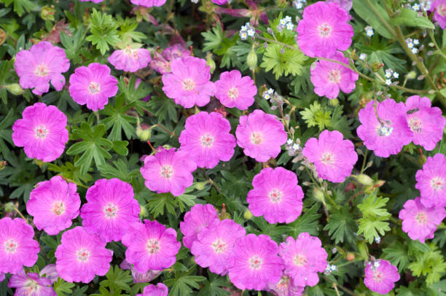
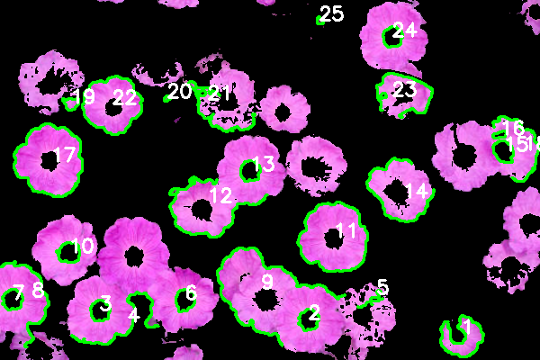
Problem Statement
Identifying flowers including that is hardly seen through eyesight
Input: Images of various colored flowers including forest images
Output: Annotated image with flower counts according to color
(a)
(b)
Figure 1: (a) Input Image (b) Target Output Image

Slide 5
Objective
Developing a system to automatically count the number of flowers
Providing an easy-to-use interface for uploading images and viewing results
Enabling flower counting for field applications

Slide 6
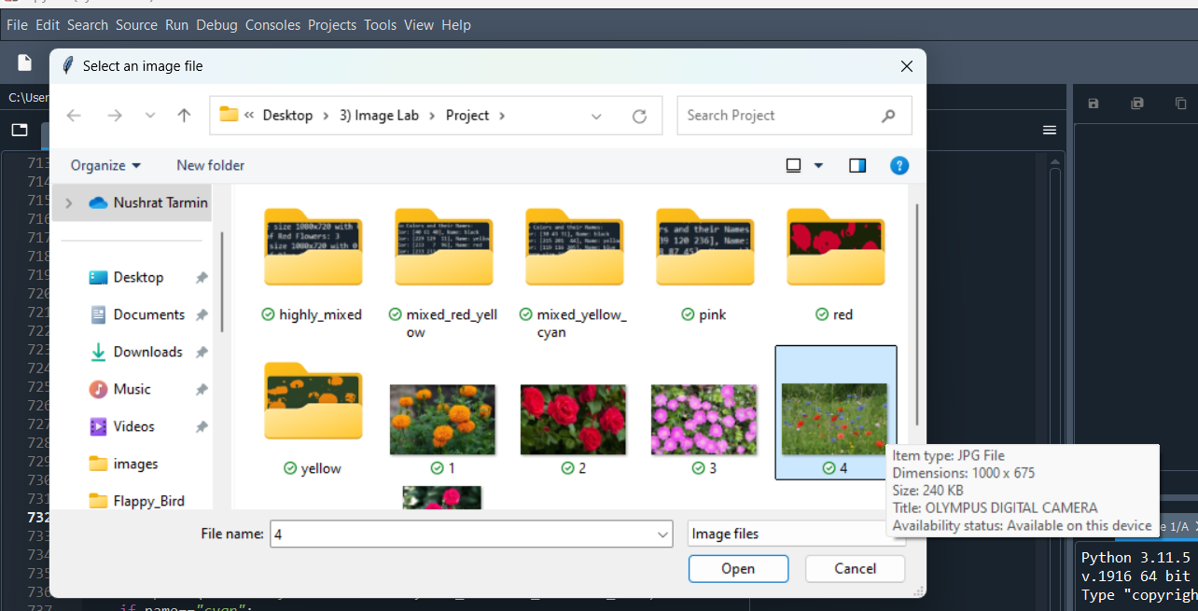
Methodology
User-friendly Interface
Figure 2: User can select real-time image

Slide 7
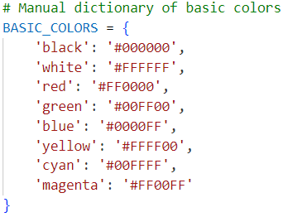
Methodology (contd.)
Used pre-defined web colors for clustering
Figure 3: Basic eight web colors used

Slide 8
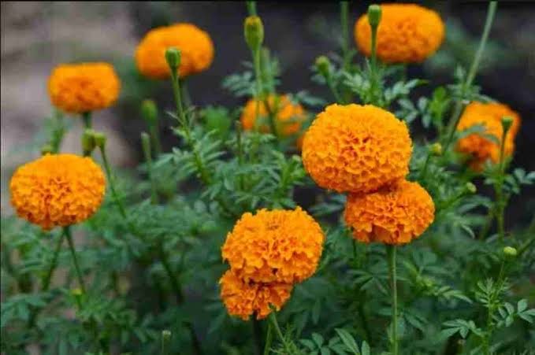
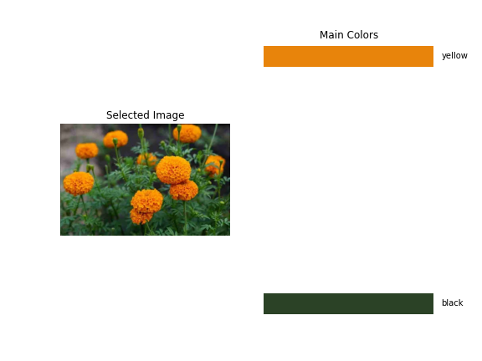

Methodology (contd.)
Applied K-shift clustering to find out main colors
Defining color ranges for flower detection (basic web color ranges)
(a)
(b)
(c)
Figure 4: K-shift Clustering Applied (a) Input Image (b) Main Colors (c) Clustered Segmented Image

Slide 9
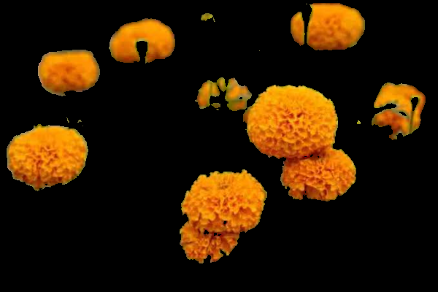

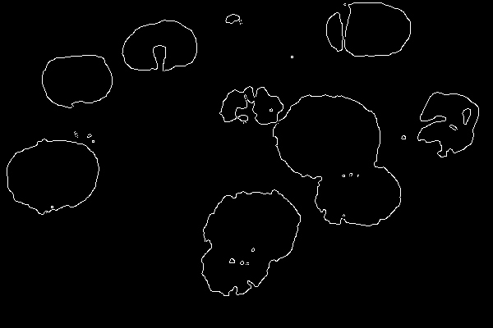
Methodology (contd.)
Creating a mask to filter out everything except the desired color range
If the segmented color region is <= 1% or (green || black) portion is >= 99% then that color of flower is not going to be counted
For finding thin edges used canny edge detection
(a)
(b)
(c)
Figure 5: (a) Masking Applied for Yellow Range (b) Black and White Image (c) Canny Edges Detected

Slide 10
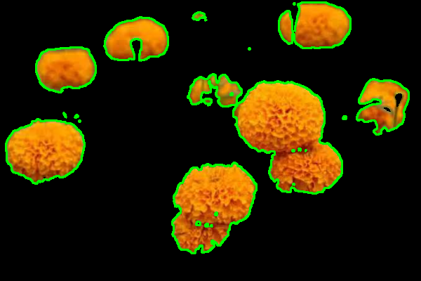
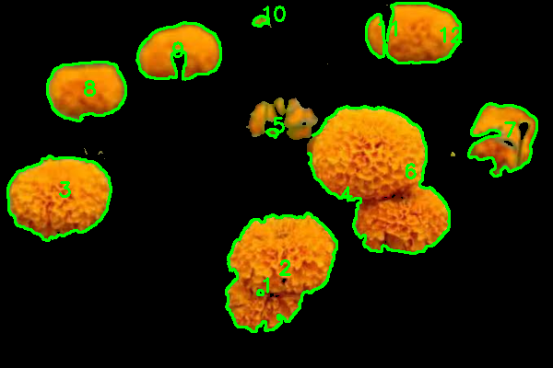
Methodology (contd.)
Using OpenCV’s find Contours function to detect boundaries of flowers
Filtering out small contours that are likely noise <20
Counting the number of filtered contours which represent individual flowers
Drawing bounding boxes around detected flowers on the original image
(a)
(b)
Figure 6: (a) Contours Detected (b) Flower Counting with Boundaries

Slide 11
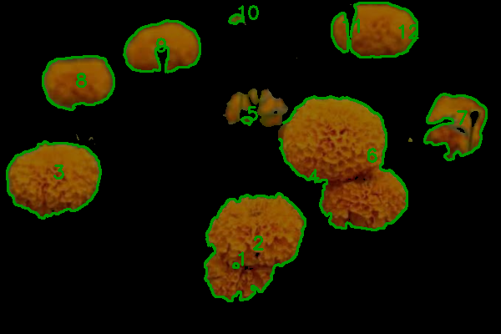
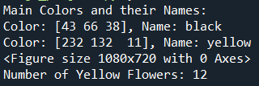
Methodology (contd.)
Blending each color range images with counting and displaying it
Output showing counting number of flowers
(b)
(a)
Figure 7: (a) Blended Image (here 1 color range) (b) Output Terminal Result

Slide 12
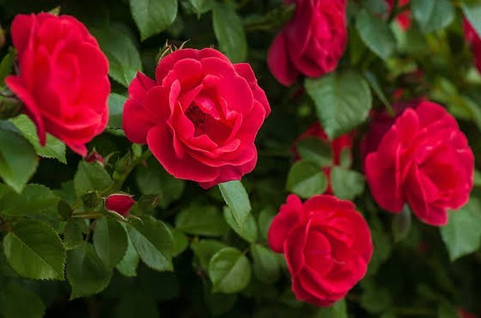
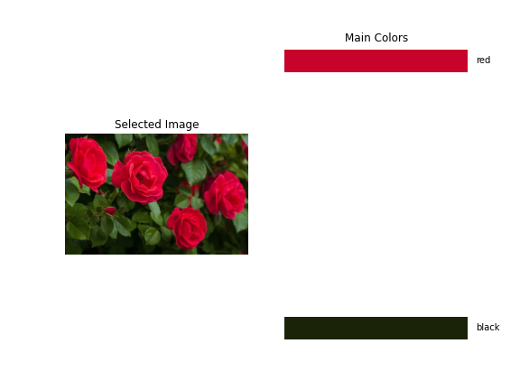





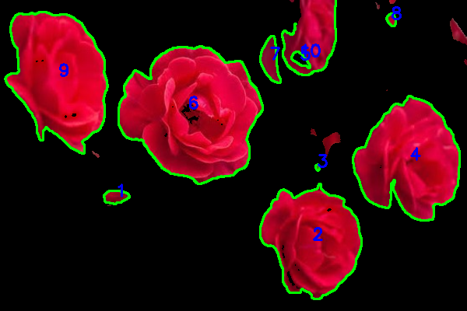
Result Analysis
(a)
(b)
(c)
(d)
(e)
(f)
(g)
(h)
Figure 8: (a) Input Image (b) Main Colors (c) Clustered Segmented (d) Mask Applied (e) Black and White (f) Canny Edge Applied (g) Contours Detected (h) Filtering and Counting

Slide 13
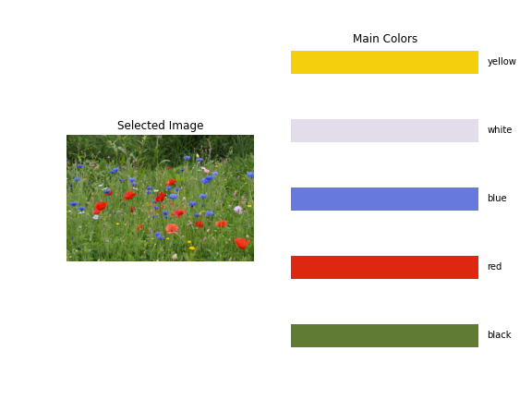
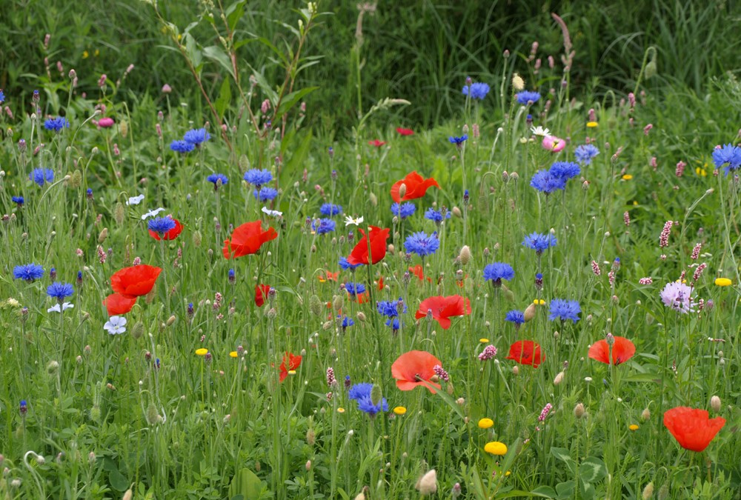
Result Analysis (contd.)
(a)
(b)
Figure 9: (a) Input Image (b) Main Colors

Slide 14
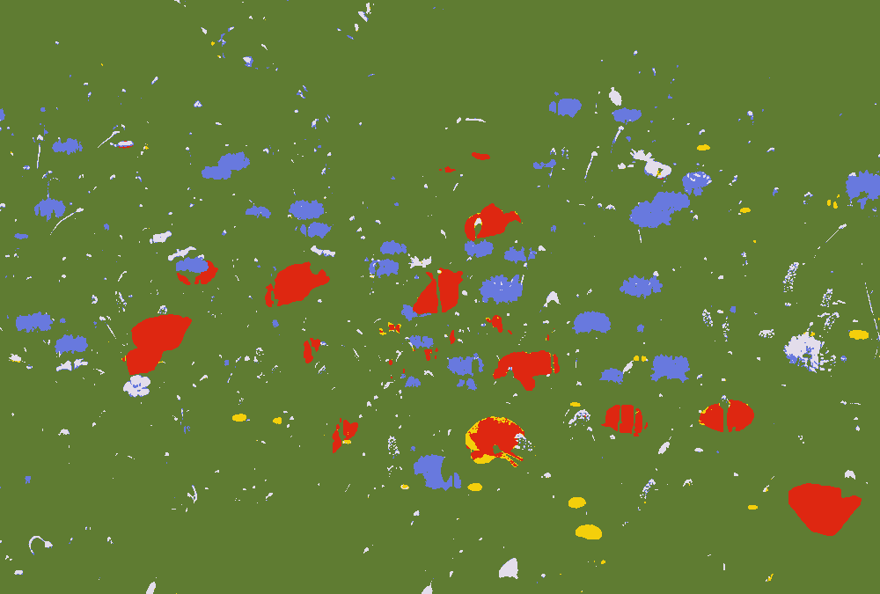


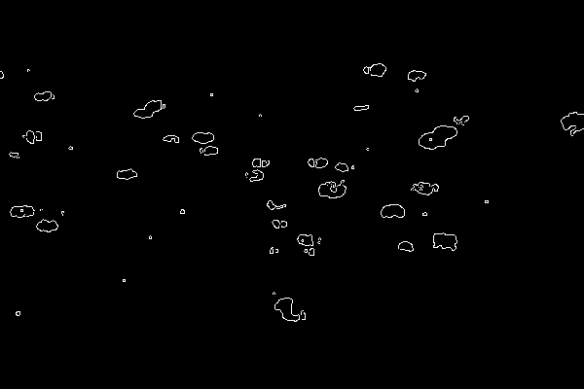
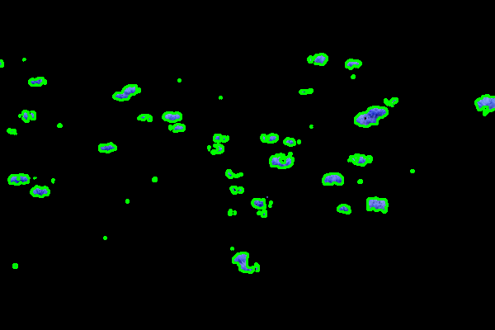
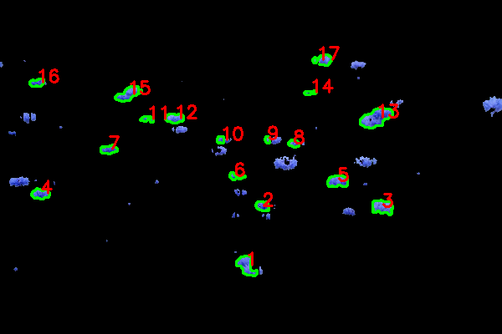
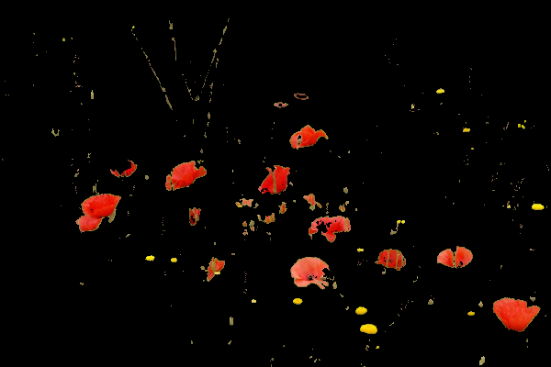

Result Analysis (contd.)
(a)
(b)
(c)
(d)
(e)
(f)
(g)
(h)
Figure 10: (a) Clustered Segmented Image (b) Blue Masking (c) Black and White of Masked Blue Region (d) Canny Edge (e) Contours (f) Blue Flower Counting (g) Yellow Masking (h) Black and White of Masked Yellow Region

Slide 15
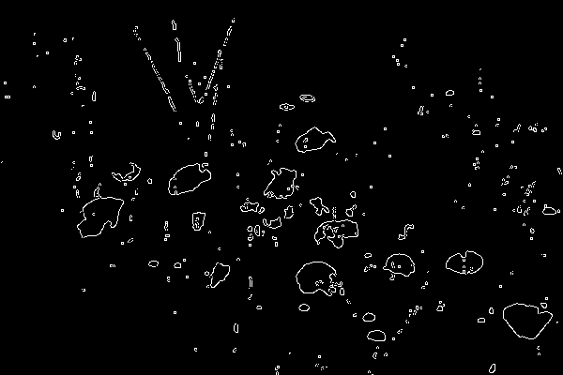
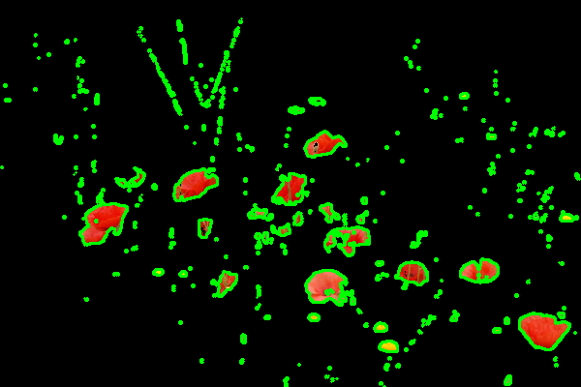
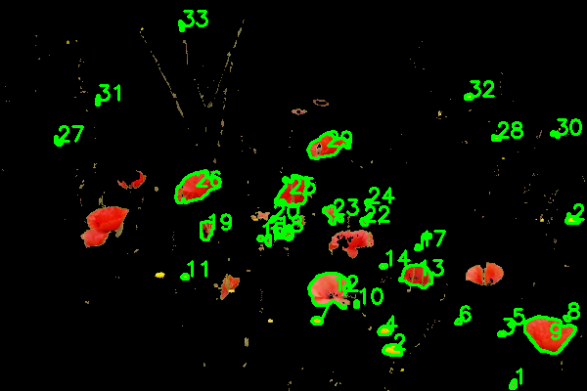



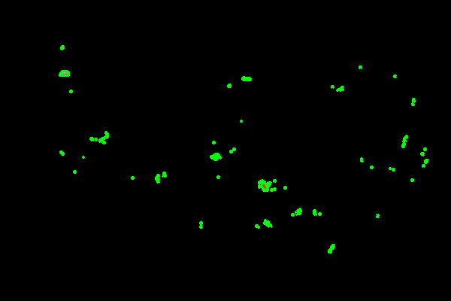
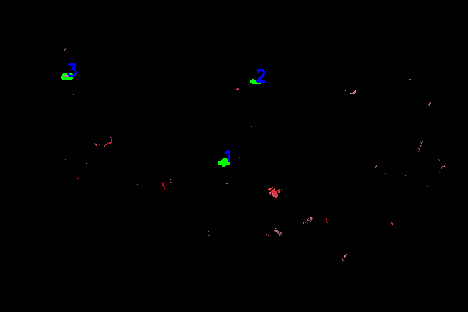
Result Analysis (contd.)
(i)
(j)
(k)
(l)
(m)
(n)
(o)
(p)
Figure 11: (i) Canny Edge of Yellow Masked (j) Contours (k) Counting of Yellow Flowers (l) Masking of Red Range (m) Black and White of Masked Red Range (n) Canny Edged (o) Contours (p) Counting of Red Flowers

Slide 16
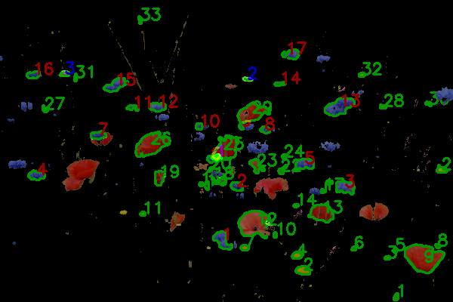
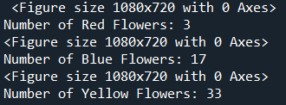
Result Analysis (contd.)
(r)
(q)
Figure 12: (q) Blended Image of Counting Blue, Red, Yellow Flowers (r) Output Terminal Result

Slide 17
Conclusion
Combination of K-shift clustering and color range masking
Extraction of main color themes from images
Making it for applications in botany of digital image processing and visual content analysis in case of real-world scenarios
In case of limitations, sometimes, overlapping of flowers counted as one flower

Slide 18
Thank You

