Slide 1

EDUSCAN
An Android application for digitization
of written information
CSE 3200 : System Development Project
Supervised by :
Md. Badiuzzaman Shuvo
Lecturer
Dept. of Computer Science and Engineering
Khulna University of Engineering and Technology
Presented by :
Nushrat Tarmin Meem
Roll : 1907083
Aciful Islam Khan
Roll : 1907119

Slide 2

OUTLINES
Introduction
Objectives
Related Works
Proposed Methodology
Result Analysis
Conclusions
Future Work
References
Appendix

Slide 3
INTRODUCTION
EduScan handling documents
Easy to use for converting text into PDF or DOC file
Complete toolkit for keeping track of attendance
Making tasks hassle-free in our digital world

Slide 4
OBJECTIVES
Digitization of handwritten information
Transition to a paperless academic system
Presentation of information in convenient format
Enhancement of user accessibility

Slide 5
RELATED WORKS
Few works on attendance checking or marks collection, developed on fully software-based applications named –
Attendance Management System [4]
Attendance Tracker [5]
Students Academia [7]
Having limitations like :
Reliability and accuracy variation
Dependency on training data to handle various handwriting styles
Possibility of challenges in handling errors on calculations

Slide 6




TOOLS USED
Firebase
Chaquopy
Java
TensorFlow

Slide 7
METHODOLOGY
An interactive android app design
Developing an image processing technique to process the images
Using machine learning models to classify necessary images
Combining the model with android app

Slide 8
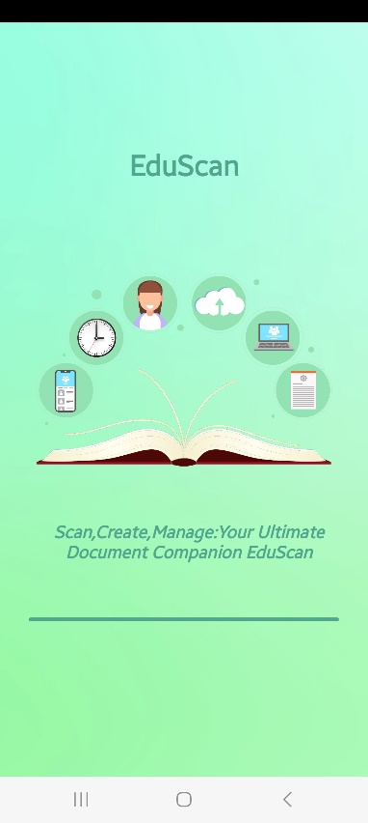
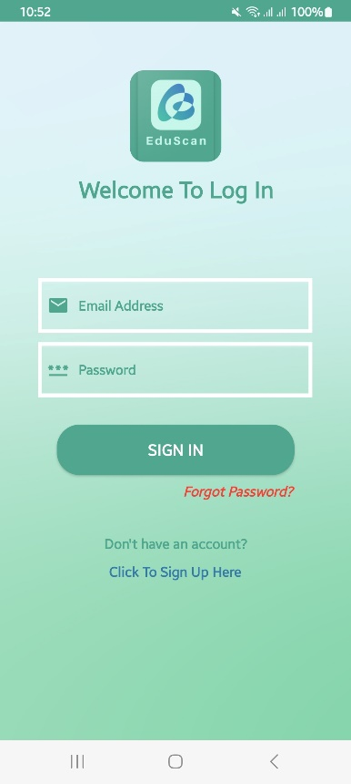
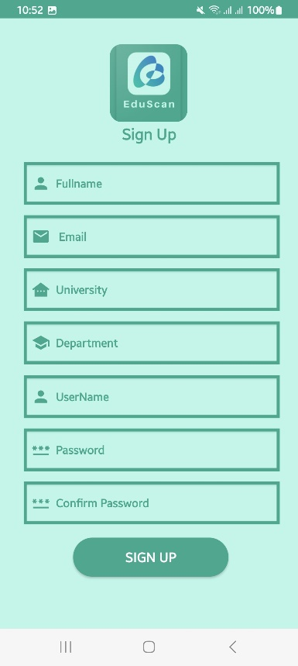
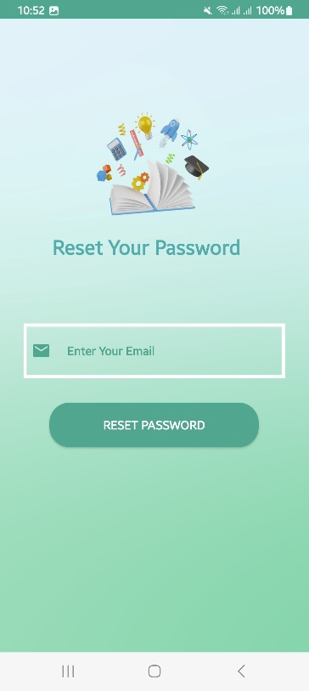
MOCKUP DESIGN OF UI
(a)
(b)
(c)
(d)
Figure 1 : Mockup design of UI (a) Splash Screen (b) Login Page
(c) Signup Page (d) Forgot Password Layout

Slide 9
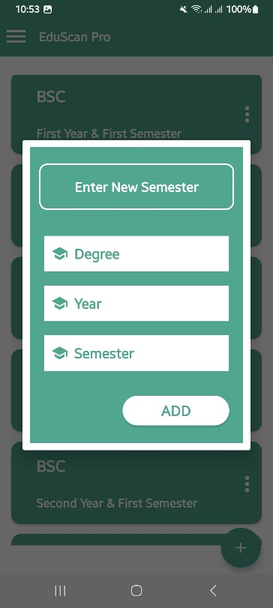
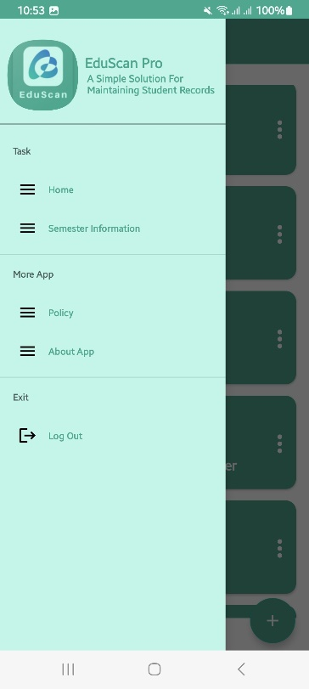
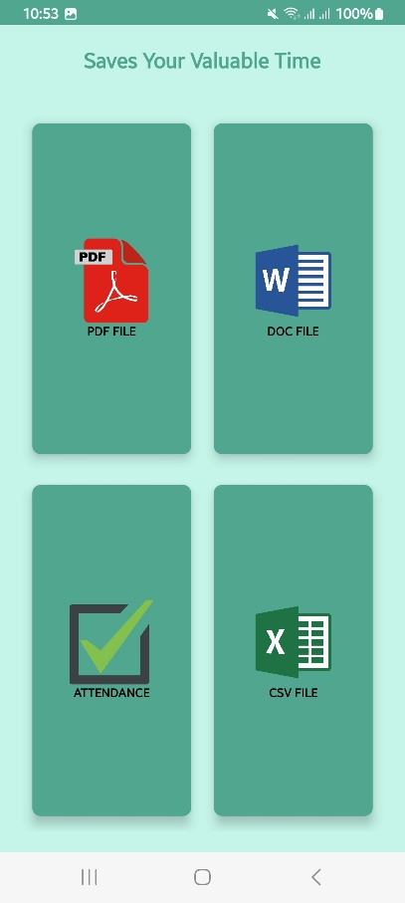
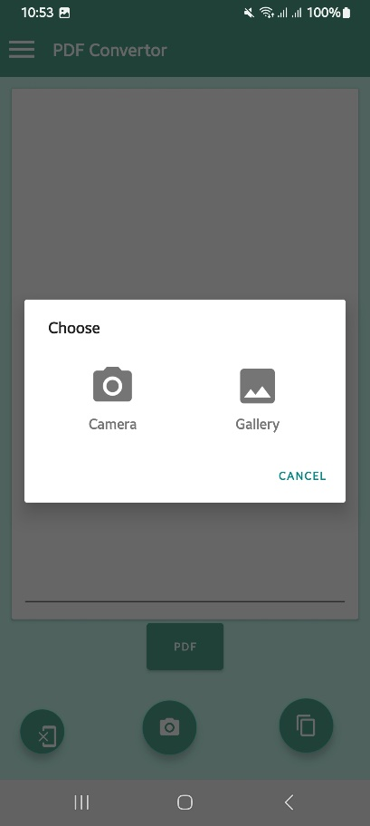
MOCKUP DESIGN OF UI (CONTD.)
(a)
(b)
(c)
(d)
Figure 2 : Mockup design of UI (a) Year Semester Layout (b) Navigation Drawer (c) Converter Layout (d) Image Capture Layout

Slide 10





DATASET
Different types of handwritten “A”, “P”, Dot symbol, Tick symbol, 0-9 digits have been trained for our model
Cropped for arranging the desired dataset
Around 1600 images of data are used for training models.
(a)
(b)
(c)
(d)
(e)
Figure 3 : Sample Images (a) Dot (b) Symbol A (c) Tick (d) Symbol P (e) Digit 5

Slide 11
DATASET (CONTD.)
Table 1 : Attendance Dataset
Table 2 : Digit Dataset
Symbol | No. of data images
A | 150
Dot | 150
P | 150
Tick | 150
Attendance Total | 600
Digit | No. of data images
0 to 9 | 100*10
Digits Total | 1000
Total no. of images in dataset = 600 + 1000 = 1600

Slide 12
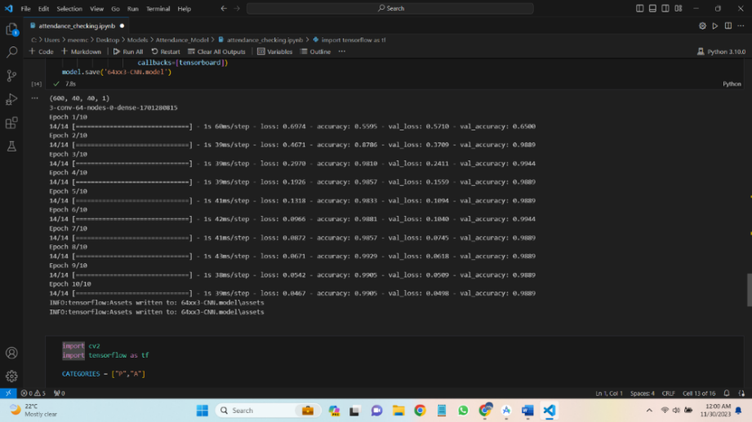
MODEL TRAINING
Models have been trained using TensorFlow
All the images were at first gray scaled with a fixed size 50
Digit detection model(multiple classifiers) attendance model(binary classifier)
Figure 4 : Attendance Model Accuracy

Slide 13
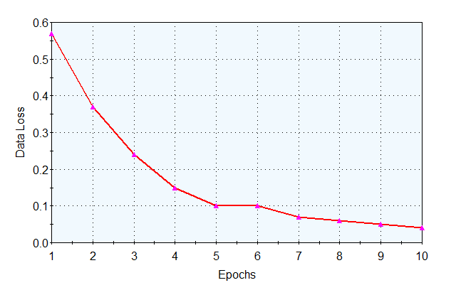
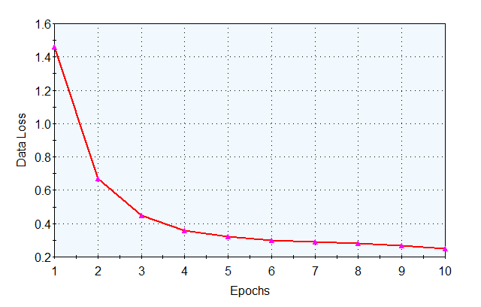
MODEL TRAINING (CONTD.)
Accuracy of trained Attendance Model is 95%+
Digit Detection Model is 90%+
(a)
(b)
Figure 5 : Data Loss Curve (a) Attendance Model (b) Digit Detection Model

Slide 14
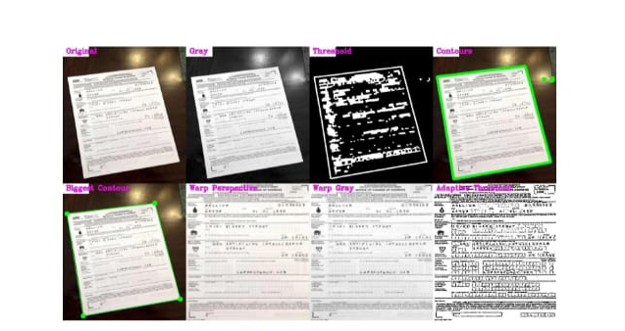
RESULT ANALYSIS
Cropping input image as biggest contour and using OCR Text recognizer v2 to convert the image text to written PDF or word file.
Figure 6 : Image Scanning before using OCR

Slide 15
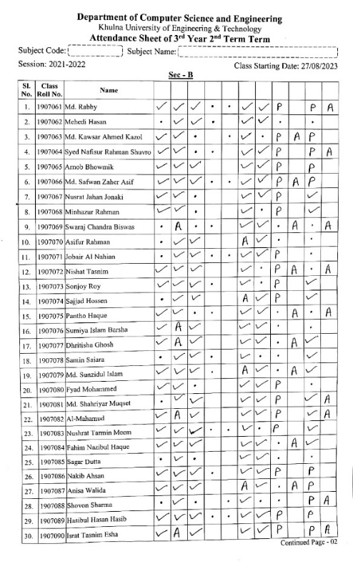
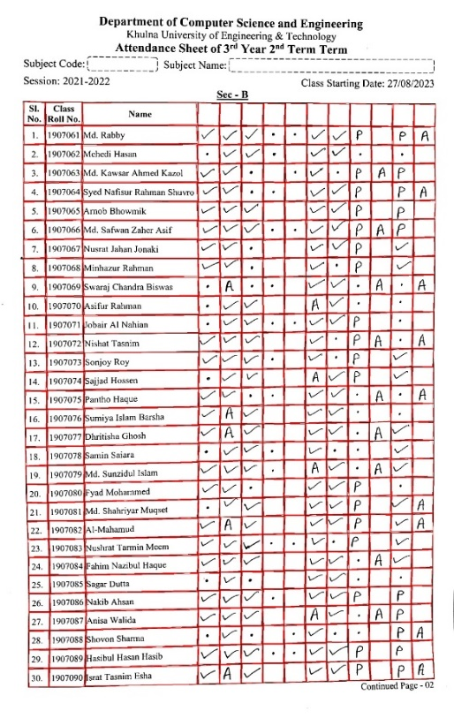
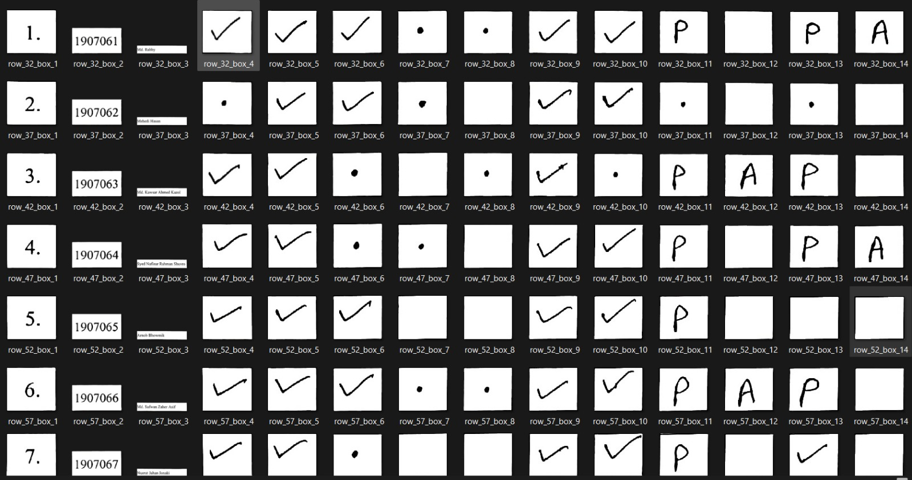
RESULT ANALYSIS (CONTD.)
For attendance sheet, cropped all the boxes from grid image using Chaquopy tool. Fetching box images those are the input for Attendance model.
(a)
(b)
(c)
Figure 7 : Attendance analysis (a) Input Sheet (b) Full Contour Image (c) Output result of images

Slide 16
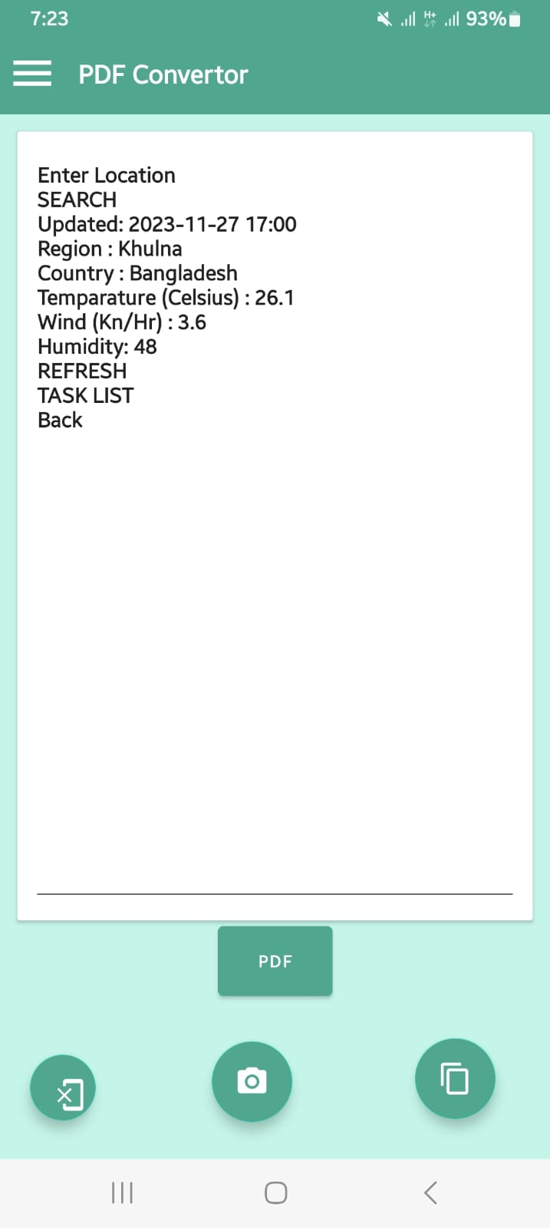
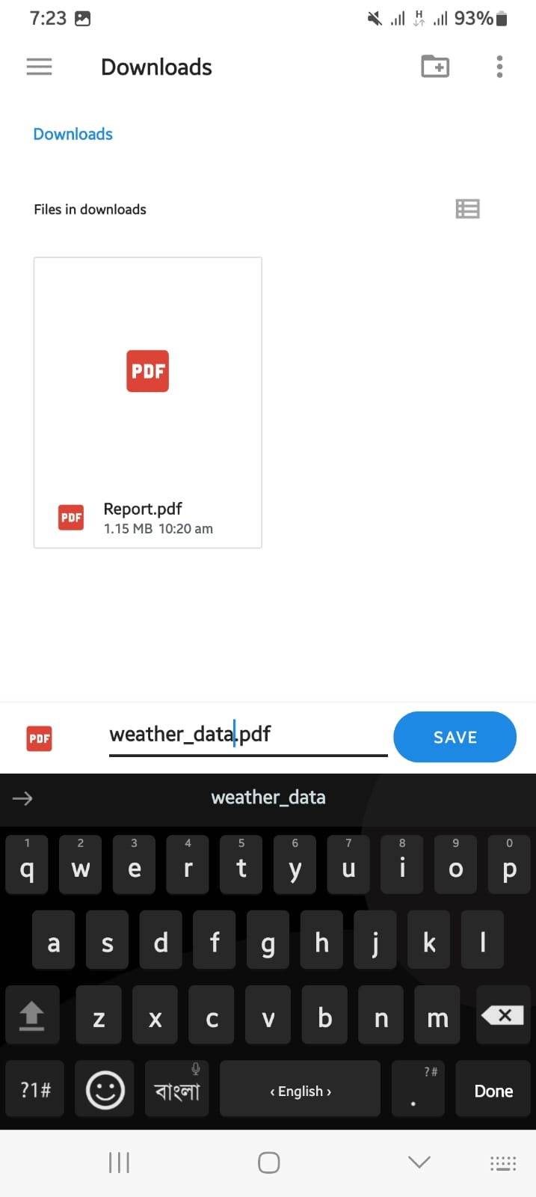
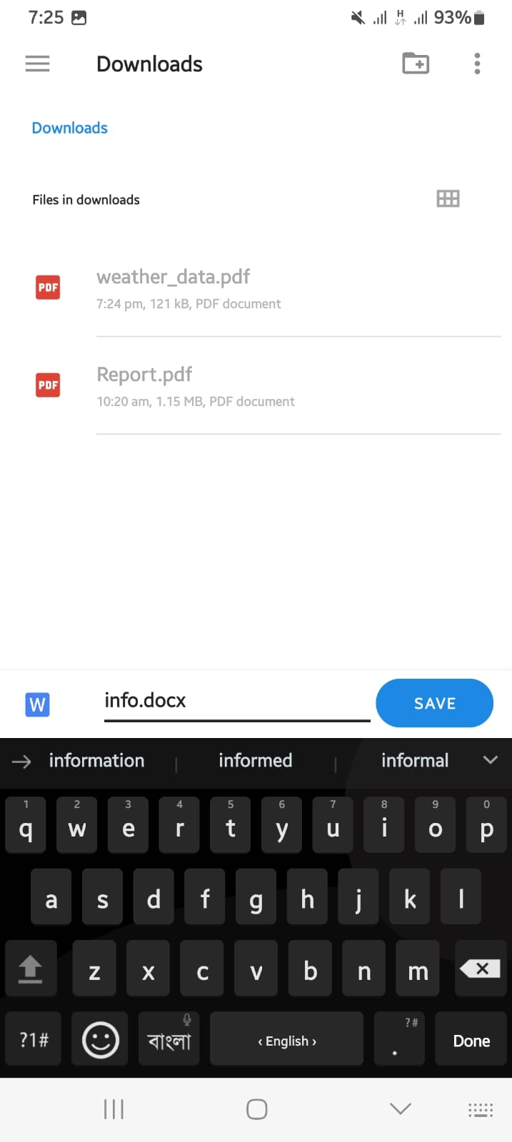
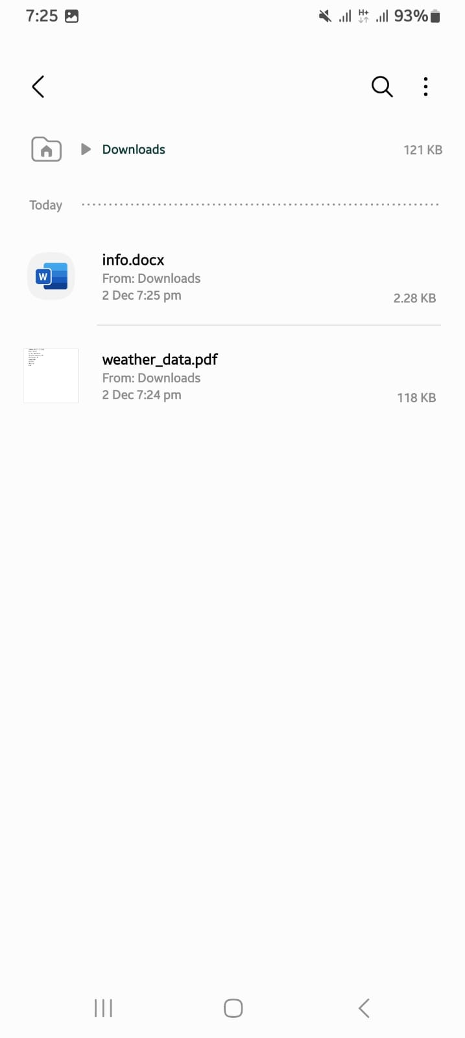
RESULT ANALYSIS (CONTD.)
(a)
(b)
(c)
(d)
(e)
Figure 8 : Converter (a) Features (b) Image to text (c) pdf file (d) doc file (e) save to downloads

Slide 17
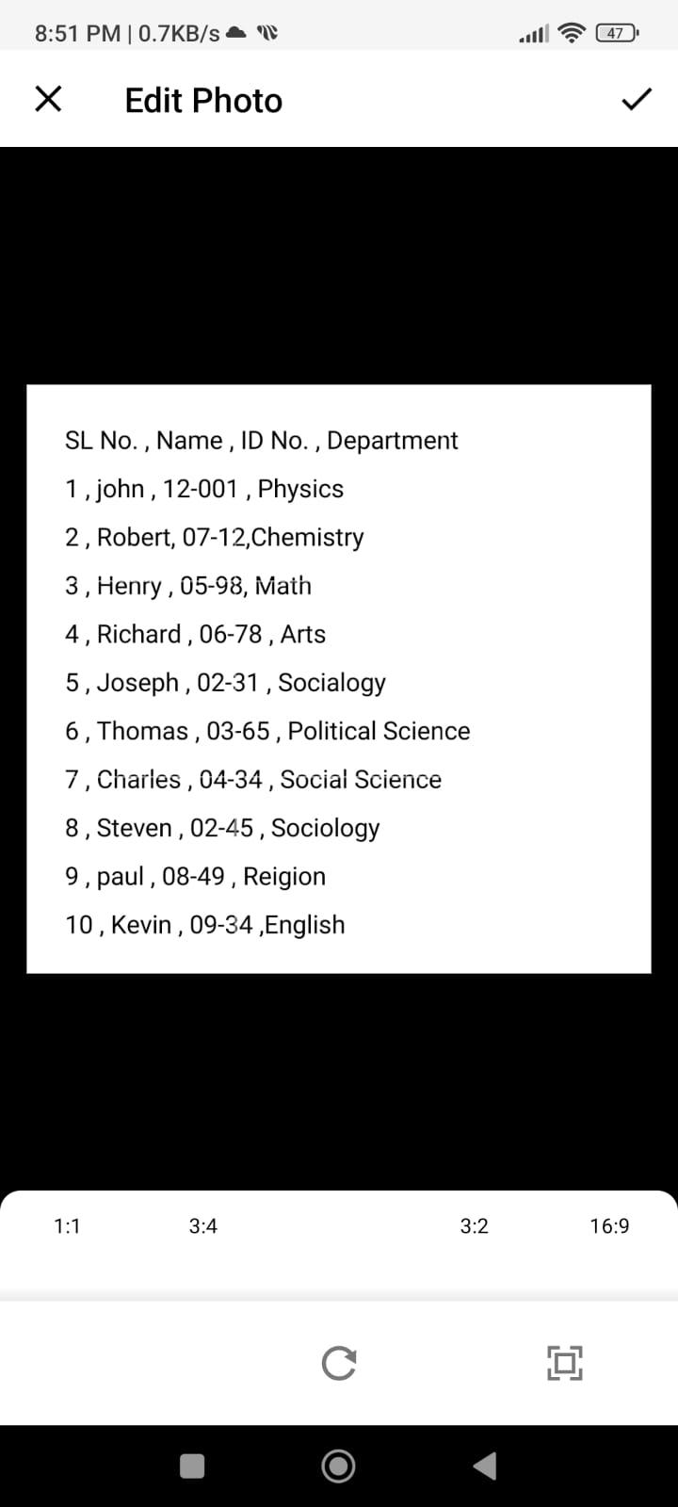
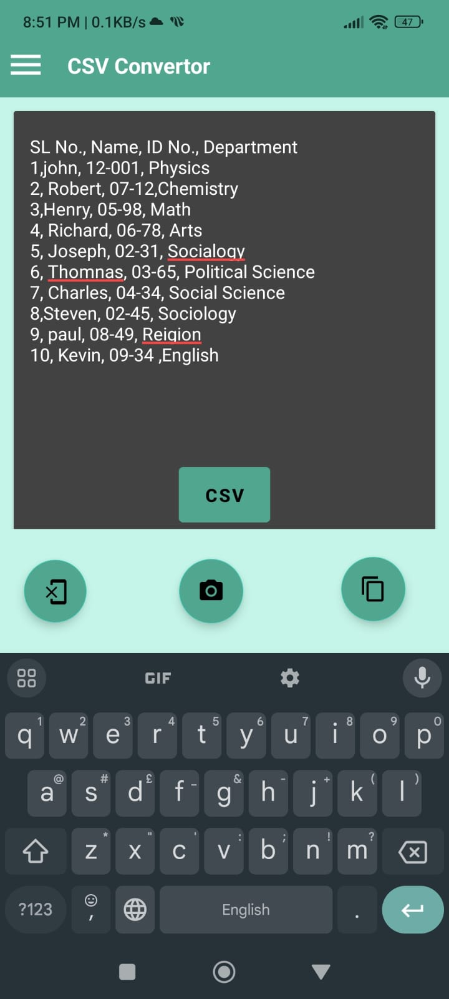
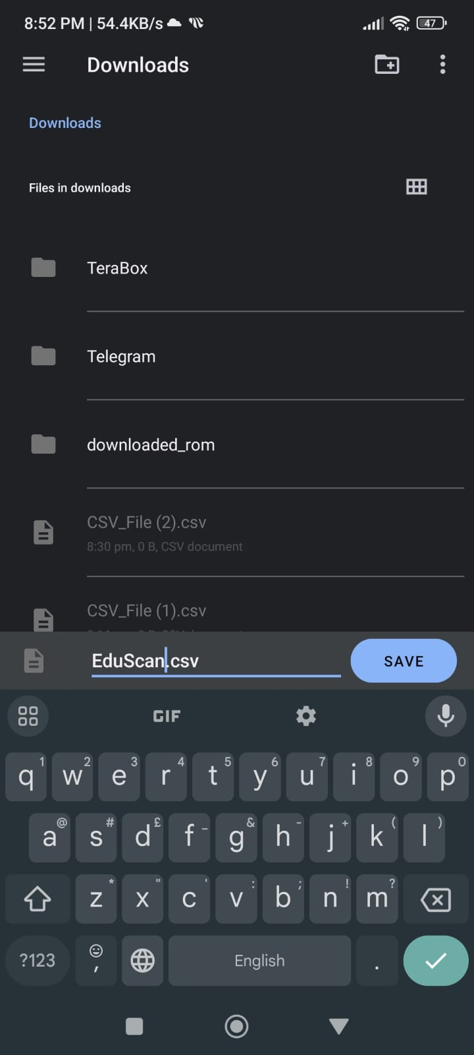
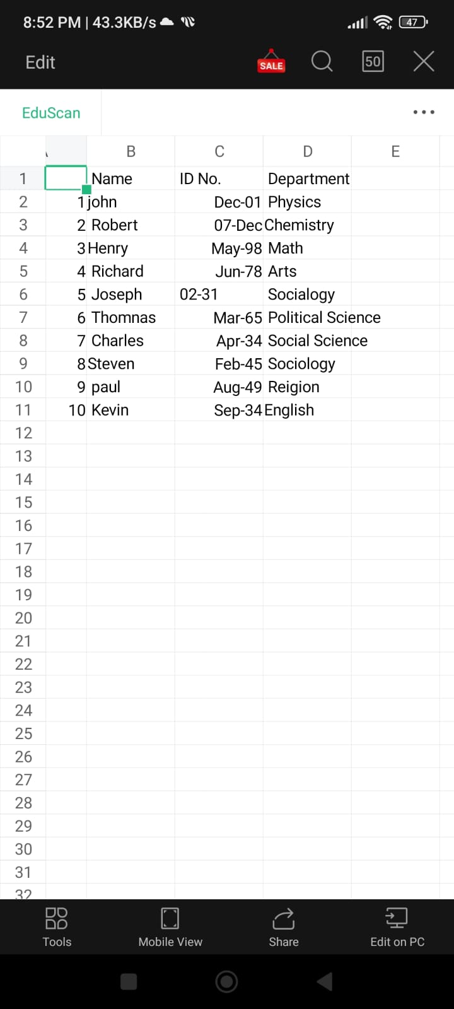
RESULT ANALYSIS (CONTD.)
(a)
(b)
(c)
(d)
Figure 9 : CSV Converter (a) Input Image (b) Image to text (c) Saving (d) Opening

Slide 18
CONCLUSIONS
Our EduScan app is a solution in attendance tracking emphasizing on innovation, environmental sustainability, and ethical considerations.
Integration of OCR and trained models, image cropping algorithms, and versatile file conversion of our app gives user-friendly interface.
Besides these, it has given positive environmental impact through a paperless workflow and cost efficiency.
Positioned as a transformative force in attendance management technological advancements.

Slide 19
FUTURE WORK
Digit detection model
Splitting of two digits
More data on dataset
Increase of model accuracy
Reducing data loss
Garbage Image handling

Slide 20
REFERENCES
https://developers.google.com/ml-kit/vision/text-recognition/v2/android
Sharvari Nande, Sakshi Nand Gaonkar, Riya Sharma, Ms. Meghana Deshpande,
"Attendance Management System Using Handwritten Character Recognition", July- 2020
https://pminsight.cipd.co.uk/10-tips-to-successfully-manage-a-time-and-attendance-project
https://copyassignment.com/attendance-management-system-project-in-java/
https://www.teamsense.com/blog/best-attendance-management-systems
http://103.82.172.44:8080/xmlui/bitstream/handle/123456789/92/Attendance%20Managmen.pdf? sequence=1&isAllowed=y
https://www.academia.edu/7760318/STUDENTS_ATTENDANCE_MANAGEMENT_S YSTEM_MINI_PROJECT_REPORT_MASTER_OF_COMPUTER_APPLICATIONS

Slide 21
THANK YOU

Slide 22
APPENDIX
TO BE CONTINUED

Slide 23
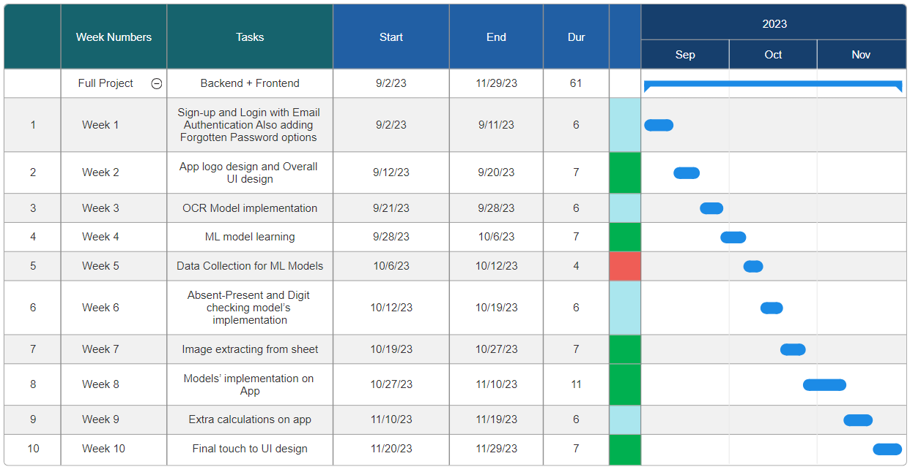
Table 3 : Week Wise Project Planning with Work Description

Slide 24
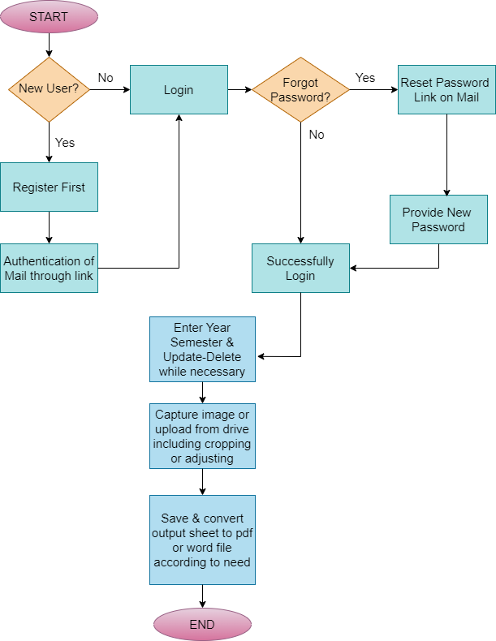
Figure 10 : DFD of Edu Scan App

Slide 25
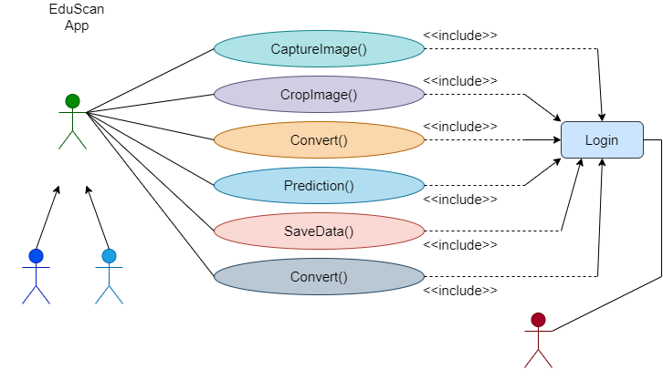

Teacher
Admin
Figure 11 : Use Case Diagram of App

Slide 26
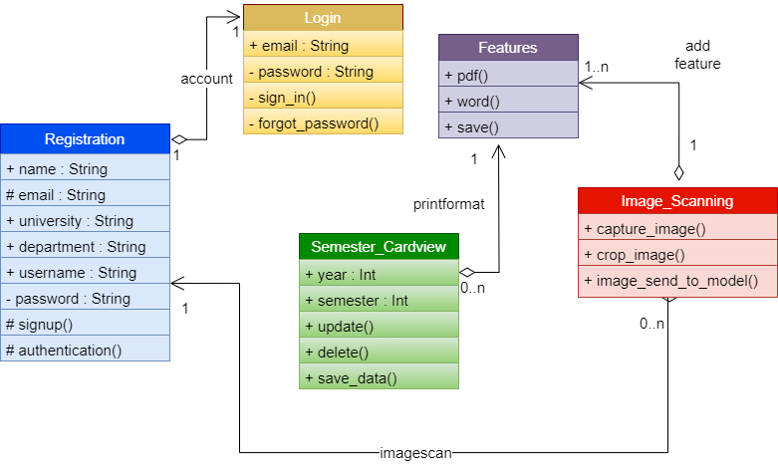
Figure 12 : Basic UML Diagram of Edu Scan App

Slide 27
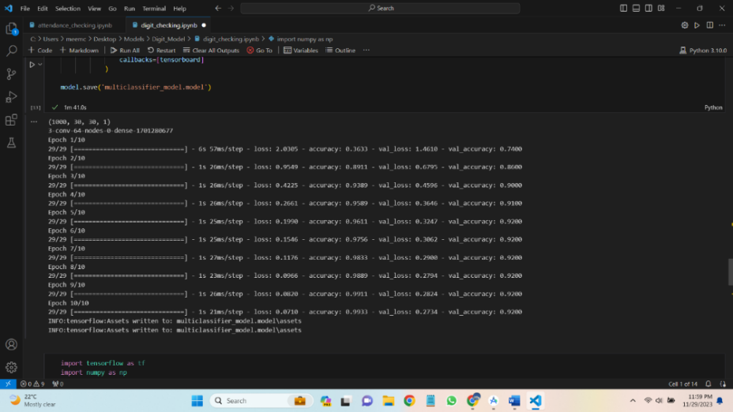
Figure 13 : Digits Model Accuracy

Slide 28
Errors on Gradle in Android Studio
Extracting images from attendance sheet data loss error
A lot of difficulties due to data loss
Model Training predictions TensorFlow error
Faced difficulties while implementing models on app
API call and connection error
Faced errors while calculating data.
Figure 14 : Overall Faced Challenges

