Slide 1
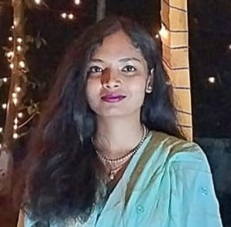



Nushrat Tarmin Meem
CSE, KUET
meem1907083@stud.kuet.ac.bd
+8801782177011
PROFILE LINKS
Currently studying at Khulna University of Engineering & Technology under the department of Computer Science and Engineering.
Github Link
LinkedIn Id
PROFILE
PROFESSIONAL SKILLS
SQL
Android Development
System Development
Database Management
Web Development
Compiler Designing
Time Management
Strategic Planner
Flexible
Section: 6, Block: B, Road No: 6, House No: 17, Mirpur, Dhaka- 1216.
ADDRESS
HSC 2019
Viqarunnisa Noon College
SSC 2017
Viqarunnisa Noon School
HOBBIES
EDUCATION
Cycling
Art & Crafts
Cooking
Story Writing

