Slide 1
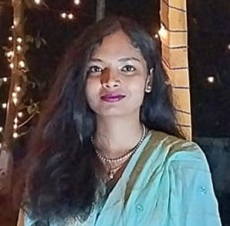


Nushrat Tarmin Meem
CSE, KUET
meem1907083@stud.kuet.ac.bd
+8801782177011
Currently studying at Khulna University of Engineering & Technology under the department of Computer Science and Technology.
PROFILE LINKS
PROFILE
Github Link
LinkedIn Id
PROFESSIONAL SKILLS
SQL
Android Development
System Development
Database Management
Web Development
Compiler Designing
Time Management
Strategic Planner
Flexible
Section: 6, Block: B, Road No: 6, House No: 17, Mirpur, Dhaka- 1216.
ADDRESS
HSC 2019
Viqarunnisa Noon College
GPA : 5.00
SSC 2017
Viqarunnisa Noon School
GPA 5.00
EDUCATION
LANGUAGES
Bangla
English
Turkey
1

Slide 2
JOB EXPERIENCE
Red Crescent Worker
2013-2016
KUETPS
2020-Running
Web Project
Take Care App
Cardiac Recorder App
Day Optimizer App
PROJECTS
REFERENCES
Cycling
Art & Crafts
Cooking
Story Writing
Dr. K. M. Azharul Hasan
Professor, CSE, KUET
Sunanda Das
Assistant Professor, KUET
HOBBIES
JOB EXPERIENCE
C
C++
JAVA
Python
JAVASCRIPT
C#
PHP
ASP.net
Board Scholarship
PSC, SSC
Deans Award
2020-2021 Session
2021-2022 Session
PROGRAMMING SKILLS
2

