Slide 1
Performance Issues and Pipeline Hazards
IN 2320
Computer Architecture
Group presentation
Batch 18,
Faculty of IT,
University of Moratuwa

Slide 2
Introduction
Pipelining - a technique used in high performance processors in order to increase the instruction throughput
Cycle time of pipelined processor (multiple cycles for one execute instructions), cycle time reduces, throughput increases
Speedup = Time(non-pipelined) / Time(pipelined)
Pipeline Hazards - they reduce the performance form the ideal speedup gained by pipelines
Pipeline hazards prevent next instruction from executing during the designated clock cycle.

Slide 3
Types of pipeline hazards
Data hazards - occurs when an instruction depends on the results of previous instruction
Structural hazards - arise from resource conflicts
Control hazards - results from branches and other instructions that affect the PC

Slide 4
Data hazard
occur when instructions read or write registers, are used by other instructions
Order differs from order seen by sequentially executing instructions on un-pipelined machine
There are 4 types of data hazards
RAR (Read After Read Hazard)
RAW (Read After Write Hazards)
WAR (Write After Read Hazards)
WAW (Write After Write Hazards)

Slide 5
RAR
ADD r1,r2,r3
SUB r4,r5,r3
Both read from same register
Not a serious problem
Execute in successive cycles
Doesn’t change register values

Slide 6
RAW
Instruction J tries to read operand before Instruction I writes it
I: ADD r1,r2,r3
J: SUB r4,r1,r3
Caused by a “Data Dependence” (True dependencies)
This hazard results from an actual need for communication
Creates pipeline stall or bubble

Slide 7
WAR
WAR data hazard represents a problem with concurrent execution.
When an instruction attempts to write to a register that has not yet been read by a previously provided but uncompleted instruction, a WAR hazard occurs.
When one instruction tries to write to a register before the previous one is reading from it
WAR hazard also not possible in the MIPS pipeline because reading happens early in the pipeline.

Slide 8
Ex:
Instruction J should write its result after it is read by I
Called an anti-dependence by compiler writers
I - ADD R1,R2,R3 #R2 is read
J - SUB R2,R4,R5 #R2 is written
WAR hazards occur when J writes R1 before I reads it.
Subtract writes R2, which is read by addition, create the WAR hazard
WAR hazards cannot occur in basic 5 stage pipeline ,
Because
reads are always in stage 2
writes are always in stage 5
instructions are processed in order

Slide 9
WAW
A Write-After-Write hazard occurs when an instruction tries to write its result to the same register as a previously issued, but as yet incomplete instruction.
Ex: j tries to write an operand before it is written by i. The writes end up being performed in the wrong order, leaving the value written by i rather than the value written by j in the destination.
This hazard is present only in pipelines that write in more than one pipe stage or allow an instruction to proceed even when a previous instruction is stalled.

Slide 10
Forwarding
Forwarding allows to use results when computed.
It allows the CPU to move a value directly from one instruction to another, hence it does not wait for the value to be stored in a register.
This requires extra connections in the Data path, and forwarding is done by feeding back the data values from the pipeline registers to the inputs of functional units that requires it.
Therefore, the result is forwarded from output of one unit to input of another functional unit.

Slide 11
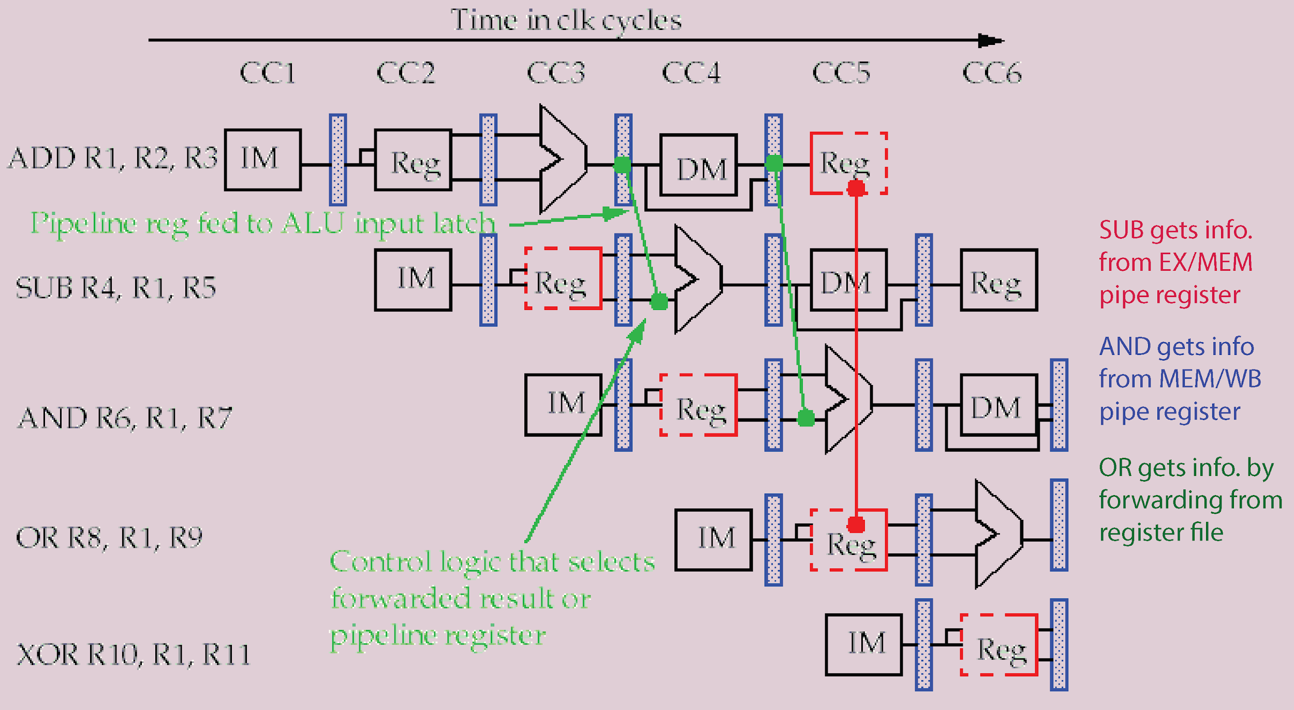
Forwarding(Continued)
Example:

Slide 12
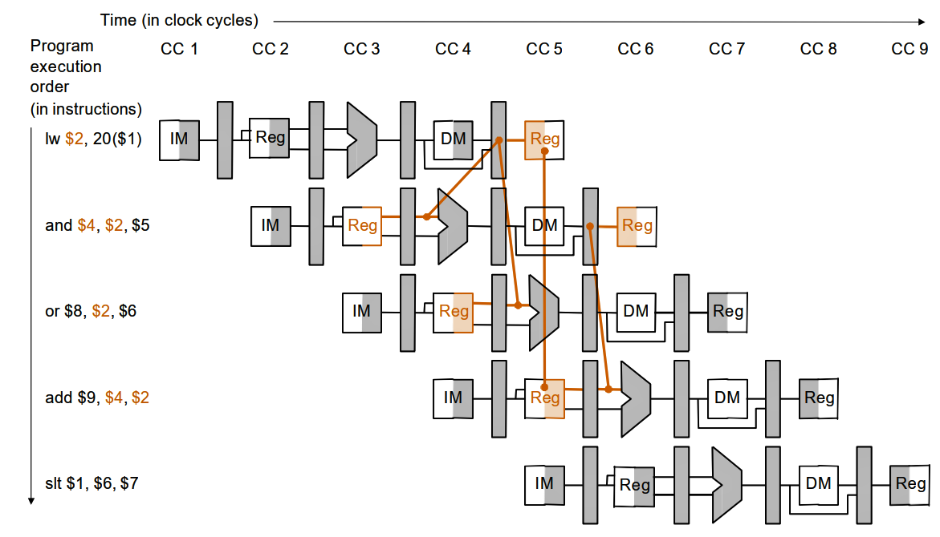
Problems in forwarding
Forwarding always works for Reg-Reg instructions. But it may not always work for other instructions.
Example: Load instructions
Load word can still cause a hazard when an instruction tries to read a register following a load instruction that writes to the same register.
In this type of case we need to use stalling for proper execution.

Slide 13
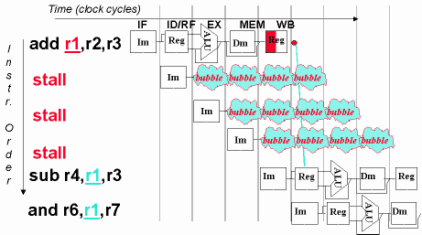
Stalling pipeline
This is done with a pipeline interlock , which stalls the pipeline until the hazard is cleared.
This inserts a bubble into the pipeline
No instructions are started during the cycle in which the bubble is inserted
This increases the number of cycles required and thus the CPI and throughput

Slide 14
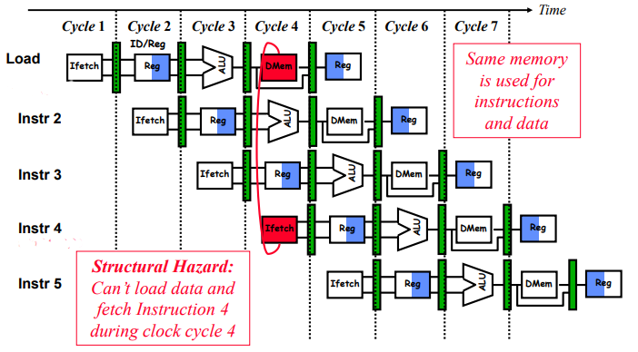
2. Structural Hazards
A Structural hazard occurs due to a resource conflict in pipeline.
Resource conflict is a situation when more than one instruction tries to access the same resource in the same cycle time.

Slide 15
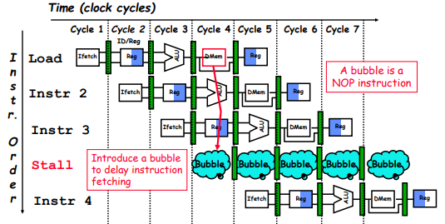
Resolving Structural hazards
Stalling
Must have mechanism to delay (stall) instruction access to resource.
A stall is called as pipeline bubble,since it floats through the pipeline taking space but carry no useful work(NOP).
Low cost
Increases CPI.

Slide 16
Redesign the pipeline
Add more hardware to eliminate the structural hazard.
Increases cost.
Example:
if load data and into memory and fetch instruction from memory happening in same clock cycle, use two memories with two memory ports
-Instruction Memory
-Data Memory

Slide 17
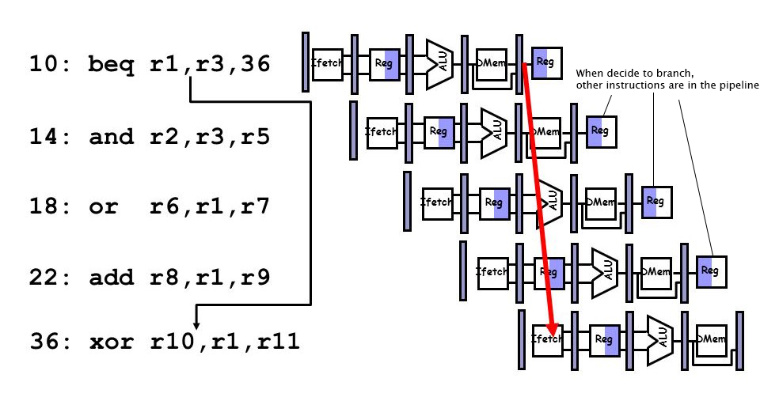
3. Control/Branch hazard
Control hazard occurs when attempt to make a decision about the program control flow before the condition has been evaluated and the new target address calculated.

Slide 18
Control Hazard solutions
Prediction
Assume an outcome and then continue fetching (undo if prediction is wrong)
Loss of cycles only on mis-prediction.
2. Stall
Stop loading instructions until result is available.
3. Delayed branch
Specify in architecture that the instruction immediately following branch is always executed.

Slide 19
Questions?

