Slide 1
Water Level and Water Quality Monitoring System
Presented by Group: 03
Name: Tanjila Sultana Joti ID: 180104007
Name: Nusrat Jahan ID: 180104020
Name: Fatema Marjan ID: 180104021
1

Slide 2
Introduction
Our project water level and pH indicator is Arduino and sensor based project.
The water level is displayed here and turns off just before the water level at the top or overflow.
And turn on while the water is at a low level.
It also provides buzzer and led notifications. The PH indicator represents the pH level of water and total dissolved solid value to measure water purity.
2

Slide 3
Required Components:
Arduino Mega2560 R3
Ultrasonic Sensor
16×4 LCD
920 taka
95 taka
318 taka
3

Slide 4
Required Components:
Relay 6 volt
IC ULN2003
Voltage Regulator
85 taka
318 taka
1100 taka
4

Slide 5
Required Components:
Buzzer
DC Motor
POT-HG
LED
300 taka
70 taka
50 taka
2 taka
5

Slide 6
Budget
Equipment | Quantity | Budget(Tk)
ARDUINO MEGA2560 R3 | 1 | 920
Ultrasonic sensor Module | 1 | 95
Relay 6 Volt | 1 | 85
16 x 4 LCD | 1 | 318
TDS Sensor | 1 | 1,100
ULN2003 | 1 | 60
Copper wire | As required | 100
Buzzer | 1 | 300
PH sensor | 1 | 3,400
POT-HG | 1 | 50
7806- Voltage Regulator | 1 | 15
9 Volt Battery/12 Volt Adaptor | 1 | 40
Total 6,483
6

Slide 7
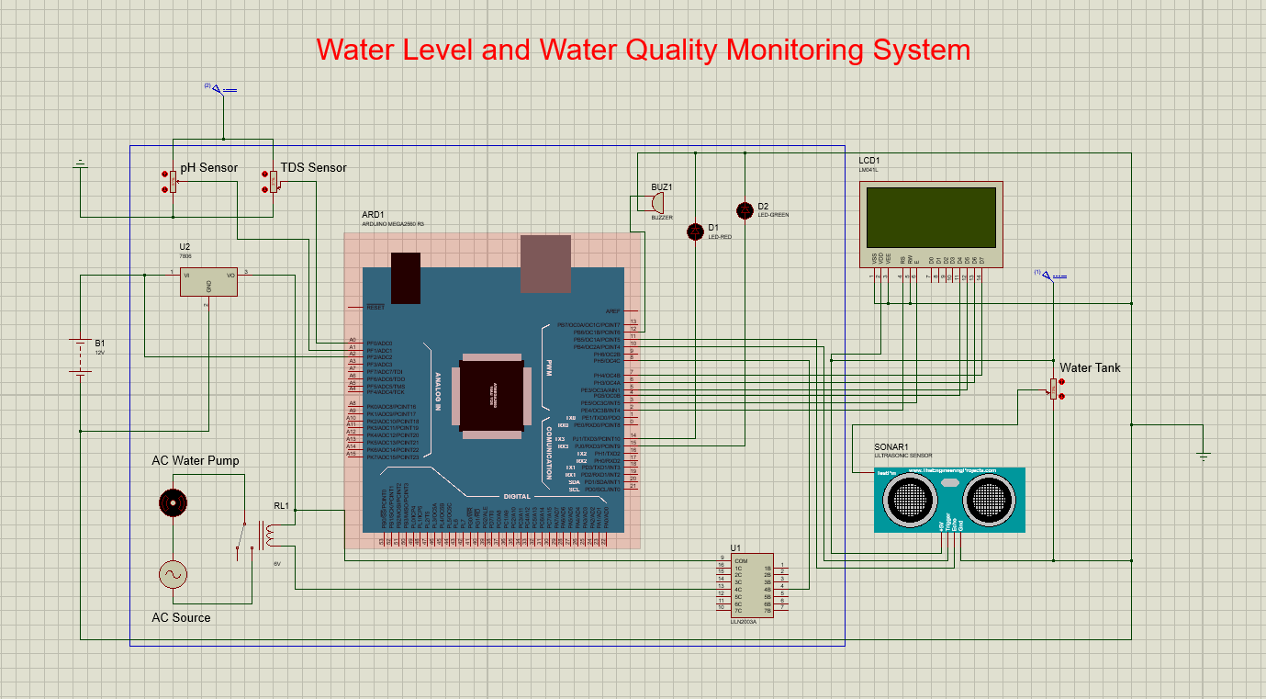
Design:
DC Motor
POT-HG
LED
70 taka
50 taka
2 taka
5

Slide 8
Working Procedure
The Ultrasonic sensor module will transmit for receiving ECHO.
The Arduino will read the time between activation and receiving from ECHO which will help calculate the water level
This sensor module will read the distance between the sensor module and the water surface and it will display the distance on the LCD screen with the message.
When the empty water level will reach at predetermined distance, the Arduino will turn on the motor and activate the relay to drive the water pump. Otherwise the Arduino will turns off on the motor.
The relay and LCD display will show the output and the buzzer will also beep for sometimes.
The PH and TDS sensor will build by to pot-hg. By varying pot, the pot sensor will take the PH and TDS value and then display this value on the LCD.
8

Slide 9
Difficulties
Due to the software implementation, we need different sensor libraries, but the sensor libraries are not available, so we use a custom potentiometer in our implementation.
if group members are not using the same proteus version, it may cause that one's proteus file does not support in another’s proteus.
9

Slide 10
Future scope:
We will like to use a turbidity sensor, which output a voltage level proportional to the amount of suspended solid particles in the water
We will like to implement Reverse Osmosis System
Will measure the temperature of the water and then set temperature of the water at suitable/required temperature

Slide 11
Social value
Helps to notify the user the amount of water that is present in the overhead water tank
Sometimes, even if the water overflows from the water tank, the water pump will continue to pump water, so it help prevent water overflow during pumping.
Helps to prevent wastage of energy and water.
Helps to determine the PH of the water
TDS meter measure TDS value which can be used as one reference point for reflecting the cleanliness of the water
Help monitor the water quality at home supply, in Agricultural Farm and fish farming.
11

Slide 12
Conclusion
Our project can detect and indicate the water level.
pH indicator can indicate the pH value
TDS sensor used for measure TDS value of tank water
12

Slide 13
THANK YOU
13

