Slide 1
Urban Shade:
Data Driven Tree Plantation
Nusrat Farzana

Slide 2
Problem:
    ➝ Urban areas like Berlin are experiencing rising summer temperature due to climate change and urbanization (concrete surfaces, limited greenery), causing discomfort, health risks, and reduced quality of life
Why this is important?
            ➝ Climate adaptation: Cities need strategies to reduce heat exposure in vulnerable areas.
➝ Urban planning: Helps policymakers prioritize tree planting efforts efficiently rather than distributing resources uniformly.
          State of art approaches:
➝ Remote sensing / satellite imagery: Some projects use satellite temperature data to detect urban heat islands.
➝ City GIS data: Mapping parks, forests, and urban green areas to estimate cooling effects.
➝ Machine learning / statistical modelling: Predicting areas prone to heat stress using temperature, land use, and population data.
➝ Urban tree inventory: Some cities maintain databases of planted trees and green areas.

Slide 3
Gaps:
➝ Many current studies provide city-wide averages, not fine-grained neighbourhood-level analysis.
➝ Automated, data-driven recommendations for tree plantation are limited.
My project:
➝ Combines multi-year temperature data, green coverage from OSM, and interactive mapping.
➝ Generates a tree priority score per neighbourhood to highlight where tree plantation is most needed.

Slide 4
Data Set :
➝ Temperature data: Extracted from Google Earth Engine (GEE) using the MODIS Land Surface Temperature dataset,
covering Berlin for June–August, last 5 years (2020–2024).
➝ Urban area boundaries: Used OpenStreetMap (OSM) data via OSMnx, which provides polygons for neighborhoods/areas in Berlin.
➝ Green coverage: Extracted from OSM by filtering polygons tagged as parks, forests, gardens, and other green areas.
Data Quality :
Strengths:
  ➝ High-resolution spatial data for Berlin.
  ➝ Multi-year temperature allows robust averaging.
  ➝ OSM green areas are up-to-date and detailed in urban environments.

Slide 5
Limitations:
➝ Green coverage uses available land-use/OSM data and may not capture: canopy density, tree height/shading and private green areas.
  ➝ Historical microclimate measurements (air temperature at street level).
  ➝ Precise population density per neighbourhood to identify heat-vulnerable populations
  Missing Data Sources:
➝ Population data: Berlin Open Data portals.
➝ Air temperature: Street-level temperature sensors or local weather station.

Slide 6
Methods
Exploratory Data Analysis (EDA) :
  ➝ MODIS Land Surface Temperature data via Google Earth Engine of 2020-2024 (June-August) and computed mean.
  ➝ berlin administrative boundaries taken from open street dynamically
  via overpass API
  ➝ Green area data from OSM using OSM polygons:
  - parks - forests - gardens
  ➝ Processed and cleaned both datasets (area names, geometry fixes).
  ➝ Calculated green coverage for each Berlin area (ratio 0–1).
  ➝ Identified hotspots with low greenery.
  ➝ Merged green coverage with temperature values.
  ➝ Computed statistical relationships and Created exploratory plots

Slide 7
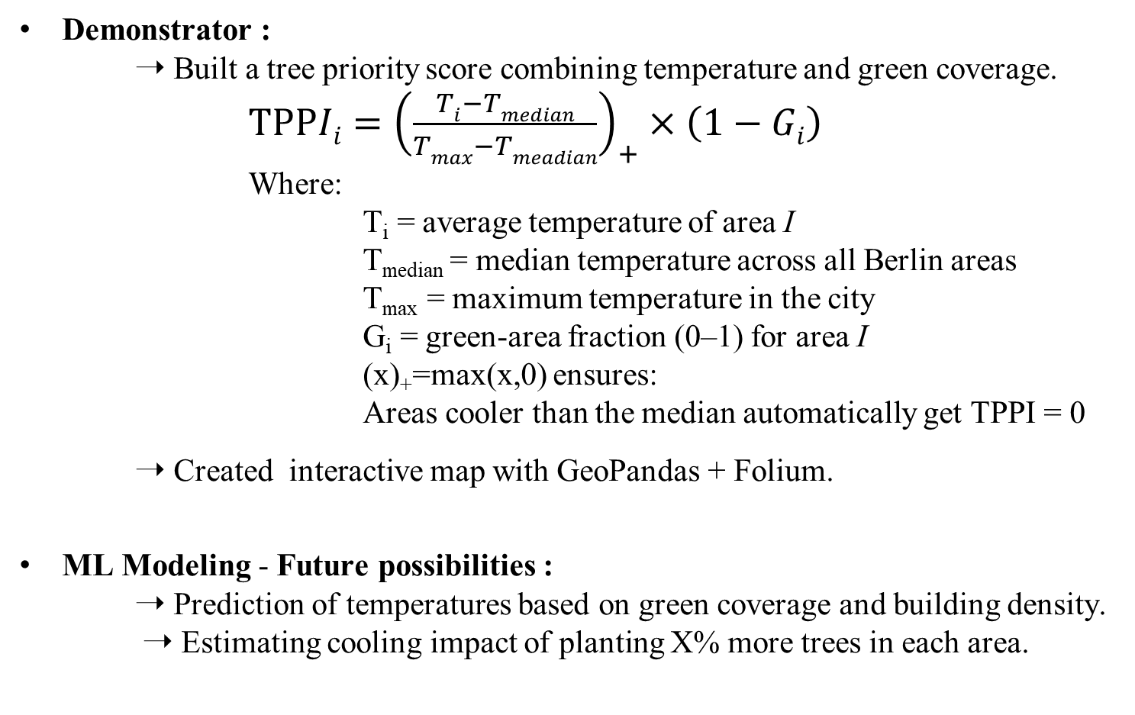
Methods
Demonstrator :
  ➝ Built a tree priority score combining temperature and green coverage.
  $TPPIi={\left(\frac{Ti−Tmedian}{Tmax−Tmeadian}\right)}_{+}×\left(1−Gi\right)$
Where:
T_{i}​ = average temperature of area I
T_{median​} = median temperature across all Berlin areas
T_{max}​ = maximum temperature in the city
G_{i}​ = green-area fraction (0–1) for area I
(x)₊​=max(x,0) ensures:
Areas cooler than the median automatically get TPPI = 0
  ➝ Created interactive map with GeoPandas + Folium.
ML Modeling - Future possibilities :
➝ Prediction of temperatures based on green coverage and building density.
➝ Estimating cooling impact of planting X% more trees in each area.

Slide 8
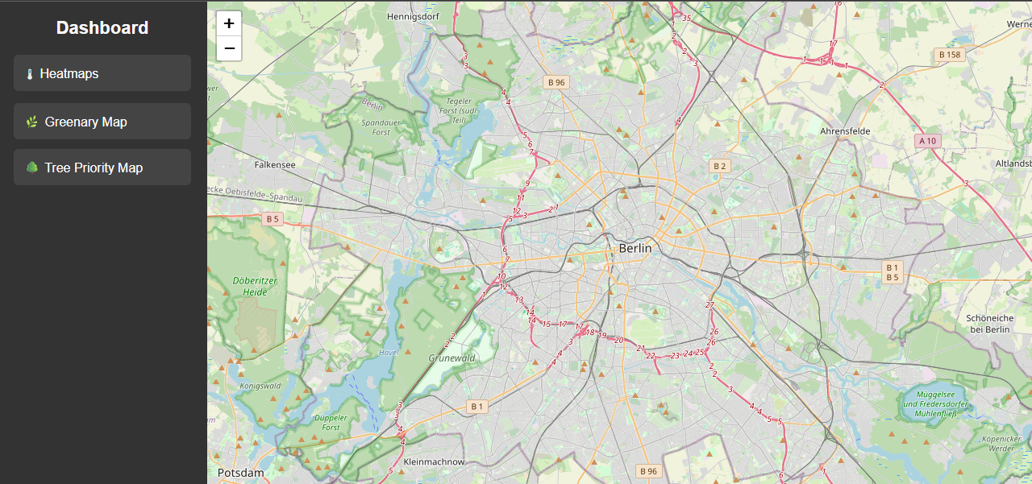
Results : Dashboard

Slide 9
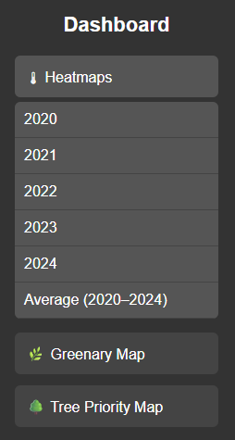
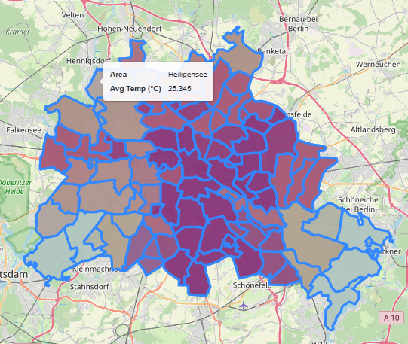
Result 01: Heat Map

Slide 10
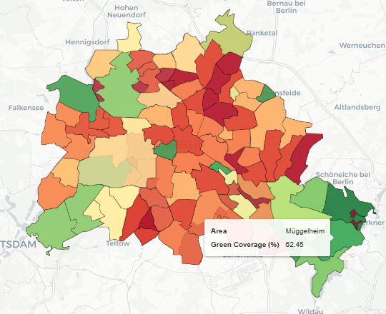
Result 02 : Greenery Map

Slide 11
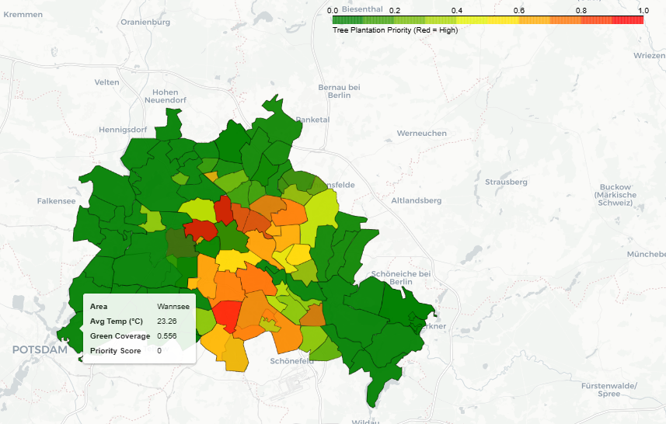
Result 03 : Tree Plantation Priority Map

Slide 12
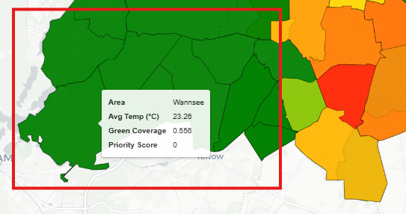
Problem 01: Low Temperature with Low Greenery

Slide 13
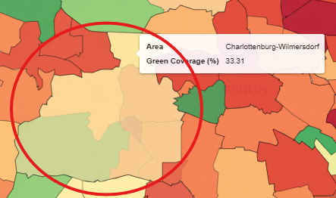
Problem 02: Area Boarder

Slide 14
Discussion
Statistical Findings :
            1. T-Test: The t-test compares the mean temperature of two groups: low- green areas vs high-green areas.
➝ Goal: To check whether green coverage leads to significantly different temperatures.
➝ Result: t = 4.256, p = 0.000050
  ➝ This very low p-value shows that low-green areas are significantly hotter than high-green areas.
2. Spearman Correlation : Spearman correlation measures the monotonic relationship between two variables: green coverage and temperature.
It does not assume linearity, so it works well for environmental data.
➝ Result: ρ = –0.380, p = 0.000030
➝ There is a moderate negative correlation: more green coverage is
associated with lower temperature.

Slide 15
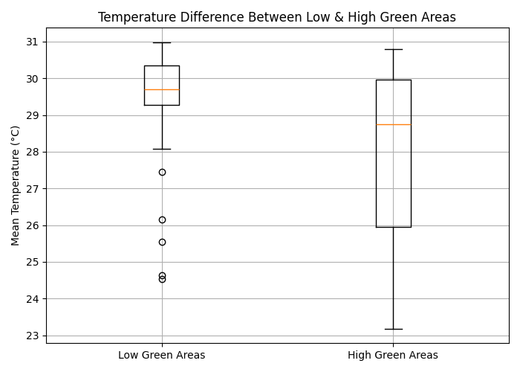
Visual representation of the T-test, showing whether areas with less greenery are significantly hotter

Slide 16
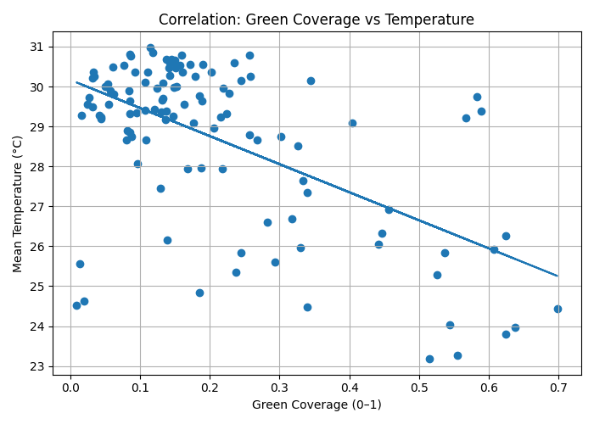
Visualize the relationship between green coverage and mean temperature.
corresponds to Spearman correlation value (rho = –0.38), demonstrating a negative relationship between vegetation and heat.

Slide 17
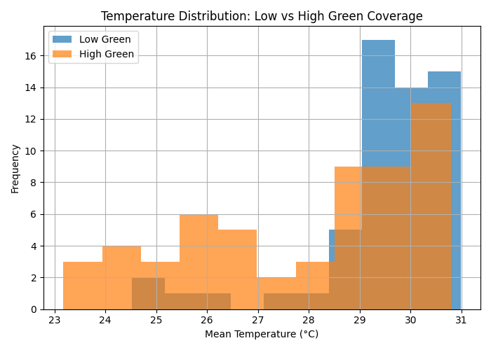
Visualize the spread and distribution differences

Slide 18
Interpretation:
➝ Both tests strongly support the conclusion that:
Green areas help reduce urban heat.
➝ Statistical evidence confirms that differences in temperature are not random, but linked to vegetation distribution.
➝ This justifies using green coverage as a basis for tree-planting priority mapping.
Implications for Urban Planning:
➝ Areas with low green coverage could benefit most from:
tree planting programs, expanding parks or green corridors and
  cooling urban design (shade structures, permeable surfaces)
➝ Results can guide priority mapping, helping decision-makers allocate resources more effectively.

Slide 19
References
Priority score equation:
➝ Zhou et al. (2011), Environmental Science & Technology
“Relationships between urban heat island intensity and land cover.”
➝ Voelkel & Hinner (2015), Applied Geography
“Urban heat and vegetation: identifying priority areas for greening.”
➝ Li et al. (2018), Landscape and Urban Planning
“Mapping heat vulnerability and identifying greening targets.”
➤
Source code :
➝ https://github.com/Nusrat2810/Heat_Map_Urban_technology

