Slide 1

IUBAT—International University of Business Agriculture and Technology
“NGO Management System ”
Presented by :
Most. Nusrat Jahan
Id : 17203084
Program : BCSE
Supervised by:
Ehsan Ahmed Niloy
Lecturer
Department of Computer Science
And Engineering

Slide 2
Contents
Organization Overview
Project Introduction
Project Objectives
Project Feasibility
Requirement Engineering
Analysis Modeling
System Planning
Risk Management
System Testing
Conclusion

Slide 3
Organization Hierarchy
Works as a trainee programmer at Soft-tech it limited.
Established in 2015 in Dhaka, Bangladesh.
Organization Services
Web design
Software development
Mobile application
Graphics & Multimedia
Domain & Hosting

Slide 4
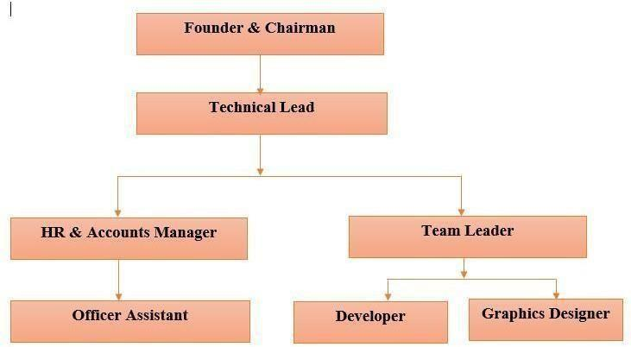
Organizational Structure
Figure: Organization Structure of Soft-tech

Slide 5
Introduction
NGO Management System includes:
Donation management
Scholarship
Books
Manage Donation
Post notice

Slide 6
Objectives
To provide user friendly system for managing Donation.
To minimize the length of manual work process
Keep all the records of all data, save data and information efficiently
Easiest platforms for all which can be easily manageable.

Slide 7
Feasibility Study
Technical Feasibility
Economical Feasibility
Operational Feasibility

Slide 8
User Requirements
User can log in
User details can be stored
Admin can add member
Approve donation
manage book
Provide notice
Approve book apply
Approve scholarship

Slide 9
System Requirements
Admin/Donor/Students can Login.
If User id and password is valid then the home page will open
System will take input and check it with database
System will display login form
Admin Can add member
Admin can add new book
Admin can see the donation amount
Admin can add notice
Donor/Student can see the notice
Student can apply for book
Student can apply for scholarship

Slide 10
Functional Requirements
Manage Donor
Manage Student
Manage Scholarship
Manage Donation
Manage Books
Manage Notice

Slide 11
Non-Functional Requirements
Security
Performance
Availability
Portability
Validation

Slide 12
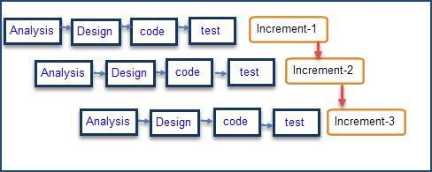
Software Process Model
Figure : Incremental Process Model

Slide 13
Reason for choosing this model
Task can be arranged easily.
The Phases of Incremental is clearly defined.
Software will be generated quickly during the software life cycle.

Slide 14
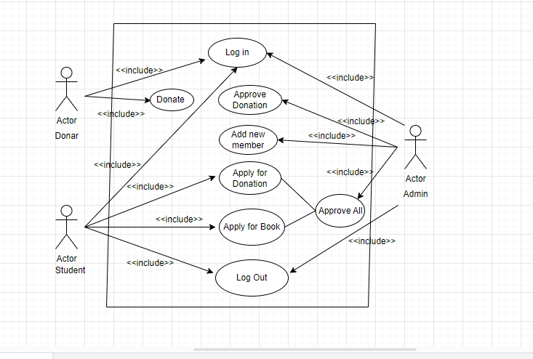
Use case diagram

Slide 15
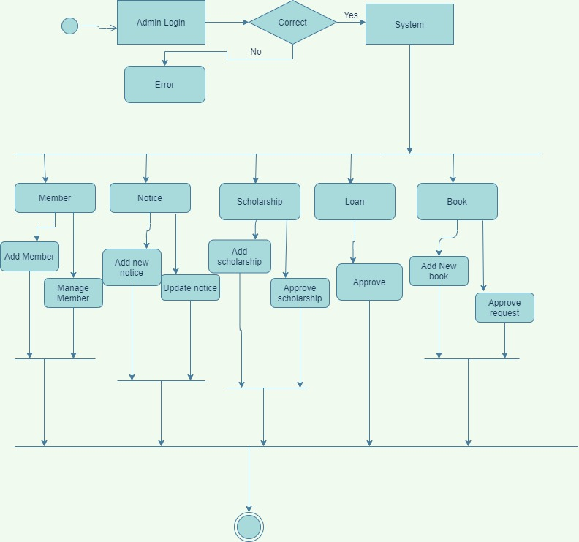
Activity Diagram
Figure : Activity Diagram of Admin

Slide 16
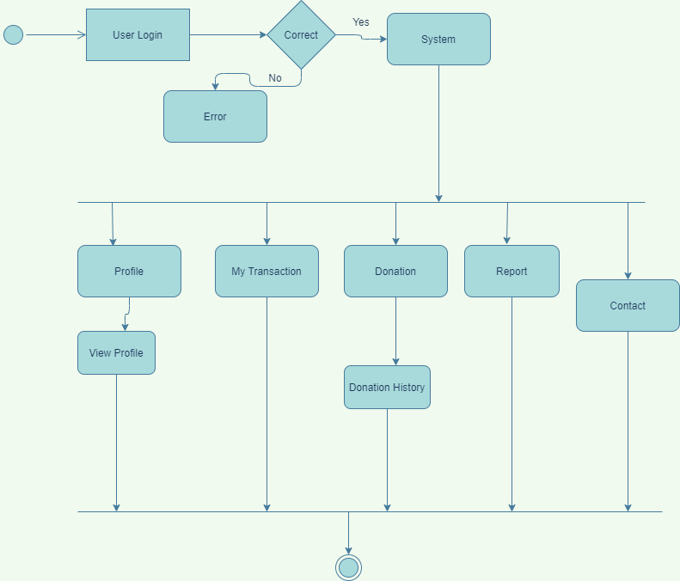
Activity Diagram
Figure : Activity Diagram of Donor

Slide 17
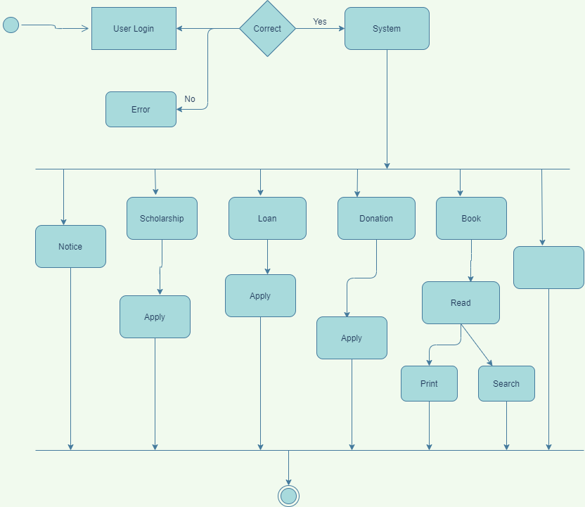
Activity Diagram
Figure : Activity Diagram of Student

Slide 18
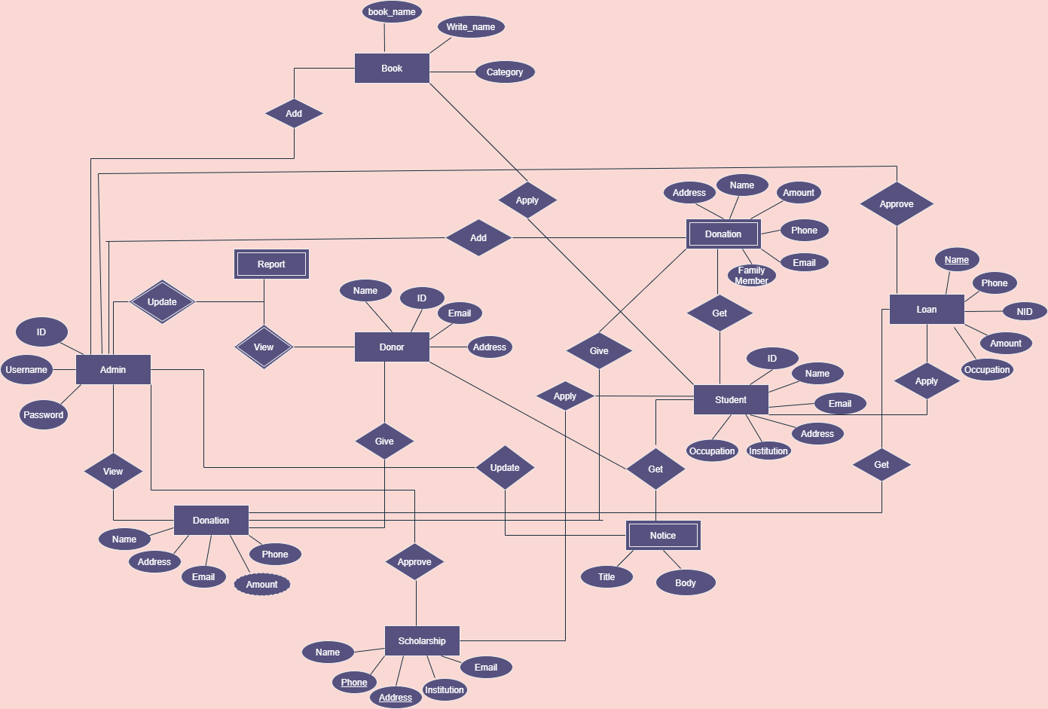
Entity Relationship Diagram
Figure : ERD of NGO management system

Slide 19
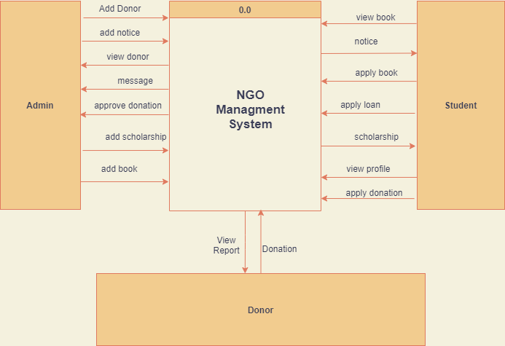
Context level Diagram
Figure : Context Level Diagram

Slide 20
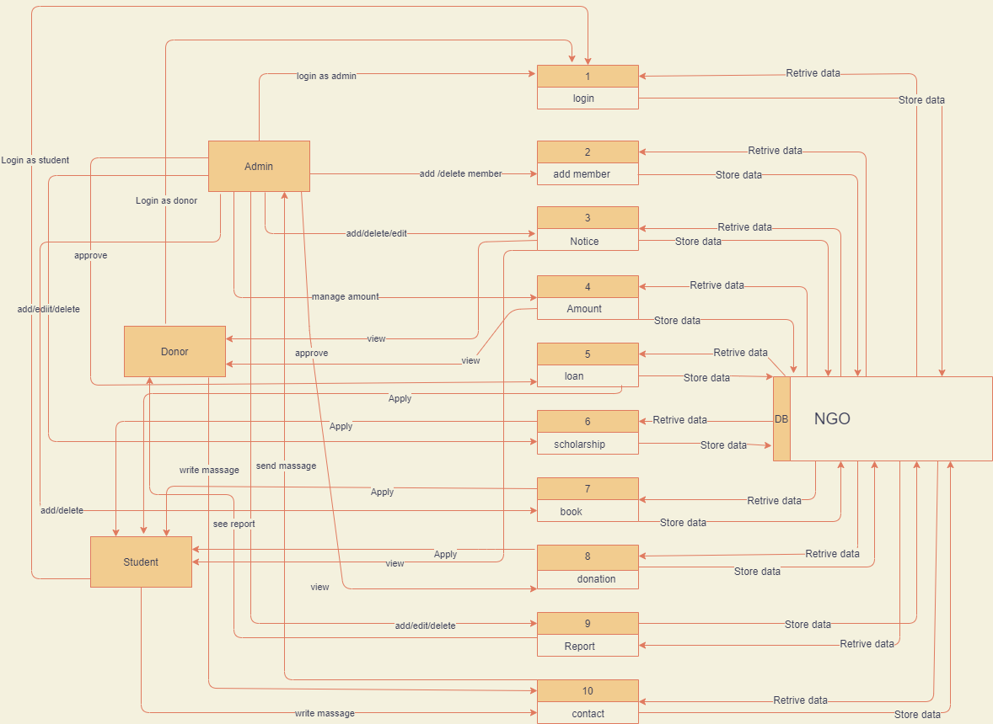
Data Flow Diagram
Figure : DFD Level 1 Diagram

Slide 21
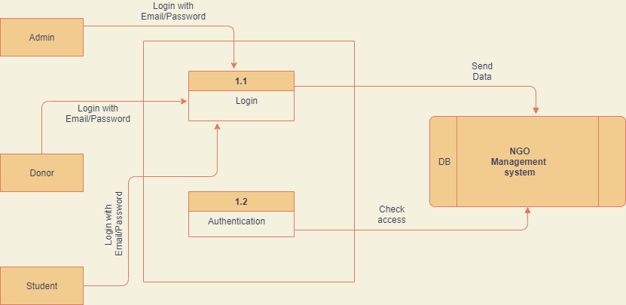
DFD Level 2(process 1)

Slide 22
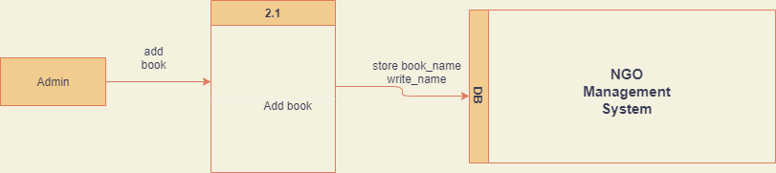
DFD level 2(Process 2)

Slide 23
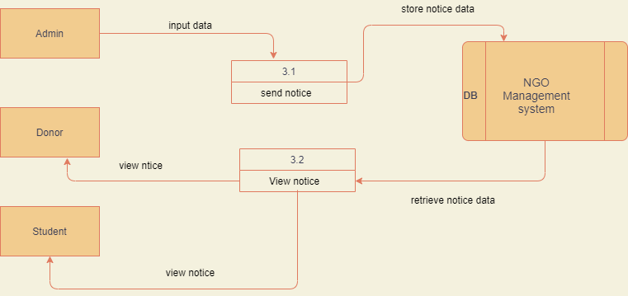
DFD level 2(process 3)

Slide 24
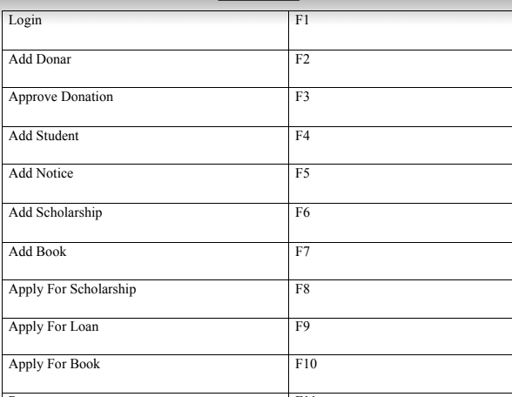
Function of Proposed System

Slide 25
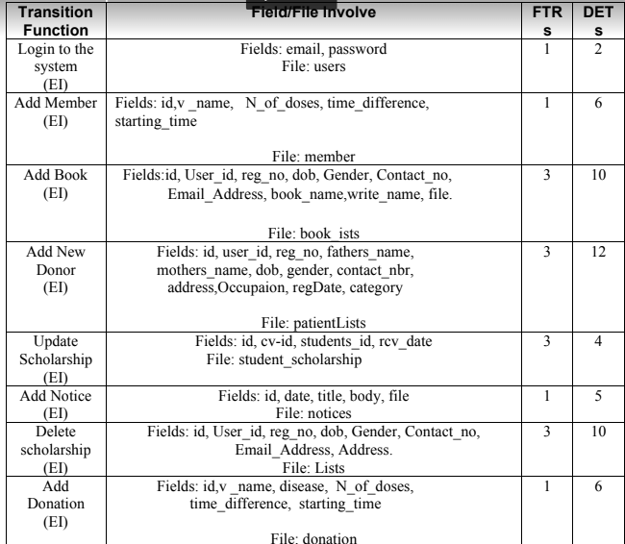
Identifying complexity of transition function

Slide 26
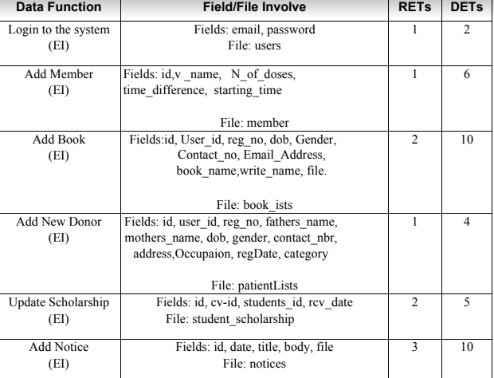
Identifying Complexity for Data Function

Slide 27
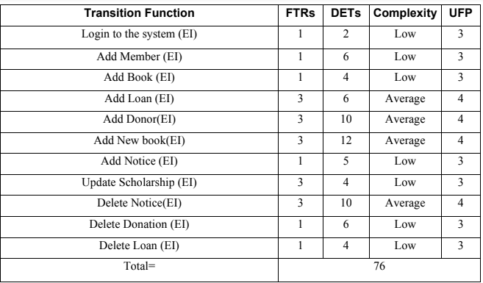
Unadjusted function point contribution for data functions

Slide 28
Function Point Estimation
Value Adjustment Factor (VAF) = (0.65+ (0.01*TDI))
= (0.65 + (0.01*32))
=0.97
Counting Adjusted Function Point:
UFP = UFP (Data function) + UFP (Transaction Function)
= 66+76 = 142
Adjusted Function Point Count = UFP * VAF
= 142 * 0.97
= 137.74
Effort for PHP = AFP x Proximity
= 137.74 * 15.5 [Productivity for PHP 15.5]
= 2134.97 person-hours / 6 hours [office = 6 hour]
= 355.83 person’s days / 26 days
= 13.68 months/3 Person
= 4.56 Month per 1 person (4 Month Approximately)

Slide 29
Effort Distribution
Figure : Effort Distribution

Slide 30
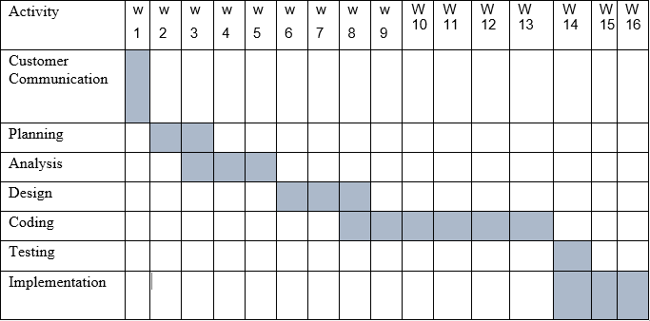
Project Schedule Chart
Figure : Project Scheduling Chart

Slide 31
Cost Estimation
Particular | TK | Total = 198000 BDT
Personnel cost | 82000 BDT
Hardware cost | 65000 BDT
Software cost | 50000 BDT
Other cost | 1000 BDT
In Word: One Lac ninety eight hundred taka only.

Slide 32
The RMMM Plan
Risk Mitigation: Proactive planning for risk avoidance.
Risk Monitoring: Assessing whether predicted risks occur or not, ensuring preventive steps are being properly applied, collect information for future risk analysis, attempt to determine which risks caused which problem.
Risk Management: Actions to be taken in the event that mitigation steps have failed and the risk has become a live problem.

Slide 33
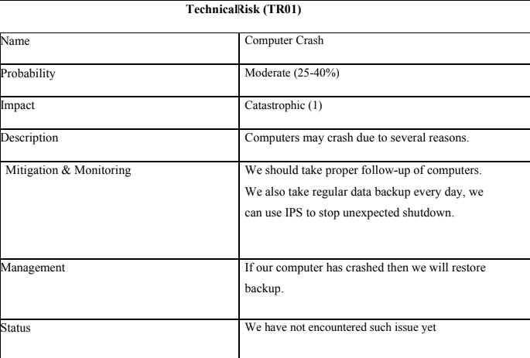
Technical Risk 1

Slide 34
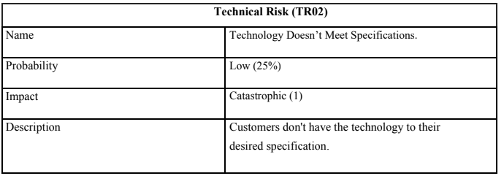
Technical Risk 2

Slide 35
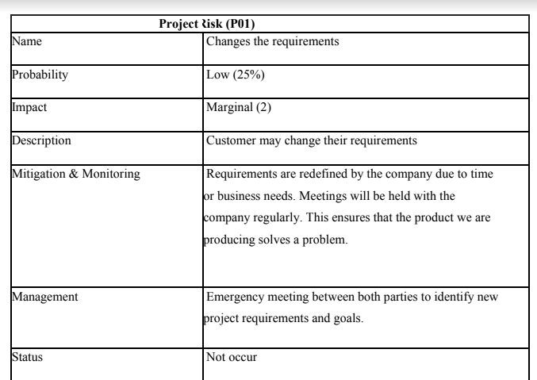
Project Risk 1

Slide 36
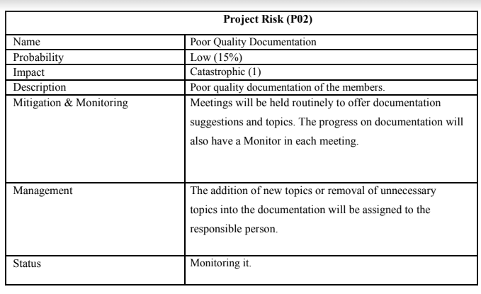
Project Risk 2

Slide 37
Testing Software
• White box testing
• Black box testing

Slide 38
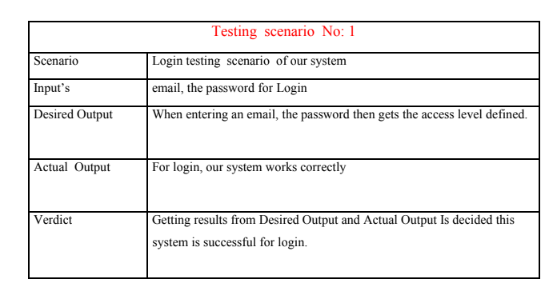
Test Case1

Slide 39
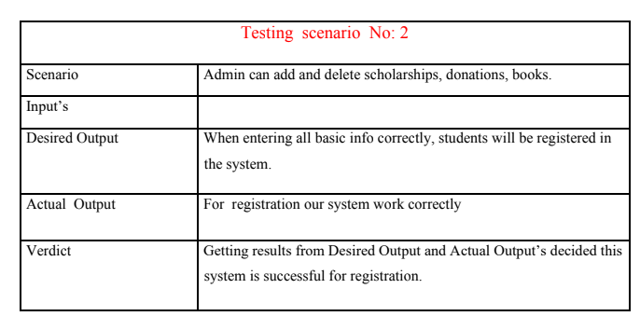
Test Case 2

Slide 40
Limitation
There is no real time internet banking system.
Ssl Commerce Session time limited

Slide 41

PROJECT DEMO

Slide 42
Future Plan
More effective panel for Admin and User.
Make a mobile version.
Update donor profile
Add new features and processes like when the new notice came student can get the notification.

Slide 43
Conclusion
My biggest experience working at soft tech is indeed being a part of designing and implementing software. My most experience was around the designing issue. I have learnt a lot of new things which was so much unknown to me. I have also learnt some technical issues which help to do better in future life. The following indicator will indicate some of the technical issues which I have learn and implemented from this project.

Slide 44


Slide 45


