Slide 1
Ticket Price Analysis of Big Mountain ski Resort
Nusrat Asrafi

Slide 2
Problem Identification
The aim of this project is to build a predictive model for ticket prices of Big Mountain ski resort based on several features related to resorts.
This model will help guide Big Mountains’ pricing strategy and future facility investments.
Dataset: 330 entries, 26 attributes

Slide 3
Recommendation and key findings
Impact of Resort Size and Features:
Larger resorts with more extensive terrain, higher vertical drops, and more advanced features (e.g., snowmaking capabilities, fast quads, terrain parks) generally command higher ticket prices.
Resorts with more diverse offerings, such as night skiing, backcountry access, and a higher number of runs, tend to have higher pricing power.
State and Regional Differences:
Geographic location plays a significant role in pricing. Resorts in states with a higher concentration of ski resorts may face more competitive pricing, while those in less competitive regions can charge premium prices.
Local demographics and tourist inflows also affect pricing, with resorts in regions attracting wealthier visitors able to sustain higher prices.

Slide 4
Influence of Resort Density:
In areas with high resort density, such as Vermont or Colorado, resorts may need to differentiate themselves through unique features or competitive pricing to attract customers.
The number of resorts in a given state relative to its population and size can either dilute or enhance the pricing power of individual resorts.
Importance of Operational Days:
The number of days a resort is operational, especially during peak seasons, directly correlates with higher pricing. Longer operational periods allow resorts to maximize revenue and justify higher prices.

Slide 5
Recommendation
Dynamic Pricing Implementation:
Resorts should consider implementing dynamic pricing models that adjust ticket prices based on factors such as real-time demand, weather conditions, and competitor pricing. This strategy can help maximize revenue during high-demand periods and fill capacity during slower times.
Investing in Key Features:
To command higher prices, resorts should invest in expanding skiable terrain, improving lift infrastructure, and enhancing snowmaking capabilities. These features are highly valued by visitors and can significantly increase ticket prices.
Scenario Planning:
Resorts should engage in scenario planning, using predictive models to understand the impact of changes in the competitive landscape, economic conditions, or climate on their pricing strategies.

Slide 6
Modeling results and analysis
Data wrangling
Exploratory Data analysis
Data Preprocessing and training data
Modelling

Slide 7
Data Wrangling
Handling Missing values
Missing ticket price(removal of several rows)
Error in certain columns necessitating corrections (data cleaning)
Removal of a complete due to inconsistencies
Merging additional data:
Data regarding U.S state populations and size from wikipedia

Slide 8
Exploratory Data Analysis
conducted to understand the relationships between various features and identify potential predictors for ticket pricing
Top States by Population: California, New York, and Pennsylvania were the most populous, with California dominating both in population and skiable area.
Resorts per State: New York led with the most resorts, though it did not correspond with the most skiable area, indicating a higher number of smaller resorts.
Total Skiable Area: Colorado, Utah, and California had the most skiable area, with Colorado leading significantly.
Resort Density Analysis:
Vermont and New Hampshire had the highest resort density per capita and per area, indicating a concentrated presence of ski resorts relative to their size and population.

Slide 9
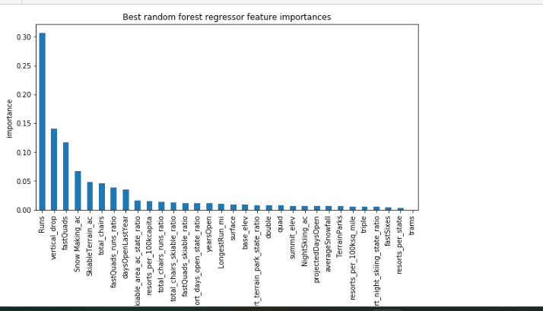
Data Preprocessing and Training the data
Algorithms
Linear Regression
Random forest
Gradient Boosting
Evaluation metics
R^2,
RMSE(Root Mean Square Error)
MAE (Mean Absolute Error)

Slide 10
Modelling
Model: The Gradient Boosting model emerged as the most accurate, with the lowest RMSE and highest R², indicating a strong predictive ability.
Various scenarios were tested using the model, such as changes in resort density, the addition of new resorts, or alterations in key features like snowmaking capabilities. The model was able to predict how these changes would impact ticket prices, providing valuable insights for strategic decision-making
The best scenario, Big Mountain is adding a run, increasing the vertical drop by 150 feet, and installing an additional chair lift.This scenario increases support for ticket price by $1.33.Over the season, this could be expected to amount to $2333333

Slide 11
Conclusion
The project successfully developed a model to predict ski resort ticket prices, providing actionable insights into how various features impact pricing. The analysis highlighted the importance of both state-level and resort-specific factors, with features like vertical drop, resort density, and snowmaking capabilities playing significant roles in determining ticket prices.
Future Scope of Work
Incorporating Visitor Data: Future work could benefit from incorporating data on the number of visitors per year, which would provide a more complete picture of demand and allow for more precise pricing strategies.
Dynamic Pricing Models: Implementing dynamic pricing models that adjust ticket prices based on real-time data, such as weather conditions, resort occupancy, and competitor pricing.
Expansion to Other Countries: Extending the model to include ski resorts in other countries, which would provide a global perspective on ski resort pricing strategies.

