Slide 1
Trends and Insight in London House Price

Slide 2
Slides
Introduction
Data Source
Cleaning, transforming, and visualizing
Modeling
Evaluating and concluding

Slide 3
Introduction
Which boroughs of London have seen the greatest increase in housing prices, on average, over the last two decades?
Which boroughs have seen the greatest increase in housing prices from 1998 to 2018?

Slide 4
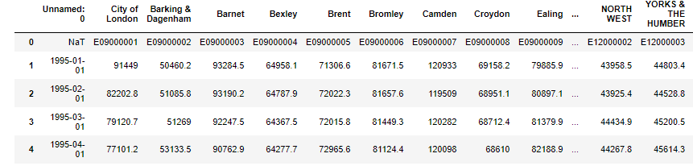
Data Source
Collected from an open-source London database.
Contains the average house prices for each borough, consisting of 353 rows and 49 columns.

Slide 5
Cleaning, transforming, and visualizing
Remove the first row (ID of each borough)
Rename the "Unnamed: 0" column to date
Remove unnecessary rows(leaving 32 rows only)
Set the date column as an index and transpose the dataset
Resetting the index and rename the 'index' column to 'London_borough'
Melted the dataset with 'London_borough' as variable _ID and 'AvergaePrice' as the value.

Slide 6
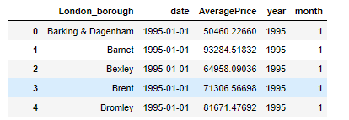
Change the data type of each column using convert_dtypes() method
Checked for missing values
Separate the month and year columns from date

Slide 7
House Price changes in month in Sutton Borough
Select the dataset for Sutton London Borough
Calculate average price on monthly basis
Visualize the data

Slide 8
Average Price Increase in London Borough(2003-2023)
Filter data for the last two decades (2003 to 2023) properties_last_two_decades
Calculate the average yearly price for each borough
Calculate the price increase for each borough from 2003 to 2023
Sort the boroughs by the greatest price increase
Plot the results using Matplotlib

Slide 9
The greatest increase in housing prices from 1998 to 2018 in London Borough
Filter data for the years 1998 and 2018
Calculate the average price for each borough in 1998 and 2018
Merge the two dataframes on Borough
Calculate the ratio of 2018 prices to 1998 prices
Sort by the ratio to see which boroughs have the highest increase
Plot the results using Matplotlib

Slide 10
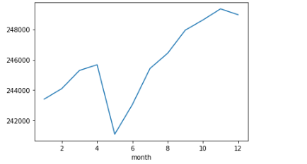
Average House Price Changes on monthly basis

Slide 11
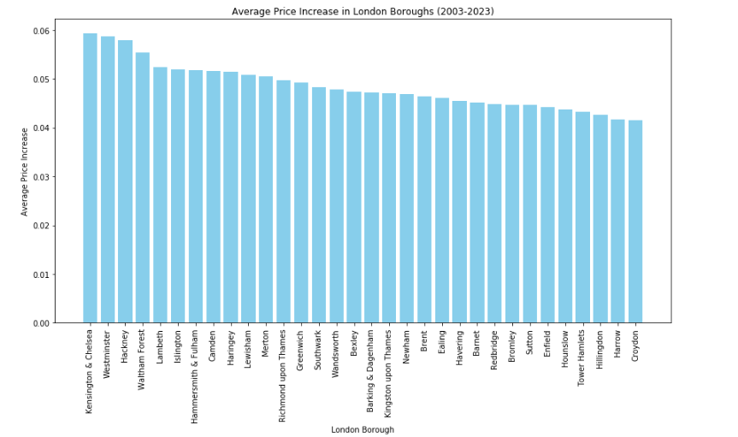
Average House Price Increase over Two Decades

Slide 12
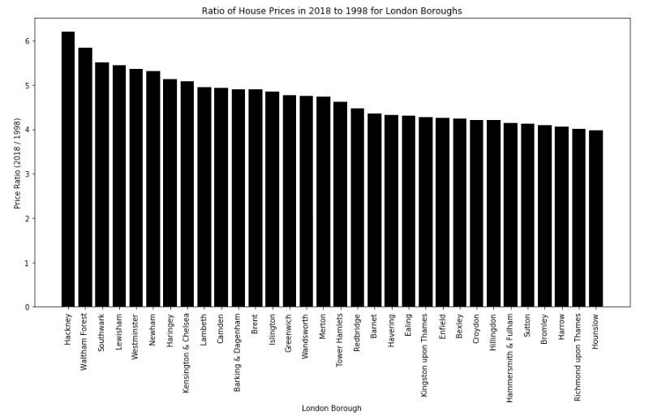
Ratio of House Prices in 2018 to 1998 for London Borough

Slide 13
Challenges
The data had missing values and inconsistencies which made it challenging to perform the analysis.I address this by using data imputation techniques for missing values and ensuring data consistency through cleaning and preprocessing.
Monthly data had to be aggregated to yearly averages to simplify the analysis.I wrote scripts to aggregate the data efficiency,ensuring that yearly averages were accurate and representative.
The dataset does not contain the information the other factors influencing the housing price are school quality,crime rate,transport link.

Slide 14
Conclusion
From 2003 to 2023,overall the house price increase all overs the London Borough.
Moreover, the Kensington & Cheisea and Westminster boroughs has the greatest increase around 5% on average and Harrow and Croydon has 4 percent increase on average which is lowest price increase.
The analysis reveals significant variations in housing price increases across London boroughs.

Slide 15
The borough of Hackney shows the highest price ratio of 6.19 , indicating that average housing prices increased more than sixfold between 1998 and 2018.
Conversely, Hounshow is the lowest increase with a ratio of 3.9.

Slide 16
Future Works
Investigate the impact of various socioeconomic factors on housing prices, such as crime rates, school quality, transport infrastructure, and economic policies. This would provide a more comprehensive understanding of the drivers behind housing price changes.
Compare the housing price trends in London with other major cities to understand if the observed trends are unique to London or part of a broader urban phenomenon.
Develop predictive models to forecast future housing prices based on historical data and identified influencing factors. This could be valuable for policymakers and investors in making informed decisions.
Study the impact of external factors like Brexit, the COVID-19 pandemic, and global economic trends on the London housing market during the period under analysis.

Slide 17
Thank you
Nusrat Asrafi
Email:asrafi.nusrat@gmail.com

